Slide 1
Terminology Services
Experimental Services for Controlled Vocabularies
Ralph LeVan
Senior Research Scientist, OCLC
levan@oclc.org
Code4Lib Pre-Conference
Brown University
23 February 2009

Slide 2
Overview
Features
Vocabularies
Indexes and Indexing
Sample Requests & Responses
SRU examples
Next Steps

Slide 3
Experimental Web Services for Controlled Vocabularies
Features
Search descriptions of controlled vocabularies
Search for concepts/headings in a controlled vocabulary
Retrieve a single concept/heading record by its identifier
Retrieve concepts/headings in multiple representations including HTML, MARC XML, Zthes, and SKOS
Search using SRU CQL syntax

Slide 4
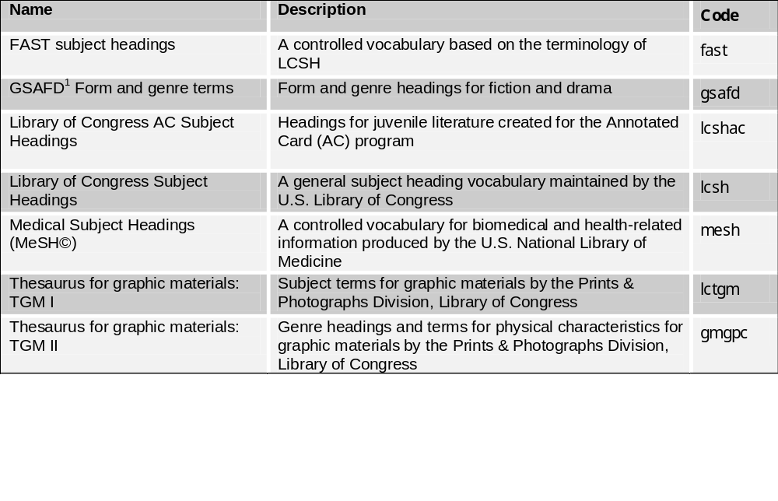
Vocabularies
Notes:
Notes
1. Guidelines On Subject Access To Individual Works Of Fiction, Drama, Etc., 2nd ed.

Slide 5
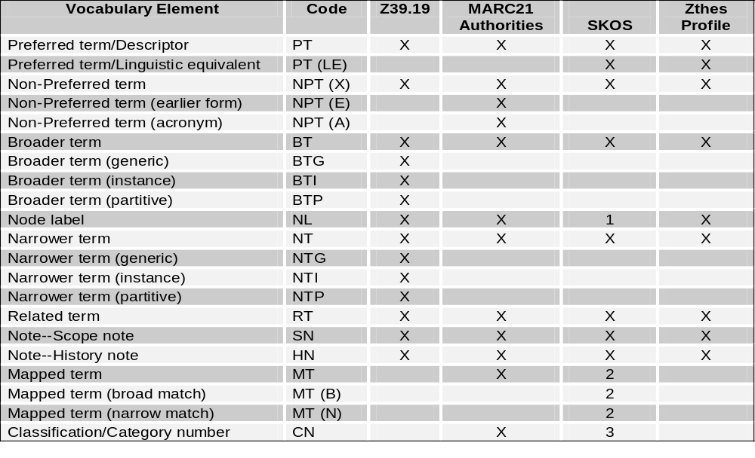
Format Comparison
Notes:
The SKOS standard will eventually have a mechanism to distinguish node labels from concept labels.
Representation of mapped terms requires the use of the SKOS mapping standard which may eventually be built into base SKOS standard.
Representation of classification and category numbers requires the use of the Dublin Core standard.
Label MARC21 SKOS Zthes
PT 1XX and 008/09=a,d,f skos:prefLabel termType=PT and termName
PT(LE) skos:prefLabel and xml:lang relationType=LE and termName
NPT 4XX skos:altLabel relationType=UF and termName
NPT(E) 4XX$w/0=a sub-property skos:altLabel relationType=X-NPT(E) and termName
NPT(A) 4XX$w/0=d sub-property skos:altLabel relationType=X-NPT(A) and termName
BT 5XX$w=g and 5XX$0 skos:broader relationType=BT and termId
BTG sub-property skos:broader relationType=X-BTG and termId
BTI sub-property skos:broader relationType=X-BTI and termId
BTP sub-property skos:broader relationType=X-BTP and termId
NL 1XX and 008/09=e [proposed] termType=NL and termName
NT 5XX$w=g and 5XX$0 skos:narrower relationType=NT and termId
NTG sub-property skos:narrower relationType=X-NTG and termId
NTI sub-property skos:narrower relationType=X-NTI and termId
NTP sub-property skos:narrower relationType=X-NTP and termId
RT 5XX$w≠g,h and 5XX$0 skos:related relationType=RT and termId
SN 680 skos:scopeNote termNote
HN 688 sub-property skos:note termNote label=HN
MT 7XX and 7XX$0 smap:exactMatch relationType=X-MT and sourceDb and termId
MT(B) smap:broadMatch relationType=X-MTB and sourceDb and termId
MT(N) smap:narrowMatch relationType=X-MTN and sourceDb and termId
CN 052,053,065,072,083,087 dct:subject relationType=X-CN and termId
Of note are the extension mechanisms: Z39.19 non-specified; MARC21-A fields XX9, X9X, 9XX and subfield-9; Zthes termType and relationType; SKOS RDF extensible by extending the schema by creating new sub-classes or sub-properties of the base class or property.

Slide 6
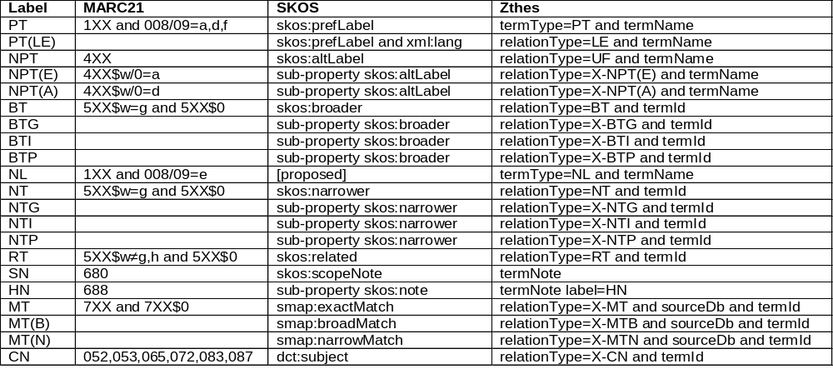
Format Comparison -- Notes
The SKOS standard will eventually have a mechanism to distinguish node labels from concept labels.
Representation of mapped terms requires the use of the SKOS mapping standard which may eventually be built into base SKOS standard.
Representation of classification and category numbers requires the use of the Dublin Core standard.
Of note are the extension mechanisms: Z39.19 non-specified; MARC21-A fields XX9, X9X, 9XX and subfield-9; Zthes termType and relationType; SKOS RDF extensible by extending the schema by creating new sub-classes or sub-properties of the base class or property.

Slide 7
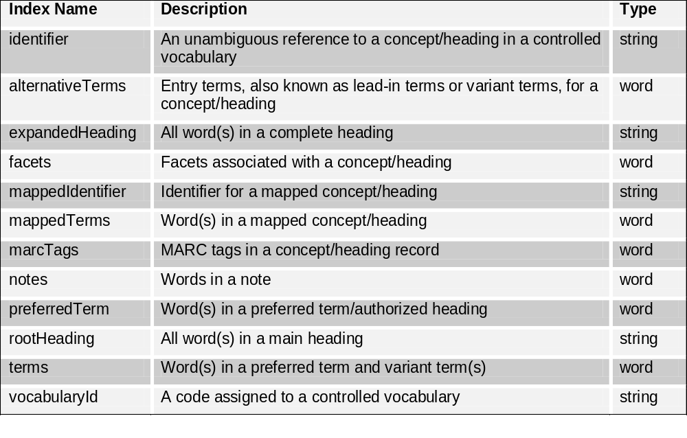
Indexes and Indexing
Notes:
Records are stored and indexed in the MARC21 authority format.

Slide 8
Sample Requests and Responses
http://tspilot.oclc.org/
http://tspilot.oclc.org/gsafd/ (SRU interface)
http://tspilot.oclc.org/gsafd/GSAFD000029
http://tspilot.oclc.org/gsafd/GSAFD000029.marcxml
http://tspilot.oclc.org/gsafd/GSAFD000029.skos
http://tspilot.oclc.org/gsafd/GSAFD000029.zthes

Slide 9
SRU examples
1. Search preferred term index for science fiction, results are retuned using server defaults
http://tspilot.oclc.org/gsafd/?query=oclcts.preferredTerm+%3D+%22science+fiction%22&version=1.1&operation=searchRetrieve
2. Search alternative terms for whodunits or thrillers results are retuned using server defaults
http://tspilot.oclc.org/gsafd/?query=oclcts.alternativeTerms+%3D+%22whodunits%22+or+oclcts.alternativeTerms+%3D+%22thrillers%22&version=1.1&operation=searchRetrieve

Slide 10
Next Steps
Conduct a pilot with selected institutions/projects
  RLG Program partners
  HILT project
  NKOS participants
Add to OCLC Developers' Network

Slide 11
Resources
Web site
  http://tspilot.oclc.org/resources/
Project team
  Andrew Houghton
  Roger Thompson
  Diane Vizine-Goetz

