Slide 1

David Walker

Slide 2

Overview of the WorldCat API
Why would you use it?
Prototype

Slide 3

Web service
SRU
  MARC-XML
  Dublin Core
OpenSearch
  RSS
  Atom
Library holdings look-up

Slide 4
Fully featured
  All indexes
  All sort options (ASC, DESC)
  Full MARC records
Supports very complex queries
  exact, any, all, not
  >, >=, <, <=

Slide 5

Enhance existing systems
  Link resolver
  Catalog
Build new services
  RSS feeds
Build a custom WorldCat interface
  Improve design
  Better availability options

Slide 6
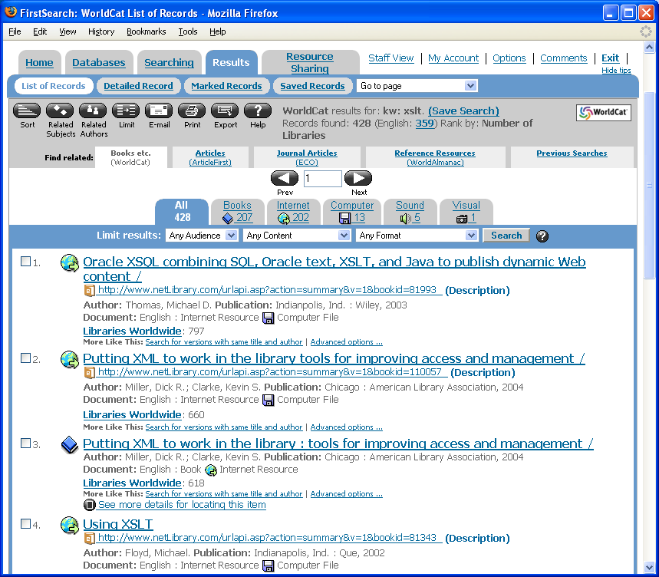

Slide 7
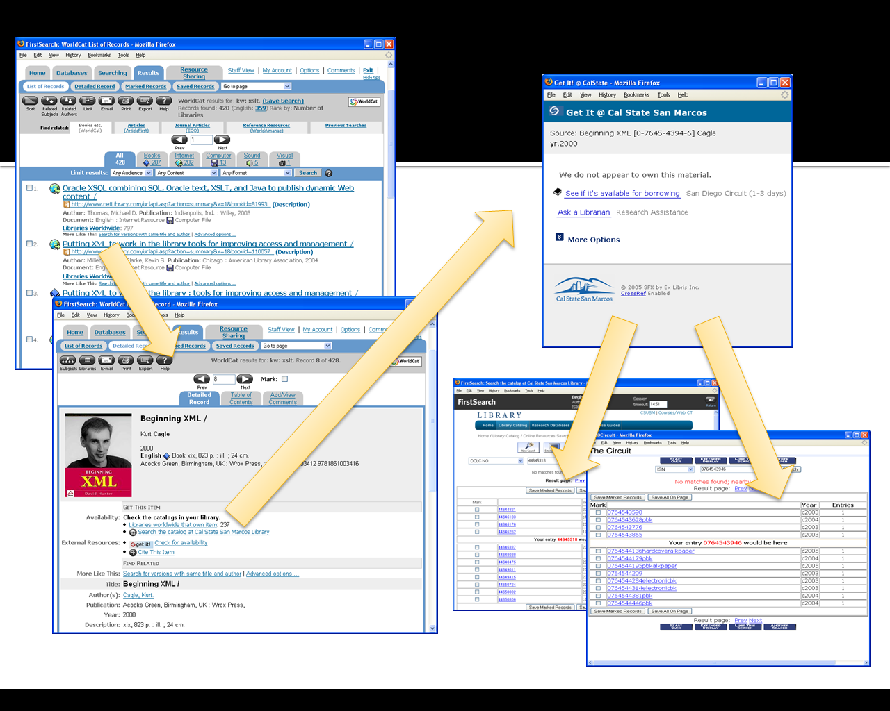

Slide 8
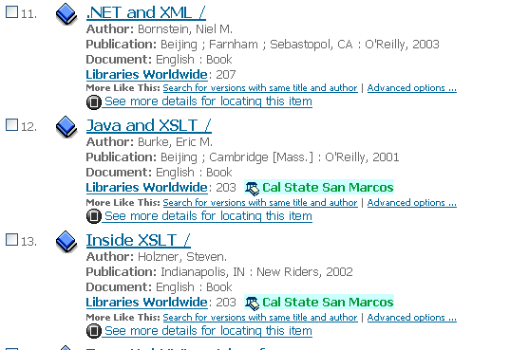

Slide 9
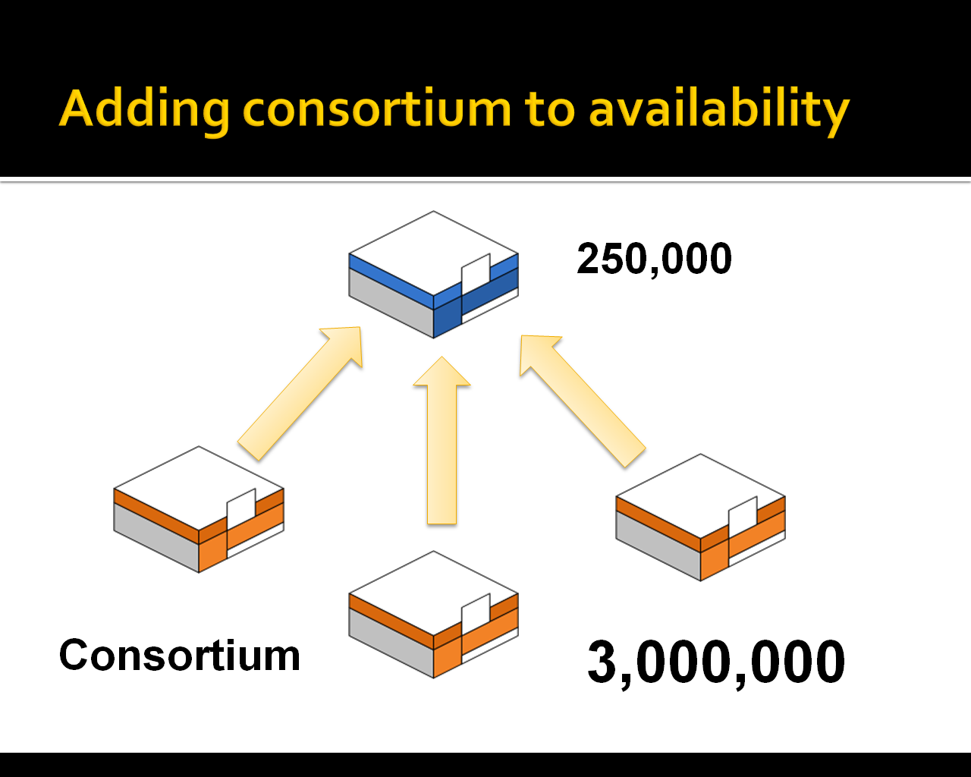

Slide 10



Slide 11

srw.li =(CS1)
( srw.li=(CS1) or
srw.li=(CDS) or
srw.li=(CUS) or
srw.li=(SDG) or
srw.li=(CDU) )

Slide 12
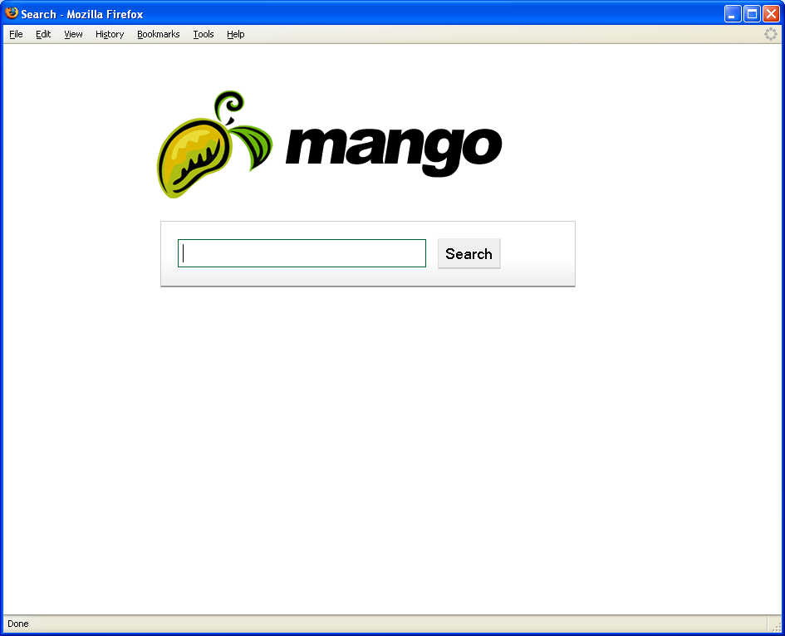

Slide 13
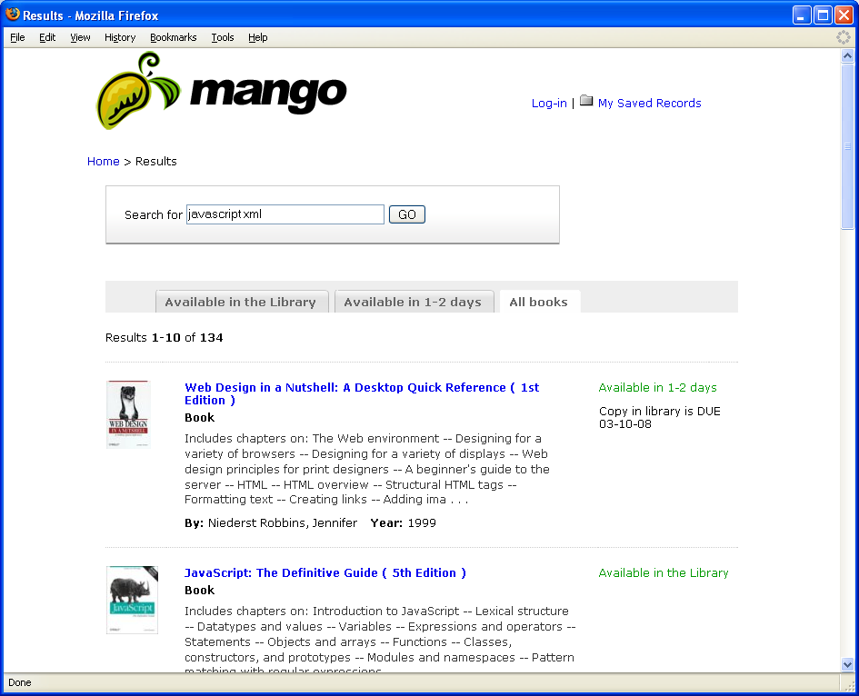

Slide 14
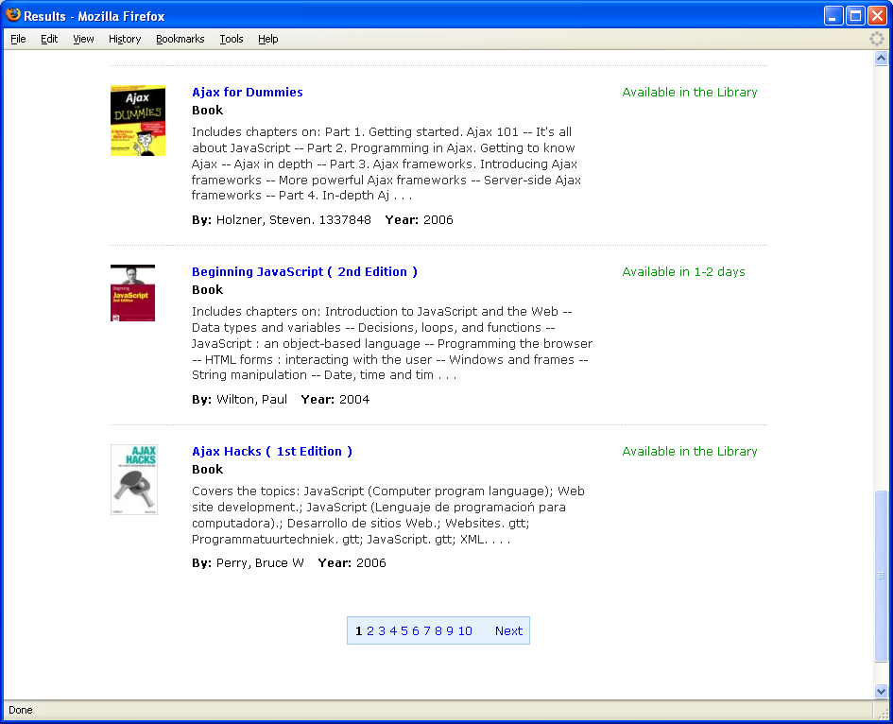

Slide 15
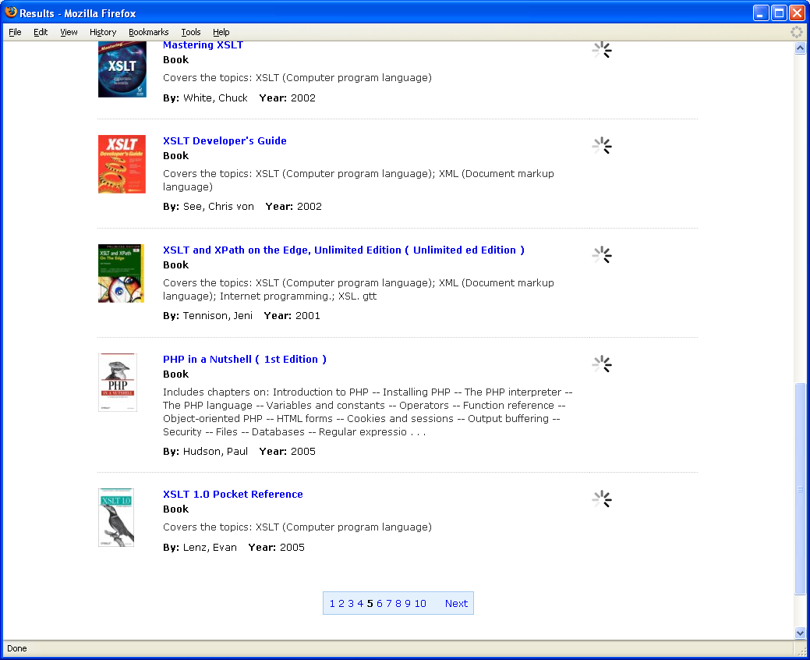

Slide 16
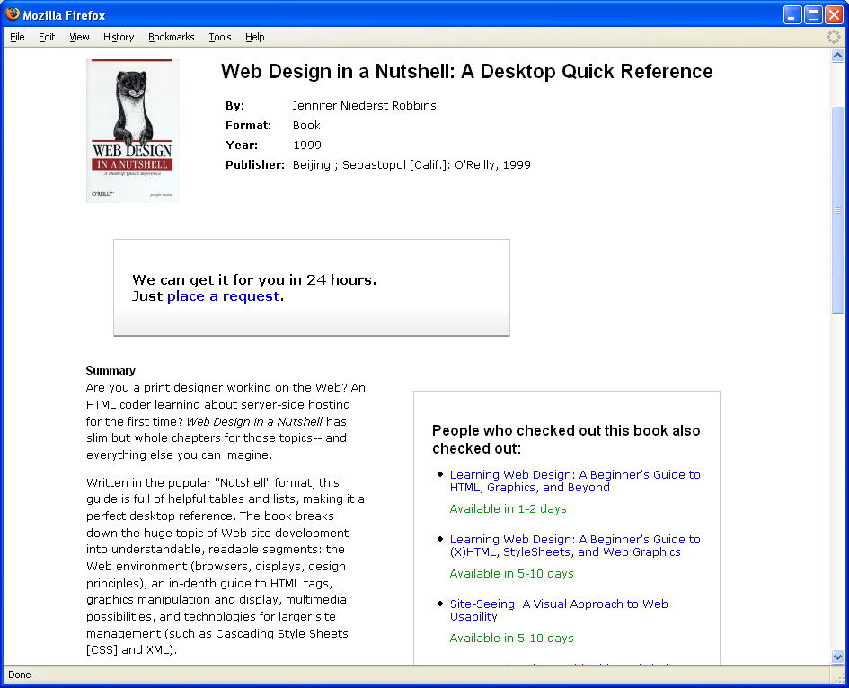

Slide 17
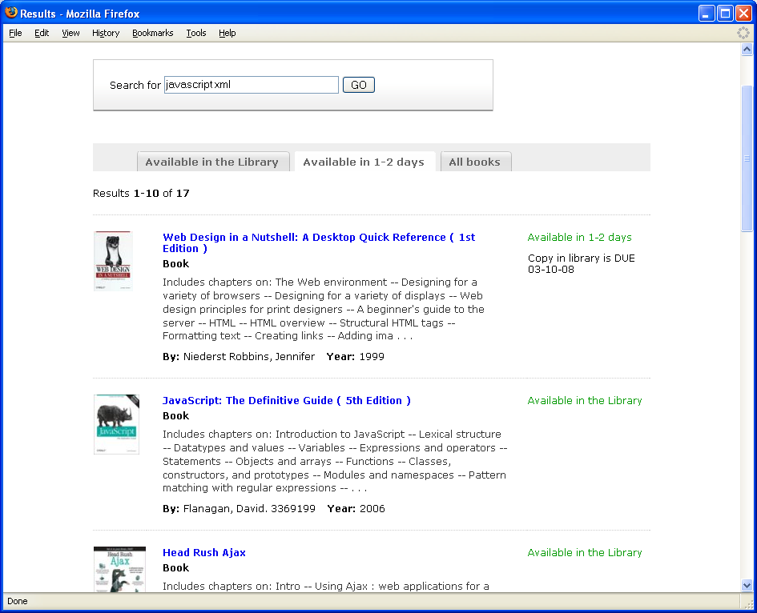

Slide 18
