Slide 2
Bathrooms: Back left corner
Wi-Fi: TheUrbanHive_Private
p/w: w0rkt0g3th3r

Slide 3

Our Core Sponsor:

Slide 4

Our Event Sponsor:

Slide 5
Special Thanks:
Code for Sac Core Team and Volunteers
Individual Donors

Slide 6

Our Meeting Space Provider:

Slide 7
Code for America’s Code of Conduct
The Code for America community expects that Code for America network activities, events, and digital forums:
Are a safe and respectful environment for all participants.
Strive to build tools that are open and free technology for public use. Activities that aim to foster public use, not private gain, are prioritized.
Prioritize access for and input from those who are traditionally excluded from the civic process.
Work to ensure that the community is well-represented in the planning, design, and implementation of civic tech. This includes encouraging participation from women, minorities, and traditionally marginalized groups.
Provide an environment where people are free from discrimination or harassment.
Github: https://github.com/codeforamerica/codeofconduct

Slide 8
Meet
Code for Sacramento!

Slide 9
Hacking
noun /ˈhækɪŋ/
Unauthorized attempts to bypass the security mechanisms of an information system or network.
Playful solving of technical work that requires deep understanding, especially of a computer system.
wiktionary.org
Notes:
Not sure I like “playful”

Slide 10
Civic Hacking
Creative solving of civic problems that requires deep understanding. Possibly using a computer system.
me

Slide 11
“Code for America was founded to build governments by the people, for the people, for the 21st century. We use the power of modern web technologies and network design principles to extend and strengthen the way citizens participate in their government.”
Code for America Brigade Organizing Handbook

Slide 12





Focus areas
Health & Human Services
Economic Development
Safety & Justice
Communication & Engagement

Slide 13
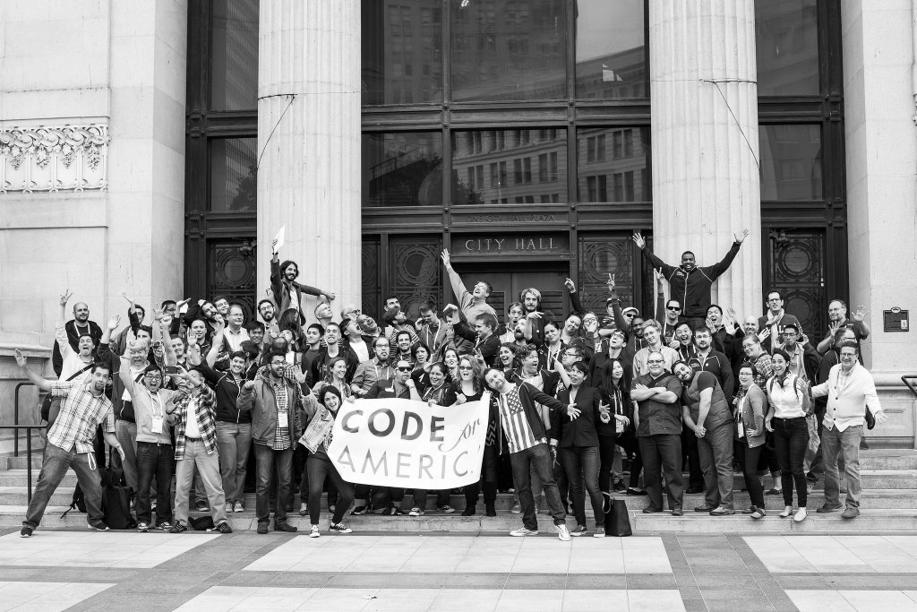


Slide 14
The Code for Sac Experience
Meetups/Hack nights
Civic events
Hackathons/Innovation challenges
Projects

Slide 15
Meetups/Hack Nights
Speakers
Pitches
Standups
Hacking!
(Pizza)

Slide 16
Ideas <> Skills
Govt <> Community

Slide 17

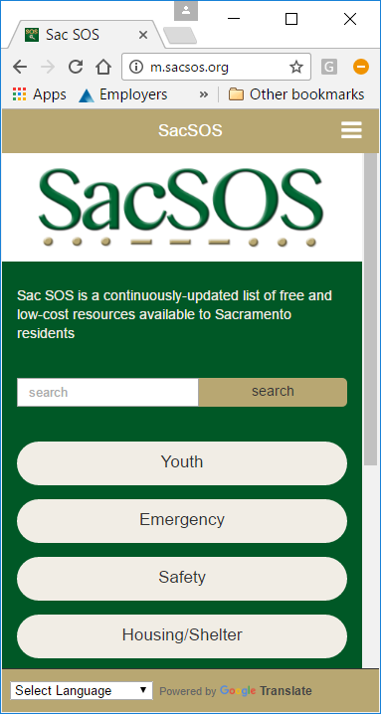

Slide 18
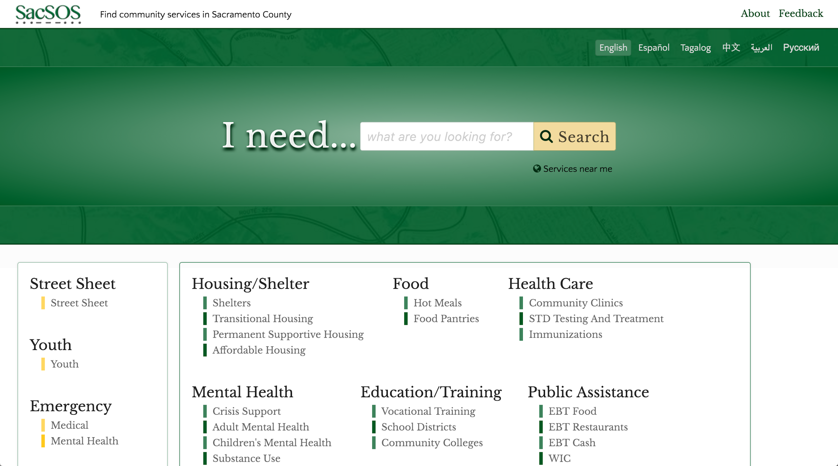

Slide 19
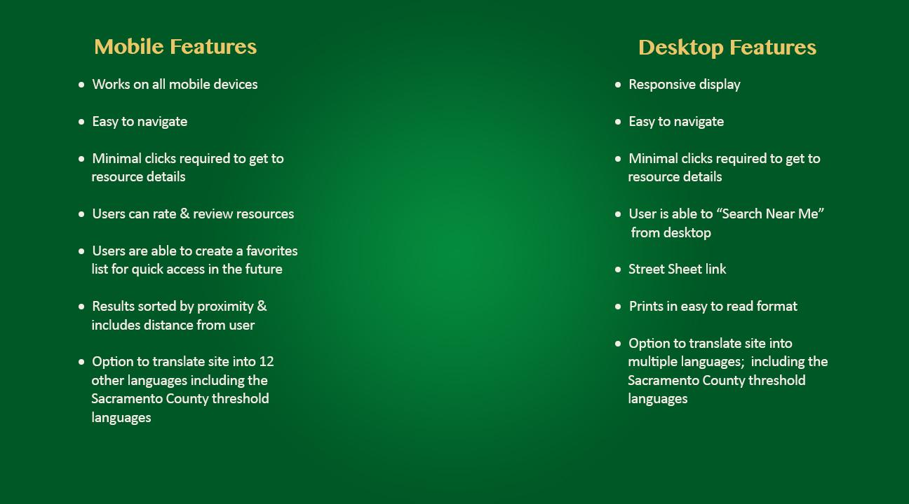

Slide 20
DataThon 3 Focus Areas:
Manual Data Entry
Scrape data from .pdfs or online datasets into .csv format
Search for, validate, and identify data that can be added to SacSOS

Slide 21
What data do we have - Hand entered street sheet data (Housing etc..) - WIC data - SNAP/EBT Food What data do we need - Anything Helpful to Homeless and Low Income People - Subsidized Child Care Providers/Info
- MediCal Physicians
- MediCal Dentists

Slide 22
Future plans/enhancements
Data
Easier data entry of .csv files -(using .csv files from DataThon)
More data and categories to increase scope and areas of service
Code
Consistent menu for Website & App reorganization and icons for easier navigation (similar to People’s Guide)
Self advocacy similar to People’s Guide
Feedback Loop to providers/financial sponsors

Slide 23
How You Can Help?
Specific for SacSOS - contact:
Joanne Werneke
joannemwerneke@gmail.com
916-470-0917

