Slide 1
project
presentation
Abes engineering college
CSe department
SEssion 2021-22
Data ANALYSIS & Data science
mini
Presentation by- Shourya Nagpal
1900320100154 CSE-C

Slide 2
2008-2020
ANalysis
Project title
indian premier league
DATA SCIENCE & DATA ANALYSIS PROJECT

Slide 3
IPL!
Project description
Since the dawn of IPL in 2008, it has attracted viewers all over the globe,within a short period ,IPL has become the highest revenue generating league of cricket .Data Analytics & Data Science has been part of sports entertainment for a long time . Being a cricket fan, visualizing the statistics of cricket is mesmerizing .Hence,I decided to get my first hand-on experience by building IPL stats project .

Slide 4
Project flow
Loading the dataset
01
02
Importing libraries
Basic eda
04
03
Cleaning the dataset
visualization
05
06
analysis

Slide 5
Technology used
Various python libraries and technology used in this project for data analysis are as follows :
Pandas
Numpy
Matplotlib
Seaborn
Plotly
Jupyter notebook
Markdown

Slide 6
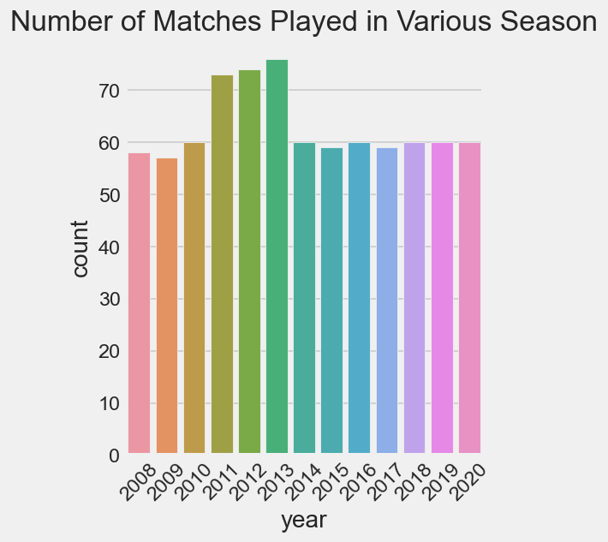
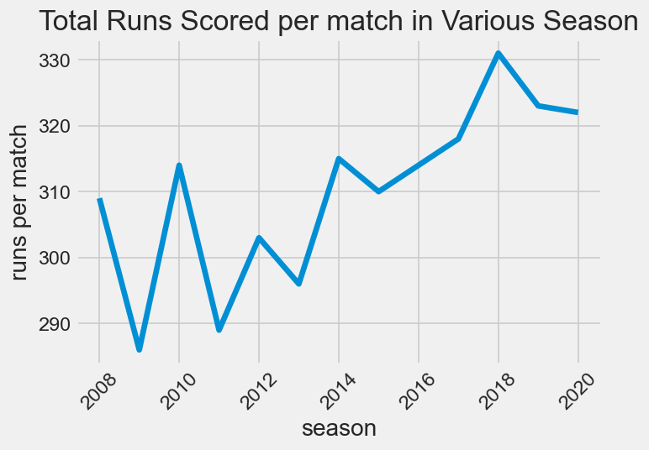
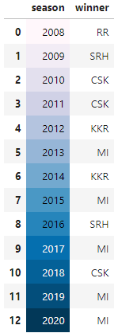
Ipl SEASON ANALYSIS

Slide 7
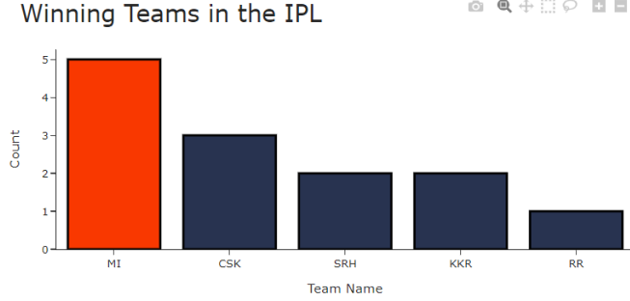
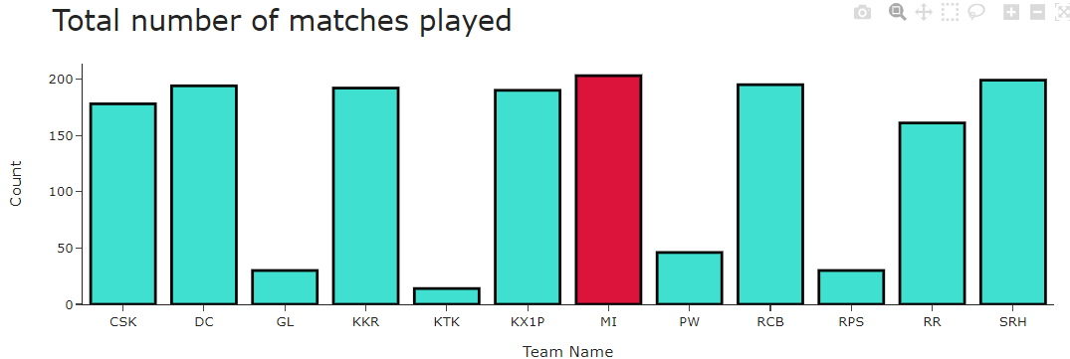
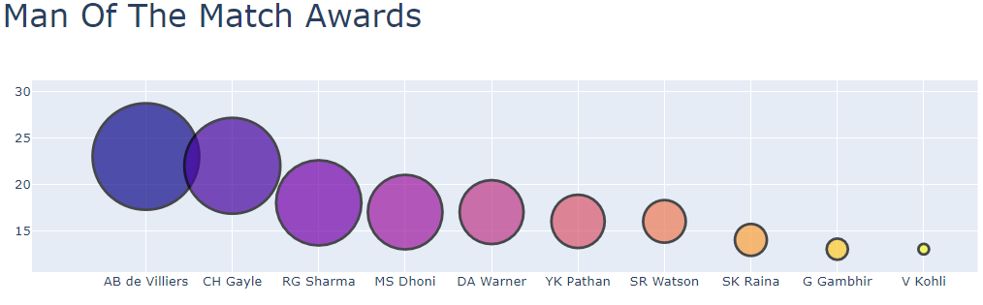
TEAMS ANALYSIS

Slide 8
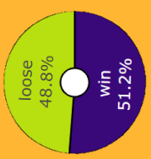
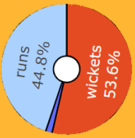
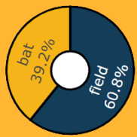
Toss analysis
MOST WIN % SITUATION AFTER BAT/FIELD FIRST
MATCH WIN / LOSE % AFTER WINNING TOSS
TOSS DECISION %

Slide 9
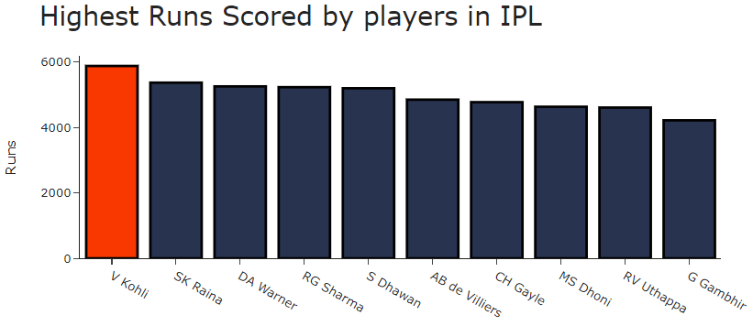
BEST PERFORMANCES

Slide 10
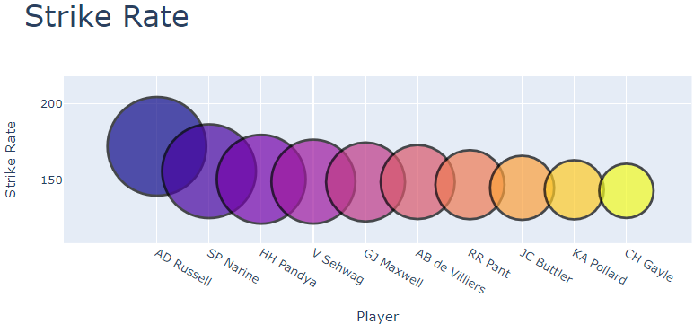
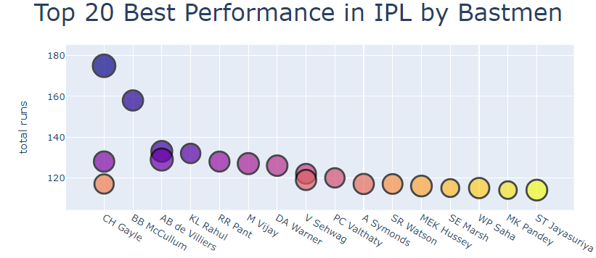
BATTING PERFORMANCES

Slide 11
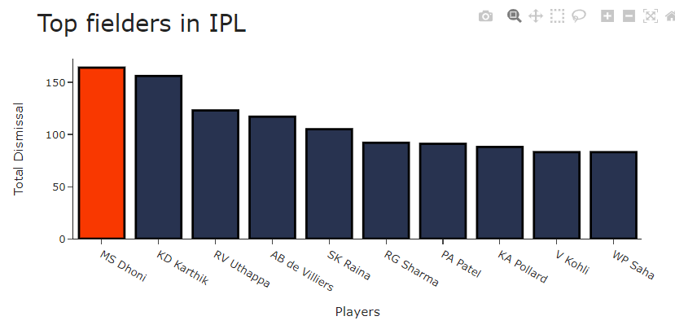
Fielding performances
MENU
ANALYSIS
CONTACT
Data ANALYSIS
MS DHONI
Wicket Keeper
Right Handed batsman
KD KARTHIK
Wicket Keeper
Right Handed batsman
aB DE VILLIERS
Wicket Keeper
Right Handed batsman

Slide 12
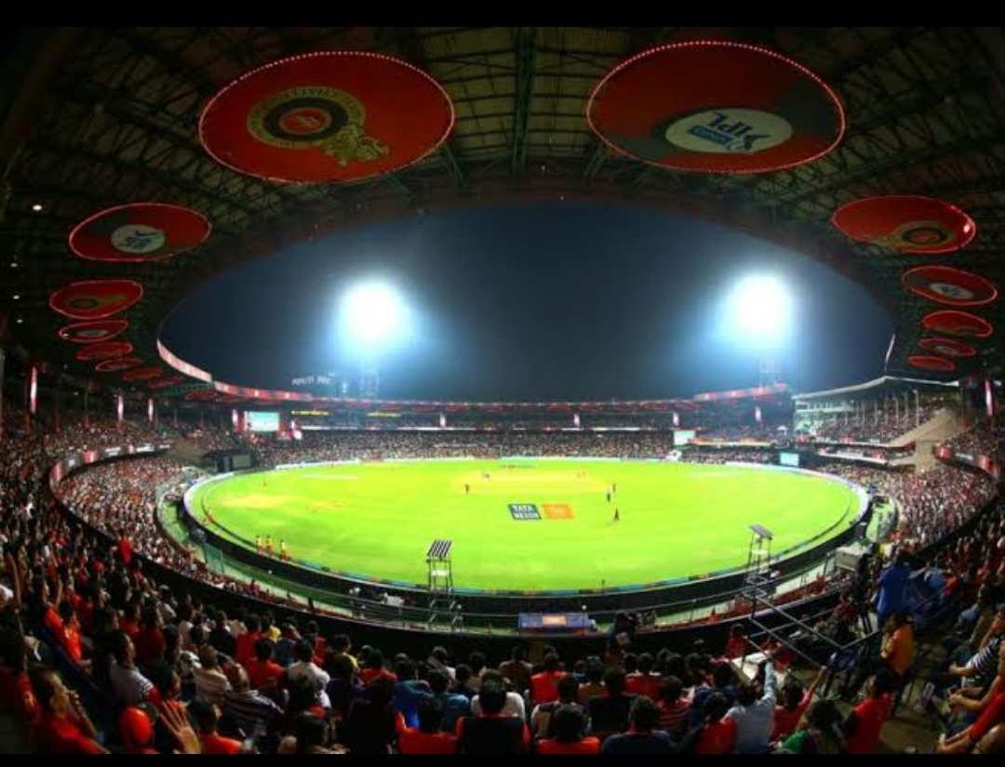
Thank you

