Slide 1
MOI (Managed object Instance) DataGrid
Project Presentation
Jayant Panwar
20/12/2022

Slide 2
About The Project
The aim is to replicate a UI component from PrOptima web where MOI values at a given time are displayed in a grid.
The dates are laid out on the horizontal header and the MOI’s are laid out on the Vertical headers.
The user can select the from date and to date from given Date boxes and on hitting submit can fetch the data from backend.
By default, the data displayed is from current date – 5 days till current date.

Slide 3
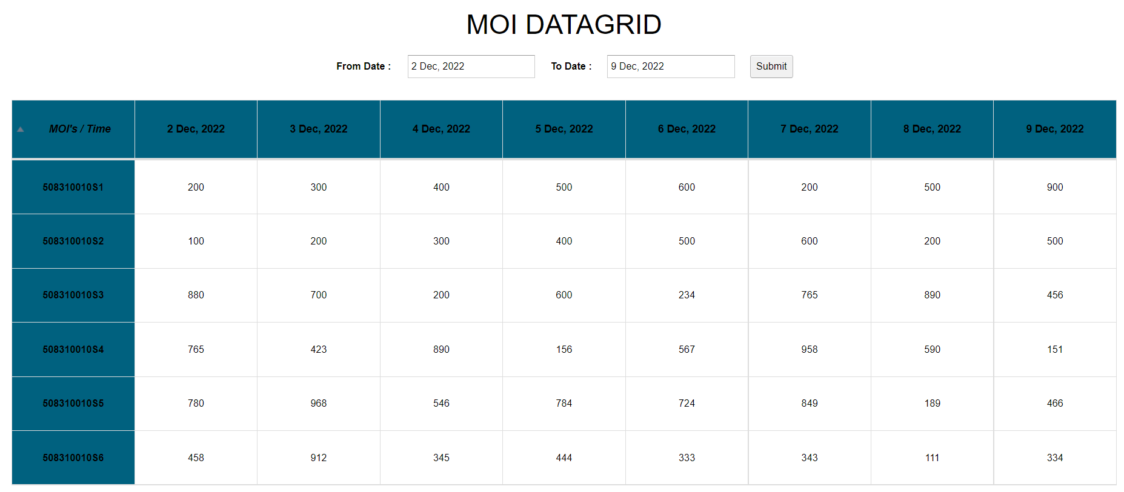
UX

Slide 4
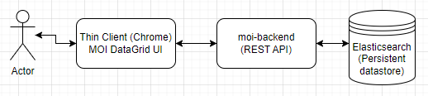
Architecture

Slide 5
Technologies Used (Frontend)
GWT - Google Web Toolkit or GWT Web Toolkit is an open-source set of tools that allows web developers to create and maintain JavaScript front-end applications in Java. GWT framework contains certain set of UI components and libraries using which the developer can write frontend web application in Java.
GWTBootstrap3 (library) – This contains GWT components which have been overridden to apply Twitter Bootstrap v3 design.
RestyGWT(Library) – A good REST client for GWT.

Slide 6
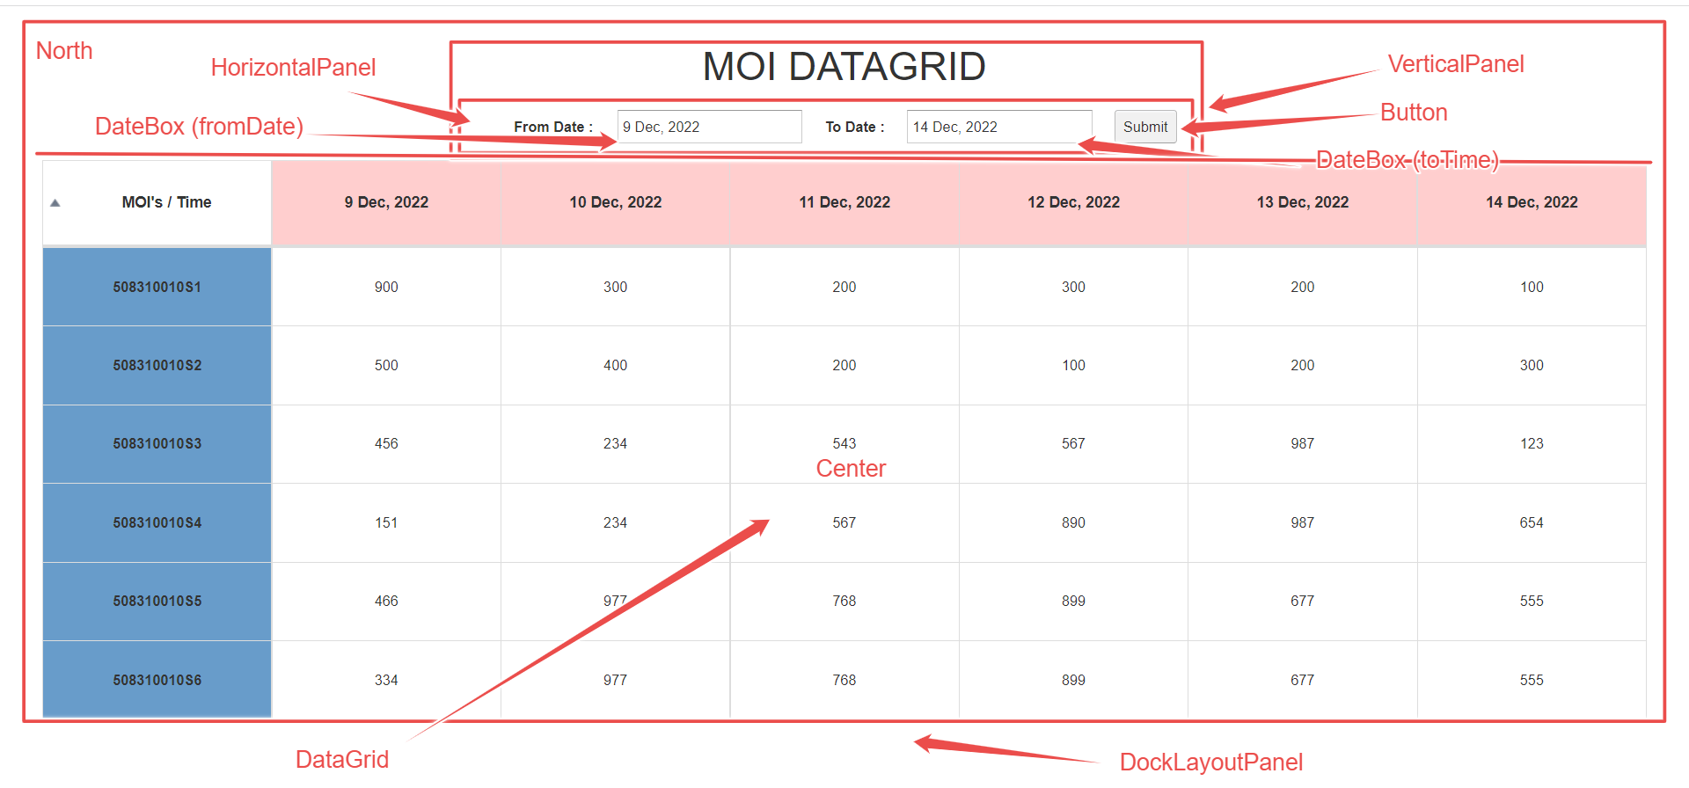
GUI Breakdown

Slide 7
GUI Breakdown (XML)
<!DOCTYPE ui:UiBinder SYSTEM "http://dl.google.com/gwt/DTD/xhtml.ent">
<ui:UiBinder xmlns:ui="urn:ui:com.google.gwt.uibinder" xmlns:g="urn:import:com.google.gwt.user.client.ui"
xmlns:c="urn:import:org.gwtbootstrap3.client.ui.gwt" xmlns:db="urn:import:com.google.gwt.user.datepicker.client"
xmlns:bs="urn:import:org.gwtbootstrap3.client.ui">
<g:DockLayoutPanel unit="EM">
<!-- DataGrid. -->
<g:north size='10'>
<g:VerticalPanel width="40%" horizontalAlignment="ALIGN_CENTER">
<bs:Heading text="MOI DATAGRID" size="H1" marginBottom="20"></bs:Heading>
<g:HorizontalPanel width="100%" horizontalAlignment='ALIGN_CENTER' verticalAlignment='ALIGN_MIDDLE'>
<g:Label styleName="bold">From Date : </g:Label>
<db:DateBox ui:field="fromDate"/>
<g:Label styleName="bold">To Date : </g:Label>
<db:DateBox ui:field="toDate"/>
<g:Button ui:field="submitButton">Submit</g:Button>
</g:HorizontalPanel>
</g:VerticalPanel>
</g:north>
<g:center>
<c:DataGrid ui:field='dataGrid' width="95%" condensed="true" bordered="true" hover="true" styleName="text-center center-block" />
</g:center>
</g:DockLayoutPanel>
</ui:UiBinder>

Slide 8
Technologies Used (backend)
Spring Boot – Used to Created standalone REST API web application which serves the MOI DataGrid UI.
Spring Data Elasticsearch – This project provides integration with the Elasticsearch search engine. Key functional areas of Spring Data Elasticsearch are a POJO centric model for interacting with a Elasticsearch Documents and easily writing a Repository style data access layer.
Elasticsearch – NoSQL persistent datastore to store MOI values at a particular time. Uses Apache Lucene based text search engine to execute performant queries to fetch data based on two timestamps (use-case for this project).

Slide 9
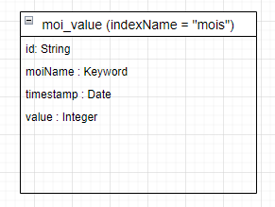
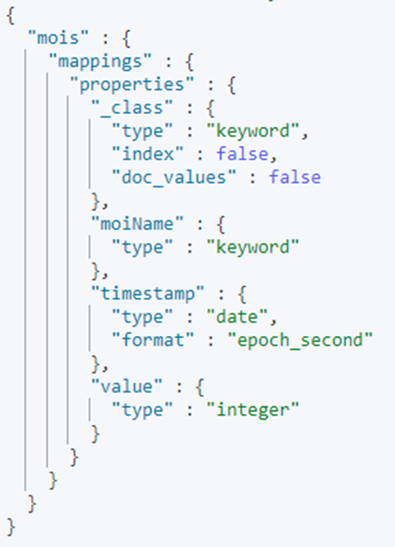
Data Model and Mappings
Data Model used in Java backend
The corresponding mappings in Elastic

Slide 10
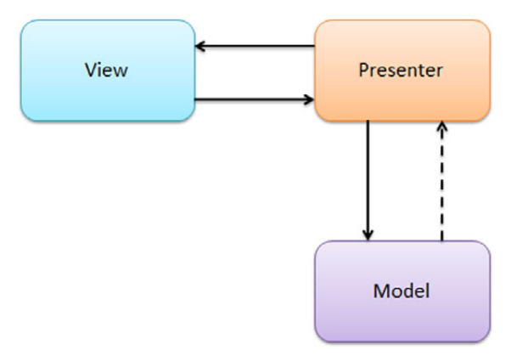
Special Mentions (MVP Pattern)
MVP design pattern for UI - MVP is a UI architectural pattern engineered to improve the separation of concerns in presentation logic.
Model – Defines the data to be displayed or acted upon.
View – Component that displays the data (model) and routes actions from UI to presenter
Presenter - Acts on model and view. Contains the business logic – populates the view and takes actions based on user interaction on view.

Slide 11
Accessibility
This application passes the WCAG (Web Content Accessibility Guidelines) standard with criteria level : AA
This has been tested with NVDA Screen reader tool.
This has also been tested with Color Contrast Analyzer tool.

Slide 12
TODO’s
There is a minor bug – The sorting order is not changed on clicking the MOI Names Header.
UI Overhaul – Will explore GWT Material Design – (https://gwtmaterialdesign.github.io/gmd-core-demo/).

Slide 13
Learnings
Technologies - GWT, Elasticsearch, Spring Data Elastic, Docker
Explored libraries like RestyGWT and GWTBootstrap3
Lesson - Not every JAVA library works with GWT.
The Java 8 new Date Time API does not work with GWT.

Slide 14
Topics explored during Ramp Up Program
Visitor Design Pattern
Domain driven design
GWT
Spring Data Elastic
Docker
Kubernates
Elasticsearch
PrOptima

Slide 15


