Slide 1
AUDIT · THEORY · LEAN 4 · REPRODUCIBLE EVIDENCE
GPU_NCA_proofer
Does pre-pre-training a transformer on neural cellular automata help it learn language? Theory, formal checks and GPU measurements from the repository.
7 LaTeX theory sections, plus 44 named Lean 4 statements (partial coverage)
Pilot 1: 15 runs, graph NCA did not help, protocol confounded
Transfer V2: matched 2,000-update language stage, 9 runs, modest gain that shuffled data matches
github.com/code8286/GPU_NCA_proofer
Notes:
Welcome. This talk walks through GPU_NCA_proofer, a repository that audits a recent claim: that training a transformer on synthetic neural cellular automata first, before text, helps it learn language faster. The repository combines a LaTeX mathematical note, partial Lean 4 formalization, and GPU experiments. Everything here follows the repository's own results ledger, updated 17 October 2026.

Slide 2
The claim under audit and how the repo tests it
The proposed idea (Lee et al., 2026)
What the repository asks
Simulate a neural cellular automaton (NCA) on a 2D grid or graph
Serialize 2D cell states into 1D token sequences
Pre-pre-train an autoregressive transformer on them
Discard synthetic embeddings, attach a language tokenizer, train on text
Claimed benefit: relational priors that speed up language learning
Dynamics: what is the message-passing system computing?
Information: how much entropy do deterministic trajectories carry?
Serialization: what artifacts does a 2D to 1D flattening create?
Optimization: what survives the embedding reset?
Economics: does any language gain repay the synthetic stage?
Notes:
The idea from Lee et al., 2026: simulate a neural cellular automaton, flatten its states into tokens, pre-pre-train a transformer on them, then swap the token embeddings for a language tokenizer and continue on text. The repository treats the NCA as a frozen random-rule data generator, not a component of the language model. Its five audit questions are on the right.

Slide 3
Where the evidence stands
1.178×
1.178×
0.886×
Language-token speedup
Same for shuffled NCA
Cumulative-time speedup
Grid NCA reaches each seed's scratch endpoint in 1600–1800 language updates instead of 2000.
Shuffled trajectories give the identical speedup, so the NCA dynamics are not isolated as the cause.
Counting the 1,000 synthetic updates, grid needs about 12.8% more recorded time at the reference.
Scope of the claims
Development setting: 3 paired seeds, one shared synthetic cache, a small corpus. The repository does not claim general acceleration, reasoning gains, or a reproduction of the paper. Graph rewiring was not tested in V2.
Notes:
Three headline numbers. First, the matched language-stage run shows grid NCA reaching the scratch endpoint 1.178 times faster in language tokens. Second, shuffled NCA, which destroys the spatial dynamics, gets the same speedup, so the contribution of the dynamics is unresolved. Third, once the synthetic stage is counted, grid needs about 12.8 percent more recorded time. All of this is a development experiment: three seeds, one shared synthetic cache, one small corpus.

Slide 4
Pilot 1: no graph benefit, but the protocol is confounded
Arm | Test NLL (nats/byte) | Byte perplexity | Seconds to target | Total tokens to target
scratch | 1.8828 | 6.572 | 6.117 | 819,200
reserve_text | 1.8790 | 6.547 | 6.117 | 819,200
grid_nca | 1.9289 | 6.882 | 8.818 | 1,160,533
graph_nca | 1.9361 | 6.931 | 8.775 | 1,160,533
shuffled_graph | 1.9363 | 6.933 | 9.276 | 1,228,800
The protocol flaw
What the pilot still shows
Scratch: 1,000 text updates
NCA arms: 100 synthetic + 900 text updates
Unequal language exposure and scheduler positions
Graph NCA: 1.432× longer to target, +5.47% perplexity
All 3 seeds favored text-only training
Means over 3 seeds; 15 runs, 61.44M tokens
Notes:
The first GPU pilot used a fixed total budget of 1,000 updates, 4,096,000 tokens per arm. Scratch saw 1,000 text updates; the NCA arms saw 100 synthetic plus 900 text. So language exposure was unequal and the scheduler positions differed, and the repository says this does not cleanly isolate transfer. The numbers are valid as a negative pilot. Graph NCA took 1.432 times as long to reach the target of 2.5 validation nats per byte, with 5.47 percent higher geometric-mean byte perplexity, and all three seeds favored text-only. Fifteen runs, 61.44 million tokens in total.

Slide 5
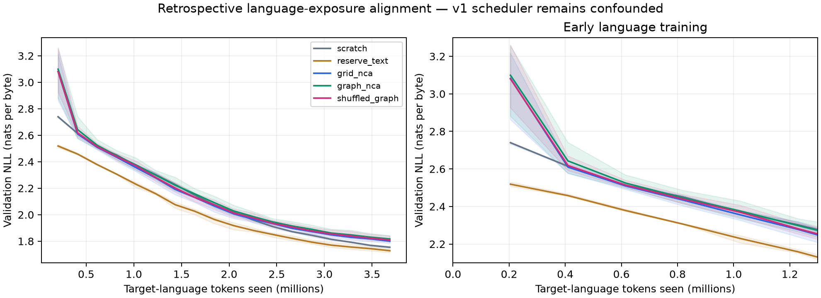
Pilot 1: graph, grid and shuffled arms are indistinguishable
Graph vs grid
Graph vs shuffled graph
Total-token speedup
Same target crossing in every seed
Mean test-loss gap 0.000215 nats/byte
0.667×, 0.667×, 0.800× vs scratch
Notes:
Aligned by language tokens, the three NCA arms track each other and trail the text arms. Graph and grid crossed the target at the same recorded update in every seed. Graph versus shuffled graph differ by only 0.000215 nats per byte in mean test loss. And although graph saved some target-text tokens, total-token speedups were only 0.667, 0.667 and 0.800 once the synthetic exposure is counted. These results apply to this small pilot and do not disprove NCA transfer at other scales or with other rules.

Slide 6
Theory §1–2: three separate objects, one exact equivalence
Three separate objects (§1)
Grid vs. graph rewiring (§2)
NCA dynamics: discrete alphabet, X(t+1) = F(X(t)); rule weights sampled once and frozen
Topology G: typed incoming relation permutations
Transformer predictor: a detached model trained only on serialized traces
It cannot backpropagate into the generator
Periodic 2D grid with 3×3 convolutions = 8-regular typed directed graph
Degree-preserving rewiring permutes incoming neighbours and keeps degree 8
It changes the diffusion spectrum and logit-margin perturbation bounds
It breaks 2D translation equivariance
Lean covers relabeling equivariance; spectral claims stay informal
Notes:
Sections 1 and 2 separate the frozen NCA rule, the communication graph and the transformer predictor. The transformer never backpropagates into the generator. A periodic 2D grid NCA with 3 by 3 convolutions is an 8-regular typed directed graph, and degree-preserving rewiring is a real change of diffusion spectrum. In Lean, the repository checks relabeling equivariance and that endpoint swaps preserve a typed permutation; the grid-to-convolution equivalence at kernel level and the spectral argument stay informal.

Slide 7
Theory §3: trajectory information is tightly bounded
64 bits
512 bits
576 bits
Known rule
Unknown rule
Total bound
H(X(0:T−1) | F,G) = H(X(0) | F,G) ≤ n·log₂q = 64 for 64 binary cells
H(F | G) ≤ q^(d+1)·log₂q = 2⁹ = 512 (at most 2^512 local rules, d = 8)
H(X(0:T−1) | G) ≤ (n + q^(d+1))·log₂q = 64 + 512
What this does and does not say
The synthetic data has a finite, discrete rule space; high marginal entropy alone is not evidence of useful temporal structure
A frequency-preserving shuffle keeps histograms and markers, so frequency and formatting structure could itself help (open question)
These bounds are LaTeX arguments; they are not formalized in Lean
Notes:
Because the rollout is deterministic given the initial state and the rule, the trajectory entropy is bounded. For the binary pilot grid, a known rule leaves only 64 bits of uncertainty. With an unknown rule, there are at most q to the power q^(d+1) local update functions, so rule entropy is at most 512 bits and the total is at most 576 bits. Shuffling preserves each trajectory's token histogram and marker positions but destroys patch ordering. The repository stresses that the retained frequency and format structure could itself help initialization. These entropy arguments are mathematical notes, not formalized in Lean.

Slide 8
Theory §4: serialization fixes lags the model must represent
288
33
18
19.125
Sequence length
Parent-lag bound
Mean lag
Lag variance
16 frames × (16 patch tokens + 2 markers)
Full-window bound 2P+1 on a 128-token window
Identical for every typed-permutation topology
153/8 for the grid (LaTeX only)
Patch encoding
What is and isn't shown
2×2 binary patch → token 256 + 1·X00 + 2·X01 + 4·X10 + 8·X11
16 patches ↔ tokens 256–271; digits recovered exactly (Lean)
Disjoint from the 256 byte tokens
Mean-lag invariance and window bounds: checked in Lean
Lag variance: informal
Effect of lags on learning: not measured
Notes:
Each 2 by 2 binary patch becomes one token: base 2 digits give 16 possible patches, offset by 256. One frame is 16 patch tokens plus 2 markers, 18 tokens, and 16 frames give 288 tokens. Predicting a cell at the next step requires attending to its neighbours in the previous frame; the full-window parent-lag bound is 33, and the mean lag is exactly 18 for every typed-permutation topology, so rewiring cannot change it. That invariance is proved in Lean. The lag variance of 19.125, which is 153/8, is a LaTeX computation. The repository does not measure whether these lags harm learning.

Slide 9
Theory §5–6: head reset, descent condition, toy convergence
Head reset and descent (§5)
Toy quadratic, H = diag(1, 10), α = 0.05 (§6)
Only the backbone transfers; embeddings and head are reset
Reset acts as a projection that keeps δB and zeroes δE (Lean)
Sufficient descent: g·δ < −R, where R is the Taylor remainder
The Taylor bound is an assumption, not derived
A toy Hessian example shows a ranking reversal
Contraction: slow 0.95, fast 0.50
Scratch (1, 1) reaches ε = 0.01 at step 39
Transferred (½, 1) reaches it at step 25: 39/25 = 1.56×
Total speedup with K synthetic updates: 39/(K+25)
K = 100 (409,600 tokens) gives 0.31×; break-even needs K < 14
Exact first hits at 39 and 25 are checked in Lean
Notes:
Transfer keeps the backbone and resets the embeddings and head, a projection that zeroes the head displacement. A sufficient condition for the backbone displacement to help is that its gradient alignment beats the second-order remainder. The Taylor bound itself is a hypothesis, not derived. The worked example is a toy two-dimensional quadratic with Hessian diag(1,10) and learning rate 0.05: contraction 0.95 and 0.5, scratch reaches the target at step 39 and transferred at step 25, a 1.56 times language speedup. With a synthetic cost of K updates the total speedup is 39 over K plus 25, so break-even needs K below 14. The pilot's 100 synthetic updates equal 409,600 tokens. These are analytic toy losses, not measured hitting times.

Slide 10
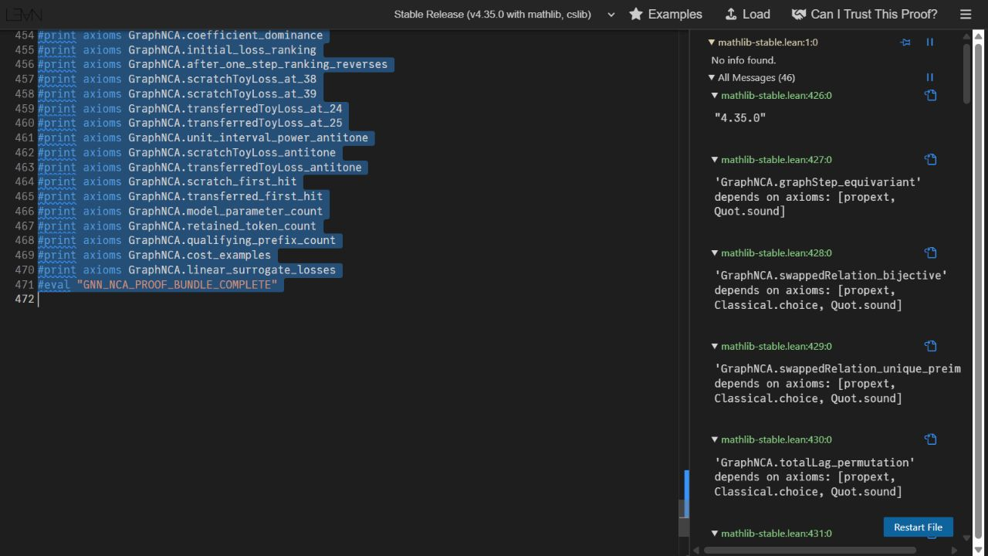
Lean 4: a partial, machine-checked core
Checked in Lean
Graph relabeling equivariance; typed permutation preserved by swaps
Mean and total serialization-lag invariance
Binary patch range, injectivity, digit recovery
Head-reset identities; algebra of an assumed Taylor bound
Scalar and diagonal recurrences; ranking reversal
Exact first hits at steps 39 and 25
Not formalized
Entropy bounds and spectral argument
Taylor remainder estimates from smoothness
Any empirical transfer effect
Trust boundary
A supplied inequality is a theorem hypothesis, not proof that the real model satisfies it. The 44 statements are not 44 independent research claims.
44 named statements incl. lemmas · Lean 4.35.0 + Mathlib · axioms: propext, Classical.choice, Quot.sound · no local lake build claimed
Notes:
The Lean folder contains 44 named statements, including supporting lemmas and exact arithmetic, checked in Lean 4.35.0 with Mathlib in the official web editor using BrowserBundle.lean. The sources avoid sorry, admit, project-defined axioms and native_decide, and only propext, Classical.choice and Quot.sound appear. The repository states plainly that formalization is partial: entropy, the spectral argument and the calculus behind Taylor estimates are informal, a local lake build is not claimed, and nothing in Lean proves real language-model acceleration. The screenshot shows axiom reports in the web editor.

Slide 11
Transfer V2: a matched language stage
1,000
2,000
3 × 3
Synthetic updates
Language updates
Seeds × arms
4,096,000 tokens; zero for the scratch arm.
8,192,000 tokens, context 1024, identical for every arm.
Seeds 17, 29, 43; scratch, grid NCA, shuffled NCA.
Controls and setup
Same architecture and fresh embeddings/head, optimizer, data order and schedule in every arm (language model 12.31M parameters; synthetic model 4.58M)
4,096 training rules (from 8,832 screened candidates) and 128 held-out rules, with disjoint rule-weight hashes
Kaggle Tesla T4; the official WikiText test split is untouched, graph rewiring is not tested
Notes:
V2 fixes the Pilot 1 exposure problem. Every arm gets an identical 2,000-update language stage, 8,192,000 tokens, with fresh text embeddings and head, the same data order, schedule and optimizer. Grid and shuffled arms first receive 1,000 synthetic updates, 4,096,000 tokens; scratch receives none. Rules are screened for complexity: 4,096 training rules retained from 8,832 candidates, 128 held-out. It ran on a Kaggle Tesla T4 with three paired seeds. Graph rewiring was not part of V2, and the official test split was not touched.

Slide 12
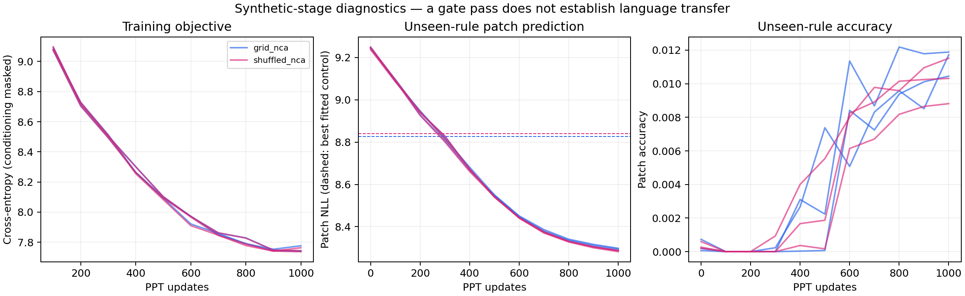
Synthetic stage: the held-out-rule gate passed
Grid: 8.2866–8.2976 vs copy control 8.8264 (−10.24% to −10.35%) · Shuffled: 8.2818–8.2873
Passing shows prediction beyond simple controls, not that the model learned local update physics.
Notes:
All three grid seeds passed the declared held-out-rule gate. Patch NLL improved by 10.24 to 10.35 percent from initialization and ended between 8.2866 and 8.2976, versus 8.8264 for the fitted copy-mixture control. All three shuffled seeds also passed, ending at 8.2818 to 8.2873 on their own validation orderings. The gate shows prediction beyond simple controls; it does not show the model learned local update physics, and native losses use different orderings, so they are not a direct dynamics comparison.

Slide 13
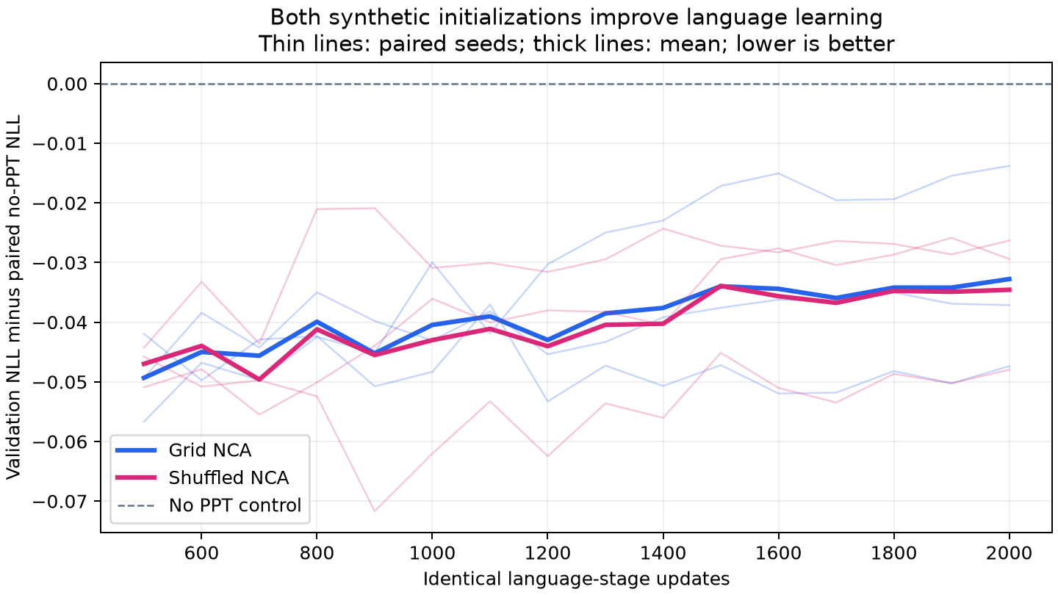
Language stage: grid NCA reaches scratch loss 10–20% sooner
Initialization | Mean final val. NLL | Language updates to scratch endpoint (seeds 17 / 29 / 43) | Token speedup
No PPT / scratch | 5.266091 | 2000 / 2000 / 2000 | 1.000×
Grid NCA PPT | 5.233321 | 1800 / 1600 / 1700 | 1.178×
Shuffled NCA PPT | 5.231528 | 1700 / 1600 / 1800 | 1.178×
Reading the result
Grid needs 10–20% fewer language updates per seed
Language-time speedup 1.180× (about 15.2% less)
Final NLL: grid −0.03277 nats/token (≈3.2% lower perplexity)
Convergence measure, not faster transformer steps
Lower is better; thin lines are paired seeds, thick lines the mean.
Notes:
The reference is each seed's own scratch final validation NLL. Grid first reached it at 1800, 1600 and 1700 language updates, shuffled at 1700, 1600 and 1800; checked every 100 updates without interpolation. The geometric language-token speedup is 1.178 times for both, and the language-time speedup for grid is 1.180 times, about 15.2 percent less language time. At the common final budget, grid improves NLL by 0.03277 nats per token, about 3.2 percent lower perplexity. This measures convergence, not faster transformer updates.

Slide 14
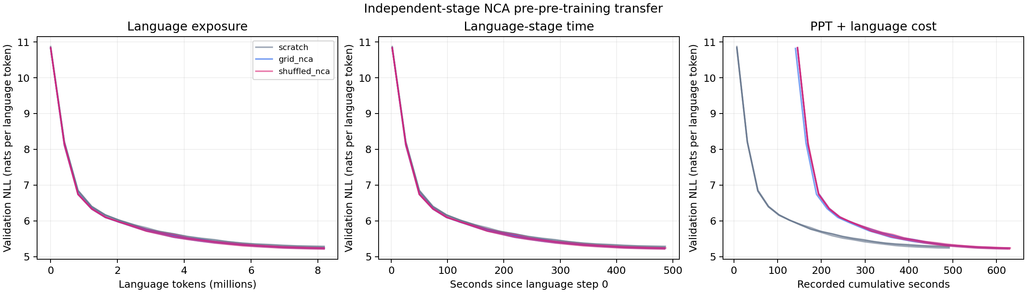
Shuffled control: the dynamics' contribution is unresolved
5.2333 grid
Grid minus shuffled, final NLL
Shuffling keeps token histograms and markers, so frequency or format structure could itself help. Which property matters is open.
Seed 17: +0.0156
Seed 29: +0.0006
Seed 43: −0.0108
5.2315 shuffled
Mean final validation NLL
No consistent grid advantage
Notes:
Shuffling keeps every trajectory's token histogram and marker positions but destroys the original patch ordering, and with it the 2D adjacency. Shuffled NCA ends at 5.2315 versus 5.2333 for grid, slightly better. Grid minus shuffled final NLL is plus 0.0156, plus 0.0006 and minus 0.0108 across the seeds. So there is no consistent grid advantage. That means the modest gain is not shown to come from cellular-automata dynamics, but the repository does not conclude that it comes from token frequency alone either: frequency and format structure survive the shuffle, and which retained property explains the transfer is open.

Slide 15
Cumulative accounting: cost recovery is not demonstrated
0.886×
Cumulative-time speedup
About 12.8% more recorded time than scratch at the paired reference.
Two views of the same run
Language stage: 1600–1800 updates instead of 2000
Full pipeline: +1,000 synthetic updates (4.096M tokens)
About 85.9 minutes summed over all measured stages
Notes:
Counting the synthetic stage changes the picture. Grid's geometric cumulative-time speedup at the paired reference is 0.886, about 12.8 percent more recorded time. Cumulative tokens at the crossings are 11.4688, 10.6496 and 11.0592 million, versus 8.192 million for scratch, because 1,000 synthetic updates, 4.096 million tokens, come first. The archive sums about 85.9 minutes across all measured stages. The language-stage result is positive; cost recovery at this horizon is negative. Timing is from the GPU logs and excludes queueing and package startup.

Slide 16
Verification and limits
What was independently checked
Limits the repository states
15 V2 checkpoints replayed on CPU: max metric gap 1.9563e-7
Pilot 1: 15 checkpoints, max CPU/GPU gap 8.2e-8
Gate decisions, crossings and token accounting recomputed
Hashes match across arms within each seed
Source and archive SHA-256 recorded
3 seeds, one shared synthetic cache
One small corpus; 32,768-token validation prefix
Development validation has been examined; official test untouched
Bitwise init/schedule bytes not reproduced across runtimes
No graph treatment in V2; no claim of general acceleration
Notes:
The repository retains its evidence. All 15 V2 development checkpoints reloaded and reproduced validation metrics on CPU within tolerance, with a maximum discrepancy of 1.9563e-7; the pilot's CPU replay differed by at most 8.2e-8. Selected checkpoints, gate decisions, crossings and token accounting were recomputed, and hashes match within each seed. A local Windows/PyTorch 2.14.1 attempt to regenerate every initialization and schedule hash failed against Kaggle's Linux/PyTorch 2.11.0, so bitwise cross-runtime reproduction of those bytes is not established. The limits listed at right are why the repository calls V2 a development experiment.

Slide 17
What the repository establishes, and what it does not
Supported by the evidence
Not established
A modest language-stage speedup (1.178×) in a matched development run
Synthetic prediction beyond simple copy controls
Mean-lag invariance and toy-model facts, checked in Lean
Pilot 1 is a negative result, and its flaw is documented
That NCA dynamics cause the gain (shuffled matches grid)
Any benefit from graph topology (not tested in V2)
That the synthetic cost is repaid (0.886× cumulative)
General acceleration, reasoning gains, or reproducing the paper
Notes:
To summarize. Established: a modest language-stage convergence signal in a matched development setting, synthetic prediction beyond simple controls, exact toy-model and combinatorial facts checked in Lean, and the pilot's negative result with its protocol flaw acknowledged. Not established: that the gain comes from NCA dynamics, since shuffled data matches it; that graph topology helps, since graph was only in Pilot 1; that the cost is recovered, since cumulative time is 0.886 times; or any general acceleration. This is evidence for caution, not a proof that NCA pre-training cannot work.

Slide 18
Next: Transfer V3 tests graph against grid
Transfer V3 protocol (prepared, not yet run)
Still needed
Five arms: grid, graph, shuffled grid, shuffled graph, no-PPT
1,000 synthetic then 2,000 language updates; 3 paired replicates
Common frozen rules chosen by one complexity filter
Language stage starts only if every seed passes the synthetic gate
About 2.5–3 hours on a T4; no GPU outcome measured yet
Independently seeded synthetic caches
Stronger frequency and format controls
A frozen confirmation protocol
Questions?
github.com/code8286/GPU_NCA_proofer · see RESULTS.md and docs/results/transfer_v2_run1/REVIEW.md
Notes:
The next experiment, V3, enters graph NCA as another pre-pre-training initialization before the same language stage, alongside grid, shuffled controls for both, and a no-PPT control. All five arms get the same 2,000-update language stage after 1,000 synthetic updates, with common frozen grid and graph rules chosen by the same complexity filter. Language training starts only if every grid and graph seed passes the synthetic gate. It is prepared and has local software checks, but no GPU outcome has been measured. Independent synthetic caches and a frozen confirmation protocol are still needed to separate dynamics from general initialization effects. Thank you, and I am happy to take questions.

