Slide 1
RESEARCH UPDATE
GNNs in Neural Cellular Automata
Mathematics, formal proofs, GPU transfer results and controlled CPU diagnostics through stage 8
Detailed research presentation
20 October 2026
github.com/code8286/GPU_NCA_proofer
Notes:
Welcome. This talk walks through GPU_NCA_proofer, a repository that audits a recent claim: that training a transformer on synthetic neural cellular automata first, before text, helps it learn language faster. The repository combines a LaTeX mathematical note, partial Lean 4 formalization, and GPU experiments. Everything here follows the repository's own results ledger, updated 17 October 2026.
Retained and updated from the supplied descriptive presentation.
Sources and status:
README.md
RESULTS.md

Slide 2
Research map
Question | Evidence
What should transfer? | Typed NCA dynamics, tokenization and optimization theory
What is mathematically established? | Worked derivations and a selected 44-statement Lean core
What happened on the GPU? | Historical pilot and separately reviewed v2, v3 and v4 runs
What do CPU diagnostics show? | Readiness failures, basic trainability, partial spatial learning and failed weighting
What comes next? | Existing-checkpoint fit/generalization diagnostic before another treatment
2
Notes:
Research status: 20 October 2026.
Source: RESULTS.md
Source: docs/theory/main.tex
CPU diagnostic, imported GPU measurement and mathematical claims retain their separate scopes.

Slide 3
Problem statement and research question
The proposed idea (Lee et al., 2026)
What the repository asks
Simulate a neural cellular automaton (NCA) on a 2D grid or graph
Serialize 2D cell states into 1D token sequences
Pre-pre-train an autoregressive transformer on them
Discard synthetic embeddings, attach a language tokenizer, train on text
Claimed benefit: relational priors that speed up language learning
Dynamics: what is the message-passing system computing?
Information: how much entropy do deterministic trajectories carry?
Serialization: what artifacts does a 2D to 1D flattening create?
Optimization: what survives the embedding reset?
Economics: does any language gain repay the synthetic stage?
Notes:
The idea from Lee et al., 2026: simulate a neural cellular automaton, flatten its states into tokens, pre-pre-train a transformer on them, then swap the token embeddings for a language tokenizer and continue on text. The repository treats the NCA as a frozen random-rule data generator, not a component of the language model. Its five audit questions are on the right.
Retained and updated from the supplied descriptive presentation.
Sources and status:
RESEARCH_CONTEXT.md
METHODOLOGY_AUDIT.md

Slide 4
Research status through stage 8
Question | Current evidence
Synthetic initialization transfers to language | V2-v4 reach scratch targets sooner in language tokens
Graph or dynamics advantage | V3 primary is partly censored. Both v4 primary tests fail
Synthetic cost recovered | No recovery within the measured v2-v4 horizon
Original random-rule competence | Stage 5 rejects all 12 structured cohorts
Controlled spatial competence | Stage 7 is partial. Stage 8 weighting worsens every coherent seed
Latest GPU evidence is v4. Stages 5-8 are local CPU diagnostics and do not authorize language training.
4
Notes:
Research status: 20 October 2026.
Source: RESULTS.md
CPU diagnostic, imported GPU measurement and mathematical claims retain their separate scopes.

Slide 5
Literature review
Primary work | Relevant idea | Role here
Gilmer et al., 2017 | Shared message passing on graphs | Typed local update representation
Vaswani et al., 2017 | Attention-based sequence prediction | Autoregressive transformer learner
Mordvintsev et al., 2020 | Neural cellular automata | Local rules and emergent spatial dynamics
Touvron et al., 2023 | LLaMA model family | Architectural context for the small local model
Lee et al., 2026 | NCA trajectories before language training | Direct motivating transfer study
5
Notes:
Sources and status:
https://distill.pub/2020/growing-ca/
https://arxiv.org/abs/1704.01212
https://arxiv.org/abs/1706.03762
https://arxiv.org/abs/2302.13971
https://arxiv.org/html/2603.10055v1

Slide 6
Reference study and this development experiment
Aspect | Lee et al. v1 | Our v2 run
Transformer scale | 1.6B in the main setup | 12.31M language model
Synthetic tokens | 164M | 4.096M per synthetic arm and seed
Language data | Web text, math and code | WikiText-2, 8.192M sampled input tokens
Reported convergence | 1.4–1.6× to scratch endpoint | 1.178× geometric token speedup
Interpretation | External research result | Small development result with matching shuffled control
Different scales, corpora, controls and budgets prevent a direct performance ranking or a reproduction claim.
6
Notes:
Sources and status:
https://arxiv.org/html/2603.10055v1
sources/nca-pre-pretraining-reference/reference.json
configs/transfer_v2.json

Slide 7
Hypotheses and falsifiable comparisons
Transfer hypothesis: synthetic initialization lowers loss or reaches a fixed language reference sooner under the same language update procedure.
Dynamics hypothesis: ordered NCA trajectories outperform frequency- and marker-preserving shuffled trajectories.
Graph hypothesis: graph-NCA initialization outperforms grid-NCA initialization under paired rules, random draws and language controls.
Cost hypothesis: language-stage savings exceed generation and synthetic optimization cost.
7
Notes:
Sources and status:
RESEARCH_CONTEXT.md
docs/TRANSFER_V2_PROTOCOL.md
docs/TRANSFER_V3_PROTOCOL.md

Slide 8
Measured v2 transfer and cumulative cost
1.178×
1.178×
0.886×
Language-token speedup
Same for shuffled NCA
Cumulative-time speedup
Grid NCA reaches each seed's scratch endpoint in 1600–1800 language updates instead of 2000.
Shuffled trajectories give the identical speedup, so the NCA dynamics are not isolated as the cause.
Counting the 1,000 synthetic updates, grid needs about 12.8% more recorded time at the reference.
Scope of the claims
Development setting: 3 paired seeds, one shared synthetic cache, a small corpus. The repository does not claim general acceleration, reasoning gains, or a reproduction of the paper. Graph rewiring was not tested in V2.
Notes:
Three headline numbers. First, the matched language-stage run shows grid NCA reaching the scratch endpoint 1.178 times faster in language tokens. Second, shuffled NCA, which destroys the spatial dynamics, gets the same speedup, so the contribution of the dynamics is unresolved. Third, once the synthetic stage is counted, grid needs about 12.8 percent more recorded time. All of this is a development experiment: three seeds, one shared synthetic cache, one small corpus.
Retained and updated from the supplied descriptive presentation.
Sources and status:
docs/results/transfer_v2_run1/aggregate.json

Slide 9
Theory: dynamics, graph and transformer
Three separate objects (§1)
Grid vs. graph rewiring (§2)
NCA dynamics: discrete alphabet, X(t+1) = F(X(t)); rule weights sampled once and frozen
Topology G: typed incoming relation permutations
Transformer predictor: a detached model trained only on serialized traces
It cannot backpropagate into the generator
Periodic 2D grid with 3×3 convolutions = 8-regular typed directed graph
Degree-preserving rewiring permutes incoming neighbours and keeps degree 8
It changes the diffusion spectrum and logit-margin perturbation bounds
It breaks 2D translation equivariance
Lean covers relabeling equivariance; spectral claims stay informal
Notes:
Sections 1 and 2 separate the frozen NCA rule, the communication graph and the transformer predictor. The transformer never backpropagates into the generator. A periodic 2D grid NCA with 3 by 3 convolutions is an 8-regular typed directed graph, and degree-preserving rewiring is a real change of diffusion spectrum. In Lean, the repository checks relabeling equivariance and that endpoint swaps preserve a typed permutation; the grid-to-convolution equivalence at kernel level and the spectral argument stay informal.
Retained and updated from the supplied descriptive presentation.
Sources and status:
docs/theory/sections/01_problem.tex
docs/theory/sections/02_dynamics.tex

Slide 10
GNN visualization from a saved topology
Periodic grid donors
Rewired graph donors
Receiver 27 draws from: 18, 19, 20, 26, 28, 34, 35, 36
Receiver 27 draws from: 18, 19, 20, 26, 1, 52, 35, 13
Historical CPU topology example. 113/512 typed slots changed. V2 used grid trajectories.
10
Notes:
Sources and status:
data/cpu_check/grid_edges.npy
data/cpu_check/graph_edges.npy
experiment.py
Data SHA-256 58b04e63afa61a16b55d8de01787b52cf703d7217bf80edf966a90c0460ed33b. Only the eight incoming edges of receiver 27 are drawn for clarity. Node positions are fixed labels, not graph geometry.
Sources and status:

Slide 11
Actual message-passing code
transfer_v2/nca.py lines 36–40
def message_logits(state, edges, rules, states):
local = F.one_hot(state[:, edges], states).float().flatten(-2)
perception = torch.einsum("bni,bic->bnc", local, rules["perception"])
hidden = F.relu(torch.einsum("bnc,bch->bnh", perception, rules["hidden"]))
return torch.einsum("bnh,bhs->bns", hidden, rules["output"])
One-hot donor states form an ordered 9q-vector. Frozen perception and hidden/output weights apply the same local rule at every cell.
Verbatim source excerpt. Long display lines wrap. Full module remains in the repository.
11
Notes:
One-hot donor states form an ordered 9q-vector. Frozen perception and hidden/output weights apply the same local rule at every cell.
Sources and status:
transfer_v2/nca.py:36-40; SHA-256 4b7bbf83f70614d2feca5619a68f4313a18172900d0fb3397d14d96f0d0bc52f

Slide 12
Grid convolution equals typed message passing
(W₁uᵢ + b₁)ₕ = b₁,ₕ + Σδ kₕ,δ sᵢ₊δ
uᵢ = (sᵢ, sπ₁₍ᵢ₎, …, sπ₈₍ᵢ₎)
Periodic 3 × 3 cross-correlation uses the same ordered inputs
Match kernel offsets to donor slots. The pointwise maps and common tie convention then yield identical logits and states. The repository checks a separate convolution implementation.
LaTeX §2 and the independent convolution/message-passing regression
12
Notes:
Sources and status:
docs/theory/sections/02_dynamics.tex: Proposition grid equivalence
transfer_v2/nca.py:convolution_logits
tests/test_transfer_v2.py

Slide 13
Relabeling equivariance and swap invariants
Pᵣ1 = 1, Pᵣᵀ1 = 1, PᵣᵀPᵣ = I
Fω,ΠG(Πx) = ΠFω,G(x)
(ΠPᵣΠᵀ)(Πx) = ΠPᵣx
A shared local rule commutes with consistent node relabeling. Swapping two donor slots preserves each typed permutation. Connectivity, self-edge exclusions and serialized-transformer invariance require separate arguments.
Formal checks: graphStep_equivariant and swappedRelation_*
13
Notes:
Sources and status:
docs/theory/sections/02_dynamics.tex
proofs/lean/GraphNCA/Graph.lean

Slide 14
Exactly solvable diffusion surrogate
QG = (I + Σᵣ₌₁⁸ Pᵣ) / 9
λab = [(1 + 2cos(2πa/s))(1 + 2cos(2πb/s))] / 9
s = 8: ρ = (1 + √2)/3 = 0.8047378541
‖Qᵗ(x − x̄1)‖₂ ≤ ρᵗ ‖x − x̄1‖₂
The bound falls below 0.1 after 11 steps and 0.01 after 22. This linear surrogate has an exact Fourier solution. The nonlinear NCA has different dynamics.
Spectral gap 0.1952621459. The spectral derivation remains informal in Lean.
14
Notes:
Sources and status:
docs/theory/sections/02_dynamics.tex
docs/theory/numerical_checks.json

Slide 15
Degree preservation does not guarantee mixing
Disconnected counterexample
Consequence
Split 64 vertices into two groups of 32.
Within each group use cyclic offsets ±1, ±2, ±3, ±4.
Every typed relation is a permutation, with eight distinct non-self donors.
The graph still has two disconnected components.
A nonconstant componentwise-constant vector has eigenvalue 1.
Directed graphs require the mean-zero singular norm ‖QG − J‖₂ for the stated Euclidean bound.
Degree constraints alone do not certify a better diffusion gap or better language transfer.
15
Notes:
Sources and status:
docs/theory/sections/02_dynamics.tex

Slide 16
Exact perturbation and a logit-margin condition
h = number of changed typed donor slots
‖SG − S₀‖F² = 2h
E ‖(SG − S₀)X‖₂² = h/2
|m(uG) − m(u₀)| ≤ 2Lm√cᵢ
The binary independent-initial-state identity gives 56.5 when the preserved GPU pilot has h = 113. A margin larger than 2Lm√cᵢ preserves that prediction. Later correlated states need a different expectation.
The discontinuous argmax map does not inherit a global Lipschitz bound from its logits.
16
Notes:
Sources and status:
docs/theory/sections/02_dynamics.tex
docs/theory/numerical_checks.json

Slide 17
Information bounds for deterministic trajectories
64 bits
512 bits
576 bits
Known rule
Unknown rule
Total bound
H(X(0:T−1) | F,G) = H(X(0) | F,G) ≤ n·log₂q = 64 for 64 binary cells
H(F | G) ≤ q^(d+1)·log₂q = 2⁹ = 512 (at most 2^512 local rules, d = 8)
H(X(0:T−1) | G) ≤ (n + q^(d+1))·log₂q = 64 + 512
What this does and does not say
The synthetic data has a finite, discrete rule space; high marginal entropy alone is not evidence of useful temporal structure
A frequency-preserving shuffle keeps histograms and markers, so frequency and formatting structure could itself help (open question)
These bounds are LaTeX arguments; they are not formalized in Lean
Notes:
Because the rollout is deterministic given the initial state and the rule, the trajectory entropy is bounded. For the binary pilot grid, a known rule leaves only 64 bits of uncertainty. With an unknown rule, there are at most q to the power q^(d+1) local update functions, so rule entropy is at most 512 bits and the total is at most 576 bits. Shuffling preserves each trajectory's token histogram and marker positions but destroys patch ordering. The repository stresses that the retained frequency and format structure could itself help initialization. These entropy arguments are mathematical notes, not formalized in Lean.
Retained and updated from the supplied descriptive presentation.
Sources and status:
docs/theory/sections/03_information.tex

Slide 18
Rule uncertainty and stochastic transitions
Exact truth-table example
Stochastic qualification
A uniformly sampled binary 9-input truth table has 512 unknown bits.
D distinct observed queries leave 512 − D unknown bits.
100 distinct queries leave 412 bits. A new query still has Bayes error 1/2.
H(X⁰:ᵀ⁻¹ | ω,G)
= H(X⁰ | ω,G)
+ Σₜ H(Xᵗ⁺¹ | Xᵗ,ω,G)
Fresh transition randomness contributes entropy. The deterministic 576-bit bound does not apply to the nonzero-temperature categorical sampler.
Uniform truth tables form an analytic example. The actual rule prior comes from sampled neural weights.
18
Notes:
Sources and status:
docs/theory/sections/03_information.tex

Slide 19
Contextual prediction and the shuffled control
E[−log qθ(Y|C)] = H(Y|C) + E KL(p(·|C) ∥ qθ(·|C))
H(Y) − H(Y|C) = I(Y; C)
Cov(Aⱼ,Aₖ) = −p(1 − p)/(M − 1)
Frequency matching preserves the marginal histogram. A finite permutation retains sampling-without-replacement dependence and marker positions. For M = 256 and p = 1/2, covariance is −1/1020.
Matching unigram entropy does not imply equal conditional entropy or zero contextual structure.
19
Notes:
Sources and status:
docs/theory/sections/03_information.tex
transfer_v2/nca.py:shuffled

Slide 20
Serialization: exact accounting and parent lags
288
33
18
19.125
Sequence length
Parent-lag bound
Mean lag
Lag variance
16 frames × (16 patch tokens + 2 markers)
Full-window bound 2P+1 on a 128-token window
Identical for every typed-permutation topology
153/8 for the grid (LaTeX only)
Patch encoding
What is and isn't shown
2×2 binary patch → token 256 + 1·X00 + 2·X01 + 4·X10 + 8·X11
16 patches ↔ tokens 256–271; digits recovered exactly (Lean)
Disjoint from the 256 byte tokens
Mean-lag invariance and window bounds: checked in Lean
Lag variance: informal
Effect of lags on learning: not measured
Notes:
Each 2 by 2 binary patch becomes one token: base 2 digits give 16 possible patches, offset by 256. One frame is 16 patch tokens plus 2 markers, 18 tokens, and 16 frames give 288 tokens. Predicting a cell at the next step requires attending to its neighbours in the previous frame; the full-window parent-lag bound is 33, and the mean lag is exactly 18 for every typed-permutation topology, so rewiring cannot change it. That invariance is proved in Lean. The lag variance of 19.125, which is 153/8, is a LaTeX computation. The repository does not measure whether these lags harm learning.
Retained and updated from the supplied descriptive presentation.
Sources and status:
docs/theory/sections/04_serialization.tex

Slide 21
A decoded categorical patch from the actual dataset
7 | 2
5 | 6
token = 7 + 10·2 + 100·5 + 1000·6
token = 6527
Repeated base-10 division recovers every cell.
10⁴ patch symbols plus two frame markers give vocabulary 10,002. A 12 × 12 frame contains 36 patches and 38 tokens.
Saved v2 held-out-rule data. Cell arrangement and token value are decoded, not a new rollout.
21
Notes:
Sources and status:
Kaggle Outputs/nca_transfer_v2_run1_review/artifacts/data/development/nca_validation.npy, rule row 0, frame 0
transfer_v2/nca.py:encode_frames

Slide 22
Actual 2 × 2 patch-token encoding
transfer_v2/nca.py lines 76–81
def encode_frames(frames, side, states):
x = frames.reshape(*frames.shape[:-1], side, side)
patches = (x[..., 0::2, 0::2]+states*x[..., 0::2, 1::2]
+states**2*x[..., 1::2, 0::2]+states**3*x[..., 1::2, 1::2]).flatten(-2)
start = torch.full((*patches.shape[:-1], 1), states**4, dtype=torch.long, device=frames.device)
return torch.cat((start, patches, start+1), -1).flatten(1)
The four positions receive powers 1, q, q² and q³. Frame markers follow the patch vocabulary and are distinct from all patch IDs.
Verbatim source excerpt. Long display lines wrap. Full module remains in the repository.
22
Notes:
The four positions receive powers 1, q, q² and q³. Frame markers follow the patch vocabulary and are distinct from all patch IDs.
Sources and status:
transfer_v2/nca.py:76-81; SHA-256 4b7bbf83f70614d2feca5619a68f4313a18172900d0fb3397d14d96f0d0bc52f

Slide 23
Parent visibility and crop boundaries
j(t,p) = t(P + 2) + 1 + p
D(p,r) = (P + 2) + p − r
3 ≤ D(p,r) ≤ 2P + 1
Binary: 33 tokens Categorical: 73 tokens
A complete preceding window can contain every one-step parent. A target near a crop boundary has only its available prefix. Binary offsets 33…128 give 96 qualifying positions, with patch membership depending on frame offset.
Visibility is a geometric guarantee. It does not establish learned parent selection or rule inference.
23
Notes:
Sources and status:
docs/theory/sections/04_serialization.tex
proofs/lean/GraphNCA/Serialization.lean

Slide 24
Mean lag is fixed while dispersion can change
E[D] = ℓ + E[p(i)] − E[p(J)] = ℓ
Var(D) = 2Var(p) − 2Cov(p(i),p(J))
Binary grid variance = 153/8 = 19.125
Uniform non-self comparison = 2720/63 ≈ 43.1746
Every typed permutation makes both endpoints uniform. Rewiring leaves mean lag exactly 18 in the binary setting. The uniform non-self comparison is an idealized law, separate from the measured partial-swap topology.
Mean/total lag: checked in Lean. Variance and its consequences for learning: informal/open.
24
Notes:
Sources and status:
docs/theory/sections/04_serialization.tex
proofs/lean/GraphNCA/Graph.lean

Slide 25
Actual synthetic target mask
transfer_v2/nca.py lines 157–164
def targets(tokens, c, patch_only=False):
labels = tokens[:, 1:].clone()
absolute = torch.arange(1, tokens.shape[1], device=tokens.device)
mask = absolute < frame_length(c)
labels[:, mask] = -100
if patch_only:
labels[labels >= c["nca"]["states"]**4] = -100
return labels
The first frame supplies context and contributes no targets. Synthetic evaluation separately reports patch-only loss so predictable markers cannot establish the gate.
Verbatim source excerpt. Long display lines wrap. Full module remains in the repository.
25
Notes:
The first frame supplies context and contributes no targets. Synthetic evaluation separately reports patch-only loss so predictable markers cannot establish the gate.
Sources and status:
transfer_v2/nca.py:157-164; SHA-256 4b7bbf83f70614d2feca5619a68f4313a18172900d0fb3397d14d96f0d0bc52f

Slide 26
Transfer mathematics and an exact convergence example
Head reset and descent (§5)
Toy quadratic, H = diag(1, 10), α = 0.05 (§6)
Only the backbone transfers; embeddings and head are reset
Product reset preserves the backbone and replaces the head (Lean)
Sufficient descent: g·δ < −R, where R is the Taylor remainder
Lean takes the Taylor bound as an explicit hypothesis
A toy Hessian example shows a ranking reversal
Contraction: slow 0.95, fast 0.50
Scratch (1, 1) reaches ε = 0.01 at step 39
Transferred (½, 1) reaches it at step 25: 39/25 = 1.56×
Total speedup with K synthetic updates: 39/(K+25)
K = 100 (409,600 tokens) gives 0.31×; break-even needs K < 14
Exact first hits at 39 and 25 are checked in Lean
Notes:
Transfer keeps the backbone and resets the embeddings and head, a projection that zeroes the head displacement. A sufficient condition for the backbone displacement to help is that its gradient alignment beats the second-order remainder. The Taylor bound itself is a hypothesis, not derived. The worked example is a toy two-dimensional quadratic with Hessian diag(1,10) and learning rate 0.05: contraction 0.95 and 0.5, scratch reaches the target at step 39 and transferred at step 25, a 1.56 times language speedup. With a synthetic cost of K updates the total speedup is 39 over K plus 25, so break-even needs K below 14. The pilot's 100 synthetic updates equal 409,600 tokens. These are analytic toy losses, not measured hitting times.
Retained and updated from the supplied descriptive presentation.
Sources and status:
docs/theory/sections/05_transfer.tex
docs/theory/sections/06_numerical.tex

Slide 27
Actual stage-boundary transfer code
transfer_v2/model.py lines 92–97
def language_model(c, vocab, seed, ppt_state=None):
model = LM(c["model"], vocab, core_seed=seed, head_seed=seed+100_000)
if ppt_state is not None:
# Never transfer synthetic embeddings, optimizer moments, or scheduler.
model.core.load_state_dict(ppt_state, strict=True)
return model
Only the saved synthetic backbone loads into a newly initialized language model. The tied language table is common across arms. Optimizer moments and the scheduler start fresh.
Verbatim source excerpt. Long display lines wrap. Full module remains in the repository.
27
Notes:
Only the saved synthetic backbone loads into a newly initialized language model. The tied language table is common across arms. Optimizer moments and the scheduler start fresh.
Sources and status:
transfer_v2/model.py:92-97; SHA-256 4394c7c226ec72113925da5fb9c50949361d652c5d47f54926e399a5b8f8c6b7

Slide 28
Taylor derivation for backbone transfer
f(B₀ + δ) − f(B₀) = gᵀδ + R
R = ∫₀¹ (1 − t) δᵀ∇²f(B₀ + tδ)δ dt
|R| ≤ (L/2) ‖δ‖²
−gᵀδ > (L/2) ‖δ‖² implies f(B₀ + δ) < f(B₀)
Assume local L-smoothness on the segment. The integral proof and calculus remain in LaTeX. Lean verifies the algebraic implication with the Taylor bound supplied as an explicit hypothesis.
This condition is sufficient and local. It has not been measured for the transformer.
28
Notes:
Sources and status:
docs/theory/sections/05_transfer.tex: eq:displacement and prop:alignment
proofs/lean/GraphNCA/Transfer.lean

Slide 29
Worked gradient-alignment calculation
f(b) = ½(b − b*)ᵀ(4I)(b − b*)
b* = (−1/2, −1/4), b₀ = (0,0), g = (2,1)
η = 0.1, gG = (1,1), ggrid = (−1,1)
ΔfG = −0.26, Δfgrid = +0.14
Initial loss 0.625 becomes 0.365 or 0.765. Equal update norms and counts allow opposite outcomes. These specified gradients are a constructed calculation, not measurements of graph or grid gradients.
Actual Adam updates also include preconditioning, clipping, weight decay and momentum.
29
Notes:
Sources and status:
docs/theory/sections/05_transfer.tex
docs/theory/numerical_checks.json

Slide 30
Exact topology-to-target surrogate
AG = (1/d)ΣᵣPᵣ, E[xxᵀ] = I, yG = AGx
Lsyn(M) = ½ E‖(M − AG)x‖² = ½‖M − AG‖F²
MG = γAG, γ = 1 − (1 − η)ᴷ
ΔLtarget = (γ²/2)‖AG‖F² − γ⟨AG,C⟩F
For equal degree with distinct neighbors, ‖AG‖F² = n/d. Graph versus grid depends on target overlap ⟨AG − A₀,C⟩F. Topology alone does not determine the favorable sign.
Lean covers finite-coordinate algebra and the scalar recurrence. The expectation/covariance reduction remains informal.
30
Notes:
Sources and status:
docs/theory/sections/05_transfer.tex
proofs/lean/GraphNCA/LinearSurrogate.lean

Slide 31
A six-node numerical topology example
Initialization for target C = AG | Target loss
Scratch M = 0 | 1.500
One step on graph offsets ±2 | 0.375
One step on cycle offsets ±1 | 1.875
n = 6, d = 2, η = 1/2. Both operators have squared Frobenius norm 3 and disjoint supports. Choosing C = A₀ reverses which synthetic task helps.
A constructed linear mechanism. The disconnected two-triangle graph helps only because the target matches it.
31
Notes:
Sources and status:
docs/theory/sections/05_transfer.tex: exact topology surrogate
docs/theory/numerical_checks.json

Slide 32
Quadratic convergence and ranking reversal
eₙ = (I − αH)ⁿe₀
fₙ − f* = ½Σⱼ λⱼ(1 − αλⱼ)²ⁿcⱼ²
H = diag(1,100), α = 0.01
Scratch: 2.5 → 0.49005 Transferred: 2.0 → 1.9602
The transferred point initially looks better but carries more slow-mode error. After one common step the ranking reverses. Mode-wise coefficient dominance is stronger than smaller total initial loss.
Exact quadratic calculations. Full Hessian diagonalization remains outside the Lean project.
32
Notes:
Sources and status:
docs/theory/sections/05_transfer.tex
proofs/lean/GraphNCA/Quadratic.lean

Slide 33
Closed-form toy loss curves
H = diag(1,10), α = 0.05. Closed-form chart values use 12 significant digits. No simulation or empirical fit.
33
Notes:
Sources and status:
docs/theory/sections/06_numerical.tex
proofs/lean/GraphNCA/Numerics.lean

Slide 34
Exact numerical first hits
Initialization | Update | Exact-expression value, rounded | Crosses 0.01?
Scratch | 38 | 0.01013827358 | No
Scratch | 39 | 0.00914979190 | Yes
Transferred | 24 | 0.01065719879 | No
Transferred | 25 | 0.00961812191 | Yes
Both loss sequences are monotone. The neighboring inequalities exclude every earlier natural step. Lean checks first hits 39 and 25, giving 39/25 = 1.56×.
34
Notes:
Sources and status:
docs/theory/sections/06_numerical.tex
proofs/lean/GraphNCA/Numerics.lean

Slide 35
Break-even derivation and numerical costs
Ctotal = Cgen + cpptK + clangNG
clang₀N₀ − clangGNG > Cgen + cpptK
Equal-cost toy: Stotal = 39/(K + 25)
K = 10: 1.1143× K = 20: 0.8667×
The same 1.56× language-stage gain can create a total gain or loss. With K = 10, generation must cost less than four language-step units to retain a strict benefit. Caching changes amortization, not the initial expense.
The measured v2 cumulative ratios use returned GPU clocks, not these toy step costs.
35
Notes:
Sources and status:
docs/theory/sections/06_numerical.tex
proofs/lean/GraphNCA/Transfer.lean

Slide 36
Parameter and token arithmetic
Quantity | Historical binary pilot | Categorical v2
Backbone blocks / width | 4 / 192 | 6 / 192
Context / vocabulary | 128 / 274 | 1024 / 10,002 synthetic; 50,257 text
Trainable model parameters | 1,857,024 | 4,577,088 synthetic; 12,306,048 text
Input tokens per update | 32 × 128 = 4096 | 2 × 2 × 1024 = 4096
Budget | 100 synthetic + 900 text | 1000 synthetic + 2000 text
Historical formula: VD + WD + L(12D² + 13D) + 2D. It does not describe the RoPE/RMSNorm/SwiGLU architecture.
36
Notes:
Sources and status:
docs/theory/sections/06_numerical.tex
transfer_v2/model.py
configs/transfer_v2.json

Slide 37
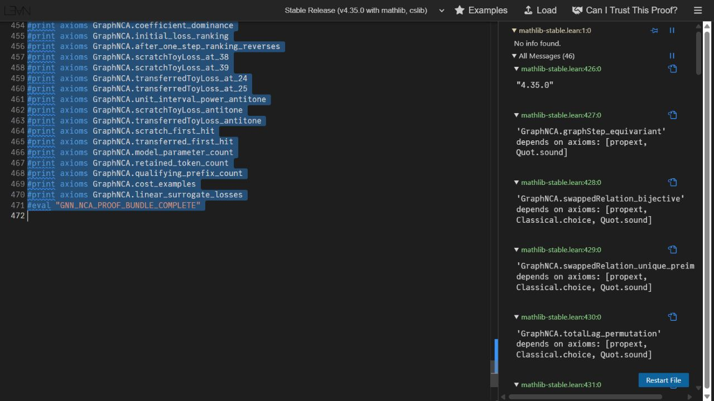
Lean 4: verified coverage and explicit boundaries
Checked in Lean
Graph relabeling equivariance; typed permutation preserved by swaps
Mean and total serialization-lag invariance
Binary patch range, injectivity, digit recovery
Head-reset identities; algebra of an assumed Taylor bound
Scalar and diagonal recurrences; ranking reversal
Exact first hits at steps 39 and 25
Not formalized
Entropy bounds and spectral argument
Taylor remainder estimates from smoothness
Any empirical transfer effect
Trust boundary
A supplied inequality is a theorem hypothesis, not proof that the real model satisfies it. The 44 statements are not 44 independent research claims.
44 named statements incl. lemmas · Lean 4.35.0 + Mathlib · axioms: propext, Classical.choice, Quot.sound · no local lake build claimed
Notes:
The Lean folder contains 44 named statements, including supporting lemmas and exact arithmetic, checked in Lean 4.35.0 with Mathlib in the official web editor using BrowserBundle.lean. The sources avoid sorry, admit, project-defined axioms and native_decide, and only propext, Classical.choice and Quot.sound appear. The repository states plainly that formalization is partial: entropy, the spectral argument and the calculus behind Taylor estimates are informal, a local lake build is not claimed, and nothing in Lean proves real language-model acceleration. The screenshot shows axiom reports in the web editor.
Retained and updated from the supplied descriptive presentation.
Sources and status:
proofs/lean/PROOF_MAP.md
proofs/lean/verification/status.json

Slide 38
An actual Lean equivariance proof
proofs/lean/GraphNCA/Graph.lean lines 19–24
theorem graphStep_equivariant {V R S : Type*} (σ : Equiv.Perm V)
(neighbors : R → V → V) (rule : S → (R → S) → S) (x : V → S) :
graphStep (relabelNeighbors σ neighbors) rule (relabelState σ x) =
relabelState σ (graphStep neighbors rule x) := by
funext i
simp [graphStep, relabelNeighbors, relabelState]
Lean reduces consistent state and neighbor relabeling to the same shared local computation. This theorem proves the statement under its declared definitions and types.
Verbatim source excerpt. Long display lines wrap. Full module remains in the repository.
38
Notes:
Lean reduces consistent state and neighbor relabeling to the same shared local computation. This theorem proves the statement under its declared definitions and types.
Sources and status:
proofs/lean/GraphNCA/Graph.lean:19-24; SHA-256 72cf666ca49daa9f75f780b596c4b1bc8418d0540443025d945f81d52bef6d67

Slide 39
An actual Lean first-hit proof
proofs/lean/GraphNCA/Numerics.lean lines 60–66
theorem transferred_first_hit :
transferredToyLoss 25 ≤ (1 / 100 : ℚ) ∧
∀ n : ℕ, n < 25 → (1 / 100 : ℚ) < transferredToyLoss n := by
refine ⟨le_of_lt transferredToyLoss_at_25, ?_⟩
intro n hn
have hle : n ≤ 24 := by omega
exact lt_of_lt_of_le transferredToyLoss_at_24 (transferredToyLoss_antitone hle)
The proof combines a checked boundary inequality with monotonicity and a natural-number bound. These are rational toy-loss statements, separate from GPU validation curves.
Verbatim source excerpt. Long display lines wrap. Full module remains in the repository.
39
Notes:
The proof combines a checked boundary inequality with monotonicity and a natural-number bound. These are rational toy-loss statements, separate from GPU validation curves.
Sources and status:
proofs/lean/GraphNCA/Numerics.lean:60-66; SHA-256 bcca26b251d6a5c31c0abd4ce12870572cd46351bae064a8d5a3283872b94b02

Slide 40
Formal proof failures, corrections and trust
Retained first full check
Final scope
Three real-valued definitions lacked noncomputable annotations.
The two-mode expression left an algebraic goal and exposed sorryAx in the failed record.
The corrected definitions and ring proof passed the complete browser bundle.
44 statements in Lean 4.35.0 with Mathlib.
Every theorem depends only on a subset of propext, Classical.choice and Quot.sound, or no axioms.
Local Lake build and remote CI remain unrun.
Failed records stay append-only. A completion marker alone does not establish an error-free file.
40
Notes:
Sources and status:
proofs/lean/verification/README.md
proofs/lean/verification/attempt-1-diagnostics.txt
proofs/lean/verification/final-diagnostics.txt

Slide 41
Historical pilot 1 and its exposure confound
Arm | Test NLL (nats/byte) | Byte perplexity | Seconds to target | Total tokens to target
scratch | 1.8828 | 6.572 | 6.117 | 819,200
reserve_text | 1.8790 | 6.547 | 6.117 | 819,200
grid_nca | 1.9289 | 6.882 | 8.818 | 1,160,533
graph_nca | 1.9361 | 6.931 | 8.775 | 1,160,533
shuffled_graph | 1.9363 | 6.933 | 9.276 | 1,228,800
The protocol flaw
What the pilot still shows
Scratch: 1,000 text updates
NCA arms: 100 synthetic + 900 text updates
Unequal language exposure and scheduler positions
Graph NCA: 1.432× longer to target, +5.47% perplexity
All 3 seeds favored text-only training
Means over 3 seeds; 15 runs, 61.44M tokens
Notes:
The first GPU pilot used a fixed total budget of 1,000 updates, 4,096,000 tokens per arm. Scratch saw 1,000 text updates; the NCA arms saw 100 synthetic plus 900 text. So language exposure was unequal and the scheduler positions differed, and the repository says this does not cleanly isolate transfer. The numbers are valid as a negative pilot. Graph NCA took 1.432 times as long to reach the target of 2.5 validation nats per byte, with 5.47 percent higher geometric-mean byte perplexity, and all three seeds favored text-only. Fifteen runs, 61.44 million tokens in total.
Retained and updated from the supplied descriptive presentation.
Sources and status:
docs/results/pilot1/REVIEW.md
METHODOLOGY_AUDIT.md

Slide 42
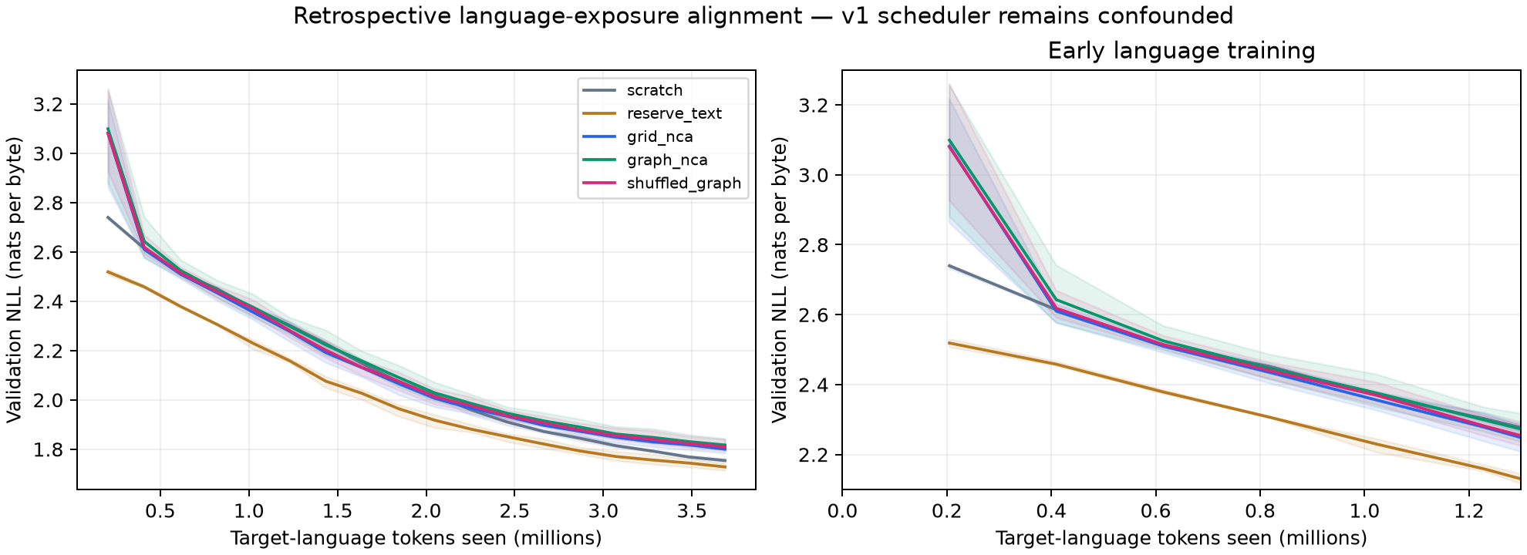
Historical pilot: language-exposure alignment
Graph vs grid
Graph vs shuffled graph
Total-token speedup
Same target crossing in every seed
Mean test-loss gap 0.000215 nats/byte
0.667×, 0.667×, 0.800× vs scratch
Notes:
Aligned by language tokens, the three NCA arms track each other and trail the text arms. Graph and grid crossed the target at the same recorded update in every seed. Graph versus shuffled graph differ by only 0.000215 nats per byte in mean test loss. And although graph saved some target-text tokens, total-token speedups were only 0.667, 0.667 and 0.800 once the synthetic exposure is counted. These results apply to this small pilot and do not disprove NCA transfer at other scales or with other rules.
Retained and updated from the supplied descriptive presentation.
Sources and status:
docs/results/pilot1/language_aligned_curves.png
docs/results/pilot1/prepretraining_diagnosis.json

Slide 43
Methodology across three versions
Version | Treatment and clock | Research status
Pilot 1 | Binary graph/grid. 1000 text vs 100 synthetic + 900 text | Imported GPU evidence. Unequal language exposure and scheduler confound
V2 | Categorical grid/shuffle/no-PPT. Same 2000 text updates | Imported GPU evidence. Modest transfer, matching shuffled gains
V3 | Grid, graph and both shuffles with no-PPT. Paired caches | Imported GPU run and CPU replay. Primary graph speedup remains unestablished
Versions stay separate. The negative historical result remains valid for its original matched-total-budget design.
43
Notes:
Sources and status:
docs/PILOT_PROTOCOL.md
docs/TRANSFER_V2_PROTOCOL.md
docs/TRANSFER_V3_PROTOCOL.md

Slide 44
V2: identical language-stage controls
1,000
2,000
3 × 3
Synthetic updates
Language updates
Seeds × arms
4,096,000 tokens; zero for the scratch arm.
8,192,000 tokens, context 1024, identical for every arm.
Seeds 17, 29, 43; scratch, grid NCA, shuffled NCA.
Controls and setup
Same architecture and fresh embeddings/head, optimizer, data order and schedule in every arm (language model 12.31M parameters; synthetic model 4.58M)
4,096 training rules (from 8,832 screened candidates) and 128 held-out rules, with disjoint rule-weight hashes
Kaggle Tesla T4; the official WikiText test split is untouched, graph rewiring is not tested
Notes:
V2 fixes the Pilot 1 exposure problem. Every arm gets an identical 2,000-update language stage, 8,192,000 tokens, with fresh text embeddings and head, the same data order, schedule and optimizer. Grid and shuffled arms first receive 1,000 synthetic updates, 4,096,000 tokens; scratch receives none. Rules are screened for complexity: 4,096 training rules retained from 8,832 candidates, 128 held-out. It ran on a Kaggle Tesla T4 with three paired seeds. Graph rewiring was not part of V2, and the official test split was not touched.
Retained and updated from the supplied descriptive presentation.
Sources and status:
configs/transfer_v2.json
docs/results/transfer_v2_run1/REVIEW.md

Slide 45
Dataset preparation and rule separation
Sample frozen categorical rules and uniform initial states on a periodic 12 × 12 lattice. Apply ten burn-in steps and temperature 10⁻⁴.
Screen independent ten-frame profiles using marker-free int32 patch IDs and gzip level 9. Keep strict ratios between 0.5 and 1.0.
Generate fresh trajectories for accepted rules. The training and held-out rule banks have disjoint actual weight hashes.
Use 4096 training rules and 128 held-out rules. Evaluate the predeclared first 32 held-out rules and reserve the official language test.
45
Notes:
Sources and status:
transfer_v2/nca.py:generate_split
transfer_v2/data.py
docs/results/transfer_v2_run1/REVIEW.md

Slide 46
Saved dataset sizes and screening outcomes
Dataset / check | Recorded value
Synthetic train array | 4096 × 1026 uint16 tokens
Synthetic validation array | 128 × 1026 uint16 tokens
Candidate rules screened | 8832 train; 256 validation
Fresh rollout median gzip ratio | About 0.5075 train; 0.5080 validation
Final fixed transition fraction | 0.195% train; 0% validation
WikiText/GPT-2 tokens | 2,403,644 train; 248,461 validation
Screening and fresh rollout use different initial conditions. Fresh scores need not remain in the screening band.
46
Notes:
Sources and status:
docs/results/transfer_v2_run1/REVIEW.md
Kaggle Outputs/nca_transfer_v2_run1_review/artifacts/data/development/manifest.json

Slide 47
Actual NCA states from the retained v2 dataset
7 | 2 | 5 | 8 | 2 | 2 | 2 | 5 | 5 | 7 | 5 | 6
5 | 6 | 2 | 2 | 5 | 2 | 6 | 4 | 2 | 5 | 6 | 6
7 | 5 | 4 | 6 | 5 | 5 | 2 | 5 | 5 | 7 | 7 | 2
0 | 2 | 5 | 5 | 2 | 2 | 5 | 2 | 2 | 4 | 4 | 5
8 | 5 | 4 | 5 | 5 | 6 | 2 | 6 | 5 | 2 | 6 | 5
4 | 7 | 7 | 7 | 2 | 8 | 4 | 4 | 2 | 6 | 5 | 2
8 | 2 | 6 | 8 | 5 | 5 | 5 | 6 | 7 | 2 | 2 | 5
2 | 5 | 5 | 8 | 7 | 7 | 5 | 5 | 6 | 5 | 6 | 2
6 | 2 | 4 | 2 | 5 | 6 | 6 | 5 | 5 | 2 | 2 | 5
6 | 2 | 5 | 4 | 2 | 7 | 2 | 2 | 2 | 5 | 6 | 2
1 | 2 | 2 | 6 | 5 | 8 | 5 | 6 | 2 | 7 | 7 | 5
2 | 6 | 4 | 2 | 6 | 2 | 2 | 2 | 2 | 2 | 6 | 8
2 | 2 | 5 | 4 | 7 | 7 | 6 | 5 | 5 | 8 | 5 | 5
0 | 4 | 2 | 8 | 8 | 7 | 6 | 4 | 2 | 6 | 2 | 5
2 | 5 | 0 | 4 | 2 | 6 | 8 | 2 | 6 | 2 | 1 | 2
6 | 2 | 8 | 8 | 7 | 2 | 6 | 7 | 8 | 6 | 1 | 8
5 | 6 | 5 | 5 | 8 | 6 | 2 | 4 | 6 | 5 | 2 | 2
7 | 2 | 6 | 7 | 2 | 8 | 6 | 6 | 5 | 2 | 6 | 6
6 | 6 | 6 | 2 | 5 | 5 | 5 | 2 | 2 | 7 | 2 | 6
2 | 6 | 5 | 5 | 2 | 2 | 5 | 5 | 4 | 4 | 6 | 7
6 | 6 | 4 | 5 | 5 | 6 | 2 | 2 | 6 | 7 | 2 | 8
7 | 2 | 8 | 6 | 2 | 8 | 7 | 7 | 2 | 6 | 6 | 2
2 | 6 | 5 | 2 | 6 | 5 | 6 | 6 | 6 | 2 | 5 | 5
6 | 3 | 6 | 5 | 4 | 4 | 7 | 8 | 4 | 8 | 7 | 2
2 | 5 | 4 | 8 | 6 | 2 | 5 | 5 | 2 | 6 | 2 | 2
6 | 2 | 5 | 2 | 2 | 6 | 2 | 2 | 5 | 5 | 5 | 5
5 | 6 | 2 | 6 | 2 | 2 | 8 | 6 | 6 | 6 | 7 | 2
2 | 5 | 2 | 2 | 5 | 5 | 8 | 5 | 4 | 6 | 2 | 4
6 | 2 | 2 | 2 | 2 | 6 | 7 | 2 | 8 | 6 | 2 | 2
2 | 8 | 2 | 6 | 6 | 5 | 3 | 6 | 2 | 5 | 5 | 7
6 | 6 | 2 | 2 | 6 | 6 | 2 | 2 | 5 | 6 | 2 | 2
2 | 2 | 7 | 6 | 4 | 2 | 4 | 3 | 5 | 5 | 5 | 6
5 | 6 | 2 | 8 | 6 | 2 | 5 | 6 | 4 | 5 | 2 | 8
2 | 7 | 7 | 2 | 5 | 4 | 2 | 8 | 2 | 2 | 5 | 4
2 | 5 | 5 | 6 | 7 | 5 | 6 | 5 | 5 | 6 | 2 | 7
6 | 7 | 2 | 2 | 0 | 6 | 8 | 7 | 2 | 2 | 5 | 5
2 | 7 | 6 | 6 | 5 | 8 | 2 | 5 | 5 | 6 | 0 | 0
7 | 2 | 4 | 2 | 8 | 2 | 6 | 2 | 5 | 6 | 2 | 5
8 | 2 | 7 | 5 | 6 | 8 | 2 | 2 | 4 | 6 | 8 | 4
2 | 6 | 5 | 4 | 6 | 2 | 2 | 2 | 8 | 5 | 5 | 6
8 | 2 | 2 | 3 | 6 | 2 | 5 | 6 | 5 | 2 | 2 | 7
5 | 5 | 6 | 6 | 8 | 6 | 5 | 5 | 7 | 2 | 2 | 4
2 | 7 | 4 | 2 | 7 | 5 | 2 | 2 | 5 | 5 | 0 | 6
5 | 8 | 2 | 5 | 5 | 2 | 7 | 5 | 6 | 7 | 2 | 5
2 | 5 | 6 | 2 | 2 | 5 | 2 | 7 | 2 | 2 | 4 | 6
3 | 4 | 2 | 5 | 5 | 5 | 8 | 6 | 7 | 5 | 4 | 5
8 | 2 | 7 | 4 | 2 | 2 | 6 | 5 | 2 | 6 | 5 | 5
1 | 8 | 2 | 8 | 5 | 6 | 6 | 2 | 7 | 2 | 7 | 6
Retained frame 0
Retained frame 1
Retained frame 10
Retained frame 26
Cell labels and colors encode states 0–9. These four frames decode one saved held-out-rule trajectory after burn-in. The categorical sampler may inject fresh randomness.
Original data remain unchanged. The slide displays decoded values, without running a new NCA or training procedure.
47
Notes:
Sources and status:
Kaggle Outputs/nca_transfer_v2_run1_review/artifacts/data/development/nca_validation.npy, row 0
transfer_v2/nca.py:encode_frames

Slide 48
Structured and shuffled data at fixed markers
7 | 2 | 5 | 8 | 2 | 2 | 2 | 5 | 5 | 7 | 5 | 6
5 | 6 | 2 | 2 | 5 | 2 | 6 | 4 | 2 | 5 | 6 | 6
7 | 5 | 4 | 6 | 5 | 5 | 2 | 5 | 5 | 7 | 7 | 2
0 | 2 | 5 | 5 | 2 | 2 | 5 | 2 | 2 | 4 | 4 | 5
8 | 5 | 4 | 5 | 5 | 6 | 2 | 6 | 5 | 2 | 6 | 5
4 | 7 | 7 | 7 | 2 | 8 | 4 | 4 | 2 | 6 | 5 | 2
8 | 2 | 6 | 8 | 5 | 5 | 5 | 6 | 7 | 2 | 2 | 5
2 | 5 | 5 | 8 | 7 | 7 | 5 | 5 | 6 | 5 | 6 | 2
6 | 2 | 4 | 2 | 5 | 6 | 6 | 5 | 5 | 2 | 2 | 5
6 | 2 | 5 | 4 | 2 | 7 | 2 | 2 | 2 | 5 | 6 | 2
1 | 2 | 2 | 6 | 5 | 8 | 5 | 6 | 2 | 7 | 7 | 5
2 | 6 | 4 | 2 | 6 | 2 | 2 | 2 | 2 | 2 | 6 | 8
4 | 6 | 2 | 2 | 5 | 8 | 5 | 6 | 8 | 7 | 5 | 6
0 | 0 | 2 | 4 | 2 | 2 | 2 | 8 | 2 | 6 | 2 | 8
6 | 7 | 6 | 6 | 2 | 5 | 2 | 5 | 2 | 7 | 7 | 6
5 | 5 | 7 | 8 | 6 | 2 | 8 | 4 | 2 | 2 | 5 | 6
7 | 2 | 5 | 4 | 4 | 4 | 2 | 5 | 2 | 2 | 7 | 6
1 | 8 | 8 | 8 | 7 | 2 | 6 | 7 | 2 | 5 | 6 | 5
6 | 6 | 5 | 8 | 5 | 6 | 5 | 6 | 7 | 8 | 6 | 5
7 | 6 | 2 | 2 | 7 | 0 | 2 | 7 | 2 | 3 | 6 | 5
6 | 2 | 5 | 6 | 2 | 4 | 7 | 4 | 7 | 2 | 4 | 4
8 | 5 | 5 | 5 | 8 | 7 | 2 | 8 | 8 | 2 | 8 | 5
7 | 2 | 6 | 2 | 5 | 2 | 6 | 2 | 4 | 7 | 5 | 5
5 | 6 | 5 | 5 | 2 | 2 | 2 | 5 | 4 | 6 | 2 | 2
Original frame 0
Decoded shuffled frame 0
The full trajectory patch multiset and marker positions match. A single shuffled frame need not preserve its own histogram.
48
Notes:
Sources and status:
Kaggle Outputs/nca_transfer_v2_run1_review/artifacts/data/development/nca_validation.npy
Kaggle Outputs/nca_transfer_v2_run1_review/artifacts/data/development/shuffled_validation.npy
transfer_v2/nca.py:shuffled

Slide 49
Actual full-trajectory token histogram
Every full-trajectory bin matches exactly, not just these ten. Marker tokens are excluded from the comparison.
49
Notes:
Sources and status:
Kaggle Outputs/nca_transfer_v2_run1_review/artifacts/data/development/nca_validation.npy
Kaggle Outputs/nca_transfer_v2_run1_review/artifacts/data/development/shuffled_validation.npy

Slide 50
Actual transformer attention and feed-forward code
transfer_v2/model.py lines 42–48
def forward(self, x):
b, t, d = x.shape
q, k, v = self.qkv(self.attention_norm(x)).reshape(b, t, 3, self.heads, d//self.heads).permute(2, 0, 3, 1, 4)
a = F.scaled_dot_product_attention(rope(q), rope(k), v, dropout_p=0., is_causal=True)
x = x+self.output(a.transpose(1, 2).reshape(b, t, d))
z = self.ffn_norm(x)
return x+self.down(F.silu(self.gate(z))*self.up(z))
The small model uses RoPE, RMSNorm, causal attention and a SwiGLU feed-forward block. V2 and v3 use the same language architecture.
Verbatim source excerpt. Long display lines wrap. Full module remains in the repository.
50
Notes:
The small model uses RoPE, RMSNorm, causal attention and a SwiGLU feed-forward block. V2 and v3 use the same language architecture.
Sources and status:
transfer_v2/model.py:42-48; SHA-256 4394c7c226ec72113925da5fb9c50949361d652c5d47f54926e399a5b8f8c6b7

Slide 51
Actual optimizers for the two stages
transfer_v2/training.py lines 76–79
def optimizer_for(model, stage, synthetic):
if synthetic:
return torch.optim.Adam(model.parameters(), lr=stage["lr"], weight_decay=stage["weight_decay"])
return torch.optim.AdamW(model.parameters(), lr=stage["lr"], weight_decay=stage["weight_decay"])
Synthetic updates use Adam. Language updates create a fresh AdamW optimizer. Equal language schedules and batch draws isolate initialization under the declared controls.
Verbatim source excerpt. Long display lines wrap. Full module remains in the repository.
51
Notes:
Synthetic updates use Adam. Language updates create a fresh AdamW optimizer. Equal language schedules and batch draws isolate initialization under the declared controls.
Sources and status:
transfer_v2/training.py:76-79; SHA-256 fa34eb401bacf01490191bbcfa4729db95e4db2fed95f0de68a15337a36abfe5

Slide 52
Actual gradient accumulation in the runner
transfer_v2/training.py lines 86–98
optimizer.zero_grad(set_to_none=True)
loss_sum = 0.
prediction_targets = 0
for _ in range(c["accumulate"]):
x, y, indices = batch(array, c, rng, device, synthetic)
order_hash.update(indices.astype("<i8").tobytes())
logits = model(x)
loss = F.cross_entropy(logits.reshape(-1, model.vocab), y.reshape(-1), ignore_index=-100)
if not torch.isfinite(loss):
raise FloatingPointError("Non-finite loss")
(loss/c["accumulate"]).backward()
loss_sum += float(loss.detach())/c["accumulate"]
prediction_targets += int((y != -100).sum())
Two microbatches of size two and context 1024 produce 4096 input tokens per update. Masked synthetic prediction targets differ from this input-token count.
Verbatim source excerpt. Long display lines wrap. Full module remains in the repository.
52
Notes:
Two microbatches of size two and context 1024 produce 4096 input tokens per update. Masked synthetic prediction targets differ from this input-token count.
Sources and status:
transfer_v2/training.py:86-98; SHA-256 fa34eb401bacf01490191bbcfa4729db95e4db2fed95f0de68a15337a36abfe5

Slide 53
Historical notebook: preserved pilot execution
kaggle_gnn_nca_pilot.ipynb cell 25
PILOT_DATA = f'data/pilot_{RUN_ID}'
PILOT_OUT = f'runs/pilot_{RUN_ID}'
run('experiment.py', 'all', '--config', 'configs/pilot.json',
'--data', PILOT_DATA, '--out', PILOT_OUT,
'--text', str(Path(SMOKE_DATA) / 'input.txt'), '--device', 'cuda')
run('verify.py', '--data', PILOT_DATA, '--out', PILOT_OUT, '--device', 'cuda')
run('plot_results.py', '--out', PILOT_OUT)
This cell invokes the original matched-total-budget experiment. Its notebook and returned evidence remain available for comparison.
Complete cell from the actual self-contained notebook.
53
Notes:
This cell invokes the original matched-total-budget experiment. Its notebook and returned evidence remain available for comparison.
Sources and status:
kaggle_gnn_nca_pilot.ipynb, cell 25; notebook SHA-256 e47cc0c3e505354f64c4d21aaf2c3d3d114ea3ea52d8d064dab6e491da9f458d

Slide 54
V2 notebook: actual development execution
kaggle_nca_transfer_v2.ipynb cell 29
run('-m', 'transfer_v2.run', 'all', '--config', 'configs/transfer_v2.json',
'--data', 'data/development', '--out', 'runs/development', '--device', 'cuda')
The self-contained notebook embeds 20 source/configuration/test files. This complete cell launches the real development run after the disposable fixture.
Complete cell from the actual self-contained notebook.
54
Notes:
The self-contained notebook embeds 20 source/configuration/test files. This complete cell launches the real development run after the disposable fixture.
Sources and status:
kaggle_nca_transfer_v2.ipynb, cell 29; notebook SHA-256 80c23b8cdceeb9dd607e92779e095357bb2c088daeb3c196dba1402de773199b

Slide 55
V2 notebook: actual result packaging
kaggle_nca_transfer_v2.ipynb cell 33
import zipfile
from IPython.display import FileLink
archive = Path('/kaggle/working') / f'nca_transfer_v2_results_{RUN_ID}.zip'
with zipfile.ZipFile(archive, 'w', compression=zipfile.ZIP_DEFLATED, compresslevel=3) as z:
for path in ROOT.rglob('*'):
if path.is_file() and not {'__pycache__', 'plot_cache'}.intersection(path.relative_to(ROOT).parts):
z.write(path, path.relative_to(ROOT))
print('WORKFLOW FINISHED:', status['state'])
print('Download:', archive, f'({archive.stat().st_size / 1e6:.1f} MB)')
display(FileLink(str(archive)))
This cell packages data identities, checkpoints, metrics, source and verification for independent review. The source notebook has no stored execution outputs.
Complete cell from the actual self-contained notebook.
55
Notes:
This cell packages data identities, checkpoints, metrics, source and verification for independent review. The source notebook has no stored execution outputs.
Sources and status:
kaggle_nca_transfer_v2.ipynb, cell 33; notebook SHA-256 80c23b8cdceeb9dd607e92779e095357bb2c088daeb3c196dba1402de773199b

Slide 56
V2 training configuration
Control | Synthetic stage | Language stage
Updates / input tokens | 1000 / 4.096M | 2000 / 8.192M
Optimizer / peak learning rate | Adam / 0.0001 | AdamW / 0.0005
Warmup fraction | 0.1 | 0.1
Weight decay / clip | 0 / none | 0.0001 / 1.0
Evaluation | 32 held-out rules every 100 steps | 32,768 validation tokens every 100 steps
Initialization at language boundary | Selected synthetic backbone | Common new tied embedding/head and optimizer
56
Notes:
Sources and status:
configs/transfer_v2.json
docs/TRANSFER_V2_PROTOCOL.md

Slide 57
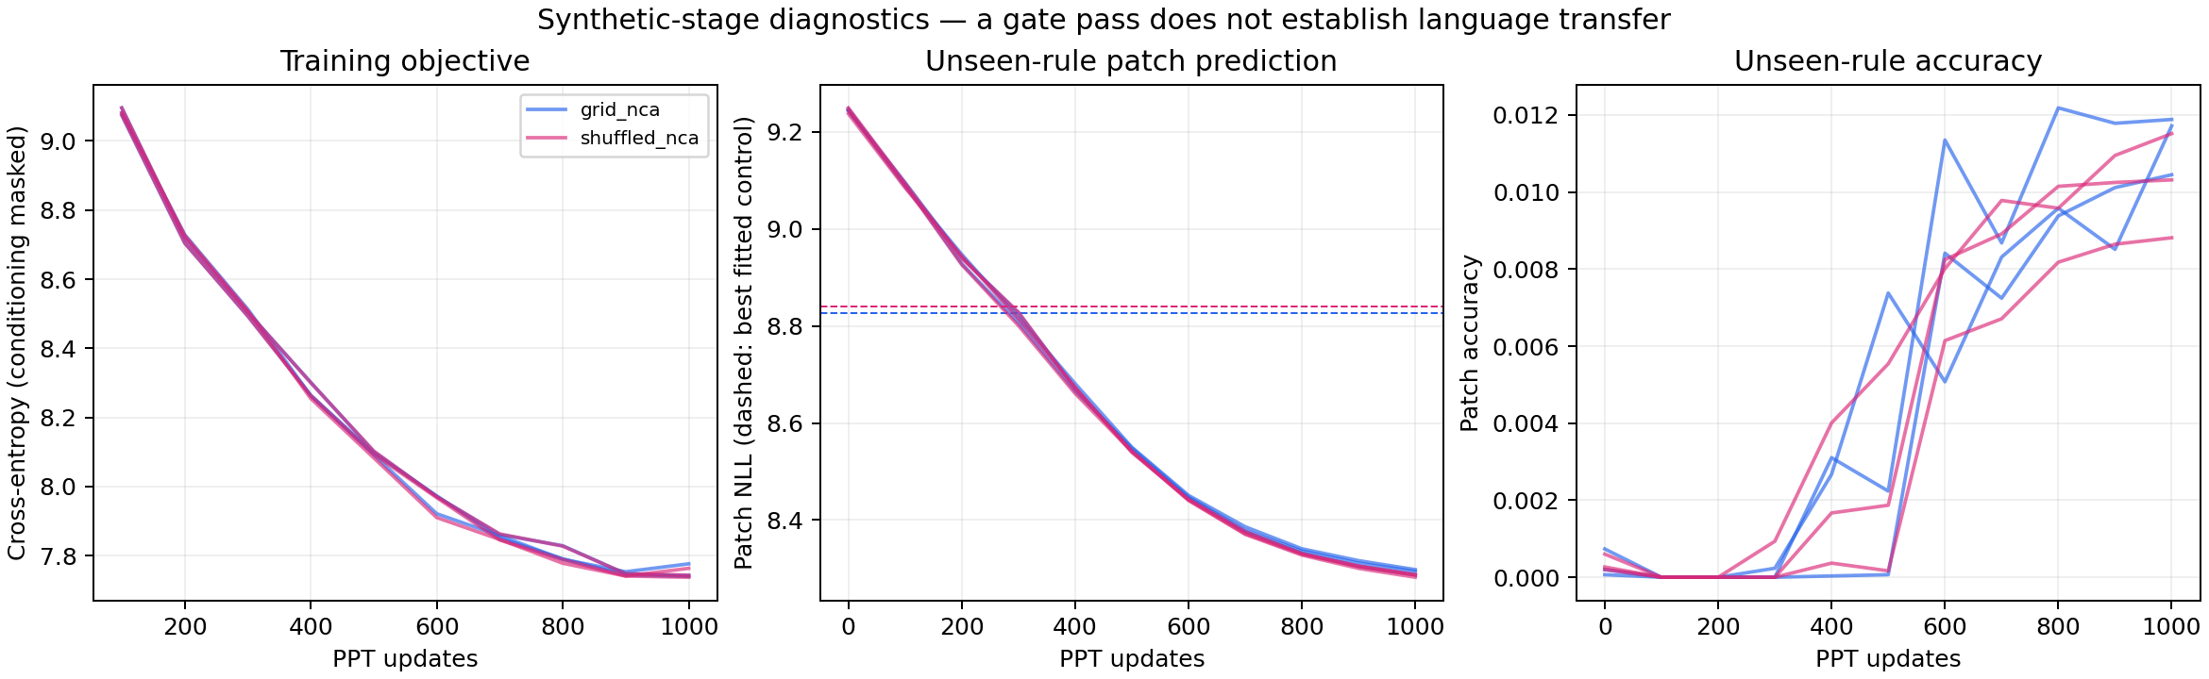
Synthetic prediction passed the declared gate
Grid: 8.2866–8.2976 vs copy control 8.8264 (−10.24% to −10.35%) · Shuffled: 8.2818–8.2873
Passing shows prediction beyond simple controls, not that the model learned local update physics.
Notes:
All three grid seeds passed the declared held-out-rule gate. Patch NLL improved by 10.24 to 10.35 percent from initialization and ended between 8.2866 and 8.2976, versus 8.8264 for the fitted copy-mixture control. All three shuffled seeds also passed, ending at 8.2818 to 8.2873 on their own validation orderings. The gate shows prediction beyond simple controls; it does not show the model learned local update physics, and native losses use different orderings, so they are not a direct dynamics comparison.
Retained and updated from the supplied descriptive presentation.
Sources and status:
docs/results/transfer_v2_run1/gpu/ppt_diagnostics.png
docs/results/transfer_v2_run1/gpu/grid_nca_17/ppt_summary.json

Slide 58
Gate definition and interpretation
Relative improvement = 1 − Lpatch,selected/Lpatch,initial
Required relative improvement ≥ 0.05
Required gap below best fitted control ≥ 0.01 nats
Grid observed improvement: 10.24–10.35%
Train-fitted unigram and previous-frame copy-mixture baselines evaluate on held-out rules. The gate establishes prediction beyond these controls. It does not determine which computation the backbone learned.
All grid and shuffled v2 seeds passed. Synthetic prediction and language transfer are distinct tests.
58
Notes:
Sources and status:
transfer_v2/training.py:quality_gate
docs/TRANSFER_V2_PROTOCOL.md
docs/results/transfer_v2_run1/REVIEW.md

Slide 59
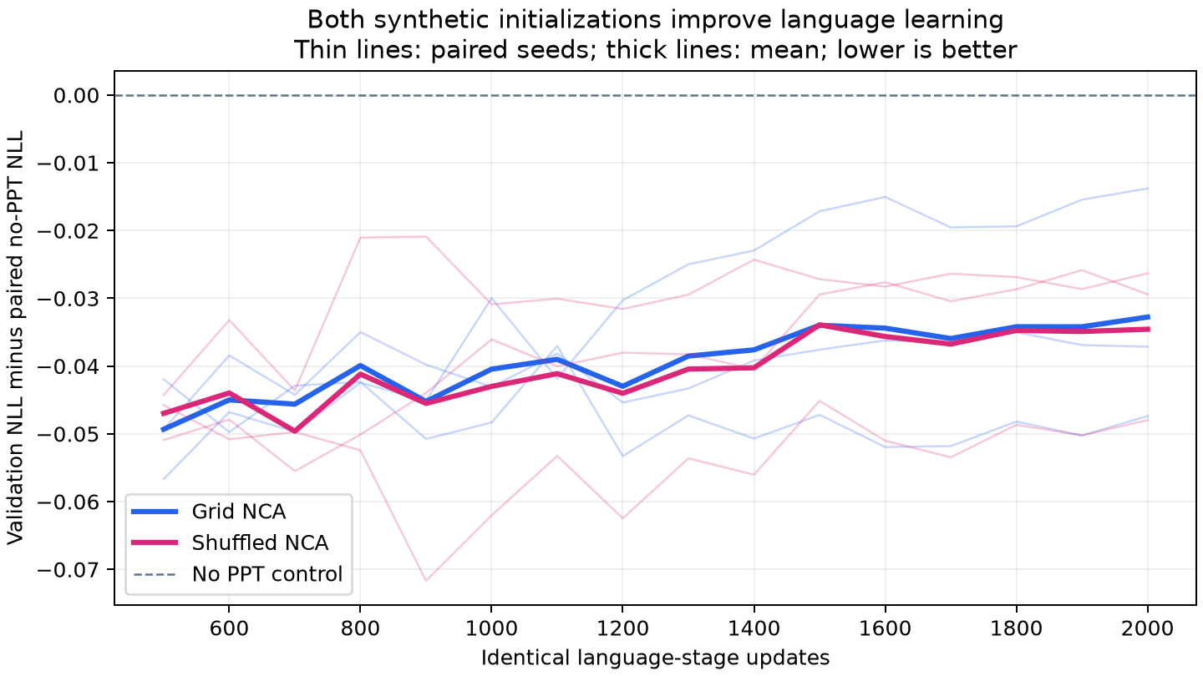
V2 language-stage result at paired reference loss
Initialization | Mean final val. NLL | Language updates to scratch endpoint (seeds 17 / 29 / 43) | Token speedup
No PPT / scratch | 5.266091 | 2000 / 2000 / 2000 | 1.000×
Grid NCA PPT | 5.233321 | 1800 / 1600 / 1700 | 1.178×
Shuffled NCA PPT | 5.231528 | 1700 / 1600 / 1800 | 1.178×
Reading the result
Grid needs 10–20% fewer language updates per seed
Language-time speedup 1.180× (about 15.2% less)
Final NLL: grid −0.03277 nats/token (≈3.2% lower perplexity)
Convergence measure, not faster transformer steps
Lower is better; thin lines are paired seeds, thick lines the mean.
Notes:
The reference is each seed's own scratch final validation NLL. Grid first reached it at 1800, 1600 and 1700 language updates, shuffled at 1700, 1600 and 1800; checked every 100 updates without interpolation. The geometric language-token speedup is 1.178 times for both, and the language-time speedup for grid is 1.180 times, about 15.2 percent less language time. At the common final budget, grid improves NLL by 0.03277 nats per token, about 3.2 percent lower perplexity. This measures convergence, not faster transformer updates.
Retained and updated from the supplied descriptive presentation.
Sources and status:
docs/results/transfer_v2_run1/aggregate.json
docs/results/transfer_v2_run1/paired_language_gain.png

Slide 60
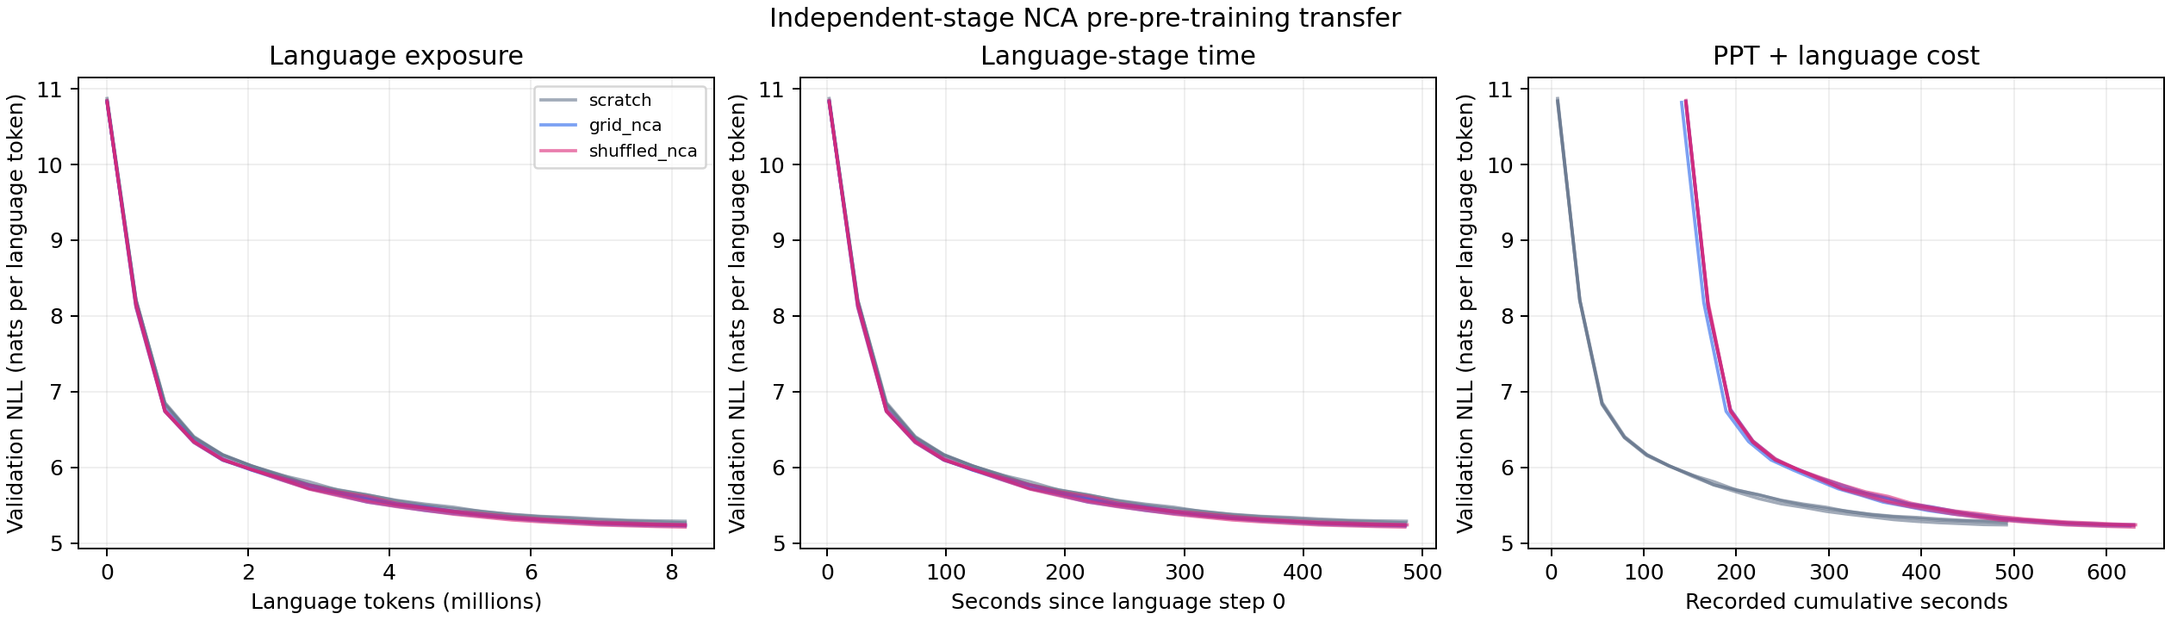
Full curves and the shuffled comparison
5.2333 grid
Grid minus shuffled, final NLL
Shuffling keeps token histograms and markers, so frequency or format structure could itself help. Which property matters is open.
Seed 17: +0.0156
Seed 29: +0.0006
Seed 43: −0.0108
5.2315 shuffled
Mean final validation NLL
No consistent grid advantage
Notes:
Shuffling keeps every trajectory's token histogram and marker positions but destroys the original patch ordering, and with it the 2D adjacency. Shuffled NCA ends at 5.2315 versus 5.2333 for grid, slightly better. Grid minus shuffled final NLL is plus 0.0156, plus 0.0006 and minus 0.0108 across the seeds. So there is no consistent grid advantage. That means the modest gain is not shown to come from cellular-automata dynamics, but the repository does not conclude that it comes from token frequency alone either: frequency and format structure survive the shuffle, and which retained property explains the transfer is open.
Retained and updated from the supplied descriptive presentation.
Sources and status:
docs/results/transfer_v2_run1/gpu/learning_curves.png
docs/results/transfer_v2_run1/comparisons.csv

Slide 61
Per-seed language updates to the scratch endpoint
Evaluations occur every 100 language updates. These are discrete recorded crossings, with no interpolation.
61
Notes:
Sources and status:
docs/results/transfer_v2_run1/comparisons.csv

Slide 62
Speedup calculation and final perplexity
Sgrid = (2000/1800 · 2000/1600 · 2000/1700)¹ᐟ³
Sgrid = 1.177830671 ≈ 1.178×
PPLgrid/PPLscratch = exp(5.233321 − 5.266091)
PPL reduction ≈ 3.22%
Grid saves 10–20% of language updates within seeds. Geometric language-time speedup is 1.1795×, about 15.2% less stage time. This measures convergence to a reference, rather than faster individual updates.
The shuffled arm has the same aggregate token speedup and slightly lower mean final NLL.
62
Notes:
Sources and status:
docs/results/transfer_v2_run1/comparisons.csv
docs/results/transfer_v2_run1/aggregate.json

Slide 63
Paired final losses and their uncertainty
Seed | Scratch NLL | Grid NLL | Shuffled NLL | Grid − shuffled
17 | 5.240872 | 5.227078 | 5.211471 | 0.015606
29 | 5.289353 | 5.241984 | 5.241380 | 0.000604
43 | 5.268048 | 5.230903 | 5.241732 | -0.010829
Shuffled is better in two seeds and grid is better in one. Three model seeds on one shared synthetic cache do not estimate independent cache/topology variance or establish a general dynamics advantage.
63
Notes:
Sources and status:
docs/results/transfer_v2_run1/comparisons.csv
docs/results/transfer_v2_run1/REVIEW.md

Slide 64
Cumulative accounting and synthetic-stage cost
0.886×
Cumulative-time speedup
About 12.8% more recorded time than scratch at the paired reference.
Two views of the same run
Language stage: 1600–1800 updates instead of 2000
Full pipeline: +1,000 synthetic updates (4.096M tokens)
About 85.9 minutes summed over all measured stages
Notes:
Counting the synthetic stage changes the picture. Grid's geometric cumulative-time speedup at the paired reference is 0.886, about 12.8 percent more recorded time. Cumulative tokens at the crossings are 11.4688, 10.6496 and 11.0592 million, versus 8.192 million for scratch, because 1,000 synthetic updates, 4.096 million tokens, come first. The archive sums about 85.9 minutes across all measured stages. The language-stage result is positive; cost recovery at this horizon is negative. Timing is from the GPU logs and excludes queueing and package startup.
Retained and updated from the supplied descriptive presentation.
Sources and status:
docs/results/transfer_v2_run1/aggregate.json
docs/results/transfer_v2_run1/comparisons.csv

Slide 65
Timing scope and input-token accounting
Counted at each paired reference
Excluded or separate
Relevant data preparation
Synthetic stage and language setup
Language optimization and validation
Grid cumulative tokens: 11.4688M, 10.6496M, 11.0592M
Scratch: 8.192M each
Queueing and package startup
Disposable calibration
Final language checkpoint/export work
85.9 minutes sums all recorded stages across the run. It is not the notebook end-to-end runtime.
Original GPU logs provide historical clocks. CPU metric replay cannot independently reproduce historical timing.
65
Notes:
Sources and status:
docs/results/transfer_v2_run1/REVIEW.md
docs/results/transfer_v2_run1/comparisons.csv

Slide 66
Independent replay, provenance and limitations
What was independently checked
Limits the repository states
15 V2 checkpoints replayed on CPU: max metric gap 1.9563e-7
Pilot 1: 15 checkpoints, max CPU/GPU gap 8.2e-8
Gate decisions, crossings and token accounting recomputed
Hashes match across arms within each seed
Source and archive SHA-256 recorded
3 seeds, one shared synthetic cache
One small corpus; 32,768-token validation prefix
Development validation has been examined; official test untouched
Bitwise init/schedule bytes not reproduced across runtimes
No graph treatment in V2; no claim of general acceleration
Notes:
The repository retains its evidence. All 15 V2 development checkpoints reloaded and reproduced validation metrics on CPU within tolerance, with a maximum discrepancy of 1.9563e-7; the pilot's CPU replay differed by at most 8.2e-8. Selected checkpoints, gate decisions, crossings and token accounting were recomputed, and hashes match within each seed. A local Windows/PyTorch 2.14.1 attempt to regenerate every initialization and schedule hash failed against Kaggle's Linux/PyTorch 2.11.0, so bitwise cross-runtime reproduction of those bytes is not established. The limits listed at right are why the repository calls V2 a development experiment.
Retained and updated from the supplied descriptive presentation.
Sources and status:
docs/results/transfer_v2_run1/cpu_verification.json
docs/results/transfer_v2_run1/stage_control_audit.json

Slide 67
Analytical survey of alternative explanations
Explanation | Evidence currently available | Discriminating next check
Learned NCA dynamics | Shuffled gains match grid | Context-adaptive frequency/format controls
Useful initialization bias | Both synthetic arms improve language loss | Gradient/update alignment and backbone probes
Exposure or scheduler advantage | V2 matches the language stage | Keep actual starting tensors, schedules and data order
Single synthetic-cache effect | V2 shares one cache across seeds | Independent paired caches/topologies in v3
Threshold selection or cadence | Paired endpoint policy and 100-step evaluations | Freeze confirmation rules and report censoring
67
Notes:
Sources and status:
docs/results/transfer_v2_run1/REVIEW.md
docs/theory/sections/03_information.tex
METHODOLOGY_AUDIT.md

Slide 68
Graph study and later diagnostic stages
Stage | Role and measured outcome
V3, imported GPU | Five arms, three paired replicates. Primary graph comparison is mixed
V4, imported GPU | Seven arms, six fresh cohorts. Both graph-advantage tests fail
Stage 5, CPU scoring | Existing random-rule checkpoints fail stronger readiness checks
Stages 6-7, CPU training | Basic complement learning succeeds. First spatial predictions remain partial
Stage 8, CPU training | Sixfold first-transition weighting fails all three coherent seeds
Every stage keeps its own source identity, declared endpoint, datasets, controls and interpretation.
68
Notes:
Research status: 20 October 2026.
Source: RESULTS.md
Source: RESEARCH_CONTEXT.md
CPU diagnostic, imported GPU measurement and mathematical claims retain their separate scopes.

Slide 69
V3 code: common random draws for graph and grid
transfer_v3/graph.py lines 65–73
def paired_rollout(rules, c, frames, generator, device, edges):
before = generator.get_state()
grid = rollout(rules, c, frames, generator, device)
after = generator.get_state()
generator.set_state(before)
graph = rollout(rules, c, frames, generator, device, edges=edges)
if not torch.equal(after, generator.get_state()):
raise RuntimeError("Paired rollout random draws diverged")
return grid, graph
The generator restores the same random stream before the graph rollout and checks equal stream consumption. Topology changes donor indices while frozen weights and draw schedules remain paired.
Verbatim source excerpt. Long display lines wrap. Full module remains in the repository.
69
Notes:
The generator restores the same random stream before the graph rollout and checks equal stream consumption. Topology changes donor indices while frozen weights and draw schedules remain paired.
Sources and status:
transfer_v3/graph.py:65-73; SHA-256 a0787e8a15f5ff058107260c5f762615cdc832848c2bfd484c927f7860022ee2

Slide 70
V3 code: a degree-preserving donor swap
transfer_v3/graph.py lines 49–56
j = int(rng.choice(slots))
u, v = rng.choice(side * side, 2, replace=False)
a, b = edges[u, j], edges[v, j]
if b in edges[u] or a in edges[v]:
continue
edges[u, j], edges[v, j] = b, a
swaps += 1
validate_topology(edges, side)
The rewirer rejects duplicate donors and extra self edges, swaps within a typed slot and validates each slot as a permutation. The changed-slot fraction is measured after accepted swaps.
Verbatim source excerpt. Long display lines wrap. Full module remains in the repository.
70
Notes:
The rewirer rejects duplicate donors and extra self edges, swaps within a typed slot and validates each slot as a permutation. The changed-slot fraction is measured after accepted swaps.
Sources and status:
transfer_v3/graph.py:49-56; SHA-256 a0787e8a15f5ff058107260c5f762615cdc832848c2bfd484c927f7860022ee2

Slide 71
V3 notebook: actual five-arm execution cell
kaggle_nca_transfer_v3.ipynb cell 30
run('-m', 'transfer_v3.run', 'all', '--config', 'configs/transfer_v3.json',
'--data', 'data/development', '--out', 'runs/development', '--device', 'cuda')
The 21-file notebook produced the reviewed five-arm v3 GPU run. The primary graph-versus-grid crossing is censored in one replicate.
Complete cell from the actual self-contained notebook.
71
Notes:
Verbatim execution cell from kaggle_nca_transfer_v3.ipynb, cell 30. The notebook produced the reviewed five-arm GPU run. One of the three primary graph-versus-grid crossings is censored. Sources: docs/results/transfer_v3_run1/REVIEW.md; docs/TRANSFER_V3_PROTOCOL.md. Research status: 20 October 2026.

Slide 72
V3 design and completed audit
Five arms each receive the identical 2000-update language stage. Four synthetic arms first receive 1000 PPT updates.
Three paired model/data/topology replicates use common frozen rules and rollout draws. Grid and graph share joint rule-eligibility filtering.
All structured gates pass. Independent CPU replay covers 27 selected stage checkpoints and three saved initializations, with maximum NLL discrepancy 1.8552e-7.
Graph reaches the paired grid endpoint at 1800, 2000 and not by 2000 updates. An all-seed primary speedup is withheld.
72
Notes:
Research status: 20 October 2026.
Source: docs/TRANSFER_V3_PROTOCOL.md
Source: docs/results/transfer_v3_run1/REVIEW.md
CPU diagnostic, imported GPU measurement and mathematical claims retain their separate scopes.

Slide 73
Research progression and unchanged comparisons
Stage | Question | Outcome
V2 GPU | PPT transfer versus no PPT | Language benefit, matching shuffle benefit
V3 GPU | Graph versus grid under paired rules | One primary crossing censored
V4 GPU | Graph versus grid and prefix control | Both frozen primary tests fail
5 CPU scoring | Frequency and ordering competence | All 12 original structured cohorts fail
6-7 CPU training | Known-rule and spatial competence | Basic success, partial first spatial prediction
8 CPU training | First-transition objective weighting | Negative result in all three coherent seeds
73
Notes:
Research status: 20 October 2026.
Source: RESULTS.md
Source: RESEARCH_CONTEXT.md
CPU diagnostic, imported GPU measurement and mathematical claims retain their separate scopes.

Slide 74
Definitions for the experimental comparisons
Term | Meaning in this study
Paired cohort | Treatments share starting states and downstream procedures within a replicate
Prefix-matched shuffle | Initial frame, markers and supervised-prefix histogram remain fixed
First recorded crossing | Earliest evaluated update meeting the declared loss target
Censored comparison | The treatment never reaches that target within the measured horizon
Readiness | A fixed predictive-frequency and ordering check before language training
Intervention | A specified input change with a mathematically known target change
74
Notes:
Research status: 20 October 2026.
Source: docs/TRANSFER_V4_PROTOCOL.md
Source: docs/READINESS_V5_PROTOCOL.md
CPU diagnostic, imported GPU measurement and mathematical claims retain their separate scopes.

Slide 75
V3 primary comparison remains partly censored
Replicate | Grid final NLL | Graph final NLL | Graph reaches grid endpoint
17 | 5.229810 | 5.213048 | 1800 updates
29 | 5.244098 | 5.242078 | 2000 updates
43 | 5.239526 | 5.241660 | Not reached by 2000
Mean graph-minus-grid NLL: -0.005550. Two favorable endpoints do not remove the third censored primary crossing.
Three paired data/model/topology replicates. No all-seed primary speedup is reported.
75
Notes:
Research status: 20 October 2026.
Source: docs/results/transfer_v3_run1/REVIEW.md
CPU diagnostic, imported GPU measurement and mathematical claims retain their separate scopes.

Slide 76
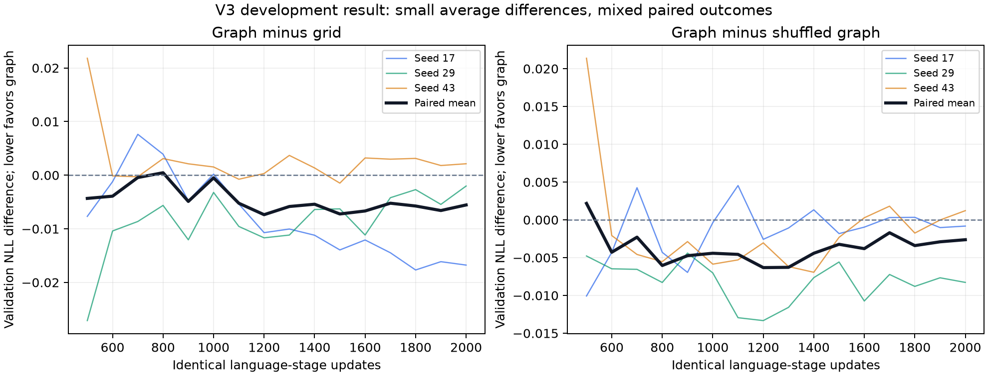
V3 paired graph effects
Imported GPU development outcomes. Primary and secondary references retain their different meanings.
76
Notes:
Research status: 20 October 2026.
Source: docs/results/transfer_v3_run1/paired_graph_transfer.png
Source: docs/results/transfer_v3_run1/REVIEW.md
CPU diagnostic, imported GPU measurement and mathematical claims retain their separate scopes.

Slide 77
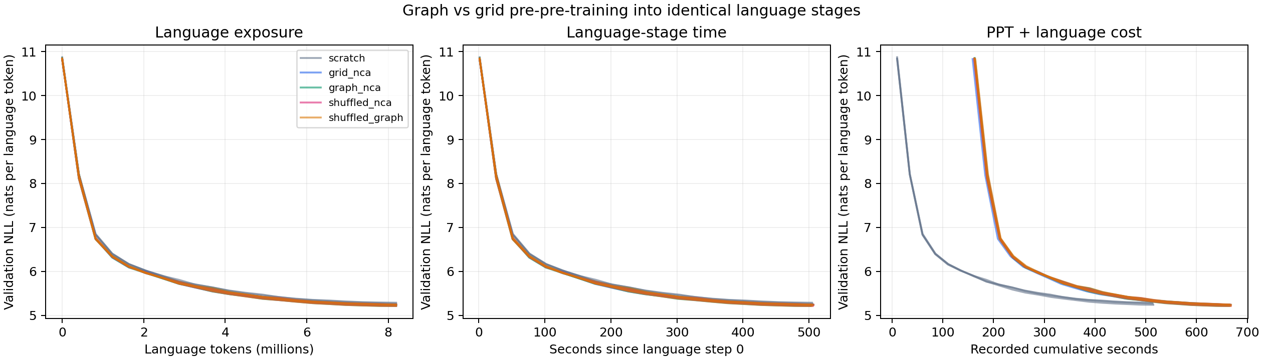
V3 recorded language curves
Original returned GPU plot. All language arms receive 2000 updates. Synthetic treatments additionally receive 1000 PPT updates.
77
Notes:
Research status: 20 October 2026.
Source: docs/results/transfer_v3_run1/gpu/learning_curves.png
Source: docs/results/transfer_v3_run1/REVIEW.md
CPU diagnostic, imported GPU measurement and mathematical claims retain their separate scopes.

Slide 78
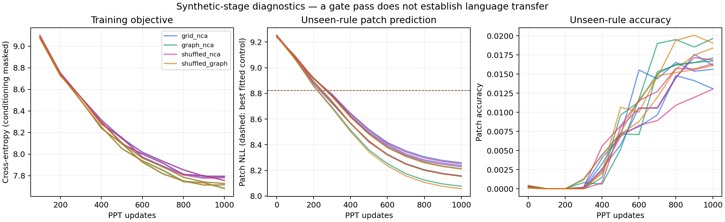
V3 synthetic learning diagnostics
Original returned GPU plot. All structured and shuffled arms pass the original diagnostic gate.
78
Notes:
Research status: 20 October 2026.
Source: docs/results/transfer_v3_run1/gpu/ppt_diagnostics.png
Source: docs/results/transfer_v3_run1/REVIEW.md
CPU diagnostic, imported GPU measurement and mathematical claims retain their separate scopes.

Slide 79
V4 strengthens the supervised-prefix control
Seven arms: scratch, grid, graph, original grid shuffle, original graph shuffle, prefix-matched grid shuffle and prefix-matched graph shuffle.
Six fresh paired cohorts use seeds 59, 71, 83, 97, 109 and 127. Every language arm receives 2000 updates. Every synthetic arm first receives 1000 PPT updates.
The new control fixes the complete initial frame, marker values and positions, and the trained-prefix patch histogram. It separately shuffles the unused suffix.
Both graph comparisons use each cohort's same scratch endpoint. A fixed one-sided sign test counts ties as non-wins, with alpha 0.025 per comparison.
79
Notes:
Research status: 20 October 2026.
Source: docs/TRANSFER_V4_PROTOCOL.md
Source: transfer_v4/controls.py
CPU diagnostic, imported GPU measurement and mathematical claims retain their separate scopes.

Slide 80
Actual v4 prefix-control code
transfer_v4/controls.py lines 15-29
def prefix_shuffled(tokens, c, seed):
result = tokens.copy()
boundary = c["model"]["context"]+1
first = frame_length(c)
if tokens.ndim != 2 or tokens.shape[1] < boundary:
raise ValueError("Trajectories must contain the complete trained prefix")
rng = np.random.default_rng(seed)
cutoff = c["nca"]["states"]**4
for row in result:
for start, end in ((first, boundary), (boundary, len(row))):
positions = np.arange(start, end)
positions = positions[row[positions] < cutoff]
row[positions] = rng.permutation(row[positions])
return result
Only patch order changes within each allowed region. The original initial frame, markers and prefix/suffix boundaries remain fixed.
80
Notes:
Research status: 20 October 2026.
Source: transfer_v4/controls.py:15-29
CPU diagnostic, imported GPU measurement and mathematical claims retain their separate scopes.

Slide 81
V4 notebook execution cell
kaggle_nca_transfer_v4.ipynb cell 34
run('-m', 'transfer_v4.run', 'all', '--config', 'configs/transfer_v4.json',
'--data', 'data/development', '--out', 'runs/development', '--device', 'cuda')
Verbatim execution cell from the 25-source self-contained notebook. The user-run T4 archive supplies the GPU measurements reviewed here.
81
Notes:
Research status: 20 October 2026.
Source: kaggle_nca_transfer_v4.ipynb:cell 34
Source: build_mechanism_notebook.py
CPU diagnostic, imported GPU measurement and mathematical claims retain their separate scopes.

Slide 82
V4 crossings at the common scratch target
Cohort | Grid | Graph | Prefix graph shuffle
59 | 1700 | 1700 | 1700
71 | 1700 | 1700 | 1700
83 | 1700 | 1700 | 1700
97 | 1800 | 1800 | 1800
109 | 1700 | 1700 | 1800
127 | 1700 | 1800 | 1700
Language updates. Every crossing is observed at the 100-update cadence. No interpolation or censoring in these two primary comparisons.
82
Notes:
Research status: 20 October 2026.
Source: docs/results/transfer_v4_run1/primary_analysis.json
CPU diagnostic, imported GPU measurement and mathematical claims retain their separate scopes.

Slide 83
V4 frozen graph-advantage tests both fail
Reference | Wins / ties / losses | Token-speed ratio | One-sided p
Grid | 0 / 5 / 1 | 0.990519x | 1.000000
Prefix graph shuffle | 1 / 4 / 1 | 1.000000x | 0.984375
Ratio = reference language tokens / graph language tokens. Values above 1 favor graph. Each comparison needs p <= 0.025, and both must pass.
Failure to demonstrate the declared advantage does not establish equivalence or exclude effects below the evaluation cadence.
83
Notes:
Research status: 20 October 2026.
Source: docs/results/transfer_v4_run1/primary_analysis.json
Source: docs/TRANSFER_V4_PROTOCOL.md
CPU diagnostic, imported GPU measurement and mathematical claims retain their separate scopes.

Slide 84
V4 language gain and cumulative cost
Initialization | Final NLL | Language-token speedup | Cumulative-time speedup
Scratch | 5.273956 | 1.000000x | 1.000000x
Grid | 5.230608 | 1.165316x | 0.864328x
Graph | 5.234337 | 1.154268x | 0.857989x
Original grid shuffle | 5.236298 | 1.143913x | 0.851626x
Original graph shuffle | 5.234172 | 1.165990x | 0.864376x
Prefix grid shuffle | 5.235063 | 1.166591x | 0.864891x
Prefix graph shuffle | 5.235680 | 1.154268x | 0.858035x
All speedups use paired scratch endpoints. Graph uses about 13.4% fewer language tokens and about 16.6% more cumulative time.
84
Notes:
Research status: 20 October 2026.
Source: docs/results/transfer_v4_run1/REVIEW.md
Source: docs/results/transfer_v4_run1/aggregate.json
CPU diagnostic, imported GPU measurement and mathematical claims retain their separate scopes.

Slide 85
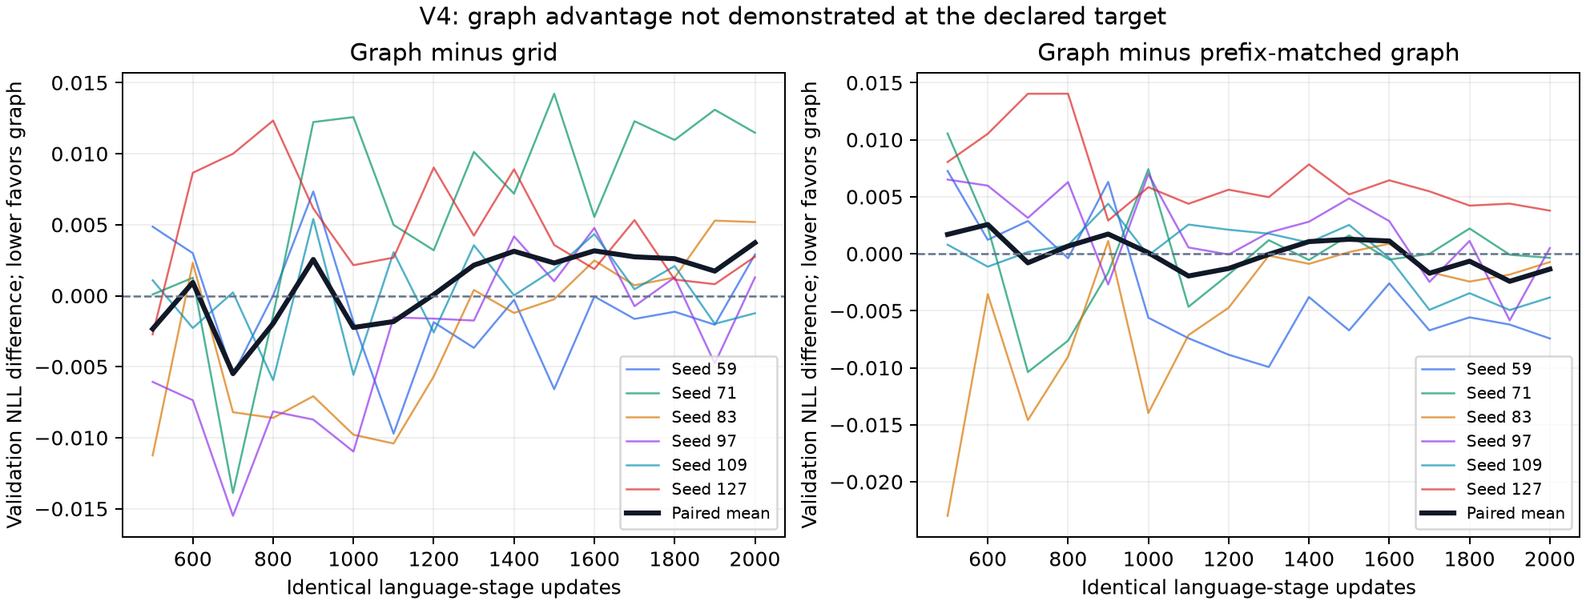
V4 paired graph comparisons
Six-cohort imported GPU evidence. Primary common-target comparisons remain distinct from endpoint quality.
85
Notes:
Research status: 20 October 2026.
Source: docs/results/transfer_v4_run1/paired_graph_transfer.png
Source: docs/results/transfer_v4_run1/REVIEW.md
CPU diagnostic, imported GPU measurement and mathematical claims retain their separate scopes.

Slide 86
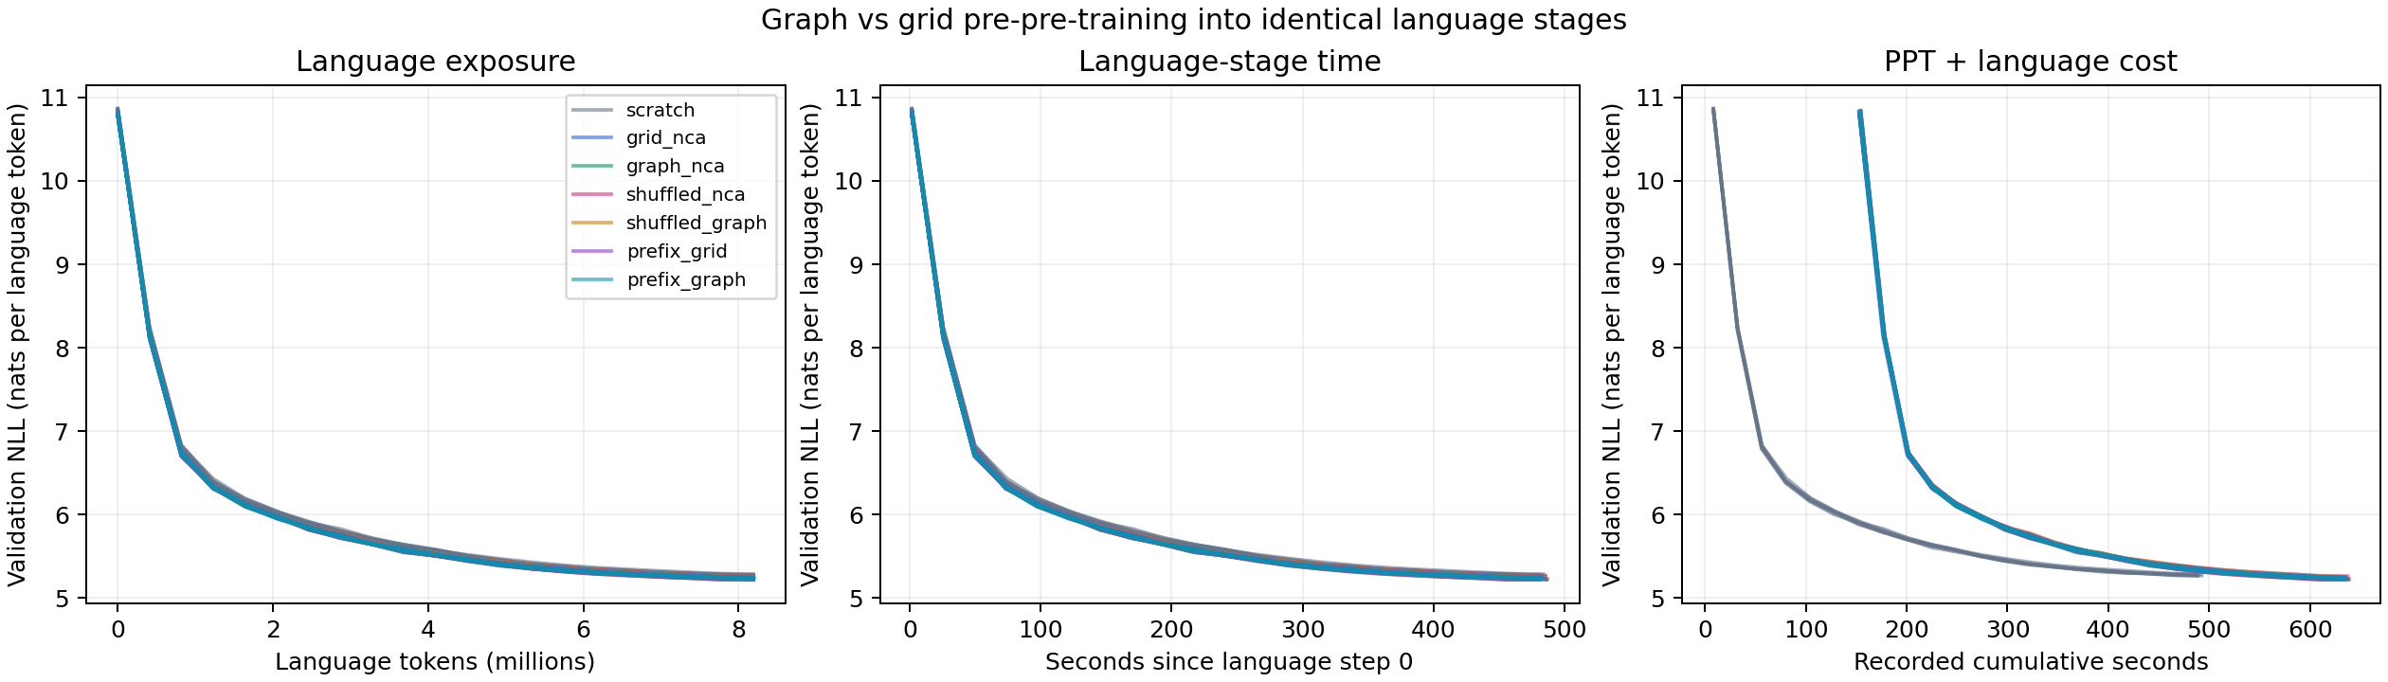
V4 recorded language curves
Original returned seven-arm GPU plot. Similar shuffled gains leave a dynamics-specific transfer mechanism unestablished.
86
Notes:
Research status: 20 October 2026.
Source: docs/results/transfer_v4_run1/gpu/learning_curves.png
Source: docs/results/transfer_v4_run1/REVIEW.md
CPU diagnostic, imported GPU measurement and mathematical claims retain their separate scopes.

Slide 87
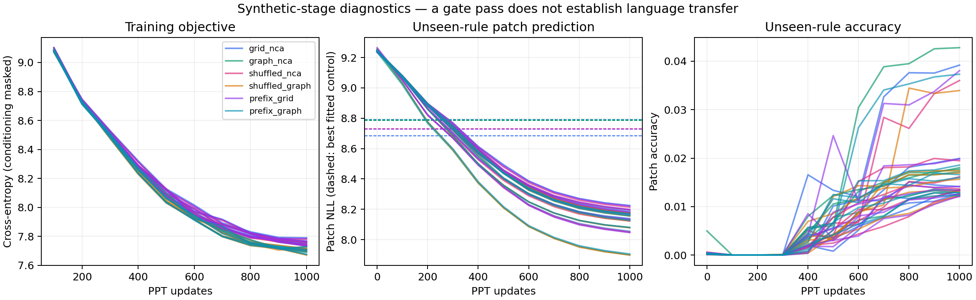
V4 original synthetic diagnostics
All 36 synthetic models pass the original gate. The later causal-frequency diagnostic exposes its limited scope.
87
Notes:
Research status: 20 October 2026.
Source: docs/results/transfer_v4_run1/gpu/ppt_diagnostics.png
Source: docs/results/transfer_v4_run1/REVIEW.md
CPU diagnostic, imported GPU measurement and mathematical claims retain their separate scopes.

Slide 88
Causal frequency and dynamics interpretation
q(v | observed patches) = (alpha * prior(v) + count(v)) / (alpha + total observed)
The predictor updates from previously observed patch counts, without spatial positions or future tokens. Its prior and concentration are fitted on training data only.
Its joint likelihood depends on initial and target histograms. Matched prefix shuffles therefore have the same total frequency likelihood.
The post-hoc CPU predictor beats every original structured PPT model. Passing global-unigram/copy controls did not establish dynamics competence.
88
Notes:
Research status: 20 October 2026.
Source: readiness_v5/frequency.py
Source: docs/results/transfer_v4_run1/frequency_diagnostic.json
CPU diagnostic, imported GPU measurement and mathematical claims retain their separate scopes.

Slide 89
Actual causal frequency likelihood
readiness_v5/frequency.py lines 20-29
def per_rule_nll(initial, target, prior, alpha):
if alpha <= 0 or np.any(np.asarray(prior) <= 0) or not np.isclose(np.sum(prior), 1):
raise ValueError('Positive normalized prior and concentration required')
a, b = torch.as_tensor(initial), torch.as_tensor(target)
q = torch.as_tensor(prior)*alpha
total = a.sum(1)+alpha
logp = torch.lgamma(total)-torch.lgamma(total+b.sum(1))+(torch.lgamma(q+a+b)-torch.lgamma(q+a)).sum(1)
if torch.any(b.sum(1) == 0):
raise ValueError('No scored patch targets')
return (-logp/b.sum(1)).tolist()
The log-gamma expression computes the sequential exchangeable probability. The predictor supplies a stronger control than global frequency alone.
89
Notes:
Research status: 20 October 2026.
Source: readiness_v5/frequency.py:20-29
CPU diagnostic, imported GPU measurement and mathematical claims retain their separate scopes.

Slide 90
Stage 5 readiness rejects the original checkpoints
Mean advantage, nats per patch | Grid | Graph
Frequency baseline minus model | -0.587546 | -0.297951
Shuffled minus coherent model NLL | 0.000849 | 0.000987
Ordering gap beyond prefix-trained model | 0.000092 | 0.000102
Both first two advantages must reach 0.01 for every structured cohort. All 12 fail both. The actual language-start guard rejects these checkpoints.
48 CPU scoring cells, 24 existing PPT checkpoints, no new neural training. Maximum native replay error: 1.6156e-7 NLL.
90
Notes:
Research status: 20 October 2026.
Source: docs/results/readiness_v5_run1/REVIEW.md
Source: docs/results/readiness_v5_run1/summary.json
Source: readiness_v5/gate.py
CPU diagnostic, imported GPU measurement and mathematical claims retain their separate scopes.

Slide 91
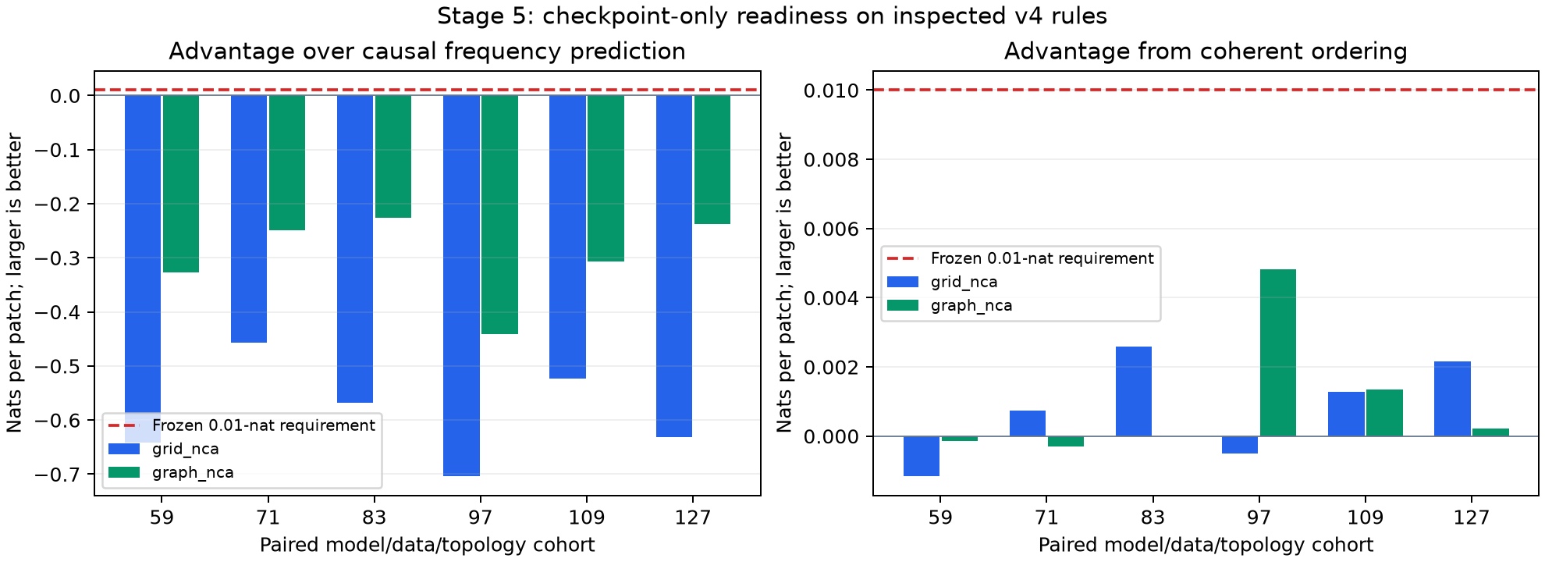
Stage 5 frequency and ordering evidence
Original checkpoint-only CPU diagnostic. Small mixed ordering gaps do not establish zero order dependence.
91
Notes:
Research status: 20 October 2026.
Source: docs/results/readiness_v5_run1/readiness_advantages.png
Source: docs/results/readiness_v5_run1/REVIEW.md
CPU diagnostic, imported GPU measurement and mathematical claims retain their separate scopes.

Slide 92
Stage 6 tests basic transformer trainability
Known binary complement rule: x next = 1 XOR x. A 4 x 4 grid, eight frames, 2 x 2 patch tokens, vocabulary 18 and context 47 simplify the task.
The full six-layer, width-192, four-head backbone remains. Three coherent/prefix-shuffle seed pairs each receive exactly 1000 updates and 188,000 input tokens.
512 training, 64 development and 128 assessment initial conditions exclude complement-phase overlap. Final checkpoints are fixed before assessment.
This jointly simplifies alphabet, grid, context and rule. A success demonstrates basic capability, while the reason for original random-rule failure remains unresolved.
92
Notes:
Research status: 20 October 2026.
Source: docs/TRAINABILITY_V6_PROTOCOL.md
Source: docs/results/trainability_v6_run1/REVIEW.md
CPU diagnostic, imported GPU measurement and mathematical claims retain their separate scopes.

Slide 93
Stage 6 learns the complement rule
Seed | Coherent NLL | Same model on shuffle | Frequency advantage | Ordering advantage
131 | 0.052766 | 4.594601 | 2.252567 | 4.541834
149 | 0.053680 | 4.590817 | 2.251654 | 4.537137
167 | 0.062805 | 4.382613 | 2.242528 | 4.319808
Mean patch NLL is 0.056417 and patch accuracy is 100%. All coherent seeds pass both 0.01-nat margins. The rule has no spatial interaction.
18 checkpoint scoring cells replay exactly. Six CPU models, 6000 updates. Language training remains disabled.
93
Notes:
Research status: 20 October 2026.
Source: docs/results/trainability_v6_run1/REVIEW.md
Source: docs/results/trainability_v6_run1/summary.json
CPU diagnostic, imported GPU measurement and mathematical claims retain their separate scopes.

Slide 94
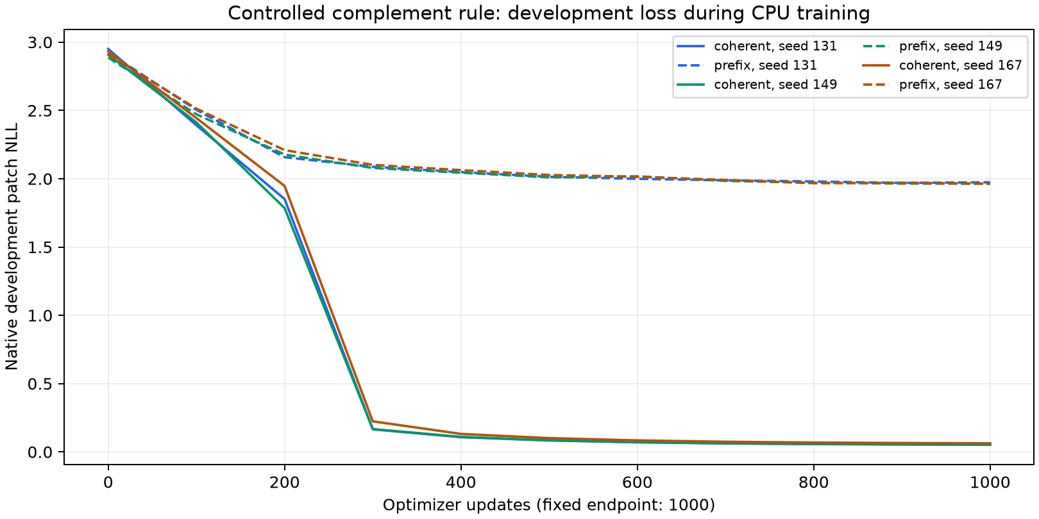
Stage 6 fixed-budget learning curves
CPU development curves, not GPU or language speedups. Final-update assessment supplies the declared result.
94
Notes:
Research status: 20 October 2026.
Source: docs/results/trainability_v6_run1/learning_curves.png
Source: docs/results/trainability_v6_run1/REVIEW.md
CPU diagnostic, imported GPU measurement and mathematical claims retain their separate scopes.

Slide 95
Stage 7 adds a matched spatial interaction
interaction_v7/data.py lines 10-15
def step(cells, rule):
if rule == 'complement':
return 1 ^ cells
if rule == 'spatial':
return 1 ^ cells ^ np.roll(cells, 1, axis=-1) ^ np.roll(cells, -1, axis=-1)
raise ValueError('Unknown frozen rule')
The spatial rule adds left/right parity across patch boundaries. The new reference and treatment share initial states, weights, batches and budgets.
95
Notes:
Research status: 20 October 2026.
Source: interaction_v7/data.py:10-15
CPU diagnostic, imported GPU measurement and mathematical claims retain their separate scopes.

Slide 96
Exact period-two structure of the spatial rule
Over binary arithmetic, let A = I + L + R and F(x) = 1 + Ax
On each periodic row of length 4: L R = I and L^2 = R^2
A^2 = I + L^2 + R^2 = I, A1 = 1
F(F(x)) = 1 + A1 + A^2 x = x
The complement and spatial maps are involutions. Period-two recall can help later frames without solving the first spatial prediction.
Source code and exhaustive tests cover all 65,536 states. This displayed derivation is separate from the retained 44-statement Lean core.
96
Notes:
Research status: 20 October 2026.
Source: interaction_v7/data.py
Source: tests/test_interaction_v7.py
Source: docs/results/interaction_v7_run1/REVIEW.md
CPU diagnostic, imported GPU measurement and mathematical claims retain their separate scopes.

Slide 97
Stage 7 full-trajectory results
Rule | Model NLL | Patch accuracy | Frequency NLL | Own-patch table NLL
Complement | 0.055023 | 100.00% | 2.352583 | 0.016619
Spatial parity | 0.303136 | 91.84% | 2.106976 | 2.814026
All spatial coherent seeds pass both readiness margins and the own-patch-table qualification. Three seeds share one new joint-orbit-disjoint data split.
Twelve new CPU models, 12,000 updates. Historical stage 6 is separate evidence, not the matched reference for this contrast.
97
Notes:
Research status: 20 October 2026.
Source: docs/results/interaction_v7_run1/REVIEW.md
Source: docs/results/interaction_v7_run1/summary.json
CPU diagnostic, imported GPU measurement and mathematical claims retain their separate scopes.

Slide 98
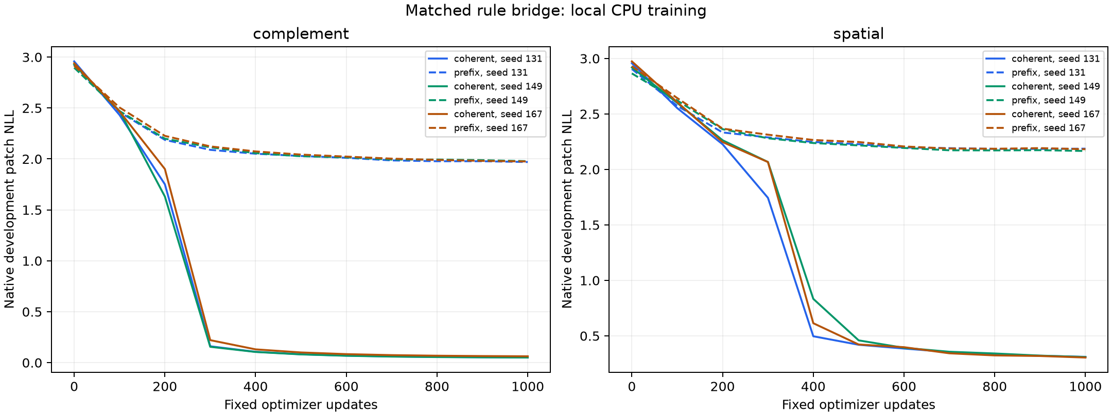
Stage 7 matched learning curves
CPU development curves for the new matched complement and spatial rule treatments. Final checkpoints supply the assessment.
98
Notes:
Research status: 20 October 2026.
Source: docs/results/interaction_v7_run1/learning_curves.png
Source: docs/results/interaction_v7_run1/REVIEW.md
CPU diagnostic, imported GPU measurement and mathematical claims retain their separate scopes.

Slide 99
First transition and neighbor intervention
Score the first patch of the first transition using only the initial full frame and next start marker. No repeated frame or next-frame patch is available.
Flip initial cell (0,3), outside the target patch but adjacent through the periodic boundary. The correct spatial output flips bit zero. Complement output stays unchanged.
Retain all 128 original queries. A fixed joint-orbit exclusion leaves 122 eligible changed pairs, preventing overlap with training/development.
This supplementary diagnostic froze during training before assessment. Its NLL test does not define an accuracy threshold or establish every spatial dependency.
99
Notes:
Research status: 20 October 2026.
Source: docs/INTERACTION_V7_FIRST_TRANSITION.md
Source: docs/results/interaction_v7_run1/first_transition/FROZEN_PROTOCOL.md
CPU diagnostic, imported GPU measurement and mathematical claims retain their separate scopes.

Slide 100
Stage 7 first spatial predictions remain partial
Seed | First-patch NLL | Original accuracy | Intervened accuracy | Both correct
131 | 1.182625 | 59.38% | 54.10% | 33.61%
149 | 1.642562 | 41.41% | 31.97% | 12.30%
167 | 1.559881 | 41.41% | 40.16% | 13.93%
Mean | 1.461689 | 47.40% | 42.08% | 19.95%
Full-trajectory accuracy is 91.84%. First-prediction and paired-intervention scores reveal the remaining error, despite passing the supplementary NLL comparison.
100
Notes:
Research status: 20 October 2026.
Source: docs/results/interaction_v7_run1/REVIEW.md
Source: docs/results/interaction_v7_run1/first_transition/results.json
CPU diagnostic, imported GPU measurement and mathematical claims retain their separate scopes.

Slide 101
Stage 8 objective and exact loss-mass accounting
L weighted = (6 * sum(first 6 target losses) + sum(later 36 losses)) / 72
First-transition mass: 6 / 42 = 1/7 becomes 36 / 72 = 1/2
Each transition contains 4 patches and 2 markers. Their total objective weight remains 2/3 patches and 1/3 markers.
The treatment changes objective weights alone. Unweighted likelihood remains the evaluation endpoint, with the same data, actual starting states, batches and 1000 updates.
101
Notes:
Research status: 20 October 2026.
Source: docs/LOSS_WEIGHT_V8_PROTOCOL.md
Source: loss_weight_v8/objective.py
CPU diagnostic, imported GPU measurement and mathematical claims retain their separate scopes.

Slide 102
Actual weighted-loss implementation
loss_weight_v8/objective.py lines 18-25
def loss(logits, labels, c, factor):
w = weights(labels, c, factor)
if not torch.any(w > 0):
raise ValueError('No supervised targets')
if factor == 1:
return F.cross_entropy(logits.reshape(-1, logits.shape[-1]), labels.reshape(-1), ignore_index=-100)
values = F.cross_entropy(logits.reshape(-1, logits.shape[-1]), labels.reshape(-1), reduction='none', ignore_index=-100).reshape_as(labels)
return (values*w).sum()/w.sum()
Masked labels have zero weight. Factor one reproduces the original update. Normalization changes relative loss mass rather than multiplying the full objective by six.
102
Notes:
Research status: 20 October 2026.
Source: loss_weight_v8/objective.py:18-25
CPU diagnostic, imported GPU measurement and mathematical claims retain their separate scopes.

Slide 103
Stage 8 fails every coherent seed
Seed | Original NLL improvement | Intervened NLL improvement | Both >= 0.01
131 | -0.716168 | -0.682965 | Fail
149 | -0.503166 | -0.288322 | Fail
167 | -0.269025 | -0.222588 | Fail
Improvement = standard NLL minus weighted NLL. Every seed worsens both first-transition likelihoods. All weighted coherent models still pass trajectory readiness.
Fixed final-update endpoint, frozen sixfold factor and all three seeds retained. No criterion changes after assessment.
103
Notes:
Research status: 20 October 2026.
Source: docs/results/loss_weight_v8_run1/summary.json
Source: docs/LOSS_WEIGHT_V8_PROTOCOL.md
CPU diagnostic, imported GPU measurement and mathematical claims retain their separate scopes.

Slide 104
Stage 8 coherent-model outcomes
Metric | Standard loss | Sixfold weight
Original first-patch NLL | 1.461689 | 1.957809
Original first-patch accuracy | 47.40% | 32.03%
Intervened first-patch NLL | 1.608771 | 2.006729
Intervened first-patch accuracy | 42.08% | 30.05%
Both predictions correct | 19.95% | 11.20%
Full-trajectory NLL | 0.303136 | 1.347235
Full-trajectory accuracy | 91.84% | 50.86%
Means across seeds 131, 149 and 167. NLL is lower-is-better. Accuracy changes are descriptive, without a new admission cutoff.
104
Notes:
Research status: 20 October 2026.
Source: docs/results/loss_weight_v8_run1/summary.json
CPU diagnostic, imported GPU measurement and mathematical claims retain their separate scopes.

Slide 105
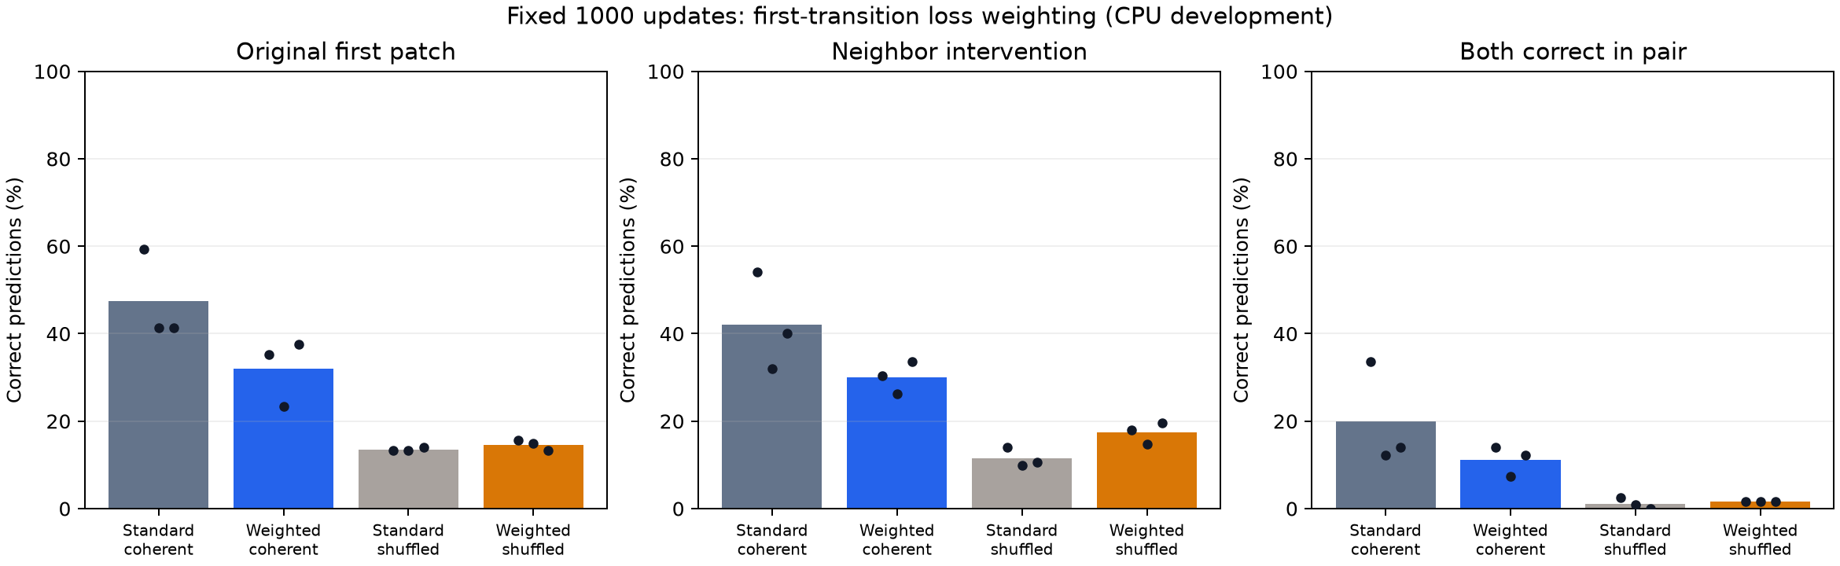
Stage 8 original and intervened correctness
CPU development comparison. Bars show means and dots show the three initialization seeds. Imported standard controls retain stage 7 identities.
105
Notes:
Research status: 20 October 2026.
Source: docs/results/loss_weight_v8_run1/first_transition_accuracy.png
Source: docs/results/loss_weight_v8_run1/REVIEW.md
CPU diagnostic, imported GPU measurement and mathematical claims retain their separate scopes.

Slide 106
Stage 8 controls, replay and cost scope
Six newly trained weighted models pair with six imported standard-loss stage 7 controls. Starting weights, cached arrays, batch orders and token/update counts match.
Coherent-minus-shuffled weighting gains are negative for every seed. Those control comparisons remain descriptive and do not revise the frozen primary.
Checkpoint reload reproduces all 30 full cases and 15 first-transition cases exactly. This replay uses the same frozen scorer, separate from a training rerun or independent loss implementation.
New stage timers total 7.481 CPU minutes versus 6.729 historical control minutes. Timer differences do not supply a controlled throughput measurement.
106
Notes:
Research status: 20 October 2026.
Source: docs/results/loss_weight_v8_run1/REVIEW.md
Source: docs/results/loss_weight_v8_run1/verification.json
Source: docs/results/loss_weight_v8_run1/PROVENANCE.json
CPU diagnostic, imported GPU measurement and mathematical claims retain their separate scopes.

Slide 107
Analytical survey of what the evidence supports
Claim | Evidence and limit
Language transfer | V2-v4 gains versus scratch, with similar shuffled gains
Graph-specific acceleration | V3 partly censored, both v4 primary tests fail
Original random-rule learning | Stronger readiness rejects all 12 structured cohorts
Known interacting-rule learning | Partial first spatial prediction and limited intervention competence
Loss weighting solves first prediction | All three coherent seeds worsen under fixed sixfold weighting
Mathematical validation | Conditional arguments and selected formal proofs, not an efficacy theorem
107
Notes:
Research status: 20 October 2026.
Source: RESULTS.md
Source: docs/results/loss_weight_v8_run1/REVIEW.md
Source: proofs/lean/PROOF_MAP.md
CPU diagnostic, imported GPU measurement and mathematical claims retain their separate scopes.

Slide 108
Next declared diagnostic and research limits
Proposed next step: compare existing checkpoints' first-transition fit and generalization across training, development and assessment under a new declaration before scoring.
Preserve the sixfold weighting failure. Do not extend this run, remove seeds or relax the two first-transition NLL requirements.
Use the next diagnostic to choose one development treatment. Fresh phase-disjoint data remains necessary for later confirmation.
Language training stays disabled. Original random-rule failures remain primary evidence for those checkpoints. No reasoning, larger-scale transfer or cumulative-cost recovery is inferred.
108
Notes:
Research status: 20 October 2026.
Source: docs/results/loss_weight_v8_run1/REVIEW.md
Source: RESEARCH_CONTEXT.md
CPU diagnostic, imported GPU measurement and mathematical claims retain their separate scopes.

Slide 109
Comparison with the motivating study
The pinned reference study reports 1.4-1.6x convergence acceleration in a different model, corpus and budget setting. Its reported result supplies context rather than a directly comparable benchmark.
Our small-model v2-v4 runs show language-stage gains versus scratch. Frequency-preserving shuffled treatments transfer similarly.
The six-cohort v4 primary comparison fails to demonstrate graph-specific acceleration, and cumulative synthetic cost remains unrecovered.
Controlled CPU rule learning and selected mathematical proofs address different questions from language-transfer efficacy or larger-scale reasoning performance.
109
Notes:
Research status: 20 October 2026.
Source: sources/nca-pre-pretraining-reference/reference.json
Source: docs/results/transfer_v4_run1/REVIEW.md
Source: docs/presentation/SOURCE_COVERAGE.json
CPU diagnostic, imported GPU measurement and mathematical claims retain their separate scopes.

Slide 110
Applications at larger scale
Potential use: a reusable synthetic initialization for language, code or mathematical sequence learning. Transfer must be tested separately in every target domain.
Scale the model and token budgets only after graph/grid/shuffle controls separate useful structure from generic initialization effects.
Measure generation, synthetic training, validation and storage cost. An amortized shared initialization needs a declared number of downstream uses.
Keep reserved confirmation data and downstream task benchmarks. Lower language NLL alone does not establish reasoning gains, robustness or an economic advantage.
110
Notes:
Sources and status:
docs/theory/sections/06_numerical.tex
docs/results/transfer_v2_run1/REVIEW.md
docs/TRANSFER_V3_PROTOCOL.md

Slide 111
Research decisions supported by the mathematics
Derived insight | Experimental consequence
Typed permutations preserve degree and mean lag | Measure dispersion, connectivity and actual changed slots separately
Deterministic entropy and stochastic entropy differ | State the transition kernel and use context-aware controls
Head reset retains backbone displacement only | Save and compare actual backbone and new head tensors
Slow-mode error governs long-horizon toy convergence | Track the full language curve, not just initial loss
Language gain and cumulative cost can disagree | Publish both clocks and retain censored comparisons
111
Notes:
Sources and status:
docs/theory/sections/07_conclusions.tex
docs/TRANSFER_V3_PROTOCOL.md

Slide 112
Conclusion through stage 8
Synthetic initialization improves language learning versus scratch in the small v2-v4 development runs. Similar shuffled gains and failed v4 primary tests leave a graph/dynamics mechanism unestablished.
Original random-rule checkpoints fail stronger readiness checks. A simplified complement task is learnable, while first spatial predictions remain incomplete.
Sixfold first-transition weighting worsens original and intervened NLL in every coherent seed. The failed fixed-budget result is retained.
The mathematics supplies conditional principles and exact toy examples. Next work concerns existing-checkpoint fit/generalization under a new declaration. Language training remains disabled.
112
Notes:
Research status: 20 October 2026.
Source: RESULTS.md
Source: docs/results/loss_weight_v8_run1/REVIEW.md
Source: proofs/lean/PROOF_MAP.md
CPU diagnostic, imported GPU measurement and mathematical claims retain their separate scopes.

Slide 113
Documentation, proofs and publication
Artifact | Current scope
README / RESULTS / VALIDATION | Reviewed status through stage 8 and evidence limits
LaTeX theory | Seven mathematical sections and worked numerical derivations
Lean package | 44 checked statements with source hashes, axioms and retained failures
Four complete notebooks | Historical pilot and v2/v3/v4 GPU runners
Diagnostic modules | readiness_v5, trainability_v6, interaction_v7, loss_weight_v8
LOGBOOK / checks / Prod | Retained changes and checks, selected sources and SHA-256 parity
113
Notes:
Research status: 20 October 2026.
Source: AGENTS.md
Source: publication.json
Source: proofs/lean/PROOF_MAP.md
CPU diagnostic, imported GPU measurement and mathematical claims retain their separate scopes.

Slide 114
Source and code navigation
Area | Canonical files
Historical and language transfer | experiment.py; transfer_v2/; transfer_v3/; transfer_v4/
Readiness and frequency | readiness_v5/frequency.py; gate.py; evaluate.py
Controlled trainability | trainability_v6/data.py; run.py
Spatial rule and intervention | interaction_v7/data.py; run.py; first-transition helpers in scripts/
Weighted objective | loss_weight_v8/objective.py; run.py
GPU notebook generation | build_notebook.py; build_transfer_notebook.py; build_graph_notebook.py; build_mechanism_notebook.py
114
Notes:
Research status: 20 October 2026.
Source: publication.json
Source: RESULTS.md
CPU diagnostic, imported GPU measurement and mathematical claims retain their separate scopes.

Slide 115
Mathematical documentation coverage
LaTeX section | Content | Lean status
1. Problem | Matched-stage estimand, reset map, two cost clocks | Reset identities and selected cost algebra
2. Dynamics | Typed graphs, equivariance, spectra, perturbations | Equivariance and typed swap preservation
3. Information | Entropy, posterior rule inference, shuffle covariance | Informal
4. Serialization | Patch bijection, visibility, mean lag and variance | Binary encoding, visibility and mean/total lag
5. Transfer | Taylor alignment, linear surrogate, quadratic modes | Conditional algebra, scalar/diagonal identities
6–7. Numerics and conclusions | First hits, cost, counts, interpretations | Exact toy first hits and selected arithmetic
115
Notes:
Sources and status:
docs/theory/main.tex
proofs/lean/PROOF_MAP.md

Slide 116
Proof module and axiom inventory
Module | Statements | Main subject
Graph.lean | 5 | Equivariance, swaps and lag sums
LinearSurrogate.lean | 4 | Squared-loss and recurrence identities
Numerics.lean | 14 | First hits and exact numerical facts
Quadratic.lean | 5 | Diagonal modes and ranking reversal
Serialization.lean | 8 | Binary coding and parent visibility
Transfer.lean | 8 | Reset and conditional transfer/cost algebra
116
Notes:
Sources and status:
proofs/lean/GraphNCA.lean
proofs/lean/verification/axiom-reports.txt

Slide 117
Evidence hierarchy and retained failures
Imported GPU measurements: historical pilot and v2-v4 retain original archives, curves, stage clocks and checkpoint identities. Later CPU replay checks consistency.
Local CPU diagnostics: stage 5 scores existing checkpoints. Stages 6-8 train declared controlled models. CPU timers do not supply GPU throughput comparisons.
Formal mathematics: 44 Lean statements have retained checker evidence under explicit definitions and hypotheses. Entropy, spectral arguments and Taylor calculus remain informal.
Readiness failures, the negative weighting result and prior execution failures remain documented. Configured CI is separate from an executed remote check.
117
Notes:
Research status: 20 October 2026.
Source: LOGBOOK.md
Source: RESULTS.md
Source: proofs/lean/verification/README.md
CPU diagnostic, imported GPU measurement and mathematical claims retain their separate scopes.

Slide 118
Primary literature and local evidence
Lee et al. (2026), Training Language Models via Neural Cellular Automata. arXiv:2603.10055v1. Pinned author code: bdd1c71e04eb2e5a2c91481faf278e95846b4431.
Mordvintsev et al. (2020), Growing Neural Cellular Automata. Distill. Gilmer et al. (2017), Neural Message Passing for Quantum Chemistry. arXiv:1704.01212.
Vaswani et al. (2017), Attention Is All You Need. arXiv:1706.03762. Touvron et al. (2023), LLaMA: Open and Efficient Foundation Language Models. arXiv:2302.13971.
Local evidence: reviewed pilot and v2-v4 GPU records, CPU diagnostics through stage 8, docs/theory and proofs/lean. The companion index maps each slide to its sources.
118
Notes:
Sources and status:
https://arxiv.org/html/2603.10055v1
https://distill.pub/2020/growing-ca/
https://arxiv.org/abs/1704.01212
https://arxiv.org/abs/1706.03762
https://arxiv.org/abs/2302.13971

Slide 119
Appendix: posterior prediction and rule inference
p(Y | C,G) = Σf p(Y | C,f,G) p(f | C,G)
H(F | C = c,X⁰,G) = 512 − D(c)
I(F; C | X⁰,G) = E[D(C)]
The latter two equalities assume a uniform independent 512-bit binary truth table and contexts containing queried patterns and answers. A neural predictor may approximate posterior prediction, but this equation does not establish that the actual transformer does.
An unknown rule, an unseen initial state and transition randomness create different prediction uncertainties.
119
Notes:
Sources and status:
docs/theory/sections/03_information.tex

Slide 120
Appendix: comparing graph and grid remainders
f(BG) − f(Bgrid)
≤ −η gᵀ(gsyn,G − gsyn,grid)
+ (Lη²/2)(‖gsyn,G‖² + ‖gsyn,grid‖²)
The derivation uses an upper graph remainder and a lower grid remainder. Subtracting two upper bounds would be invalid. A greater graph alignment must exceed the displayed remainder for this sufficient certificate.
This local, one-step comparison supplies no measured sign for the transformer.
120
Notes:
Sources and status:
docs/theory/sections/05_transfer.tex: eq:graphvsgrid
proofs/lean/GraphNCA/Transfer.lean

Slide 121
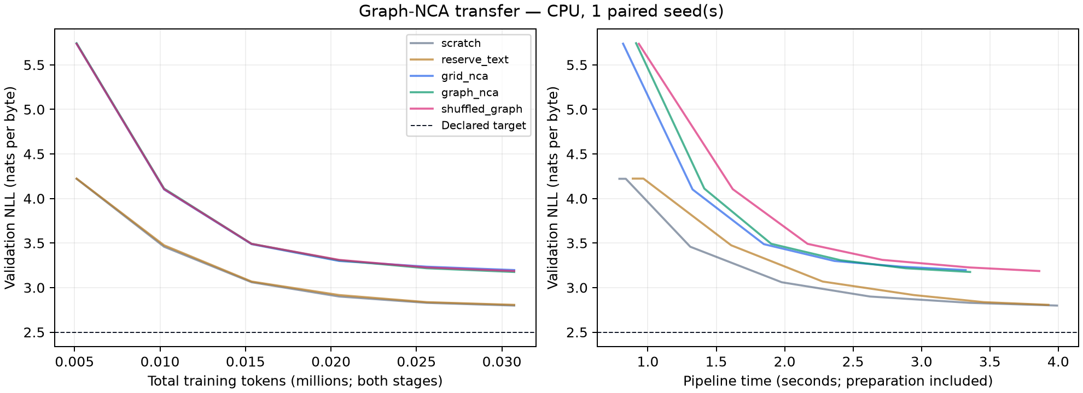
Appendix: historical verified CPU learning curves
Historical 60-update diagnostic with five arms. Its fixture-scale losses and total-step clock remain separate from the returned GPU transfer result.
121
Notes:
Historical 60-update diagnostic with five arms. Its fixture-scale losses and total-step clock remain separate from the returned GPU transfer result.
Sources and status:
runs/cpu_verified/curves.png

Slide 122
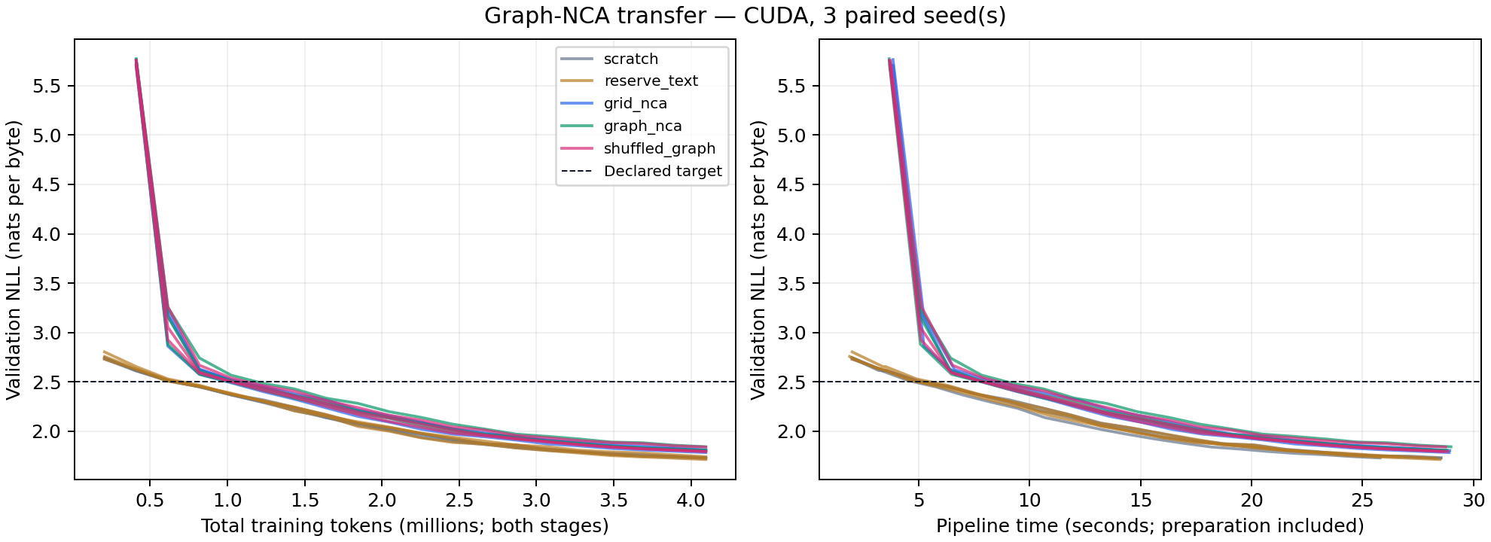
Appendix: original pilot GPU learning curves
Original matched-total-budget GPU plot. Unequal text exposure and the scratch scheduler boundary limit transfer interpretation.
122
Notes:
Original matched-total-budget GPU plot. Unequal text exposure and the scratch scheduler boundary limit transfer interpretation.
Sources and status:
Kaggle Outputs/gnn_nca_results_1_review/artifacts/runs/pilot_20261016_214947_390021/curves.png

Slide 123
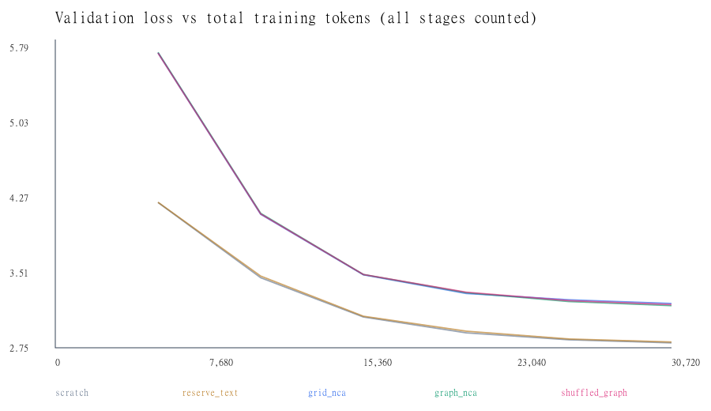
Appendix: earlier local CPU diagnostic
Earlier retained local diagnostic. The complete provenance and later independently replayed CPU result remain in the research workspace.
123
Notes:
Earlier retained local diagnostic. The complete provenance and later independently replayed CPU result remain in the research workspace.
Sources and status:
runs/cpu_check/curves.svg

Slide 124
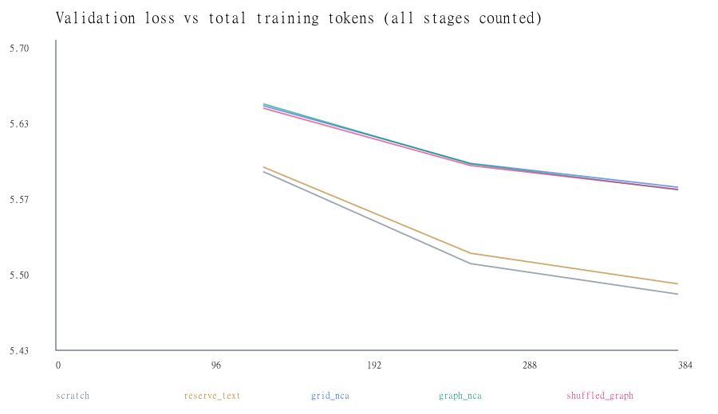
Appendix: local smoke execution diagnostic
Execution fixture only. A short pipeline check does not estimate language-transfer performance.
124
Notes:
Execution fixture only. A short pipeline check does not estimate language-transfer performance.
Sources and status:
runs/smoke/curves.svg

Slide 125
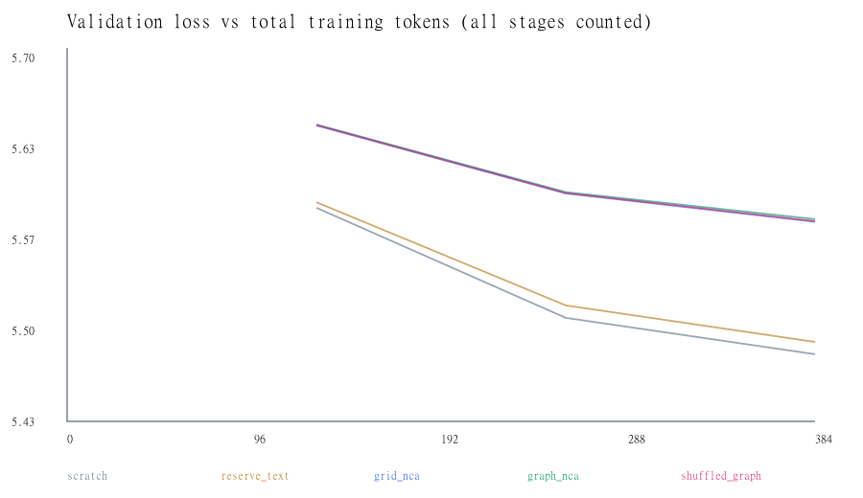
Appendix: returned pilot smoke diagnostic
Returned GPU execution fixture, excluded from the scientific pilot comparison.
125
Notes:
Returned GPU execution fixture, excluded from the scientific pilot comparison.
Sources and status:
Kaggle Outputs/gnn_nca_results_1_review/artifacts/runs/smoke_20261016_214947_390021/curves.svg

Slide 126
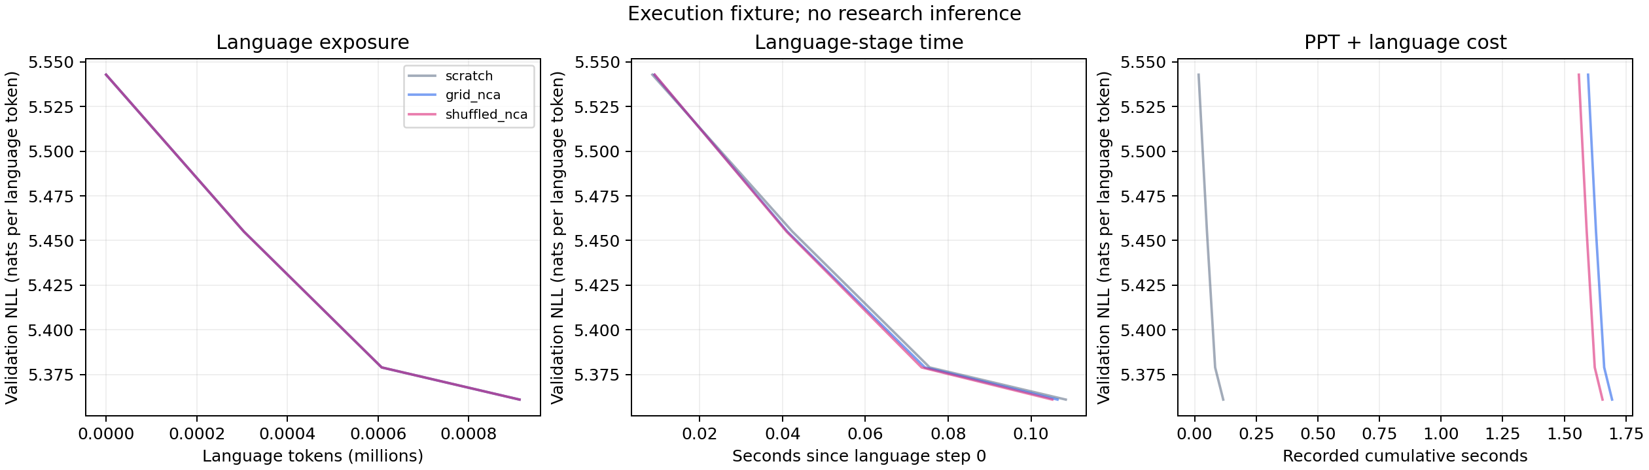
Appendix: returned v2 language execution fixture
Fixture plot from the returned archive. Its short language curves are excluded from all development-result aggregates.
126
Notes:
Fixture plot from the returned archive. Its short language curves are excluded from all development-result aggregates.
Sources and status:
Kaggle Outputs/nca_transfer_v2_run1_review/artifacts/runs/smoke/learning_curves.png

Slide 127
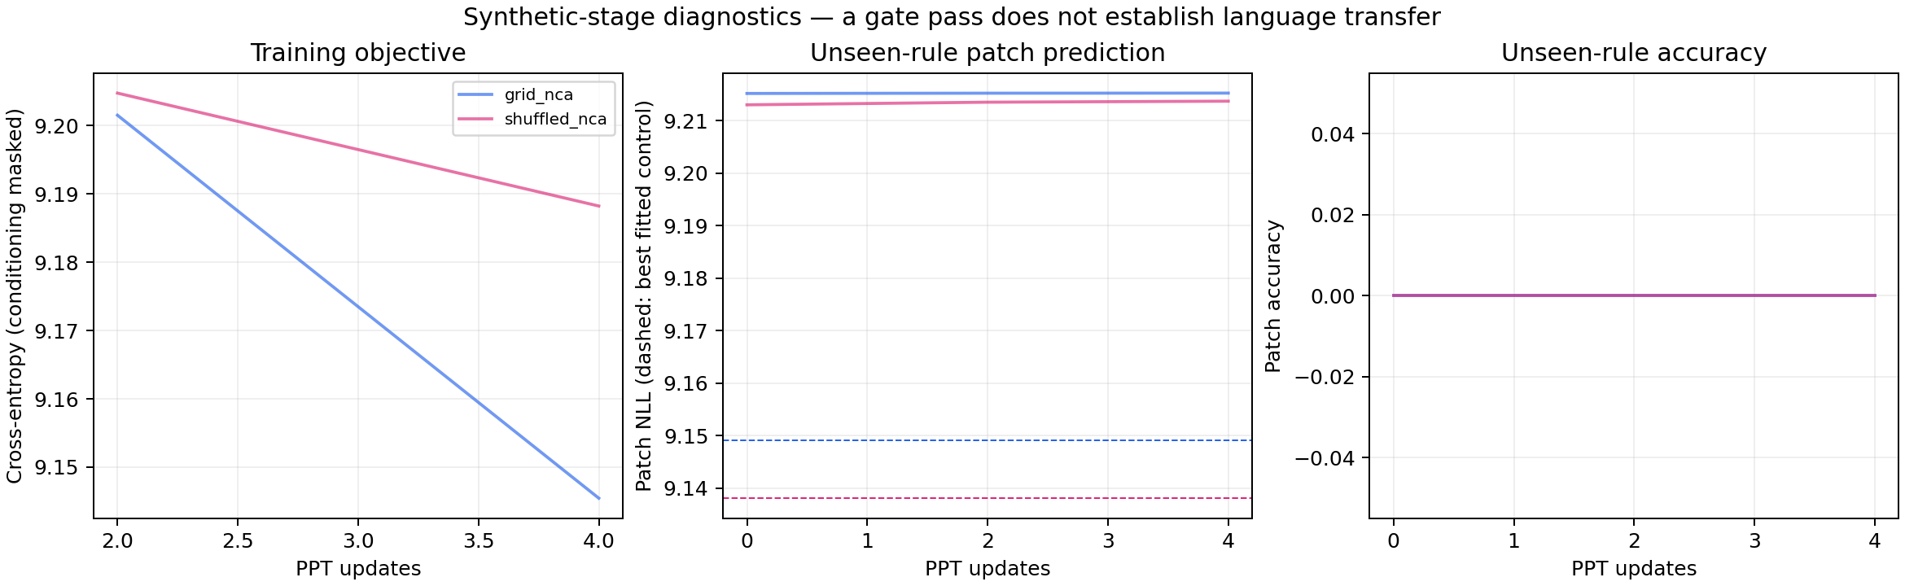
Appendix: returned v2 synthetic execution fixture
Synthetic execution fixture. This plot checks the workflow and does not supply the real held-out-rule gate result.
127
Notes:
Synthetic execution fixture. This plot checks the workflow and does not supply the real held-out-rule gate result.
Sources and status:
Kaggle Outputs/nca_transfer_v2_run1_review/artifacts/runs/smoke/ppt_diagnostics.png

Slide 128
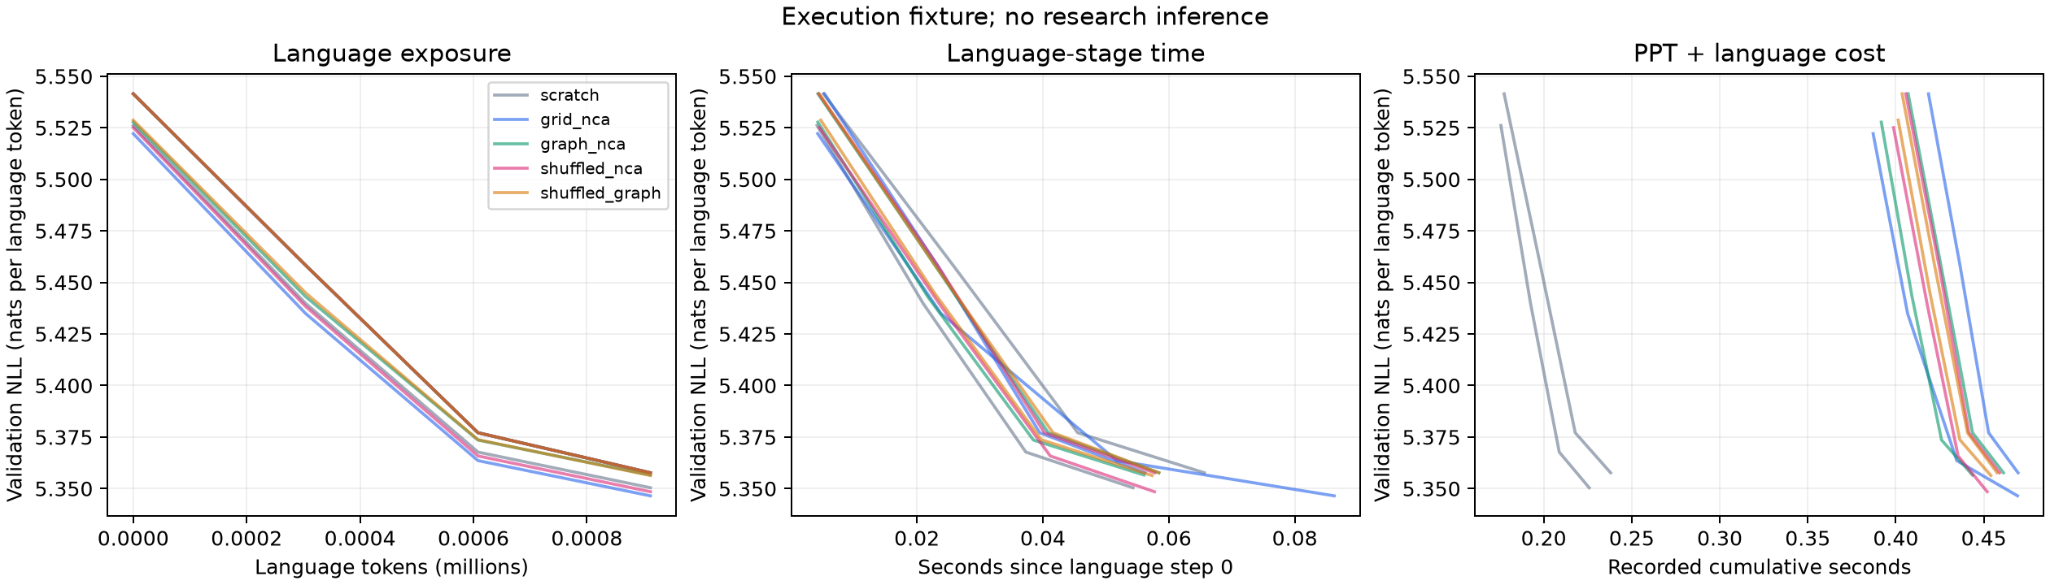
Appendix: v3 local five-arm execution fixture
Local CPU fixture with paired grid/graph controls. It exercises the five-arm workflow. No v3 GPU measurement or scientific transfer conclusion follows.
128
Notes:
Local CPU fixture with paired grid/graph controls. It exercises the five-arm workflow. No v3 GPU measurement or scientific transfer conclusion follows.
Sources and status:
tmp/transfer_v3_check_ed51a18898ec4460bc1a79ac2ac40da4/run_complete/learning_curves.png

