Slide 1
Lecture 13b
Logistic Regression After R Demo
Breitzman 8/14/2018

Slide 2
Logistic Regression
Recall that logistic regression is useful for classifying binary categorical data (yes/no) as opposed to continuous data
For example does a patient have diabetes?
Is a transaction fraudulent?
Does a person make more than X income?
Will someone buy a lawn mower?
Etc.

Slide 3
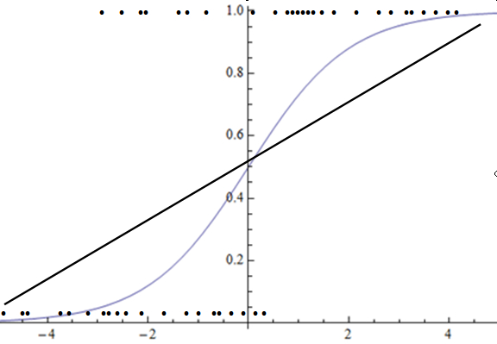
Here’s The Picture we Used

Slide 4
The idea is that the logistic curve should fit better than a regression line
We used logistic regression on the income data but…
We never showed the plot to see how the prediction data looked compared to the actual income data
See next slide

Slide 5
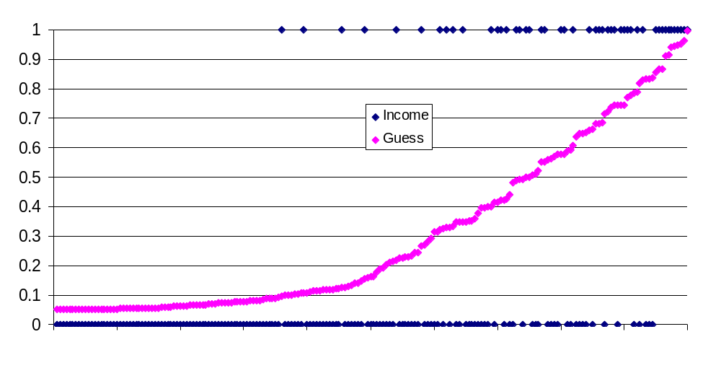
Plot of Actual Data

Slide 6
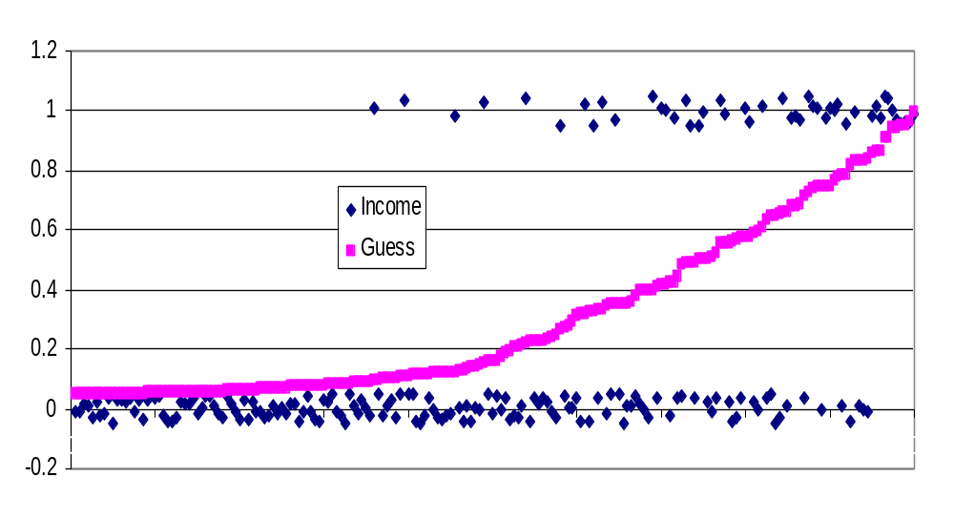
Easier to Visualize if we Shake the Income Data

Slide 7
Plot Implications
From the previous slide we see that a cutoff of 0.5 is reasonable
We also see that it’s not exactly a logistic curve
Also see why a linear regression would do a pretty good job on this, provided we made the slope pretty low
Finally we see that we’re always going to get false negatives and false positives

Slide 8
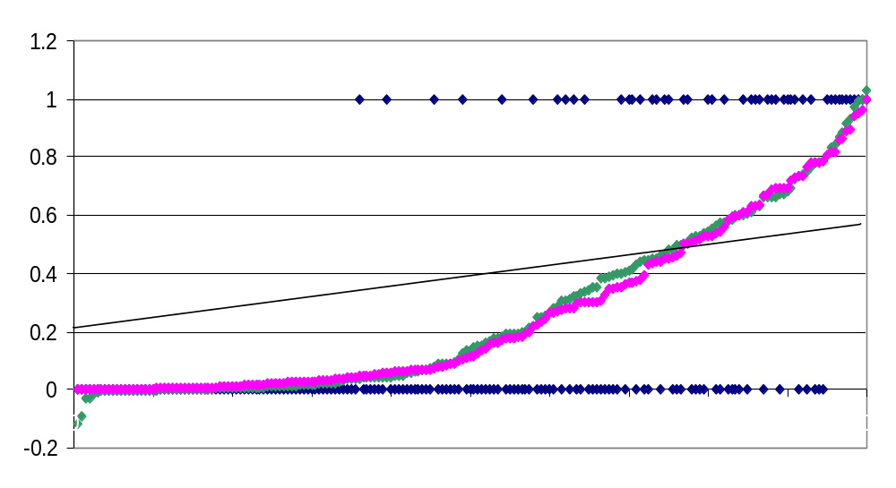
Comparison of Logistic, Neural Net, and Linear Fits to Income Data

Slide 9
Income Prediction
All three of the models on the previous page were about as accurate
Each had between 83% and 86% accuracy and combined we could get 88% by combining them carefully

