Slide 1
Lecture 9b –Word Clouds
Breitzman 8/1/2018

Slide 2
Why Word Clouds?
Nice quick topic and useful for presentations
Word clouds are easy to make with Python
Typically a text file is read and the most popular words appear in the cloud with the word size proportional to its frequency
Word clouds are useful for summarizing a set of documents (or tweets in this case)

Slide 3
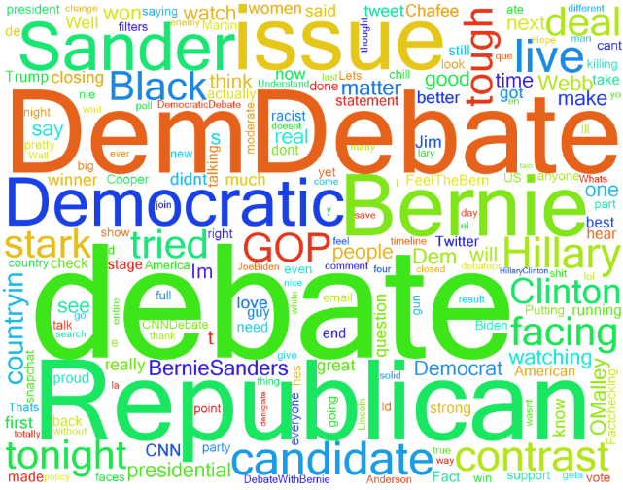
5000 Tweets from October 2015 Democratic Debate Night (keyword: debate)

Slide 4
Debate Cloud
Note that Bernie Sanders is bigger than Hillary Clinton
This suggests more people were tweeting about Bernie than Hillary (Bernie had a much younger voting base then Hillary)
Note that Lincoln Chafee and Martin O’Malley are tiny indicating they are barely mentioned in tweets

Slide 5
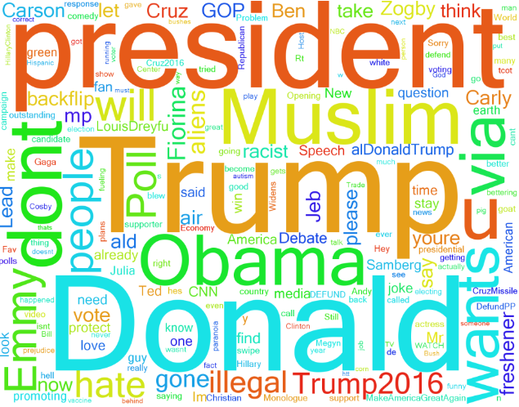
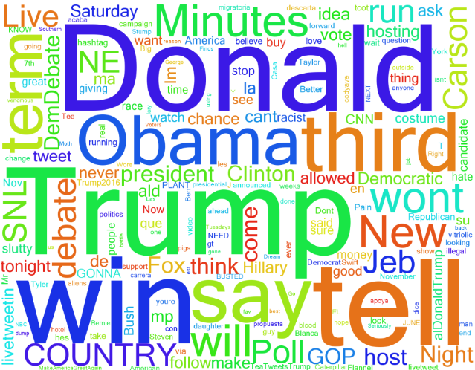
Clouds Mentioning Trump
9/21/2015 10/13/2015

Slide 6
Trump Clouds
Note that September 21 Cloud mentions Illegal Aliens, Immigration, and Muslim
Those terms not nearly as prominent in October 13 Cloud
Win is very large in October, but Won’t is half as large, so quite a few tweets say won’t win
October 13 cloud mentions SNL. He was announced that day as the November 7 host of SNL

Slide 7
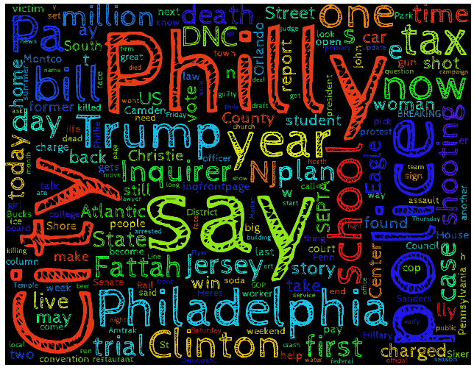
Philadelphia Inquirer Twitter Feed
(Week ending 7/22/16)

Slide 8
Inquirer Word Cloud
Note we can change the font or background color
Clinton and Trump are prominent (This was done the week of the Republican convention and the week before the Democratic Convention)
If we were going to publish this we could add ‘Say’ as a stopword to prevent it from showing up
Go To Python Code to see how these are created

