Slide 1
Lecture 9a – Naïve Bayes Classification
Breitzman 8/1/18

Slide 2
Review of Conditional Probability
Flip a coin twice. What is the Probability of 2 heads?
{HH, HT, TH, TT} so ¼
What if we know the result of the first flip is heads? Pr(HH|H). In this case the probability is obviously ½.
This is called a conditional probability (when we try to predict a probability given some additional information)

Slide 3
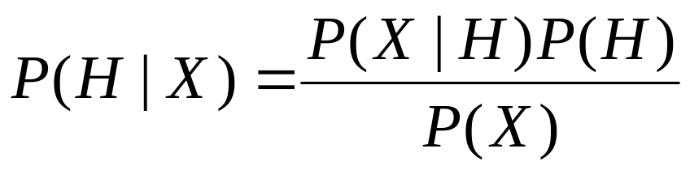
Bayes’ Theorem for Conditional Probability
Named for Thomas Bayes. 18th century clergyman and amateur mathematician
Let X be a data set (evidence) and let H be a hypothesis based on X.
P(H|X) is the probability of the hypothesis given the evidence
Bayes’ Theorem says we can compute P(H|X) in terms of P(X|H), P(X), and P(H)

Slide 4
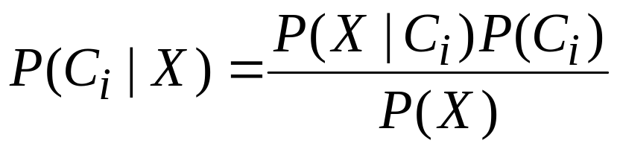
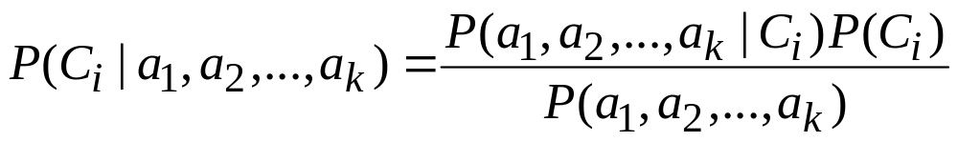
Naïve Bayes
In our view we want to classify a variable Ci based on various attributes, a1, a2,…,ak in X
So becomes
The naïve assumption is that all of the attributes are independent so that

Slide 5
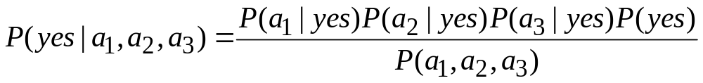
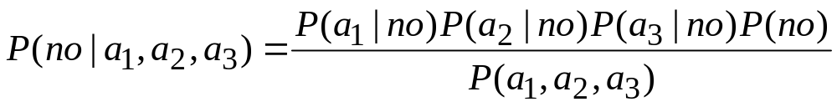
Naïve Bayes (II)
Suppose we are trying to predict something with 2 classes (yes or no) and 3 attributes. Then the Naïve Bayes becomes
We choose the class with the highest value
Since both have the same denominator, we don’t actually have to compute it

Slide 6
Naïve Bayes (III)
In general the independence assumption may not be true
In this case, the use of Bayes Theorem is not naïve, it’s just plain wrong
For this reason, purists often call the method “idiot Bayes,” while data analysts call it “naïve Bayes” or “simplified Bayes” or “Bayesian Classifiers”
The reality is, no matter what you call it, it often gives results that are better than more sophisticated models

Slide 7
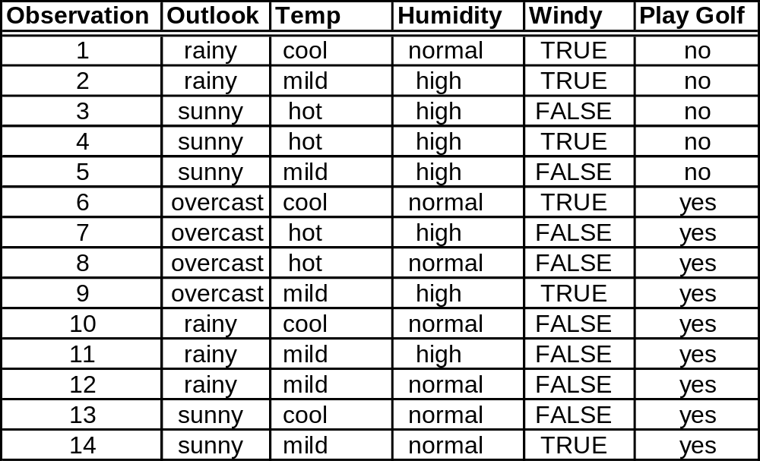
Training Data
Are we likely to play golf on a sunny, cool, humid, windy day?

Slide 8
Probabilities
Both denominators are the same, so we’ll let them be k
Overall, we see 14 cases with 9 yes and 5 no, so P(yes)=9/14 and P(no)=5/14
Of the 9 yeses, 2 are sunny, so P(sunny|yes)=2/9. Similarly P(cool|yes)=1/3, P(humid|yes)=1/3, P(wind|yes)=1/3

Slide 9
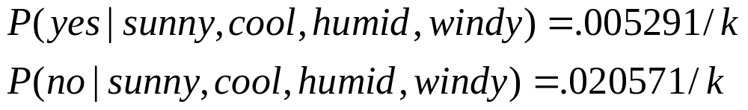
Probabilities (II)
What do we do about k? Let k=.005291+.020571
Then P(Yes to Golf)=20.5% and
P(No to Golf)=79.5%

Slide 10
What if we have a zero case?
If you have a case where P(a|b)=0 then obviously the entire product will be 0 and that is not good
The workaround is we add 1 to numerators and denominators
For example P(overcast|yes)=4/9 and P(overcast|no)=0/5. The latter probability will 0 out the product regardless of how many other attributes have high probabilities.
We change values to P(overcast|yes)=5/10 and P(overcast|no)=1/6
The net result is similar weights for these attributes without messing up the entire computation
This is called Laplace Smoothing if you want to impress your friends, or additive smoothing if you don’t

Slide 11
Missing Values are Handled Very well by the Model
During training, if an attribute is missing, it’s simply not counted within the frequencies
During classification, a missed attribute will be omitted from the computation.
For example P(yes|cool,humid,windy)=(1/3)(1/3)(1/3)(9/14)/k
P(no|cool,humid,windy)=(1/5)(4/5)(3/5)(5/14)/k
We don’t have an attribute for outlook, so we keep it out of the computation

Slide 12
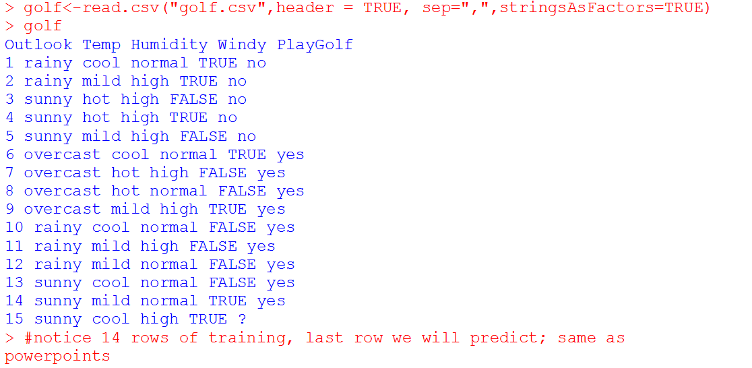
Some R

Slide 13
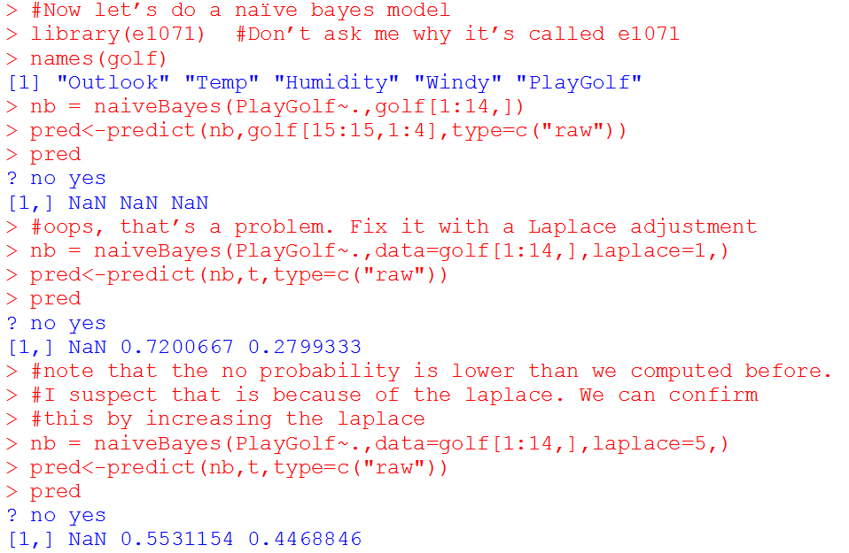
R Continued

Slide 14
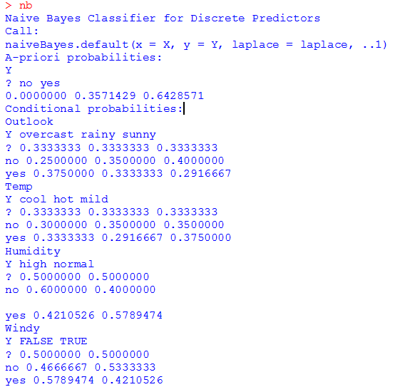
R Continued
Call NB and it shows
all of the intermediate probabilities (in case we care; we usually don’t)

Slide 15
Spam Filters
The current best spam filters all use Naïve Bayes
We can describe the key ideas, but spammers seem are always a step ahead so we’ll need more than Naïve Bayes

Slide 16
Spam Phrases
What makes Naïve Bayes a great choice is that with a little bit of training we can identify certain phrases that appear in a lot of spam but in very few real emails.
E.g. ‘Viagra’, ‘Hair Loss’, ‘Hot Stock’, ‘Weight Loss’, ‘Mortgage Rate’, etc. are phrases that P(Spam|Phrase)=90% and P(NonSpam|Phrase)=10% or vice-versa
Spam Filters train on a few hundred spam emails versus non-spam emails and identify phrases that have low spam probability or high spam probability
They also continually train on new messages that the user identifies as spam

Slide 17
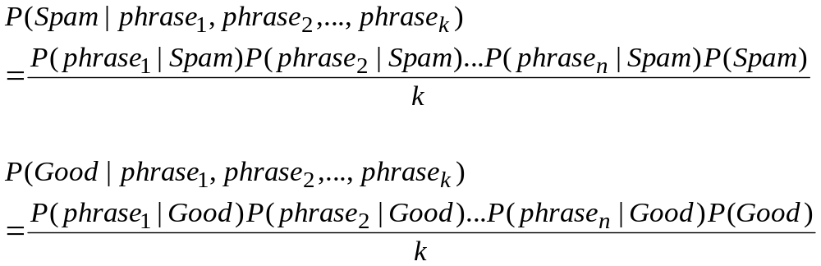
Naïve Bayes
We can assume P(Spam)+P(Good)=1
K as before is the sum of the Spam and Good numerators

Slide 18
Unfortunately Spam has Evolved
Recent spam generally contains non-spam words that are hidden (using a white font for example)
The actual spam message is likely a web link that is not active until the message is clicked on
The Title will still give it away as spam so that’s why you see deliberate mis-spellings such as vi@gr@
Once we see these alternate spellings we can add it to our dictionary, so as spam evolves so do spam filters

Slide 19
Another Great Application: Sentiment Analysis
If we have an entity: (Trump, Hillary, American Airlines, Comcast, etc.) we wish to find out what the current sentiment about the entity is at a given time.
We can do it by monitoring social media and computing:
Pr(Pos. Sentiment|word1,word2,…,wordn)
Pr(Neg. Sentiment|word1,word2,…,wordn)
By Naïve Bayes all we need is:
Pr(word1|Pos. Sentiment), Pr(Word2|Pos. Sentiment) etc.

Slide 20
How do we do it?
Get a bunch of positive tweets, negative tweets, and neutral tweets.
We then compute the probability that a word has a negative connotation or positive connotation.
For example presumably Pr(Pos|‘happy’) should be pretty high while Pr(Neg|‘happy’) should be fairly low.
But how do we get probabilities for individual words?
Emoticons!

Slide 21
Emoticons
I’ve harvested about a half million tweets with variants of :) and :(
For a control, just to get a set of neutral tweets I’ve downloaded a bunch of tweets for the New York Times, Philadelphia Inquirer, Reuters, Newsweek etc.
We’ll ignore any words that are almost equally associated with all types of tweets and concentrate on words that are mostly on the negative or positive side
We can then attach a probability of positive or negative sentiment to any tweet based on the combined probabilities of the entire tweet
That’ll give you a taste. We’ll actually do it in Text Mining…

