Slide 1
Deeper into Logistic Regression, Lift and Gain Charts
(Thanks Graham)
8/19/2018

Slide 2
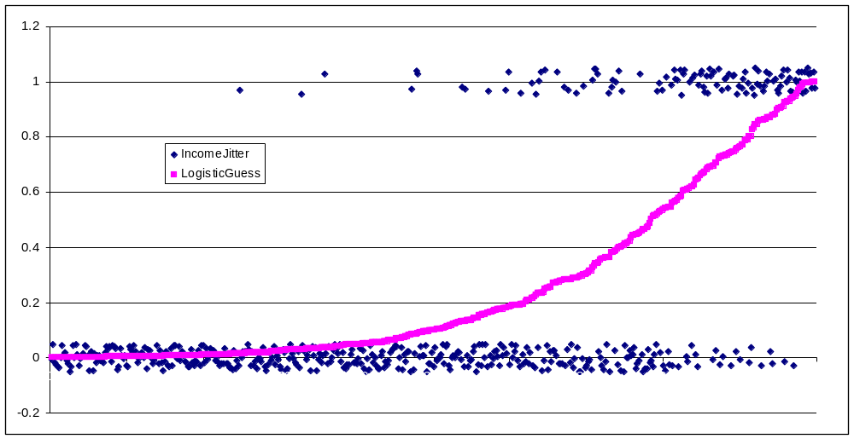
I showed this chart last week
Graham asked: What is the x-axis
I answered it’s complicated and I don’t quite remember but I will check
Before answering let’s take a quick look at the math of Logistic Regression

Slide 3
Watch
https://www.youtube.com/watch?v=BfKanl1aSG0
From 1:30 to 10:22; speed = 1.25

Slide 4
Now Back to Graham’s Question
My assumptions (which could be wrong since there is a lot going on in a multivariate logistic regression)
  Outputs of the regression model should be on the logistic curve
  The higher the output between 0 and 1 from the logistic model the further on the x-axis we must be
Cogitate on those 2 assumptions for a moment.

Slide 5
Now Back to Graham’s Question (II)
So to make the plot…
  I randomly select 500 out of the 16,281 results
  Sort them by regression output (continuous between 0 and 1 rather than the rounded/truncated version we use for prediction)
  Label the sorted data from 1 to 500 and that becomes the x-axis.
  So in a way it’s meaningless but if the 2 assumptions are correct than it should mimic the logistic curve
What does give me pause of course is the actual x-axis is probably some kind of projection of the 37 attributes and I don’t actually know how to show that on a 2-dimensional graph

Slide 6
Go to Excel
Once we have the data sorted to draw the graph above, it’s also easy to generate gain and lift charts, so we might as well go over that….

