Slide 1
Lecture 3 – Random Forests, Bagging, Ensemble Methods
Breitzman
9/19/2018

Slide 2
Intro To Ensemble Methods
Ensemble methods combine a number of different models in the hopes that the combined model will be more accurate than the individual models (doesn’t always work)
Ensemble methods have been called the most important development in data mining in the last decade (Seni and Elder, 2010)
We will talk about multiple ensemble methods during this course, but tonight we start with Random Forests
Random Forests (Breiman, 2001) take a number of decision trees and average them together
One of the key ideas behind Random Forests is Bagging, which has since been used in other ensemble methods

Slide 3
Recall Decision Trees
We discussed them in Data Mining 1 and we had a homework problem and Midterm problem where we built them by hand
Remember decision trees were good at answering yes/no questions like: Is X a terrorist? Will Y buy a house? Might Z develop diabetes? Etc.
A key advantage is that decision trees can be made into a set of rules so they are much less opaque than Neural Networks and other models
A big disadvantage was that they are susceptible to over-fitting, sometimes rules get duplicated over and over, correlations get ignored, and missing data will confuse the model
A random forest overcomes the over-fitting problem and the duplication problem but not the missing data problem

Slide 4
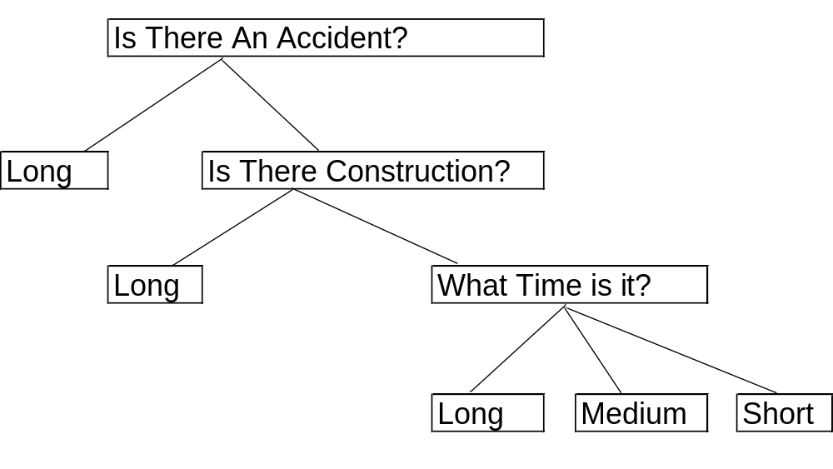
A Very Simple Decision Tree from DM 1
Predicting Commute Length

Slide 5
Idea of Random Forests
(wake up this is the most important slide!)
The idea behind a random forest is we build a bunch of decision trees using multiple random training sets and random subsets of attributes
The assumption is:
  Any given decision tree is mostly right!
  Mistakes of different decision trees will be in different places
Therefore if we average them together we should get a better result

Slide 6
So the key is…
the trees have to be truly random
if we keep building the same tree over and over again, it will keep making the same mistakes and averaging them together will give us no advantage
Breiman’s insight was to get the randomness from 2 sources called ‘Bagging’
  Step 1: Bootstrap Aggregating (Bagging): Sample the training set with replacement so different trees use different training sets
  Step 2: Attribute Bagging: Sample the attributes, so that each tree uses a different subset of attributes and therefore will be different from its neighbors

Slide 7

Bootstrap Aggregating comes from Bootstrapping
Bootstrapping is a re-sampling method from statistics
Suppose you are trying to model a population and you have a sample with n elements, but you don’t have any idea of how big the actual population is so you are unsure if n is large enough
You might pick a portion of the n-samples with replacement and build a distribution
Then repeat several times and average to get a better idea of the true distribution
Sampling with replacement in R
First time 1, 9, 10 used multiple times but 2,3,4 omitted
Second time 2,4, 10 used multiple times but 1 and 9 omitted

Slide 8
Attribute Bagging
In attribute bagging we randomly select a subset of attributes to build the tree with
For example in our breast cancer data set we have 32 attributes. In each iteration we select Sqrt(32) or 5 of those attributes
Squareroot seems to be the most popular. Research is still ongoing. There are some who also use Log(n)+1 or even just 1 attribute and get decent results

Slide 9
Putting It all Together
So instead of building a single tree we build something like 2000 trees all of which use a different sample of attributes and all of which use only a sample of the training data
The rest of the training data is concurrently used in each step to gauge how accurate a given tree happens to be
How do we get a result? Popular voting or weighted voting
  In popular voting we submit a test vector to all 2000 trees. If a majority pick class X then we return class X. If our assumption about most trees being mostly right is true then there should be a clear winner (say 1800 out 2000 trees agreeing)
  We can also do weighted voting since after each iteration the algorithm has a good idea of how accurate each subtree is. Most implementations seem to just use the popular voting method though with good results.

Slide 10
R Implementation
Go to breastcancer3.docx
Look at variable meanings for V30 and V26

Slide 11
Homework
Sensitivity analysis to confirm V26 and V30 picked by SVM and neural network See Canvas

Slide 12
Conclusions
We didn’t know it ahead of time, but our breast cancer data is not as rich as we thought.
With 32 variables it’s surprising that we only need 2 to do a very good prediction
That’s ok. Sometimes half of data mining is exploratory. It’s useful to realize the dataset can be greatly simplified
In this case since there are only a few variables that matter, we probably don’t need a random forest
However, in general a random forest will outperform a single decision tree on most data sets

