Slide 1
Lecture 4b – Boosting
Breitzman 9/25/2018

Slide 2
Introduction
Decision Trees – One of the most popular data mining methods
Advantages are many
  Easy to implement
  Learns by example
  Classifies yes/no questions as well as multi-class questions
  Decision process completely clear (unlike Neural Networks which are opaque at best)
  Can be turned into an (if-then) rule generator
  Can be vetted by analysts just by looking at tree
  Works on large data sets/very efficient
  Decision run time proportional to height of the tree
  Tree height is independent (and smaller) than database size
Has some disadvantages as well
  Doesn’t handle continuous data well (data must be categorized)
  Missing data will confuse the model (branch decisions depend on data)
  Susceptible to overfitting (pruning can help)
  Complicated data can lead to very large trees
  Correlations among data points are ignored
  Doesn’t handle noisy data well

Slide 3
Overfitting
In general, the overfitting problem is the main disadvantage
Pruning helps but it adds complexity, and one of the advantages of trees is their simplicity
Earlier we learned bagging. That creates a set of simpler trees by randomly selecting attributes and then combines the results by popular voting. It is robust against overfitting
Another approach is boosting which takes a set of stupidly simple trees called ‘decision stumps’ (essentially one level trees) and combines them via voting so that overfitting is unlikely to occur

Slide 4
Weak Learners
Boosting works with other kinds of learning algorithms and works on multi-class problems but it’s easiest to explain with weak binary class learners
Suppose we have a binary classification problem (Is x a bad credit risk?)
We can label the choices +1 or -1
A weak classifier is one that is at least better than a coin toss (i.e. error < .5)
If the classifier is no better than a coin toss then we can never get convergence, but as long as it’s better than random we should get convergence
In Boosting we combine weak learners where we reweight the mis-classified cases so that they have more weight in the future

Slide 5
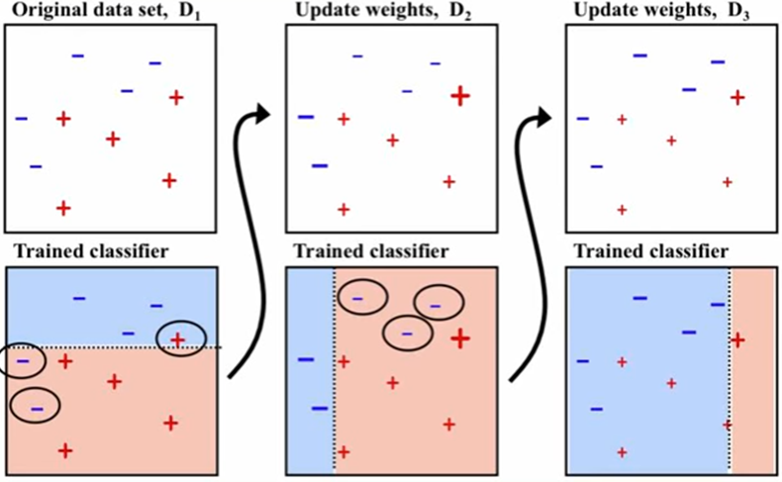
Basic Idea of Boosting
(Binary Case with classes +1,-1)
Slide source: Professor Ihler, U of Calif., Irvine

Slide 6
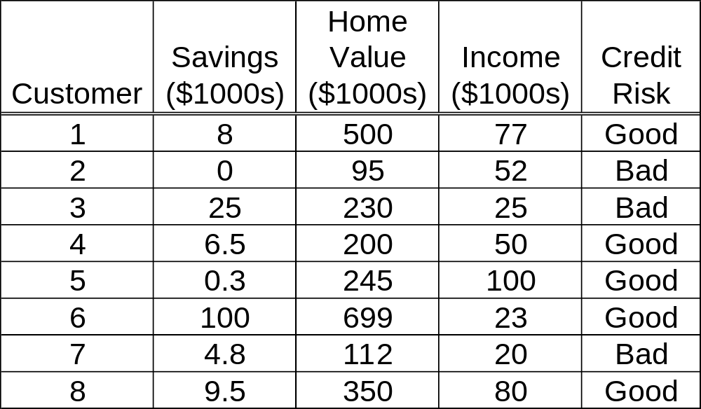
Example from Data Mining 1: Training Data Used to Predict Credit Risk for a Bank Loan
We must change the ‘continuous data’ to ranges or Low, Medium, High or similar

Slide 7
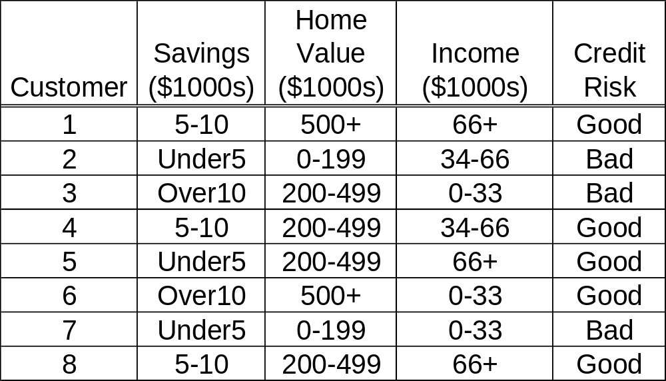
Modified Training Data
We could use more categories or ranges, but that would be a bit silly with only 8 data points

Slide 8
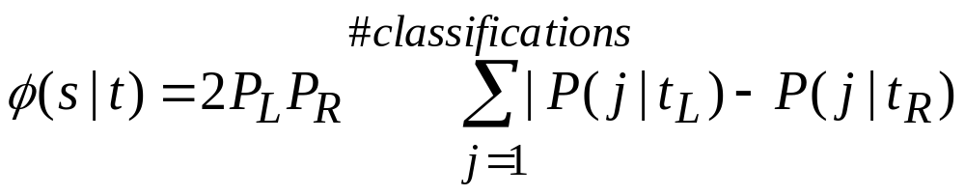
CART-Review
(Classification and Regression Trees)
Only makes binary trees
Every attribute will have a potential left and right child node
Greedy part is the split that maximizes the equation
We’ll define all of these variables next

Slide 9
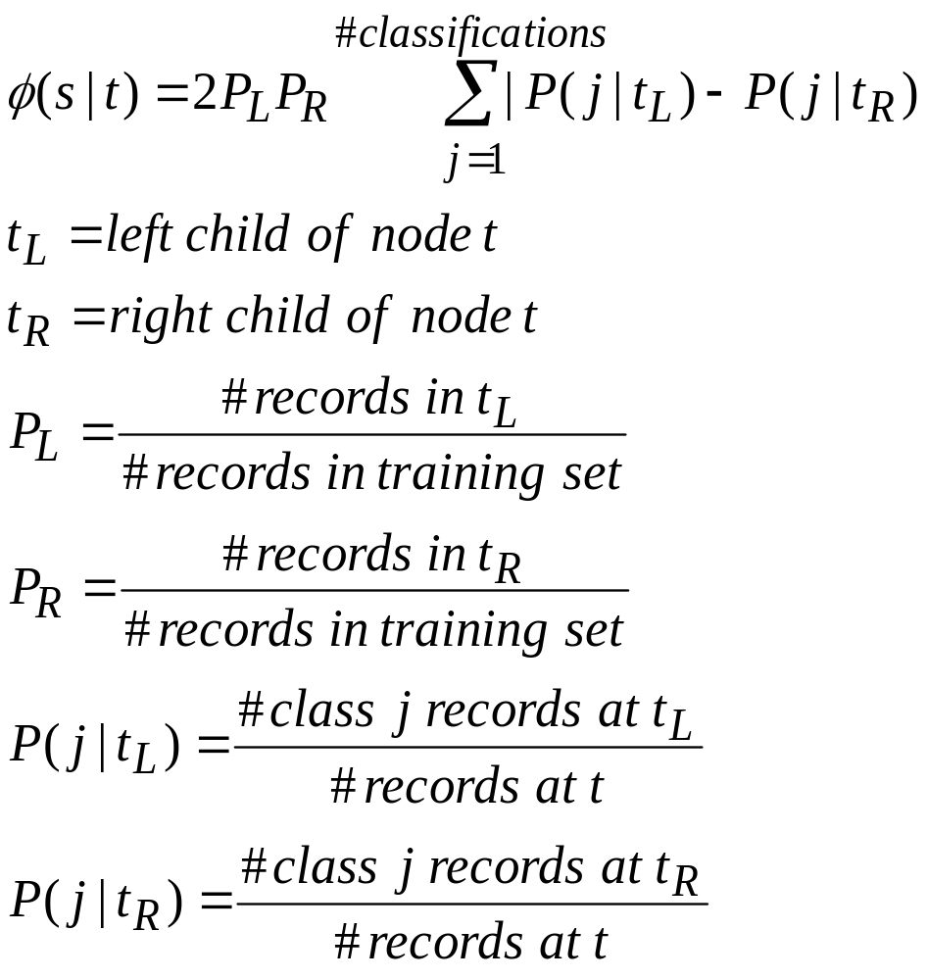
CART (II)

Slide 10
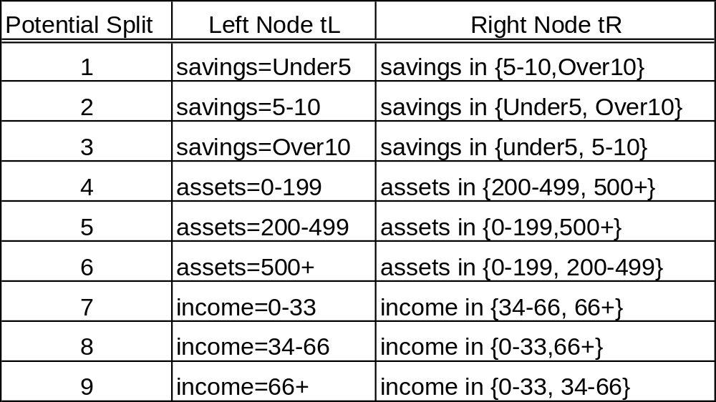

Potential Splits for t = root node
Now we just have to figure out which of these maximizes

Slide 11
Potential Split 1 Example
Left Child is Savings=Under5, Right Child is {5-10, Over10}
PL=(3 records with savings under5 / 8 examples total)=3/8
PR=(5 records with savings in {5-10,Over5}=5/8
P(j|TL) = 1/3 for good credit, 2/3 for bad credit
P(j|TR) = 4/5 for good credit, 1/5 for bad credit
2PLPR= 2(3/8)(5/8)
Sum=|1/3-4/5|+|2/3-1/5|
Φ(s|t)=2PLPR*Sum=(2(3/8)(5/8))*(|1/3-4/5|+|2/3-1/5|)
We compute φ for each of the 9 cases on the previous slide and choose the largest

Slide 12
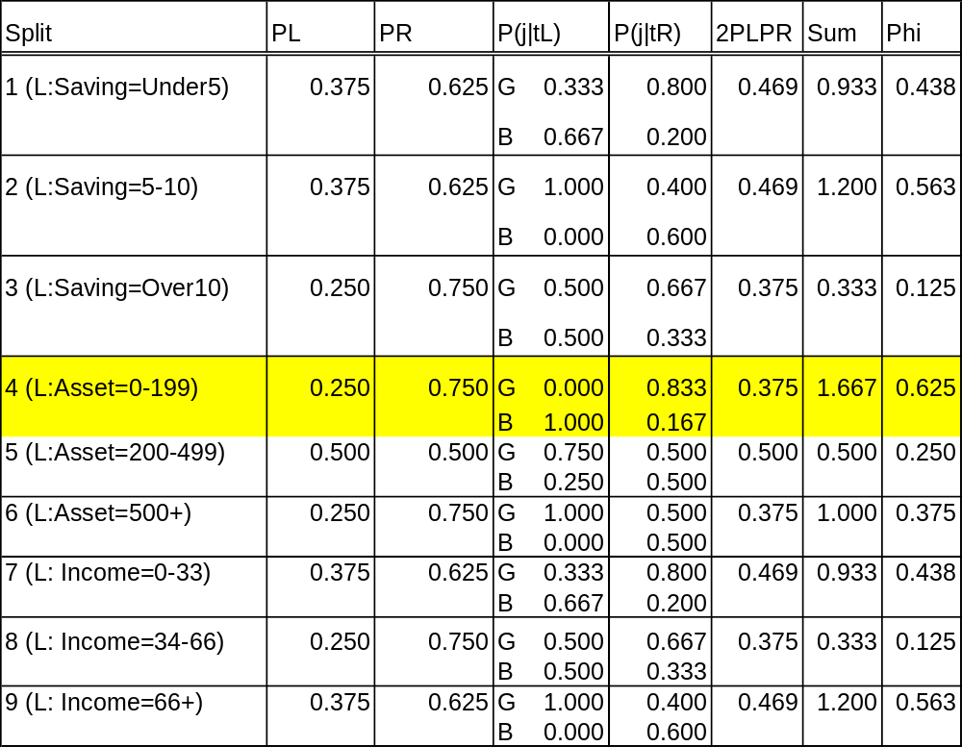
All Splits for Root Node
So the first split is on Assets (Home Value) 0-199. The example data records 2 and 7 go in left tree and become a node with target equal bad.
It then builds a new tree on the right based on example records 1, 3, 4, 5, 6, 8.

Slide 13
Excel
If we’re building a full CART tree we do the exact same process on the left sub-tree of 0-199 and the right subtree
For boosting we just use the ‘decision stump’ for 0-199
We then find the records classified right and wrong. Reweight the data accordingly and then repeat.
Go to Excel worksheet to discuss both methods

Slide 14
Sanity Check
Before moving on, make sure we talked about
  Normal Split
  Boosting Split
  Popular Voting
  Weighted Voting

Slide 15
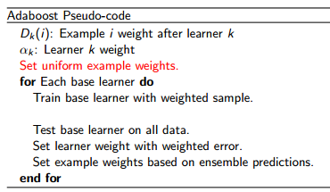
AdaBoost
Uniform weights usually start out at 1/n
In next iteration there is a complicated formula so that the new weights add up to 1
After k iterations we have k models. Test data is given to all k models with either popular voting or weighted voting applied

Slide 16
History
Boosting Schapire 1989
AdaBoost (Adaptive Boosting) is the first successful boosting algorithm. Schapire and Freund, 1997
Key aspect of AdaBoost is the adjustment of weights of mis-classified points
A central topic of Machine Learning is Gradient Descent. (Recall from Calc III a gradient is a directional derivative that maximizes increase or decrease.) Gradients are used in all kinds of optimization algorithms to change weights (Neural Nets for example)
1998 Breiman (the bagging guy) used gradients as an alternative to weighting the mis-classified points. He created a cost function and then used gradients to adjust weights to converge to lowest cost. This is gradient boosting
Gradient descent is a good computer science topic in general. Perhaps we will talk about it one day but not today!

Slide 17
AdaBoost in General
Most popular implementation is with decision stumps
Can be implemented with any classifier that can add weights. (e.g. Neural Networks, but not SVMs)
Can be extended to multiclass using methods we’ll talk about next week, or by using multiclass trees
Can be combined with Bagging
Go to R example. BreastCancer7a.pdf

