Slide 1
Lecture 6b – Paper Presentation of
“SMOTE: Synthetic Minority Over-sampling Technique”
Breitzman 10/9/2018

Slide 2
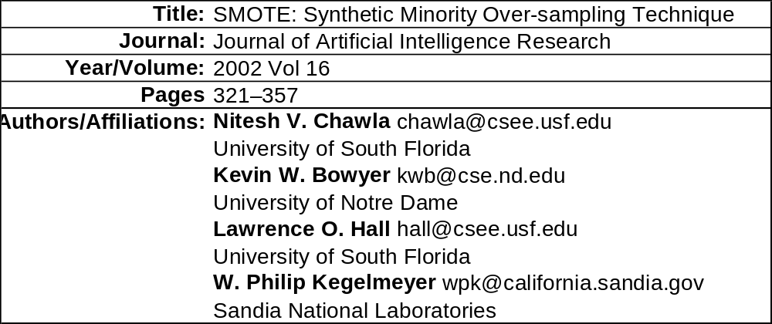
Bibliographic Information
This paper has 4,223 citations according to Google Scholar, which suggests this is a significant paper
It addresses the issue of unbalanced sets, which we have recently run into with our Wine example (only three quality ‘9’ wines, but 1,700+ quality ‘6’ wines)

Slide 3
Basic Problem-Unbalanced Data Sets are Prevalent
A dataset is unbalanced if the classes are not approximately equally represented
In Data Mining, often interesting problems will have unbalanced sets
  For example in fraud detection imbalance on the order of 100 to 1 is typical
  A Typical mammography data set might contain 98% normal pixels and 2% abnormal pixels
  Bomb on a plane example I gave earlier

Slide 4
Previous Approaches
Previously unbalanced data sets have been dealt with in 2 ways
  Increase the weights of minority class training tuples.
    This only works with trees and or ensemble methods using voting.
    In the former it can lead to over-fitting.
    The latter can be complicated to implement and take a long time to train
  Resample the original data while undersampling the majority or oversampling the minority
    Undersampling the majority in extreme 100-1 cases will not give enough training data
    Oversampling the minority just consisted of re-using the same data over an over again (consider our 3 quality ‘9’ tuples. If we wanted 300 samples we would have 100 each of the same data.)
    This would cause over-fitting in a tree or Neural Net, and have 0 effect on an SVM

Slide 5
New Approach: SMOTE
SMOTE: Synthetic Minority Over-sampling TEchnique
As previously mentioned over sampling the minority by re-sampling the same data repeatedly has been tried and does not work
Instead the authors propose to over-sample the minority by creating new data points related but different from the existing points
The approach is inspired by a technique that proved successful in handwritten character recognition (Ha & Bunke, 1997)
  In this case minority writing examples were changed slightly by adding slight rotations, changing skew angles, and adding random jiggles
The SMOTE technique takes a minority vector and a “nearby” vector and creates a new vector some random distance between them

Slide 6

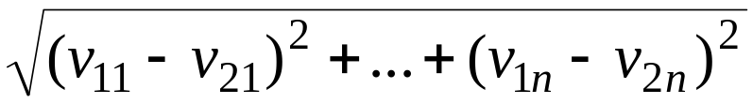
Creating a Synthetic Point (or vector or tuple)
Recall from high school the distance formula
This is known as Euclidean Distance and it can be extended to higher dimensions as follows
For 2 vectors of length n v₁=(v₁₁,v₁₂,v₁₃,…,v_{1n}) and v₂=(v₂₁,v₂₂,v₂₃,…,v_{2n}) the distance formula can be extended to
Algorithm: If I have a minority vector v₁=(v₁₁,v₁₂,v₁₃,…,v_{1n}) and a nearby vector v₂=(v₂₁,v₂₂,v₂₃,…,v_{2n}), I compute d_{n} = v_{1i}-v_{2i} for i=1,…,n.
Next Let m_{i} = rand()*d_{i} where rand() picks a random real number in (0,1)
Synthetic tuple is v₃=(v₁₁+d₁,v₁₂+d₂,v₁₃+d₃,…,v_{1n}+d_{n})
See example on next page

Slide 7
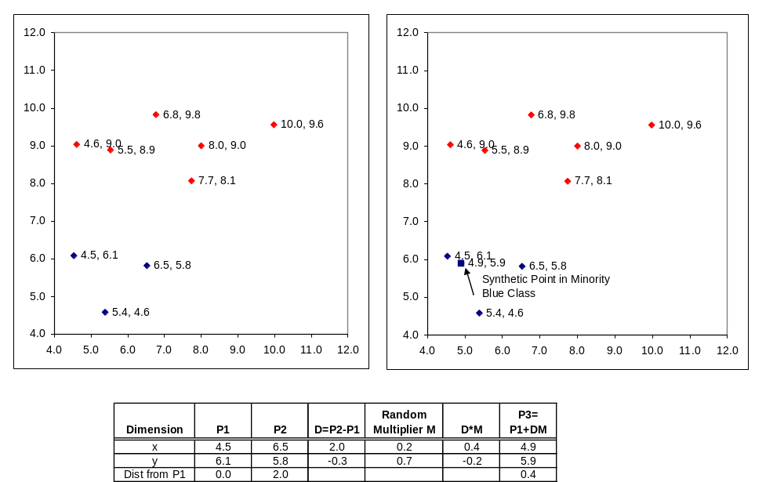
Synthetic Point Insertion
(2D Example; Works for any Dimension)

Slide 8
General Algorithm Pseudocode
Let’s assume we wish to increase a minority class by 100*k% (e.g. k=1 increases by 100% or doubles it, k=2 triples it etc), and assume class has n members now.
Also assume we have a function getSynthPoint() that gets a synthetic point using process on previous slides
synSet[] = Function(classVec,n,k){
count = 1
for (i in 1:n){
NN[]=getNearestNeigbors(classVec[i],k)
for (j in 1:k){
synset[count]= getSynthPoint(classVec[i],NN[j])
count++
}
}
count--
}
This is simplified to handle cases where we want to double or triple the number of points, but it can be extended to cases where we want to add say 60% more points instead

Slide 9
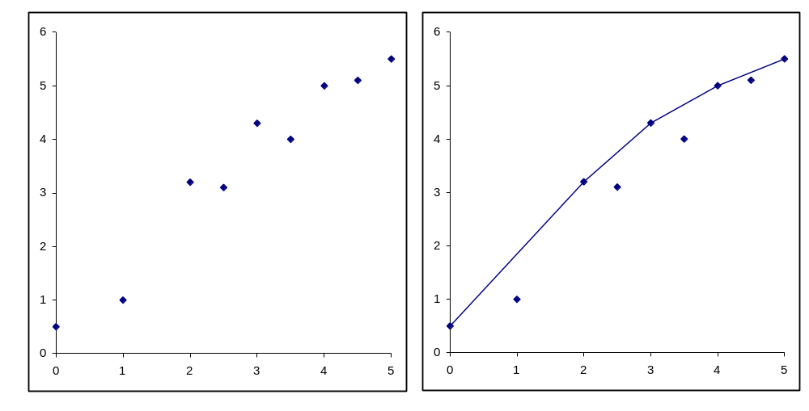
Backtrack: Convex Hull of a Set of Points
Given a set of points, the convex hull is equivalent to wrapping a rubber band around the first and last point. (Picture on right is the hull of the left)
Formal definition
  Linear interpolation is used between adjacent points.
  No point lies above the final curve.
  For any pair of points used to construct the curve, the line segment connecting them is equal to or below the curve.
Hull is used to compare ROC curves. Curves on the hull, may be optimal

Slide 10
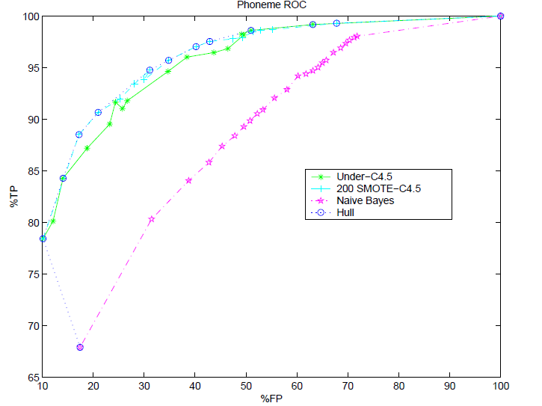
Some Results: Phoneme

Slide 11
Phoneme Results
These examples are straight from the SMOTE paper
The Phoneme dataset is from the ELENA project. The aim of the dataset is to distinguish between nasal (class 0) and oral sounds (class 1). There are 5 attributes. The class distribution is 3,818 samples in class 0 and 1,586 samples in class 1.
The purple is a Naïve Bayes classifier with no over or under sampling
The green classifier used a C4.5 Tree and undersampled the 3,818 vectors in the majority class to match the 1,586 in the minority class. This will still work because 1,586 is a decent sized sample
The blue classifier used SMOTE to create to identical 3,818 member classes and then used a C4.5 tree
The SMOTE ROC curve has many more points on the hull, which suggests it is better than the other methods

Slide 12
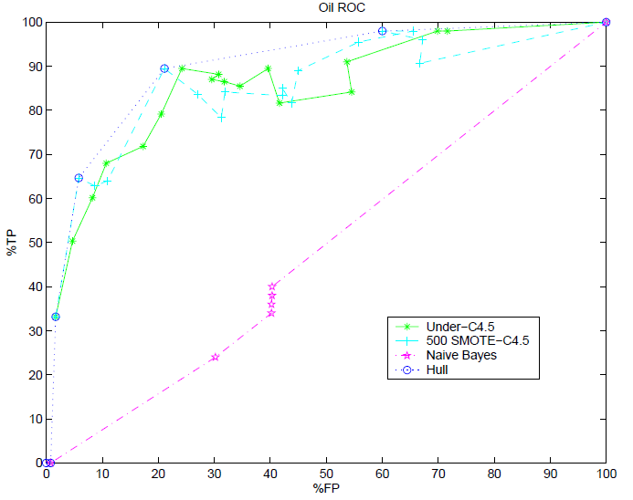
Some Results: Oil

Slide 13
Oil Results
The Oil dataset was provided by Robert Holte and is used in their paper (Kubat et al.,1998). It contains satellite images of oil slicks and non-oil slicks, used to predict if an oil spill has occurred. This dataset has 41 oil slick samples and 896 non-oil slick samples.
The purple is a Naïve Bayes classifier with no over or under sampling
The under classifier does surprisingly well with only 41 of each class
SMOTE does better sometimes, but worse other times

Slide 14
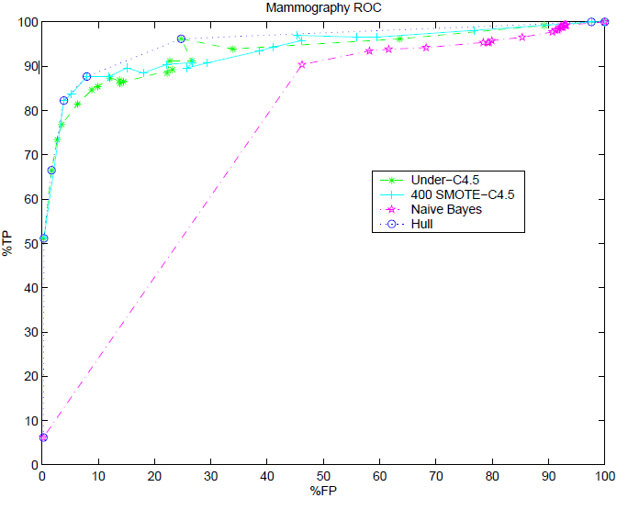
Some Results: Mammography

Slide 15
Mammography Results
The Mammography dataset (Woods et al., 1993)h as 11,183 samples with 260 calcifications. If we look at predictive accuracy as a measure of goodness of the classifier for this case, the default accuracy would be 97.68% when every sample is labeled noncalcification. But, it is desirable for the classifier to predict most of the calcifications correctly.
The purple is a Naïve Bayes classifier with no over or under sampling
SMOTE wins by having more points on the hull, but undersampling does pretty well too
This is not surprising since 260 of each is decent sized sample

Slide 16
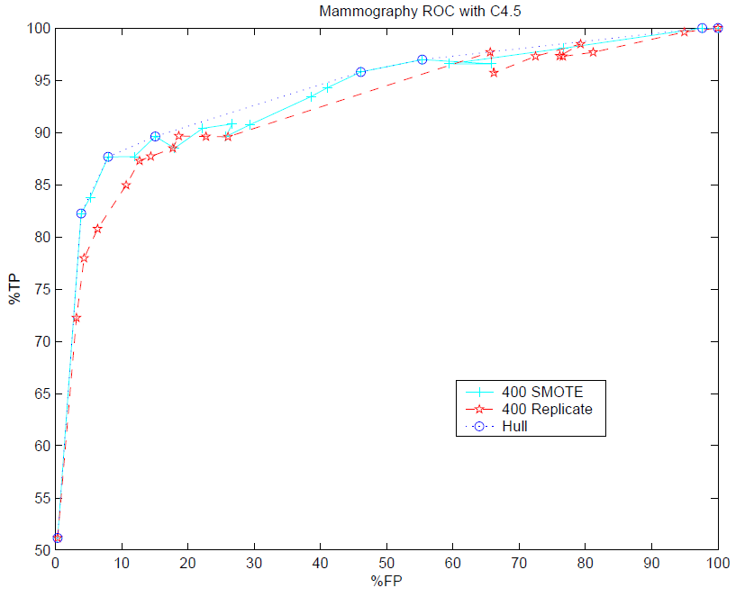
Some Results: Mammography2

Slide 17
Mammography2 Results
This is an interesting chart because it directly compares SMOTE to oversampling by simply replicating the original calcification data points
For TP above 75%, SMOTE wins most of the time

Slide 18
Conclusions
Many interesting data sets are unbalanced
Because of low number of data points in some minority classes, we can’t always under-sample the majority
In those cases, we are better off generating synthetic points via SMOTE then just making duplicates because of over-fitting and other issues
SMOTE was tested on several real data sets and outperformed other methods
Future work: The method only handles binary classifiers, but extensions should be possible and will be explored.
Go to R and create SMOTE by hand as well as test ROSE package

