Slide 1
Lecture 6c – Case Study on K-Nearest Neighbors
Breitzman 10/9/2018

Slide 2
Intro
When we did SMOTE we used a distance function to create an artificial vector between 2 existing vectors in the same class
I worked on a project last week that used the ideas of Nearest Neighbors and k-Nearest Neighbors; hopefully when we see a non-toy example we’ll gain an appreciation for KNN.

Slide 3
The Setup
I have 370,000 geocoded tweets. That is, I have a latitude and longitude for each of the 370,000 tweets
The application is not important but I need to map the tweets to the nearest zipcode. Possible applications:
  – look at differences in word choice over different regions
  Identify cities and suburbs with the most tweets on a topic
  Sentiment analysis: are some cities more positive/negative than others
  Do some cities tweet more relative to their overall population
  Countless applications

Slide 4
The Issue
I’ve got my 370,000 tweets with (Lat, Long)
I’ve got a file of 33,000 US zip codes with (Lat, Long)
If I try a direct match it will fail because the zip code (Lat, Long) are center of town, while the tweets are based on Phone location at time of tweet
We can develop a distance function
D = abs(tweetLat – zipLat) + abs(tweetLong – zipLong)
Then for each of the 370,000 tweets I compute the distance to each of the zip codes and the closest distance wins. (This is essentially finding the nearest neighbor of each tweet. Algorithm dates to 1950’s)
That’s 12 billion distance computations. I tried to run it because it’s easy to code. Killed it after 24 hours.

Slide 5
Refresher
Remember the idea behind K-Nearest Neighbors
Suppose we have 10,000 data points in 20 clusters and we’re trying to figure out which cluster a new data point should belong.
Rather than compare the distance between the new data point and the other 10,000 data points, we compare the distance between the new data point and 20 centroids and pick the closest 3. We then compare the distances between each point in the 3 clusters. (about 1,500 computations instead of 10,000)

Slide 6
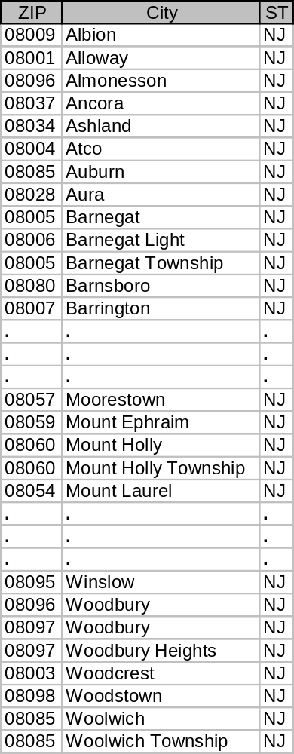
My Process (II)
I don’t have my tweets clustered, and I don’t feel like doing so (a lazy programmer is a good programmer!)
I can easily cluster zip codes by 3 character regions
For example I can compute the average (Lat,Long) for the 235 zip codes starting with 080 in about 5 seconds (see table to right)
Computing all 929 centroids takes less than a minute and computing the distance between all tweets to centroids and then all tweets to the full 5 digit zip codes within the best 3 regions is less than an hour.
It’s clear why: Instead of comparing distance between every tweet and 33,000 zip codes. We’re now comparing every tweet to 929 centroids and an average of 3*76 zip codes. So it should be about 30 times faster

