Slide 1
Lecture 7a – Generic Ensembles
Breitzman 10/16/2018

Slide 2
Introduction
Boosting
  Previously we talked about Boosting
  Idea was to take a bunch of weak classifiers (decision stumps) and combine them to get a strong classifier
Previously we talked about Bagging
  Randomly selected training subset and attribute subset and built decision trees
  Decision trees were likely to be different because they used different attributes
  Key attributes are found over time and voting modified so that accurate subtrees had more weight
Both methods used a combo of decision trees
Tonight we’ll talk about methods of ensembles of general classifiers

Slide 3
Introduction (2)
Ensemble methods have been called the most important development in data mining in the last decade (Seni and Elder, 2010)
Ensembles really started to pick up steam with Brieman’s random forests (Bagging) in the 1990s and Schapire 1995 (Boosting)
So this is all fairly recent stuff compared with say Calculus which is 300 years old or the Fast Fourier Transform 1965, or Stacks, Queues, Spanning Trees etc. which go back to the dawn of computing or further

Slide 4
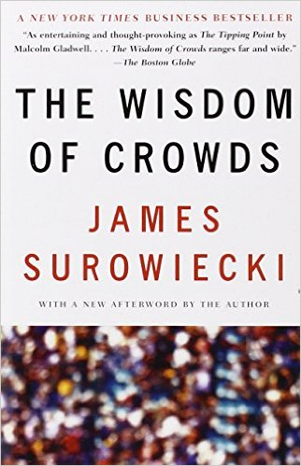
Key Idea - Wisdom of Crowds
The Wisdom of Crowds: Why the Many Are Smarter Than the Few and How Collective Wisdom Shapes Business, Economies, Societies and Nations, published in 2004

Slide 5
Opening Anecdote in the Book
Relates Francis Galton's surprise that the crowd at a county fair accurately guessed the weight of an ox when their individual guesses were averaged (the average was closer to the ox's true weight than the estimates of most crowd members)
By the way Sir Francis Galton 1822-1911 was an English Victorian statistician, progressive, polymath, sociologist, psychologist anthropologist, eugenicist, tropical explorer, geographer, inventor, meteorologist, proto-geneticist, and psychometrician.
He produced over 340 papers and books. Created the statistical concept of correlation and regression toward the mean. He was the first to apply statistical methods to the study of human differences and inheritance of intelligence…

Slide 6
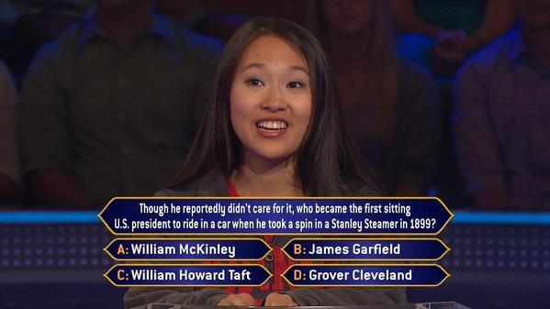
Who Wants to Be a Millionaire?
Why does ask the audience often produce the right answer in this game?
The audience is filled with average people that had nothing better to do that day.
They have no specialized knowledge

Slide 7
Who Wants to Be a Millionaire? (2)
Let’s look at the probabilities
  Assume 100 people in the audience
  Maybe only 10 know that McKinley was president in 1899
  Other 90 will guess randomly presumably.
Results: 10 for A, (90/4 for A, B, C, D)
Roughly .325 for A, .225 each for B, C, D so crowd gets it right
In many cases the crowd will do better because some will be able to rule out one or more wrong presidents so the number of right guesses will be above the random 90/4

Slide 8
Majority Voting (simplest ensemble)
Suppose you are trying to predict something (e.g. who is a bad credit risk)
You have 3 classifiers that are each 70% accurate
Surprise! If you combine them with majority voting you will get a model that’s 78% accurate
How?
  Probability all 3 right = .7*.7*.7 = .343
  Probability exactly 2 right = 3*(.7*.7*.3) = .441
  Probability exactly 2 wrong = 3*(.7*.3*.3) = .189
  Probability all 3 wrong = .3*.3*.3 = .027
  Note all of those probabilities add to 1 as expected, but the majority vote probability is .343 + .441 = .784

Slide 9
Majority Voting (2)
I’ll leave it as an exercise but it can be shown easily that if you have 5 classifiers with 70% accuracy the majority voting goes to 83%, and keeps increasing as you increase the number of classifiers
This is why boosting works even though we have weak classifiers that are barely better than a coin toss. If we combine a lot of them we will get better accuracy

Slide 10
Correlation
Suppose we’re trying to predict who is likely to become diabetic in the next 5 years
Suppose we have a string of 10 training records that are all positive
+ + + + + + + + + +
Next we have 3 classifiers (one 80% accurate, two 70% accurate)
Unfortunately they’re all correlated
Truth + + + + + + + + + +
80% Model A + + + + + + + + - -
70% Model B + + + + + + + - - -
70% Model C + + + + + + + - - -
Combined + + + + + + + - - -
Because of correlation we only get 70% accuracy

Slide 11
Correlation (2)
Next suppose we have less accurate models but they are uncorrelated
We have a string of 10 training records that are all positive
+ + + + + + + + + +
Next we have 3 classifiers (one 80% accurate, one 70% accurate, one 60%)
This time although less accurate they happen to be uncorrelated
Truth + + + + + + + + + +
80% Model A + + + + + + + + - -
70% Model B + - + + - + + + - +
60% Model C - + - + + + - - + +
Combined + + + + + + + + - +
Because they are uncorrelated we get 90% accuracy

Slide 12
Correlation (3)
This is another reason why Boosting works so well
We are taking a lot of weak classifiers and combining them
But they are very likely to be uncorrelated because at each iteration we are concentrating on getting the records right that the previous classifier got wrong
So Boosting uses many uncorrelated classifiers and converges provided the weak classifiers have better than random probability of being right

Slide 13
Weighted Voting
Suppose we have a classifier that returns a class + or -, but also a confidence rating
We notice when the classifier returns .9 it is virtually always right, but when it returns .6 it is rather inaccurate.
If we have many different classifiers with this feature it would make sense to give more weight to the confident classifiers rather than do a strict majority voting
We saw a variation on this with Boosting where we weighted the vote using the error rate of each decision stump

Slide 14
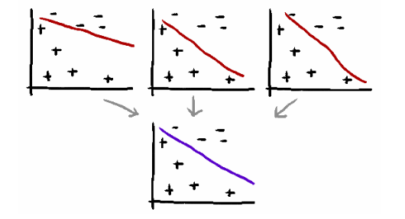
Averaging Models
Purple model is an average of 3 red models
It might not be better than red models, but is unlikely to be worse

Slide 15
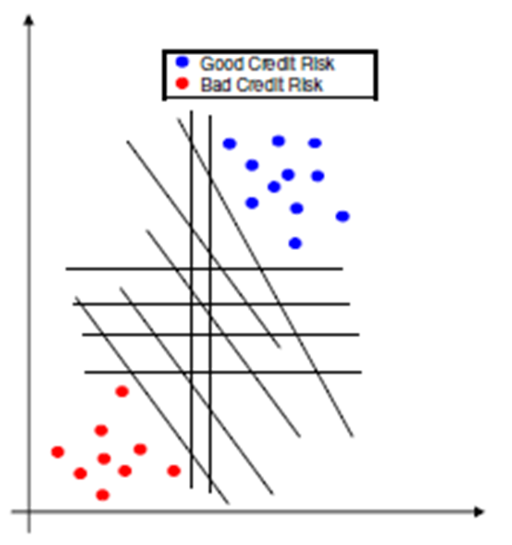
Recall the picture below from our SVM lecture

Slide 16
Averaging Models
You might recall the Support Vector Machine attempted to find the solution with the most “support”
In the previous slide all of the black lines were potential solutions, but the green one is the best because it’s most likely to properly classify new points correctly
Finding that particular support vector is complicated, but if we average all of the black lines we’re likely to get a line that if not in the center, will at least be away from the edges and likely close to the vector with max support

Slide 17
Model “Stacking”
Suppose we have a training set
Now suppose we have 10 classifiers
C1, C2 ,…, C10
These could be Neural Networks, SVMs, Decision Trees, whatever.
x1 | x2 | x3 | …. | xn | Result
0.1 | 0.3 | 0.7 | …. | 0.3 | +
0.7 | 0.34 | 0.8 | …. | 0.4 | +
0.6 | 0.32 | 0.9 | …. | 0.5 | -
0.5 | 0.28 | 0.1 | …. | 0.6 | +
0.4 | 0.4 | 0.2 | …. | 0.4 | -
0.5 | 0.33 | 0.4 | …. | 0.3 | -

Slide 18
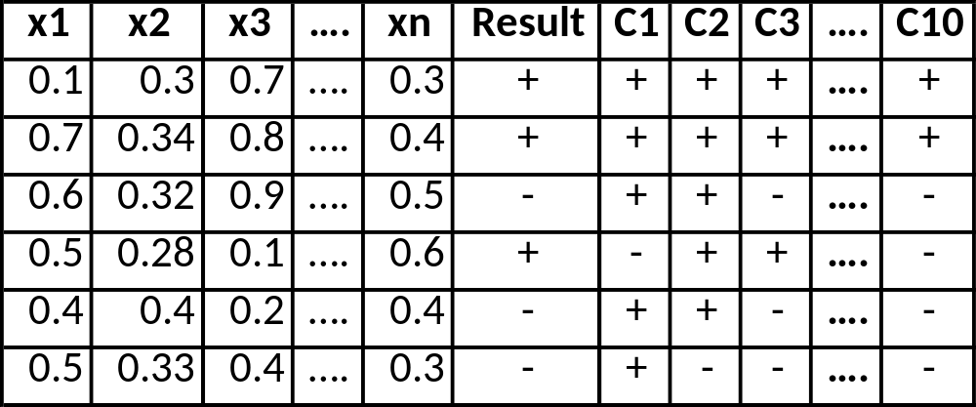
Model “Stacking” (2)
The idea behind model stacking is we can make a brand new classifier C11 that uses C1 to C10 as attributes
C11 can be a Neural Network or any other kind of classifier but Logistic Regression seems to be the most popular choice
We can also use x1 to xn as well as c1 through c10 as attributes

Slide 19
Model “stacking” (3)
One advantage is the new model can be fairly standard and take advantage of sophisticated models that someone else built
For example imagine a Kaggle strategy where the teams in 2nd to 10th place joined forces to beat the first place team by building a simple stacked model that does nothing more than use the 9 good models as attributes
This seems to be a common strategy in Kaggle contests
This is how the Netflix contest was won.

Slide 20
NetFlix Prize (2012)
Contest ran for two years in which the first team to submit a model improving on Netflix’s internal recommendation system by 10% would win $1,000,000.
Contestants were supplied with entries from a huge movie/user matrix and asked to predict the ranking (from 1 to 5) of a set of the blank cells.
over 20,000 teams submitted a model

Slide 21
NetFlix Prize (2)
near the end of the contest, when the two top teams were extremely close to each other and to winning the prize, the final edge was obtained by stacking the models of the next 30 competitors.
In the end more than 100 models were combined to win the prize since the 30 competitor models were themselves ensembles
The resulting model was so complicated that NetFlix never implemented it, since the engineering effort was not worth the minor improvement in rankings.
The Netflix prize was one of the first Data Science contests and inspired Kaggle.com
Right now if you are not using an Ensemble in a Kaggle contest you aren’t winning

Slide 22
Last method: Mixture of Experts
This one is actually easier said than done.
The idea is we build specialized models for specific solution spaces and than a model to predict which region we’re in
For example, recall our wine quality problem
  Suppose we had a model that could distinguish between 8,9
  Another model that can distinguish 3,4
  Another that can distinguish 5,6,7
  Finally we have model that can decide whether we have a poor wine, an ok wine, a good wine
This is illustrated on the next page where our first classifier chooses the regions pink, yellow, blue. Than the domain specific classifier takes over.

Slide 23
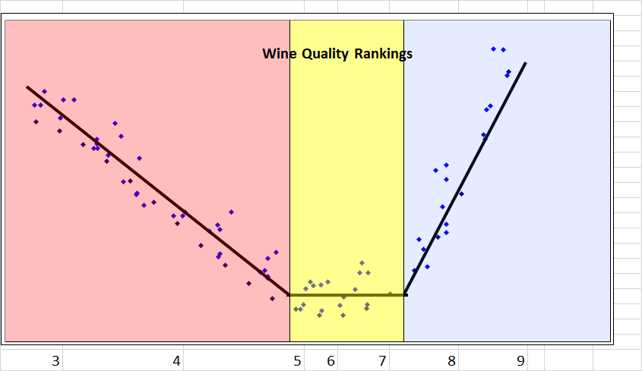
Mixture of Experts (2)

Slide 24
Next Week
We’re not exactly done ensemble methods yet
We have to talk briefly about error correcting codes
We can then talk about 1 v. 1 models and 1 v. all models
That will give us yet another perspective on our wine data set
We also have a midterm next week, but that will only take up the last hour

