Slide 1
Lecture 9 – Multi-Class Classifiers
Breitzman 10/31/2018

Slide 2
Introduction
Most classifiers work best on binary problems
  E.g. is x a bad credit risk?
  Is y at risk for diabetes?
  Is z a terrorist?
A lot of interesting problems are multi-class
  Will it rain, snow, or be sunny?
  Is the wine rated bad, ok, good?
  Does she have the flu, a cold, or just allergies?

Slide 3
Classifiers
Multinomial Logistic Regression extends Logistic Regression to Multiclass
K-Nearest Neighbors is essentially multi-class
Naïve Bayes is easily extended to multi-class
Trees and Neural Nets can be multi-class but it may be better to build simple ones and extend to multiclass using methods below
SVMs, Linear Regressions and several other methods are strictly binary
Using the methods we’ll learn tonight we can make any classifier multi-class

Slide 4
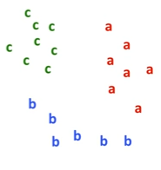
The Setup
Suppose we’re trying to classify 3 items a,b,c (method easily extends to millions of items)

Slide 5
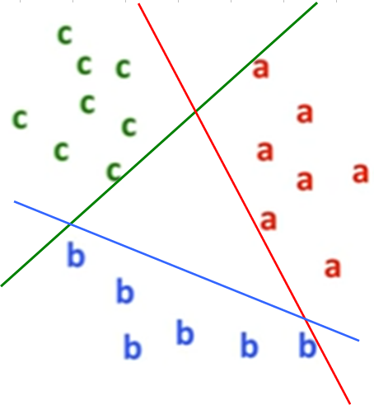
Method 1: One Versus All (OVA)
We use three binary classifiers.
Green classifier is + on c and – on everything else
Similar with red and blue classifiers

Slide 6
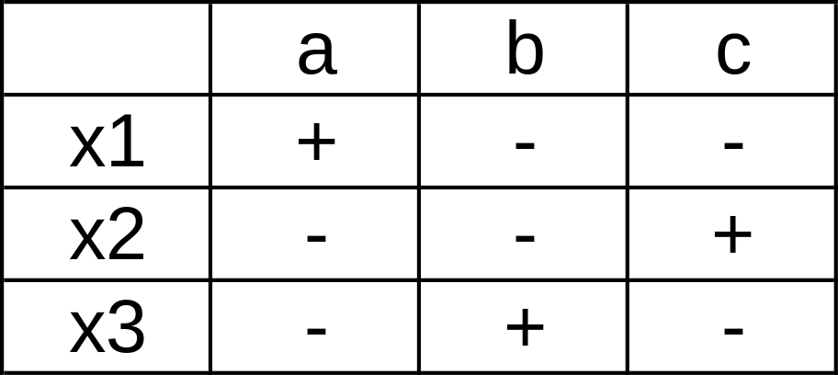
Method 1 OVA continued
We’re trying to classify a data point as being part of a, b, or c
We build a classifier x1 that recognizes a versus not a, a classifier x3 that recognizes b versus not b etc.
New data points are classified by whichever column comes up +
If there are 2 + columns we pick the one with the highest confidence (based on our classifier accuracy)

Slide 7
Method 1 OVA continued
Downsides
  If we have k classes and k classifiers we need all to be accurate for this to work
  If each are 80% accurate the overall classifier is less than 80% accurate
  Data that follows a continuum doesn’t work very well with one versus all
    For example for our wine quality we would need a classifier that predicts 5s versus (3 to 4) union (6 to 9). Of course
    5 versus (3 to 4) is probably easy and 5 versus (6 to 9) but not both
    Similarly predicting snow versus not-snow would involve building a classifier that predicts snow versus (rain, sun, etc.) which is rather unnatural

Slide 8
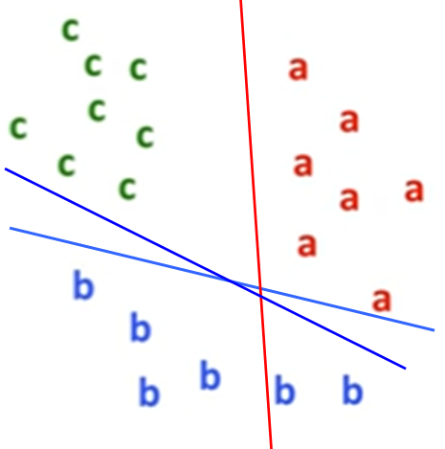
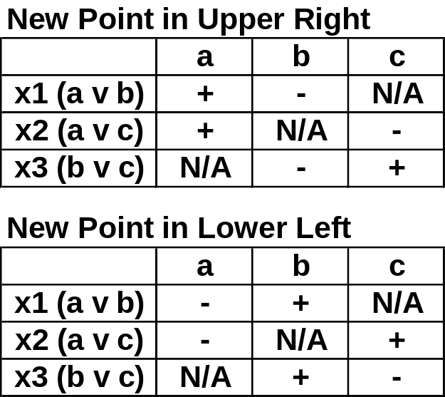
Method 2: One Versus One
Also Known as All-Pairs and OVO
We create n(n-1)/2 classifiers a v b, a v c, b v c in this case
Column with most + wins
Two examples provided on left

Slide 9
OVO Continued
Downsides
  n(n-1)/2 classifiers needed. That’s a problem if you have lot’s of classes
  Run time can be slow for both training and running a trained model
  If even one classifier is wrong we have a problem
In spite of the downsides it is usually far superior to OVA

Slide 10
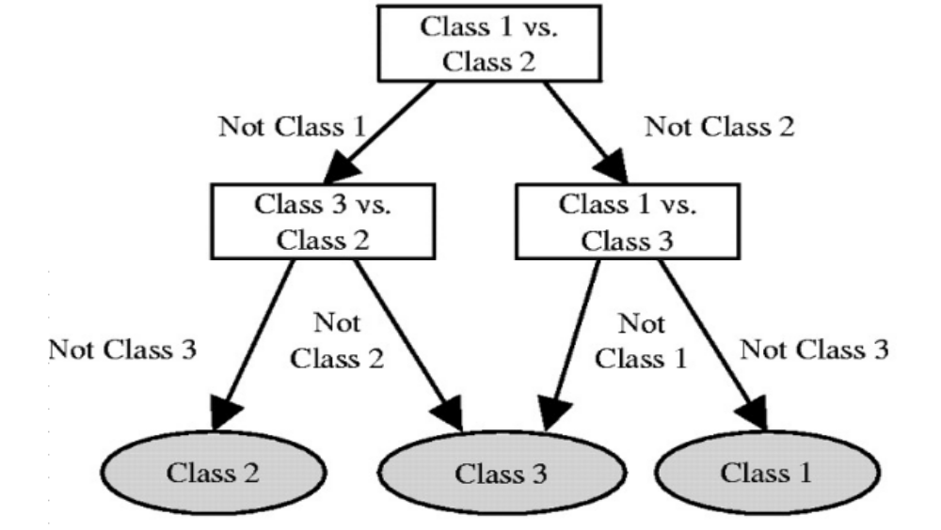
Another OVO Method

Slide 11
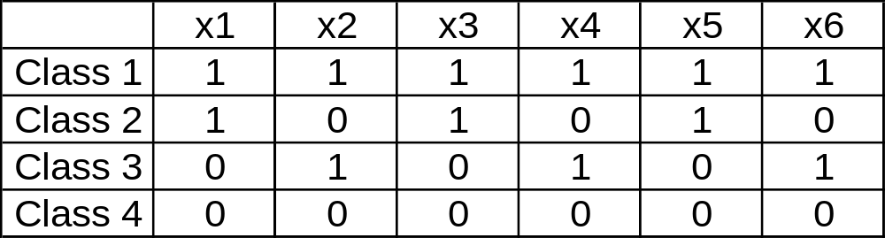
Error Correcting Codes
Error correcting codes are used in communication where redundant bits are sent in case some get messed up
For example if the 4 classes above were the only possible bit strings we have a number of redundant bits because 4 different messages should only need 2 bits
Define the Hamming distance H() to be the number of bits that have to be changed to go from one class to another. For example H(C1,C4)=6, H(C1,C2)=3, etc.
Hamming distance of the above 4 classes is at least 3
This implies if we have classifier x1 = (c1,c2) v (c3, c4), x2=(c1,c3) v (c2, c4) etc. then even if 2 of the 6 classifiers are wrong we can predict the correct class

Slide 12
Wine Again: Go to R
Don’t show all 29 pages but do show:
  That One V All is doomed to fail
  That 3-4 v 8-9 and 3-4 v 7 get pretty good results
  Show the two 4 bit approaches
  Show that Boosting is atrocious for 7 v 8-9 but random forest is not great but not awful

Slide 13
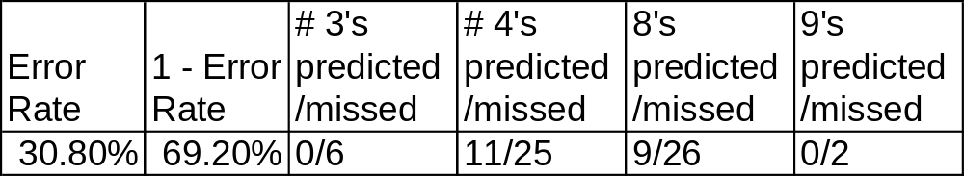
Wine Classes 3 to 9
Recall predicting individual ratings 3 to 9 was 69% accurate using random forest and less accurate using other classifiers
We could get better accuracy by grouping (3-4)=bad, (5-6-7)=ok, (8-9)=good
That accuracy was a mirage however because ok outnumbered bad and good so much that 90% accuracy could be achieved without being able to identify good wine.

Slide 14
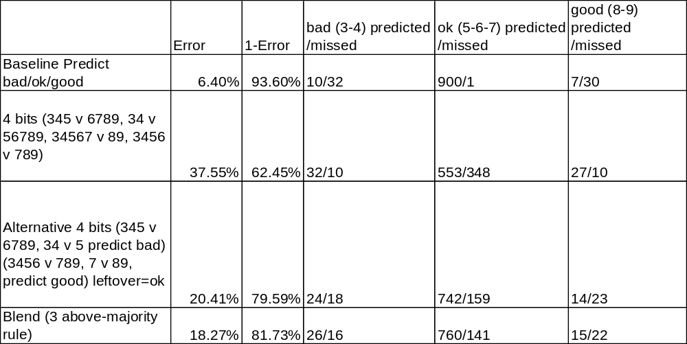
Wine Classes (Bad/Ok/Good)
Which is better a 93% accurate model that is incapable of finding good wine or an 81% model that identifies more than half the bad wines and almost half the good wines?

