Slide 1
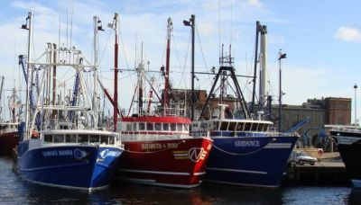
New Bedford Ship Traffic Analysis (Fishy, Fishy)
Ron Neely
Rowan Data Mining 2, December 18, 2018
Professor: Anthony Breitzman

Slide 2
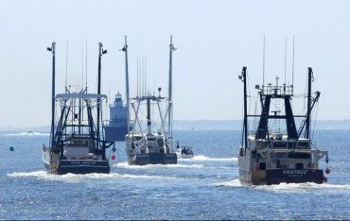
How can Automatic Identification System (AIS) traffic provide insight for optimizing operation of the Port of New Bedford, Massachusetts?
New Bedford tops nation in dollar value of fishing
2015: $322 million landings, 16 years running (fisherynation.com)
AIS tracks vessels via required transponders on each ship
Originally meant for maritime safety
What additional info can be gained?
Port Congestion?
Scheduling?
Fishing hot spots?
Fishing timing?
Time is Money – Reduce time to unload fish
Fresh fish is better for you

Slide 3
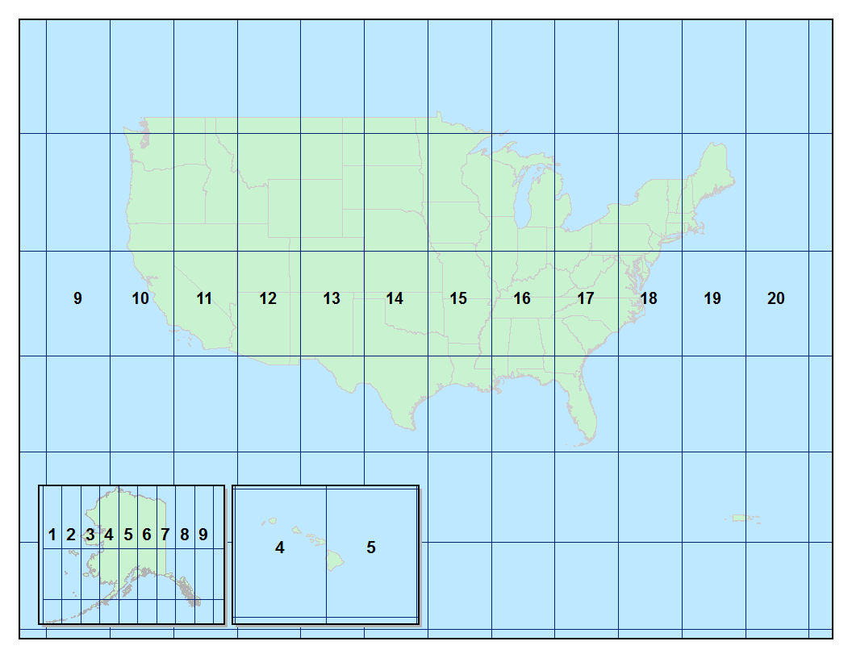
Data: https://marinecadastre.gov/ais
New Bedford
AIS Vessel Traffic Data Collected by US Coast Guard
2015-2017 down sampled per minute
Zones 18, 19 – Northeastern US
154 GB
1,324,008,655 records
36 CSV Files, 1 per month
Max 4.1GB file
25,000 boats (Zone 19)

Slide 4
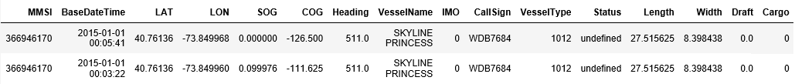
CSV Format

Slide 5
Tools
Python
Pandas – DATA TOO BIG
Numpy
Scikit-Learn
Csvkit – cut, stack, SQL query CSV files from command line
Tableau – heatmaps

Slide 6
Process
Reduce size of files
CSV Kit to stack files
Python script iterate over files to/from disk
Extract all ship in port (~1050 ships)
Python script extract for 1050 ships from Zone 18 + Zone 19 files
3 Days to Run
O(N)*1050 search on 1 Trillion records
Explore Data with Pandas and Tableau
New Bedford Lat Long from https://www.maps.ie/coordinates.html
nb_top = 41.67983548546637 # Latitude
nb_bottom = 41.616469012250825 # Latitude
nb_left = -70.92945098876954 # Longitude
nb_right = -70.89649200439454 # Longitude

Slide 7
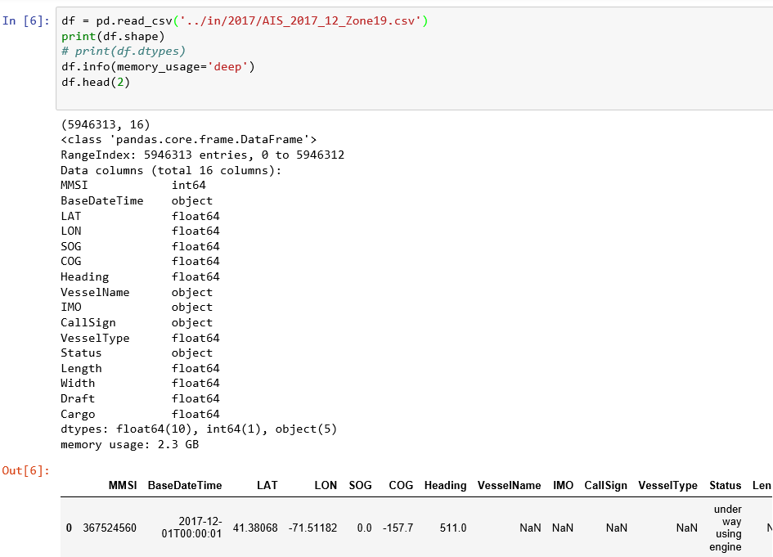
Pandas – Memory Optimization Baseline 2.3GB
https://www.dataquest.io/blog/pandas-big-data/

Slide 8
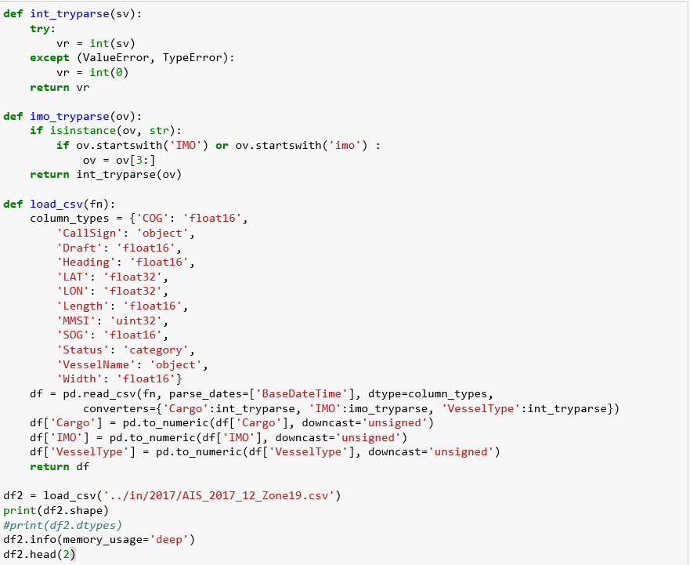
Pandas – Memory Optimization Code
@ read_csv
parse_dates
Specify dtypes
Use converters
Downcast numerics

Slide 9
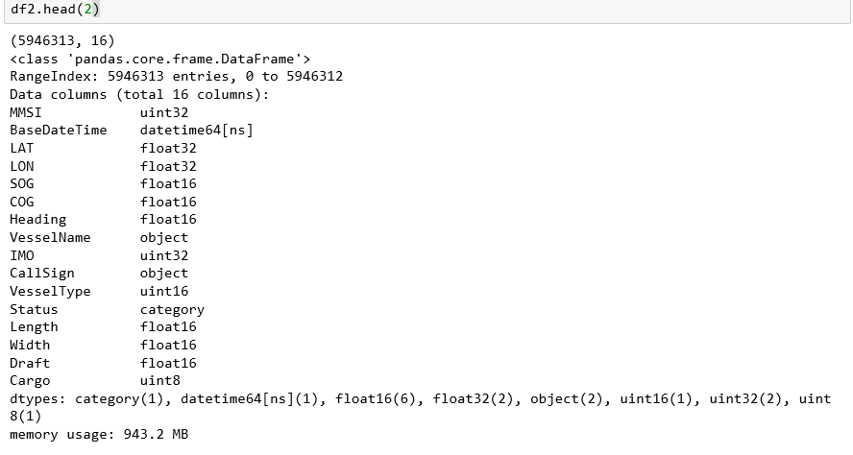
Pandas – Memory Optimization Code – 943.2 MB
2.3GB -> 943 MB
Memory reduction to
42% original size

Slide 10
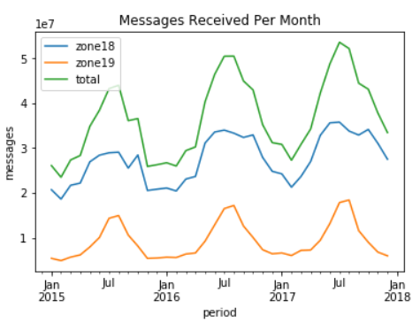
Insight: Much More Boat Traffic in Summer with Overall Boat Traffic Trending Up

Slide 11
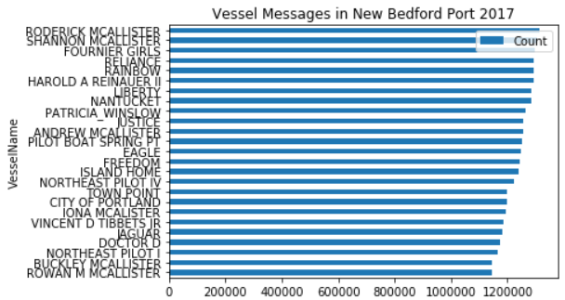
Insight: Top Messaging Vessels – Lots of McAllisters

Slide 12
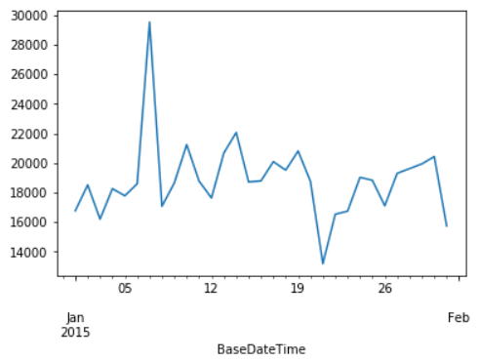
Insight: Weather Affects Message Traffic (Blizzard Jan 25-26 2015) - Not sure about sharp peak and drop
Messages
Received

Slide 13
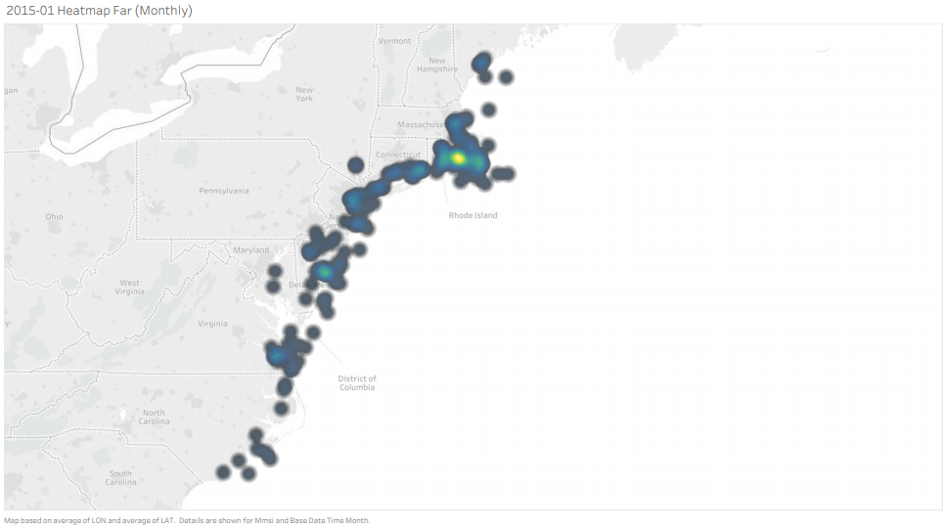
Heatmap Monthly: Boats spend most time in port

Slide 14
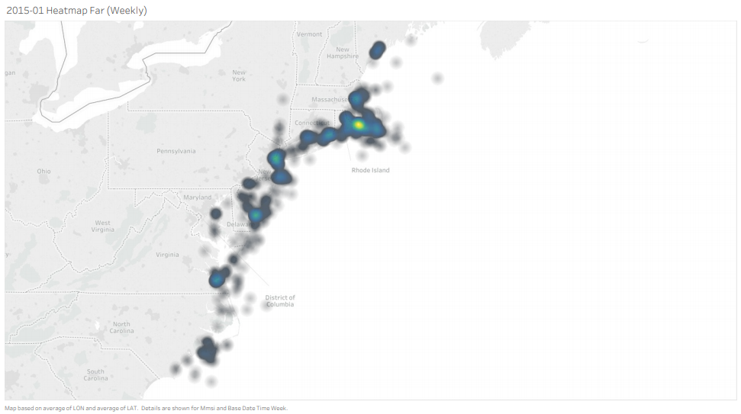
Heatmap – start to see traffic and fishing spots

Slide 15
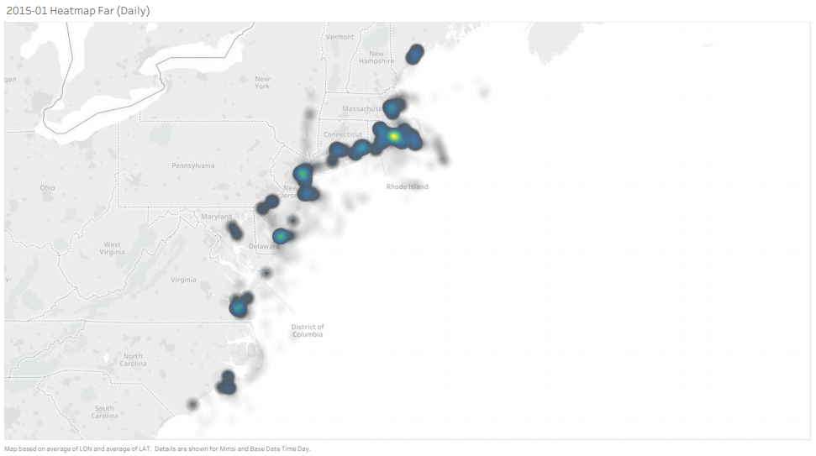
Heatmap Daily – more traffic lanes and fishing spots

Slide 16
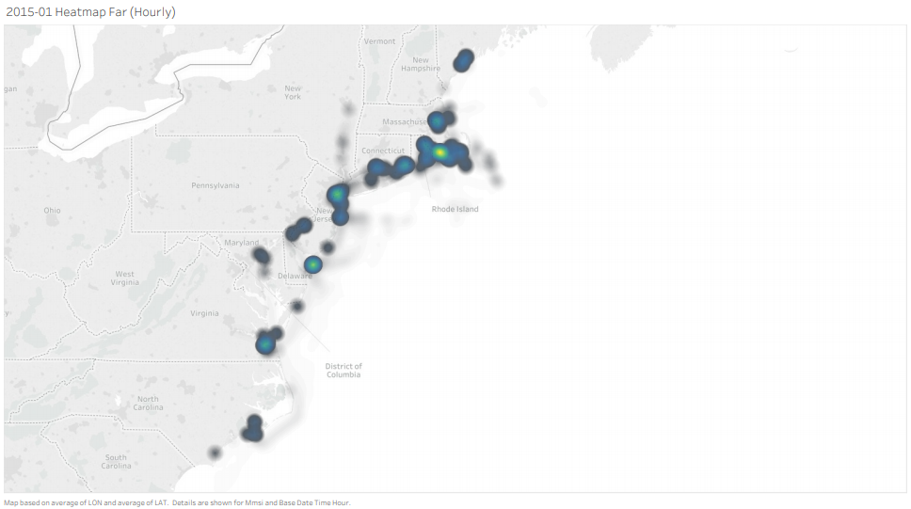
Heatmap Hourly – refined view of fishing spots

Slide 17
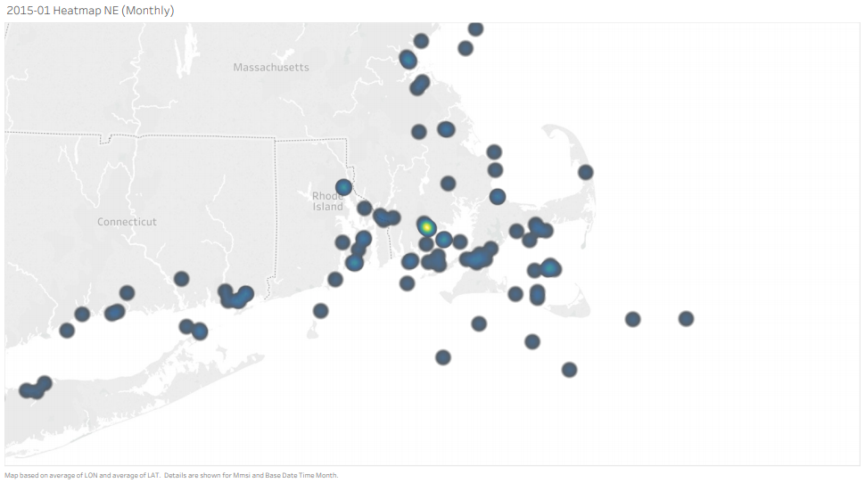
Heatmap Monthly

Slide 18
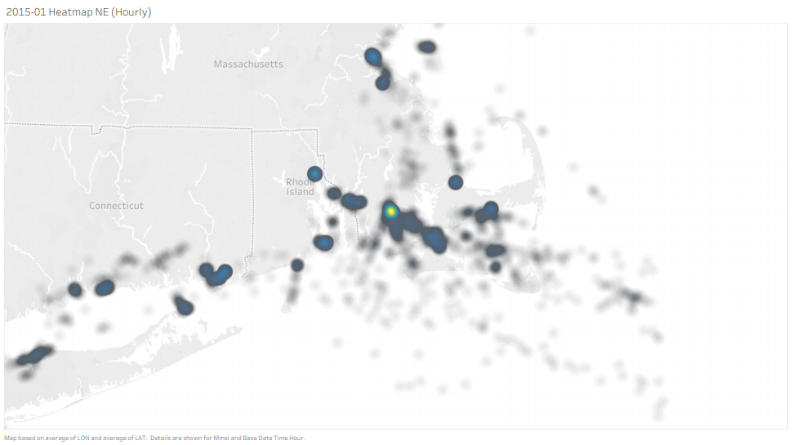
Heatmap Hourly

Slide 19
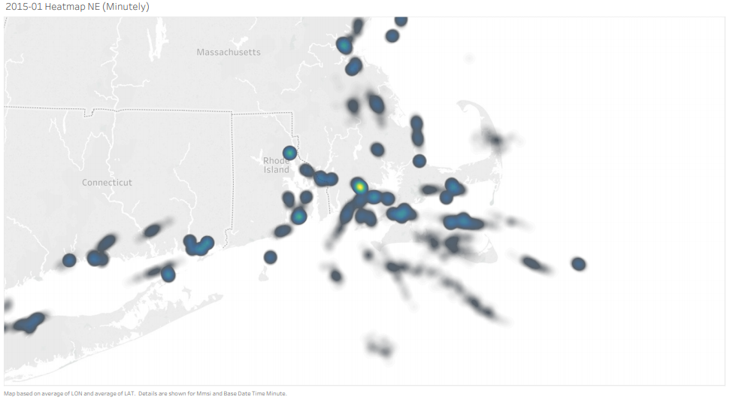
Heatmap Minutely – wow very hot spot toward right

Slide 20
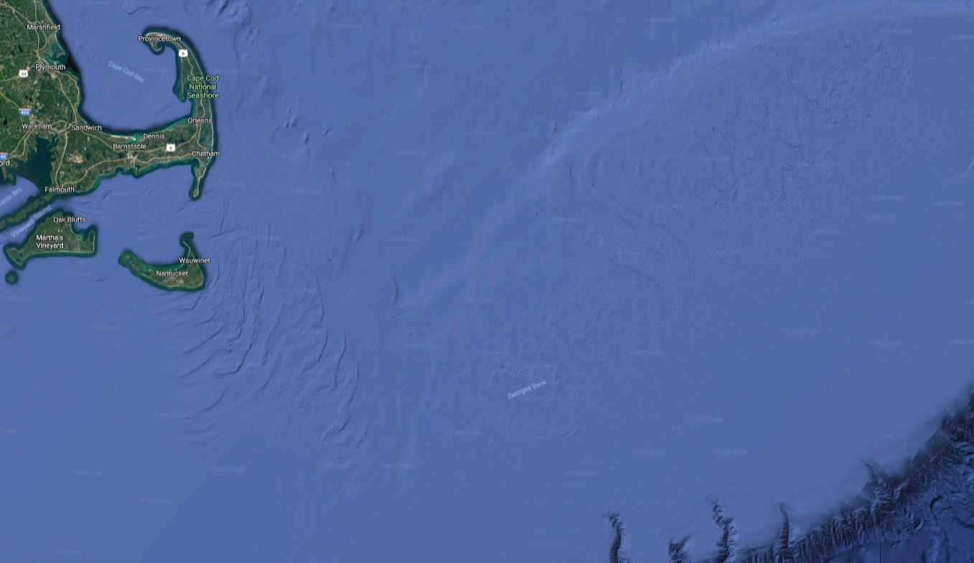
Georges Bank

Slide 21
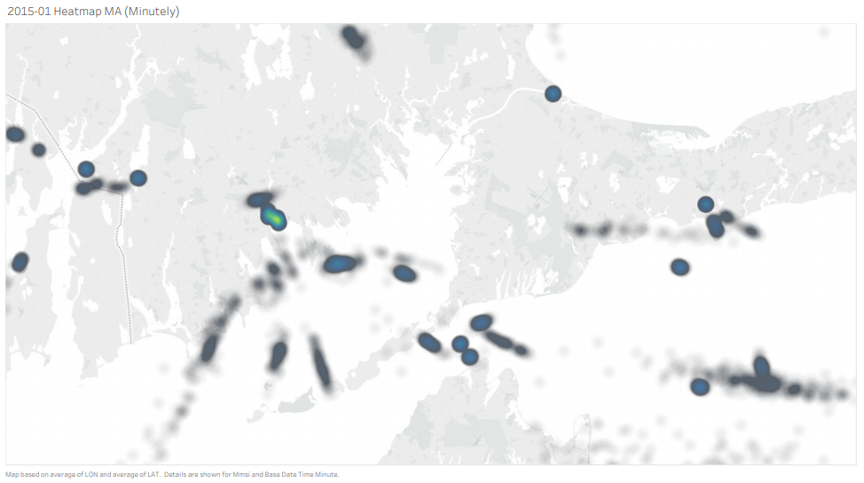
Heatmap Minutely – see navigational lanes

Slide 22
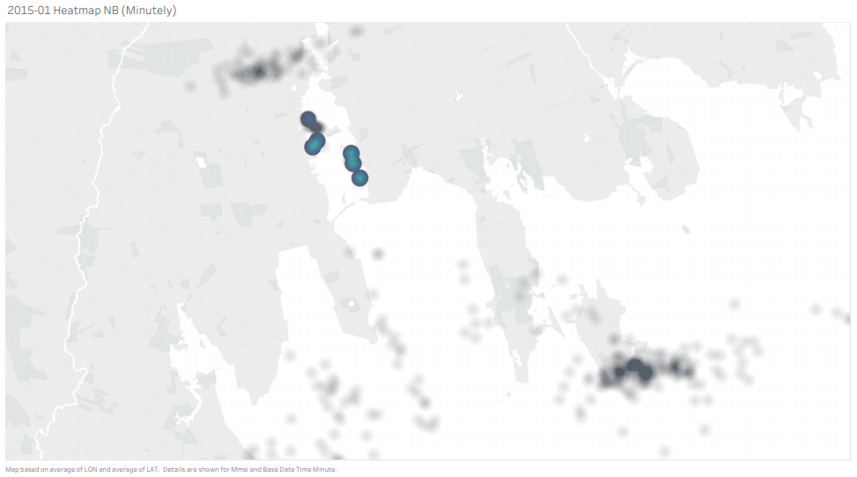
Heatmap Minutely – In Port

Slide 23
Lessons Learned
Original Concept: Heatmaps for Fishing Hotspots
Don’t bite off more data than you can chew
Start with less data if needed
(Random) Down sample data to manageable chunks
Minimize memory footprint of Pandas Dataframe
csvkit is great for working with csv files
Tableau is useful for looking at data
George’s Banks Is A Great Fishing Spot

Slide 24
Next
Analyze “In Port” data vs. “Out of Port” data
Predict when port will be congested
Calendar analysis
Straight math / vector path problem
LSTM (may be overkill)
Go fishing
Thank You – Ron Neely

