Slide 1
Lecture 11b
Wrap Up
Breitzman 6/20/2018

Slide 2
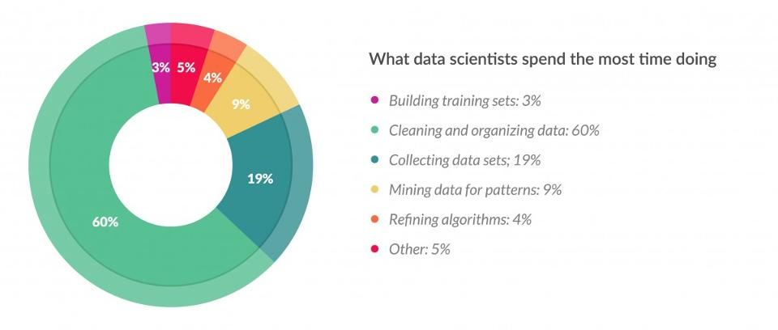
Remember This Graph?
(Forbes Article Shown in an old lecture)

Slide 3
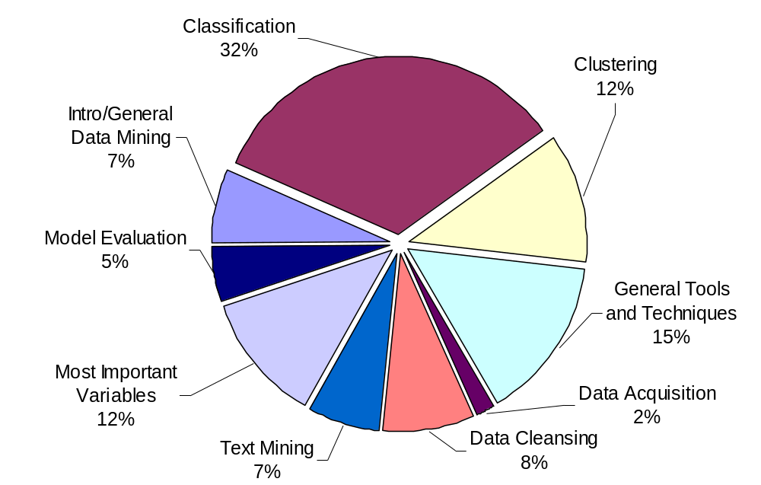
Percent of Time Spent on Aspects of Data Mining
(Data Mining 1 and 2 Combined)

Slide 4
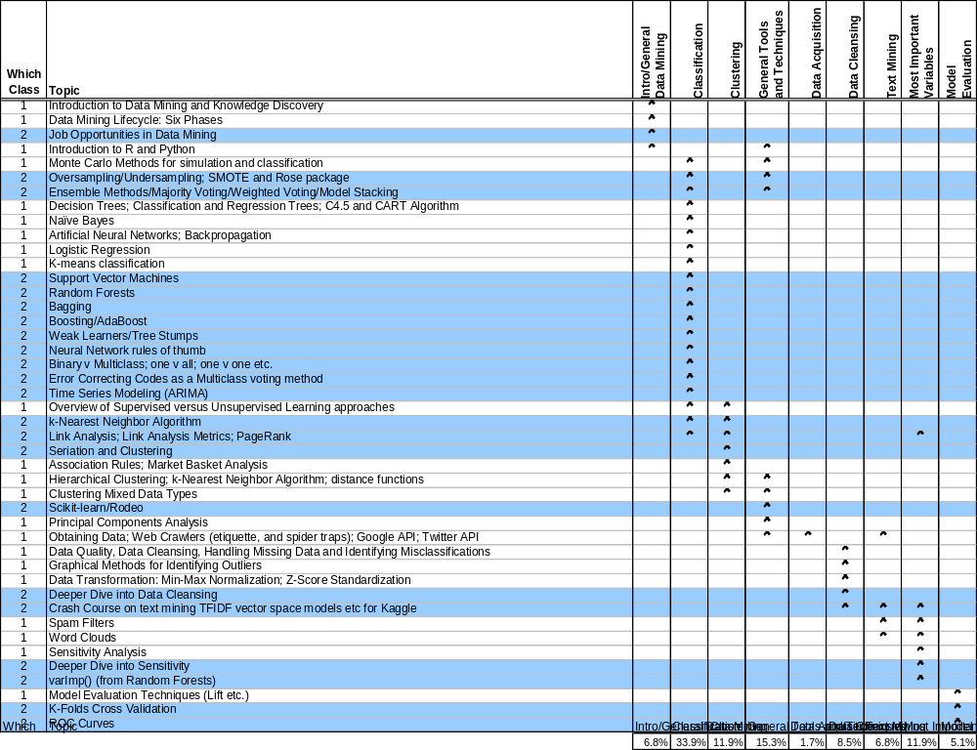
Percent of Time Spent on Aspects of Data Mining

Slide 5
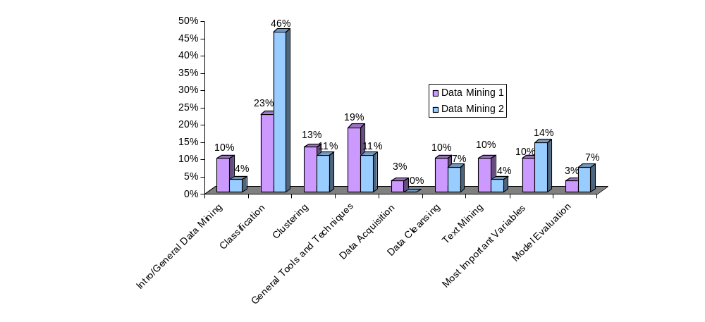
Comparison of Topic Categories (DM 1 v DM 2)

Slide 6
If we had more time… Topics we touched on, but deserve a few more weeks
Boltzmann Machines and Restricted Boltzmann Machines – You’ll see it in Machine Learning
One Shot Learning – Cool idea
Fuzzy Learning, Fuzzy Sets, Fuzzy Matching – Cool old topic
Presenting Data and Visualizations – You’ll see it in Visual Analytics
CNN’s – We used them for the digit recognizer
Anomoly detection – This actually needs a couple of weeks

Slide 7
Well…
I hope you learned something.
Enjoy Visual Analytics and Adv. Databases.
I will see you for text mining

