Slide 1
Lecture 14a
Multi-Dimensional Scaling – Part II
Breitzman 12/5/2018

Slide 2
Introduction
A couple of follow-up items to last week
Recall: Multidimensional scaling takes a distance matrix and attempts to plot it in fewere dimensions while preserving pairwise distances as best as it can

Slide 3
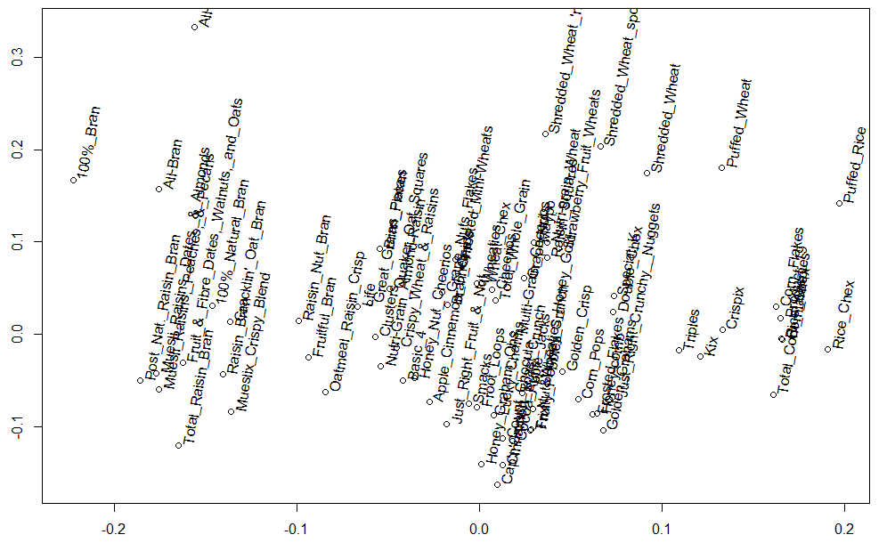
We Showed this Plot Last Week

Slide 4
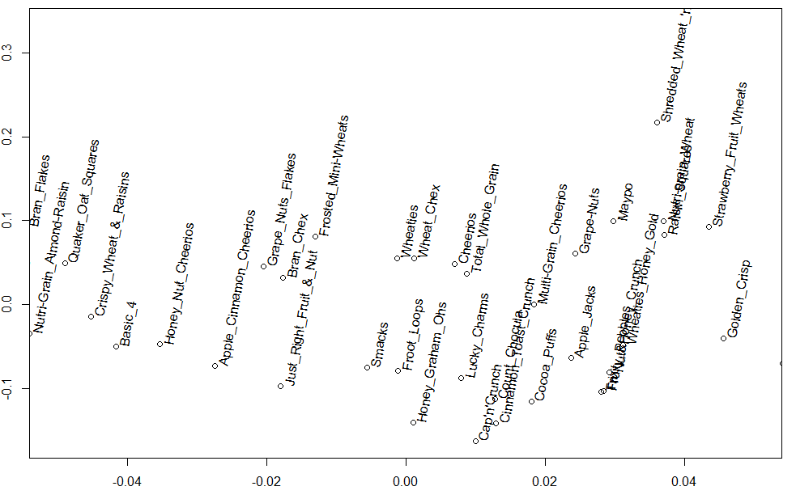
And This Zoom in to the middle

Slide 5
Color
It occurred to me later, that those plots would be better if we colored them based on rating
Then we could see whether there was any hope of creating a model to predict rating
Here’s how…

Slide 6
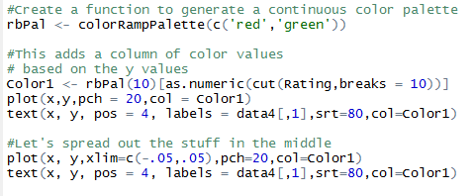
Color (II)

Slide 7
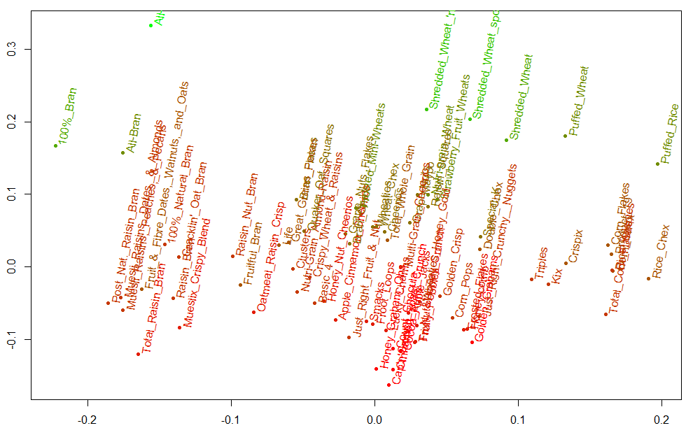
Color (III)

Slide 8
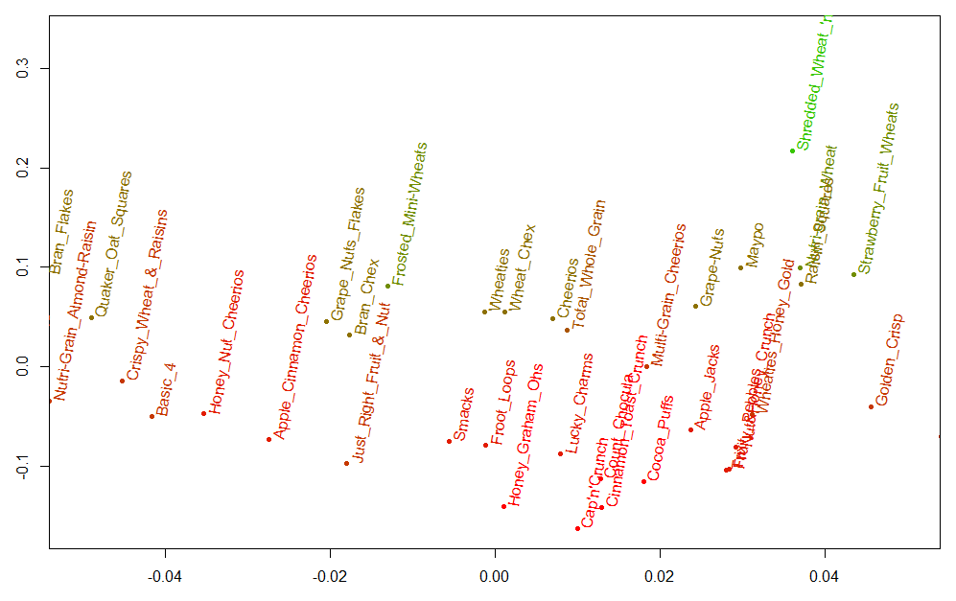
Zoom-In

Slide 9
Python-SciKit
The other thing I forgot to mention is how to do MDS in Python
sklearn contains function sklearn.manifold.MDS, and can be used via Orange

Slide 10
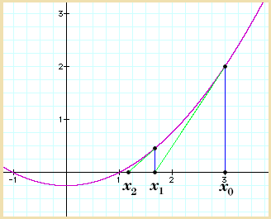
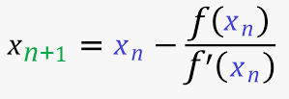
Computations
Also last week, Ron seemed kind of disappointed that we didn’t do any MDS computations, so here is a short version of the Math
Recall Newton’s Method allows us to numerically find the roots of a function

Slide 11
Computations (II)
So we learned in Calc 1 that Newton’s method could be used to find zeros of a function as shown in previous slide
We also learned in Calc I that to find local mins and maxs we need to find when the first derivative is 0
It follows that if we use the method of the previous page we can find zeros of the derivative simply by making the numerator a first derivative and the denominator a second derivative
When we do this it is called Newton Optimization instead of Newton root finding
This tends to be faster than gradient descent which is another way to find local minimum that we’ve talked about and you will see in Machine Learning

Slide 12
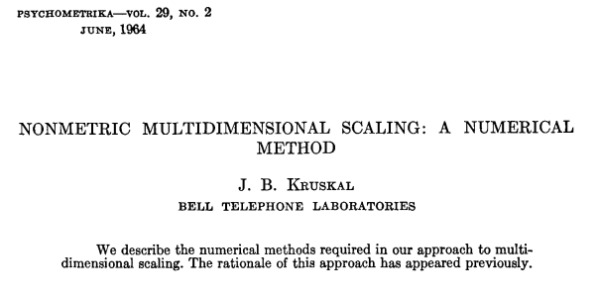
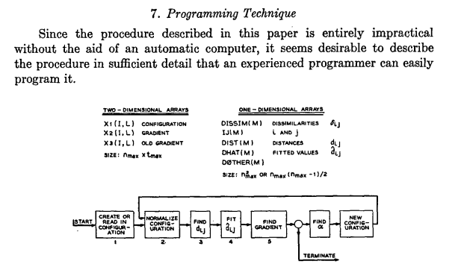

Slide 13


Computations (III)
Translating the paper, here are the key steps
Pick Random points in the dimension desired for each of your original data points
Create a distance matrix for the assigned points ( )
Compare to original (desired) distance matrix (D)
Minimize using Newton or Gradient Descent
Note it’s possible for Newton to get stuck in local minimums so repeat a couple of times with new random points

Slide 14
Go to Excel
We’ll use solver, because computing Newton by hand can be a pain.
I make my students do it exactly once in Calc I and that’s enough
Don’t forget to come back here after Excel!

Slide 15
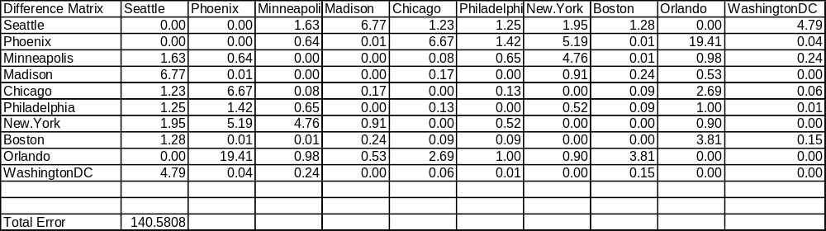
From Excel (Difference Matrix)
Off by a total of 140 miles
Most off by a few miles. Worst is Phoenix, Orlando (19.41)
Probably something to do with curvature of the earth

Slide 16
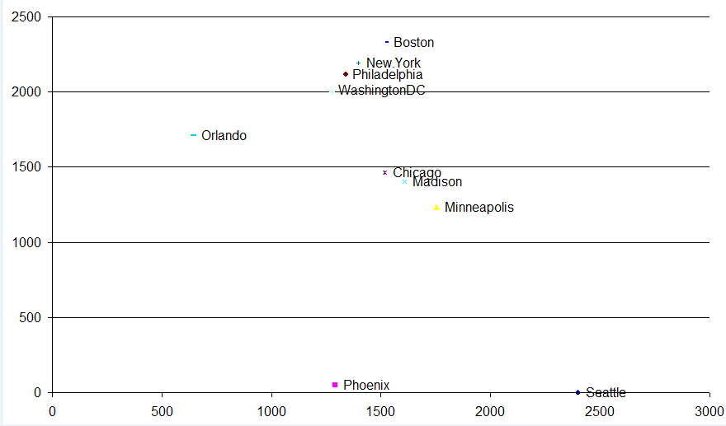
Best Result from Solver (Error = 140 Miles)
Actually pretty good. Needs to be flipped and rotated to look right

Slide 17
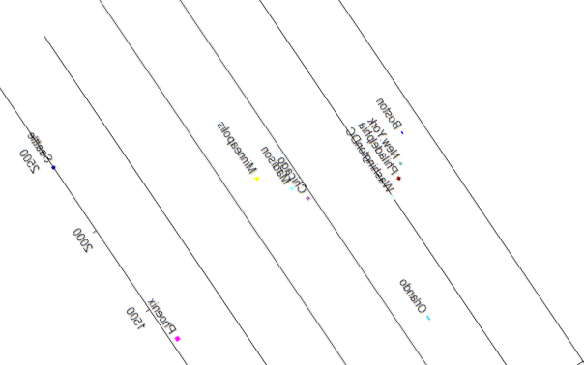
Flip and Rotate

Slide 18
Summary
Filled in some details left out of last week
Use R or Python, but can be done in Excel or by hand if you wanted
Note: If Error cannot be brought down no matter what, then increase dimension
For example if we have 100 starting attributes and error is huge in 2 dimensions then maybe we can bring it down by going to 3 or 4 or 5 dimensions
Note even if we can’t bring it down to 2 or 3 dimensions to visualize it, if we can mimic the distance matrix fewer than the original dimensions, this can sometimes be as effective as PCA

