Slide 1
Lecture 3
Clustering and Scoring
Breitzman 7/8/2018

Slide 2
Supervised vs Unsupervised Learning
Much of Data Mining is supervised
  We use a training set of data to try and model a situation and then see how new data fits in
  Or we have particular target variable and we wish to determine whether it will appear, increase, decrease etc.
  We will see supervised methods when we discuss decision trees, neural networks and k-nearest neighbors
The classical Unsupervised method is clustering
  Often we have no idea what we are looking for so to get a handle on the data we try to find some structure via clustering
  In this case we input a number of variables for each record and see if the clustering algorithm can group things together
Often clustering is used first. Clusters are then named and described to identify variables of interest. Then a supervised method is invoked.

Slide 3
Classification vs Clustering
One of the central problems of data mining is classification
  Banking: determining fraud, credit risk, or potentially rich customers
  Medicine: determining whether a patient has or may develop a particular disease
  Security: determining whether a person with specific behavior represents a threat
Classification involves a target variable (e.g. income level) which is partitioned into predetermined classes (e.g. high, moderate, low)
Clustering refers to the grouping of records in classes of similar objects
  Clustering differs from classification in that there is no target variable for clustering
  Clustering algorithms do not try to predict a target value of a variable but instead try to segment a data set into relatively homogeneous subgroups or clusters where the similarity of records within a cluster is high and the similarity to records outside the cluster is low

Slide 4
Tonight…
We will discuss a couple of clustering algorithms (k-means clustering and hierarchical clustering)
All of these methods require us to be able to measure the distance between records via a scoring mechanism
There are numerous scoring systems and numerous papers discussing new ones every month
We will concentrate on the cosine measure which is a good overall distance measure that can be used on systems with hundreds or thousands of variables

Slide 5
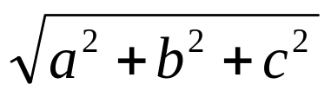
5 Minutes of Linear Algebra
Recall the dot product of 2 vectors A=<a,b,c> and B=<d,e,f> is given by A•B=ad+be+cf
Recall the norm of a vector A=<a,b,c> is ||A||=
Finally recall if A and B are vectors A•B=||A||*||B||*Cosϴ where ϴ is the angle between A and B
It follows of course that Cosϴ =(A•B)/(||A||*||B||)

Slide 6
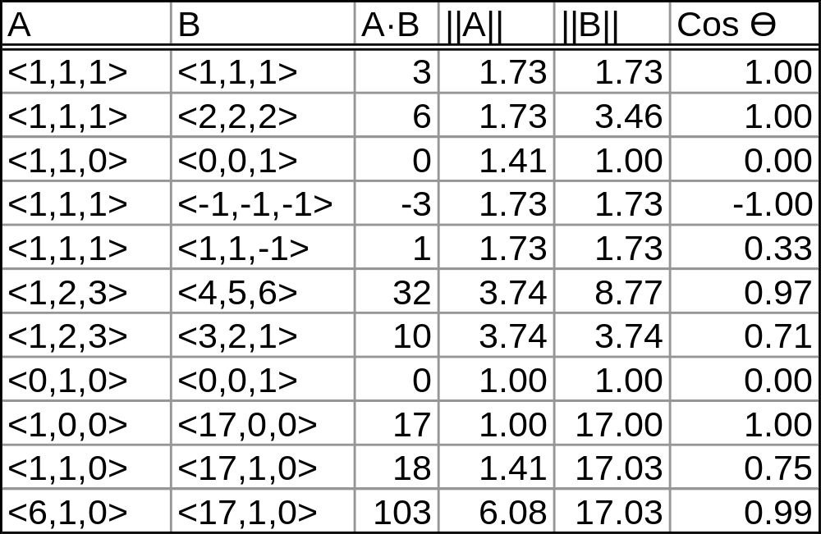
Some Examples

Slide 7
Why do we Care?
Suppose we have a bunch of records with 3 variables
We can put them into vectors like on the previous page
<1,0,0> and <0,0,1> would represent records with nothing in common and would be scored 0 as expected
<1,0,0> and <-1,0,0> would be scored -1 as expected
<6,1,0> and <17,1,0> would be scored .99 which may or may not be a problem
To fix the latter case we would normalize all variables using the min-max score we talked about last time

Slide 8
Why do we Care (2)?
More importantly the cosine distance works for vectors with hundreds or thousands of variables since a 1000 entry vector is just a vector in 1000 dimensional space, and the angle of the vector still makes sense
Also we can weight each vector entry so that variables that we think are important are weighted higher than those that are less important

Slide 9
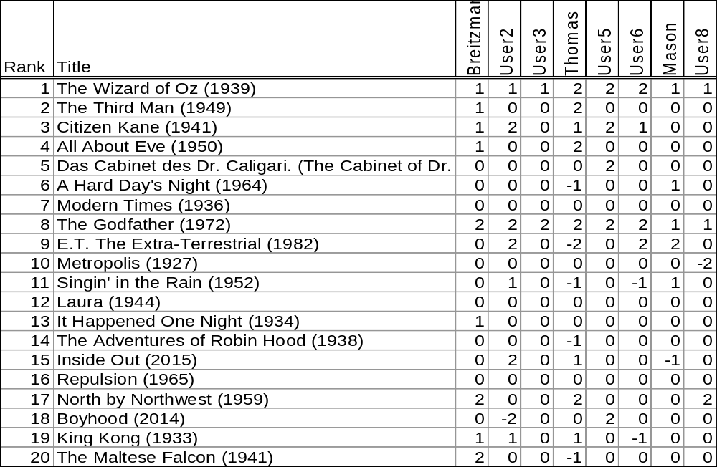
Part of the list of 100 Movies I sent out to 50 People Last Time I taught the Course
(received 7 responses)

Slide 10
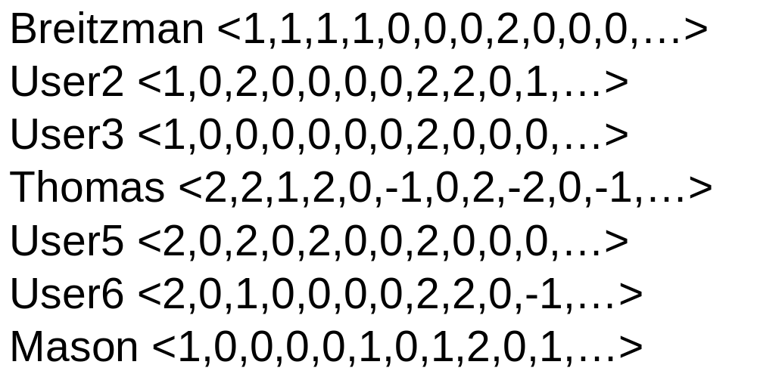
The Spreadsheet on Previous Page Can be Turned into the following Sparse 100D Vectors

Slide 11
Similarity
Similarity between user_{m} and user_{n} is (user_{m}•user_{n})/(||user_{m}||*||user_{n}||)
A similarity matrix contains similarity scores between every user and every other user
Matrix shown on next page. Can easily be done in Excel, Access, Python or R

Slide 12
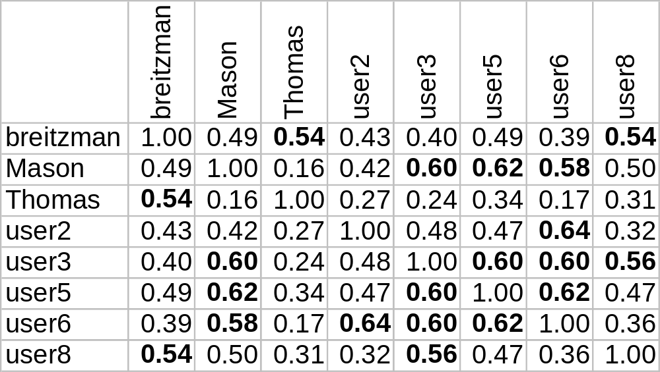
Similarity Matrix for Movie Vectors

Slide 13
Notice…
The similarities are pretty low
The highest similarity is 0.64 between user2 and user6.
Roughly speaking, this suggests their tastes overlap by about 64%
If we had more responses we would be able to find users that had 90% in common with each user
If for example user10 and user1 had 0.9+ similarity than we could recommend to user 1 that he/she might like movies on user10’s like list and avoid those on the not like list

Slide 14
Weighting Factors
Notice that all responders like ‘The Wizard of Oz’ and ‘The Godfather’ but ‘Inside Out’ received 2 likes and a Don’t like
It’s clear then that Inside Out has much better discriminating power than The Godfather
So we should give the Wizard of Oz a lower weight than Inside Out
The idea is stolen from information retrieval related to summarizing documents: ‘and’ is in every document so it gets a low weight even if it is mentioned many times in a document, while ‘ribonucleic’ is rare so it gets a high weight in terms of describing the document

Slide 15
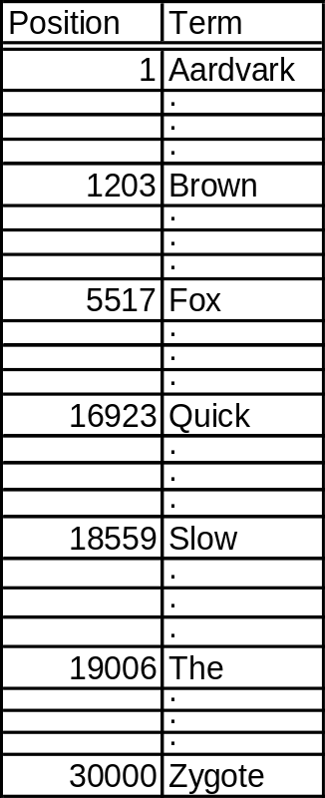
5 Minute Overview of Information Retrieval
Suppose we have a million documents (Corpus)
We identify every word that appears in any document and make a list

Slide 16
5 Minute Overview of Information Retrieval (II)
Then every document can be represented by a vector with a lot of zeros and a few entries containing term frequencies
Ex: “The Ardvark” = <1,0,…,0,1,0,…,0>
A document that mentioned Aardvark 17 times would have a 17 in the first vector entry
The entire corpus consists of a million different sparse vectors

Slide 17
Inverse Document Frequency (IDF)
In Information Retrieval or Text Mining the Term Frequency (TF) is the number of times a term appears in a document
The Inverse Document Frequency (IDF) is
Log((# Documents Total)/(# Docs containing Term))
If we assume ‘and’ is mentioned in every document its IDF=Log(10^6/10^6)=0
If we assume ‘ribonucleic’ is mentioned in only 400 documents then its IDF= Log(10^6/400)=5.99
Processing documents for similarity or for returning a query is sometimes called TF-IDF Weighting

Slide 18
Back to Our Movie Example
In our example the Movies are ‘terms’ and the corpus consists of 8 vectors (each user is a document) of length 100
Note the IDF of ‘Wizard of Oz’ is Log(8/8)=0
IDF of ‘Inside Out’ is Log(8/3)=1.9
The IDF is not perfect for our case because a document can’t have -1 frequency and -1 actually has a large effect
Also we really don’t want the IDF of Wizard of Oz to be 0 since it certainly is a more valuable discriminating term then ‘and’ is in a random document
So we solve these problems by having 2 weights. Wt1=IDF+0.5
Wt2 = 1 if there is no sign change and 2 if there is a sign change
Wt=Wt1*Wt2 so the Wt(Wizard of Oz)=0.5*1=0.5 and Wt(Inside Out)=2.4*2=4.8

Slide 19
Breitzman Movie Vector
It was <1,1,1,1,0,0,0,2,0,…>
The weight vector corresponding to these movies is <0.5,1.89,1.19,1.89,2.58,3.77,0,0.5,…>
The new Breitzman weighted vector is <0.5,1.89,1.19,1.89,0,0,0,1.0,0,…>

Slide 20
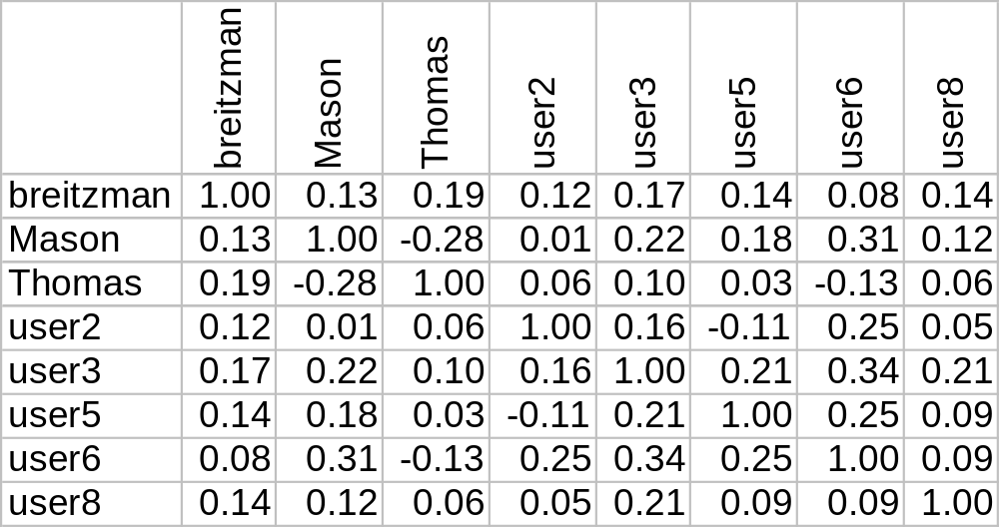
New Similarity Matrix

Slide 21
Notice…
The similarities are even lower than before
This is because movies in common like Wizard of Oz, the Godfather, and Toy Story have very little weight
Differences of less popular movies have a lot of Weight: (e.g. Maltese Falcon +2 for Breitzman and -2 for Thomas)
Mason and Thomas actually have a negative similarity which makes sense since they have opposite views on 12 different movies
The small sample size is hurting us in this example. If we had a few hundred people in the model there would certainly be high similarities between some pairs

Slide 22
Weights
As we see, weighting can have a large effect on similarity
We can further tweak this by increasing the weights for pre 1980 movies or particularly obscure movies
We can also improve the vectors by assigning a genre to each movie and then adding vector values for comedy, drama, action, musical, etc. Each vector would become longer, but the latter entries would have higher numbers than 1 or 2 (e.g. 4 comedies with scores of (2,2,1,1) would add a 6 to the comedy position.

Slide 23
Other Distance Measures
We used the cosine measure because it works well with any dimension, it still works with weighted vectors and it makes sense.
There are other scoring methods like the Jacard Distance |A∩B|/|AUB|. This measures the entries in common divided by all entries. Disadvantage is it is not easily weighted.
There is also Euclidean Distance which we will talk about in a few weeks
Also Dice's Coefficient, Sørensen similarity index, simple matching coefficient, Mountford's index of similarity, Most frequent k characters, Hamming distance, Tversky index, and about a million others

Slide 24
More on Similarity Matrices
Once we have a similarity measure, we can compute a similarity matrix which contains pairwise distances between every entry and every other entry
The similarity matrix is symmetric and contains 1=max distance on the diagonal
Some clustering algorithms use a dis-similarity matrix
To compute a dis-similarity matrix, take each entry a_{ij} and replace it with 1-a_{ij}

Slide 25
K-Means and Hierarchical Clustering
K-Means is the more popular clustering method because
  It’s fast
  It’s easy
It’s not without it’s shortcomings though
  It’s not repeatable. That is, if you run it 2 times in a row with different seeds, you may get ‘slightly’ different answers
  You have to decide how many clusters you want when you potentially don’t know anything about the data
Hierarchical clustering is
  Slightly more complicated and slower
  But, it’s repeatable. That is it always gives the same answer

Slide 26
K-Means Algorithm
Randomly name k elements C₁ through C_{k}
All other elements are assigned to C₁ through C_{k} based on similarity distance
Calculate mean centroid for each cluster C₁ to C_{k}
Recalculate similarities and reassign all members to new clusters
Stop when clusters are same 2 times in a row
Show on Board and then in R

Slide 27
Hierarchical Clustering Algorithm
Build similarity matrix
Find max similarity ignoring diagonals (which are always 1)
If max similarity is at row i and column j then merge i and j and recalculate similarity matrix
If old similarity matrix was n x n then new one is (n-1) x (n-1). Go to step 2
In theory we stop when we have one giant cluster, but usually we stop at a specific number of clusters or at a specific similarity value
Draw dendrogram (Don’t go to R until after next slide!)

Slide 28
Hierarchical Clustering Algorithm (II)
If we are naïve about this, it can be very slow. We don’t really want to recalculate the similarity matrix at each step
If we merge the similarity matrix at each stage we need to define how to change the merged rows and columns.
Suppose we are merging element 4 and element 5. In this case we adjust row 4 and zero out row 5.
Choices for row 4 include (average of row 4 and row 5 – “Average Link”, max of row 4 and 5 – “Single Link”, “min of row 4 and 5 – “Complete Link”)
The naïve method of recalculating similarity matrix by merging vectors will be equivalent to average link. (Actually, average link is usually computed wrong, so it’s not quite the same but still effective)

Slide 29
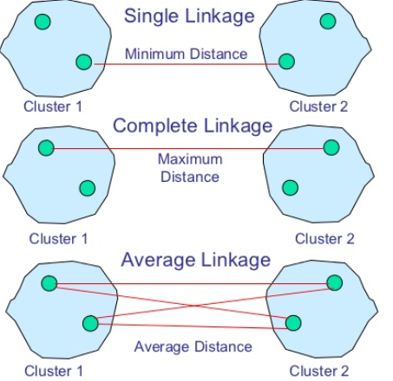
Single, Complete, Average Link
Note we can merge any 2 clusters using these methods without computing a centroid (Although except for very extreme cases, the average link and closest centroids will usually be very similar)

Slide 30
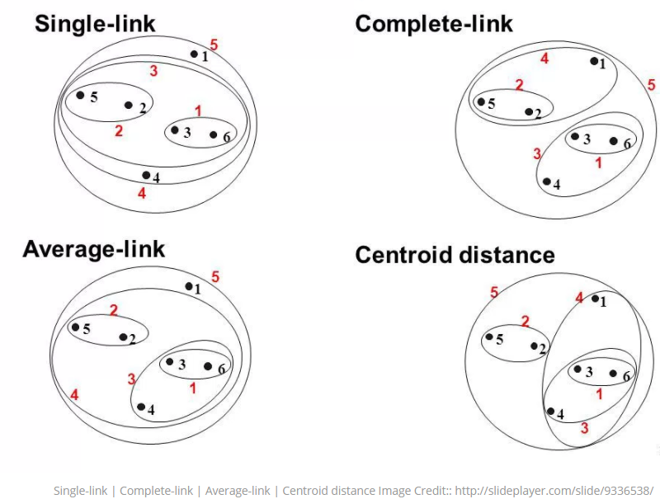
Single, Complete, Average Link

Slide 31
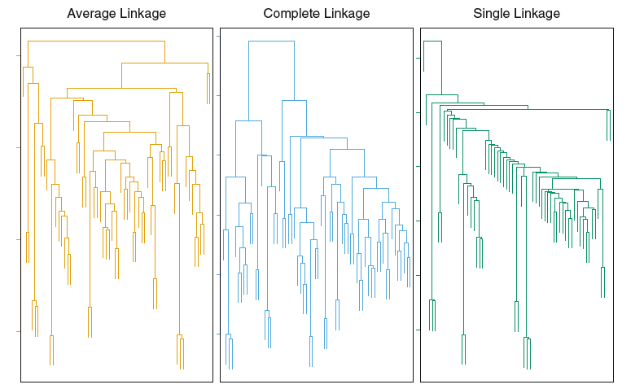
Note that Complete Link and Average Link sometimes yield more balanced clusters
http://www.dormantroot.com/2014/03/my-experiment-with-clustering.html

Slide 32
Hierarchical Clustering Algorithm (III)
The Single Link method when merging two elements changes the similarity metric to the maximum of the two similarities. This has the effect of connecting 2 clusters based on the most similar members
The complete link method takes the minimum of all similarities. This has the effect of connecting clusters based on their least similar members
Complete link leads to many small clusters, while Single link leads to larger more diverse clusters
Average link is somewhere in between
Computing average link properly can be expensive so most people fudge it by taking averages of averages
Now go to R

