Slide 1
Lecture 8a
Centroids
Breitzman 7/29/2018

Slide 2
R-Centroid Document
Go to centroids.html with examples…

Slide 3
Why do we care about centroids?
We only care about centroids when we use
k-means. We don’t actually need centroids for hierarchical clustering
In general with k-means and R we have to be a little bit careful. k-means usually wants to compute Euclidean centroids
When we want to use cosine similarity that’s called spherical k-means and there are packages in R to do that
What if we want to do something more exotic then Euclidean or Cosine distances? Clustroids. See next slide.

Slide 4
Clustroids
Recall that a centroid need not be a point in the cluster
  It’s thought of as the center point, or the point that is most equidistant to all the points in the cluster
A clustroid is an actual point in the cluster that is closest to the actual theoretical centroid. (If we have a crowded cluster, the clustroid will be very close to the centroid)
We use clustroids when the centroid would be hard to compute
For example if we have an exotic distance function then the clustroid is the point in the cluster that is closest to all the other points using that distance function
  As a practical matter, we compute it by computing the sum of squares of distances between all points and all other points in the cluster
  See next page

Slide 5
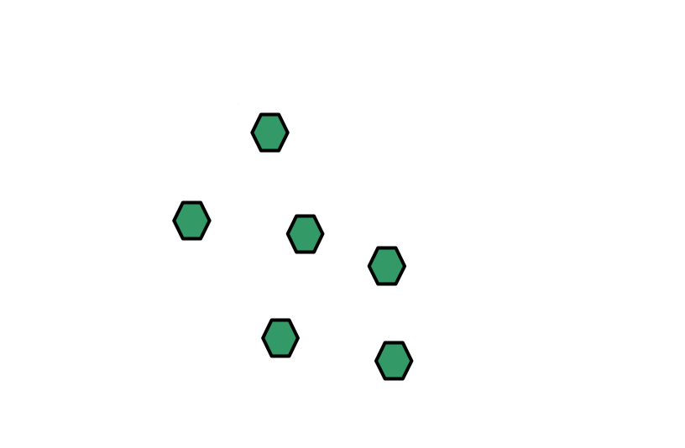
Clustroids
In the case of Euclidean distance we see that X would be fairly close to the actual centroid
It’s clear that the sum of the square of distances between X and everything else is much smaller than the sum of the squares of distances from say A and everything else
The clustroid can be computed using whatever distance function we have in an analogous way

Slide 6
K-Means in R
There are a lot of k-means libraries in R. Make sure
  If it takes a distance matrix that it doesn’t just assume it’s Euclidean distance
  If it says spherical k-means then it’s cosine, but otherwise many k-means functions will default to Euclidean
  If you are using a distance measure on mixed data types you may have to use your own distance function and calculate your own clustroids to get proper behavior
The same caveats apply. See https://stackoverflow.com/questions/19226925/spherical-k-means-implementation-in-python for tricks
K-Means in Scikit Learn or SciPy

Slide 7
Back to Hierarchical Clustering
We never need a centroid for hierarchical clustering because the clusters are defined by point-wise distances
See visual on next slide for single link, complete link, average link

Slide 8
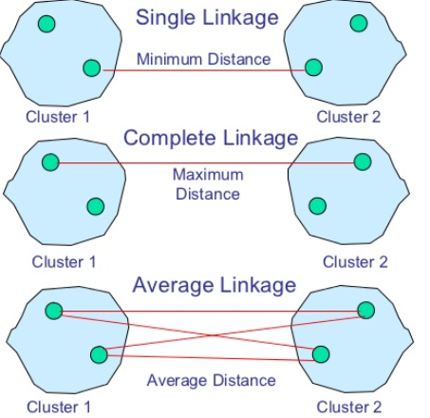
Single, Complete, Average Link
Note we can merge any 2 clusters using these methods without computing a centroid (Although except for very extreme cases, the average link and closest centroids will usually be very similar)

Slide 9
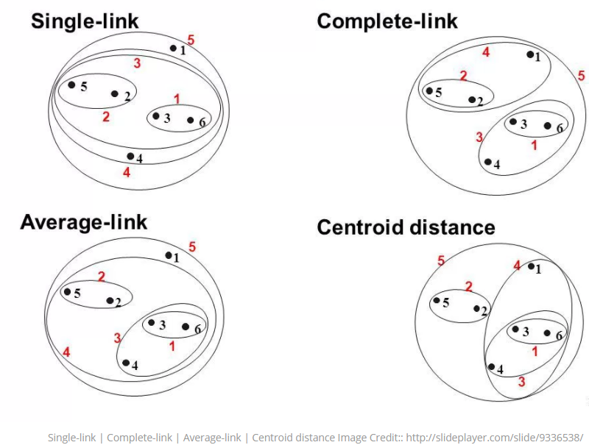
Single, Complete, Average Link

Slide 10
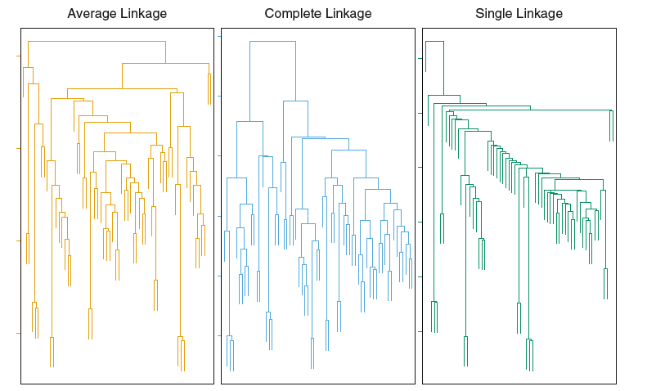
Note that Complete Link and Average Link sometimes yield more balanced clusters
http://www.dormantroot.com/2014/03/my-experiment-with-clustering.html

Slide 11
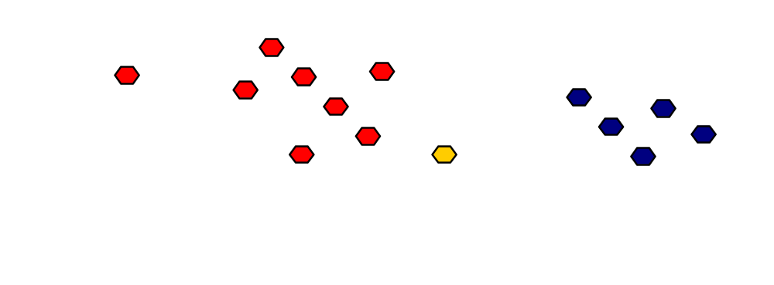
Is Bob a Good or Bad Credit Risk?

Slide 12
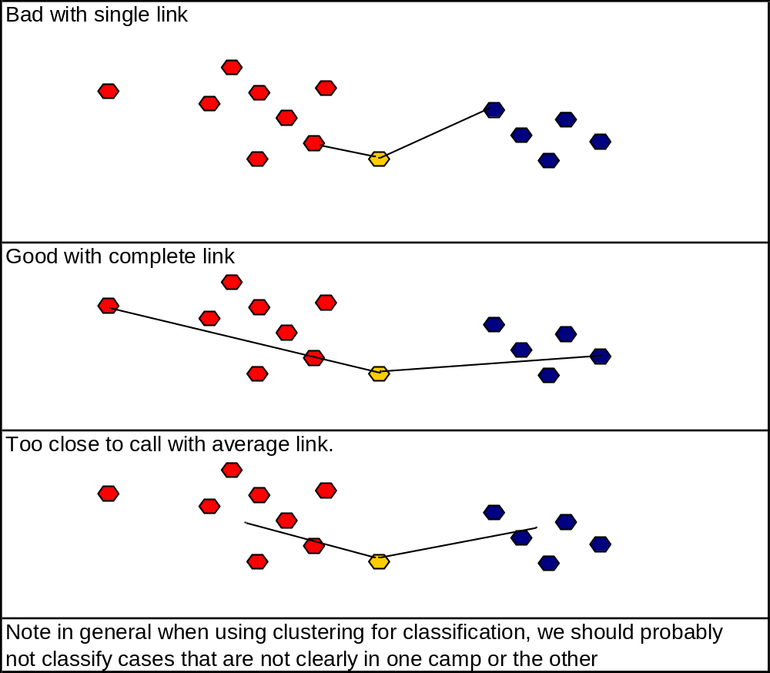
Is Bob a Good or Bad Credit Risk?

Slide 13
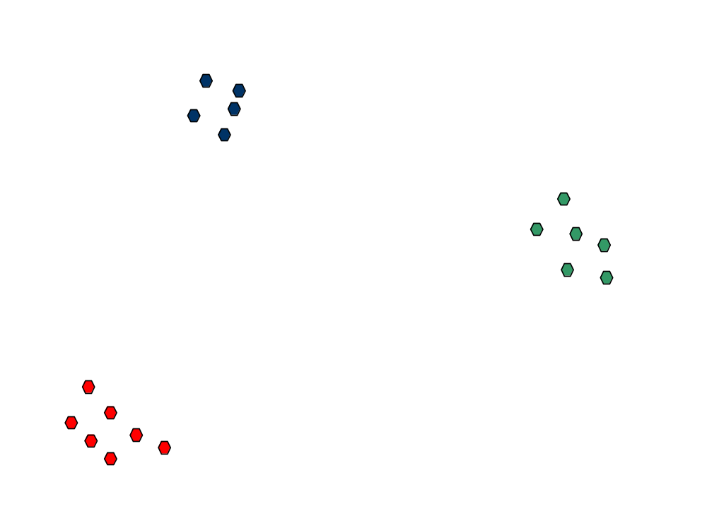
Before we get too far afield…
As a practical matter, if we have distinct clusters like below, then no matter the method (k-means or hierarchical) and no matter whether we use single, complete, or average link: we will always get the same 3 clusters
It’s only when dealing with messy data that there is a distinction

