Slide 1
Lecture 12
Principal Components Analysis
Breitzman 8/12/2018

Slide 2
PCA
Principal Components Analysis (PCA) is a dimension reduction method
We’ve seen several cases, where it would be nice to reduce the number of variables (Neural Networks in Particular, but also decision trees, Naïve Bayes etc. benefit from dimension reduction)
For those of you that know some linear algebra, the idea is that we take our original N variables and create a new set of variables that are independent (orthogonal) and a linear combination of the original variables
The principal components actually form an orthonormal basis if you remember what that means. (If you don’t, it doesn’t matter)

Slide 3
Z-Score Normalization
Recall from week 1, z-score normalization
Normalizes an attribute so that the mean is 0 and standard deviation is 1
For a vector X=<x1,x2,x3,…,xn>,
zi=(xi-mean(X))/sd(X)
PCA only works if all attributes are normalized this way

Slide 4
Houses Data
We will use a data set from http://lib.stat.cmu.edu/datasets/
Several interesting data sets can be found here
The one we are using houses.zip contains block groups from 1990 California Census

Slide 5
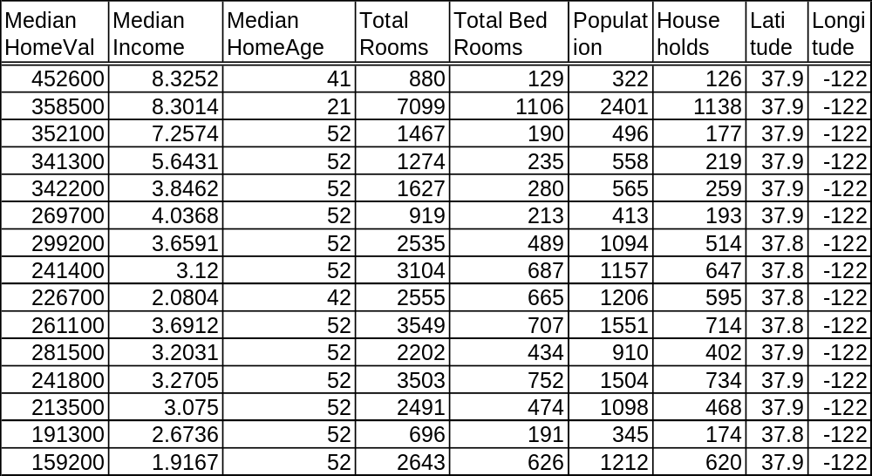
Houses Data – First 15 Rows (20,640 total)

Slide 6
Houses Data
All data somewhat self-explanatory except
Median Income seems to be already scaled
20,640 records from 1990 California Census

Slide 7
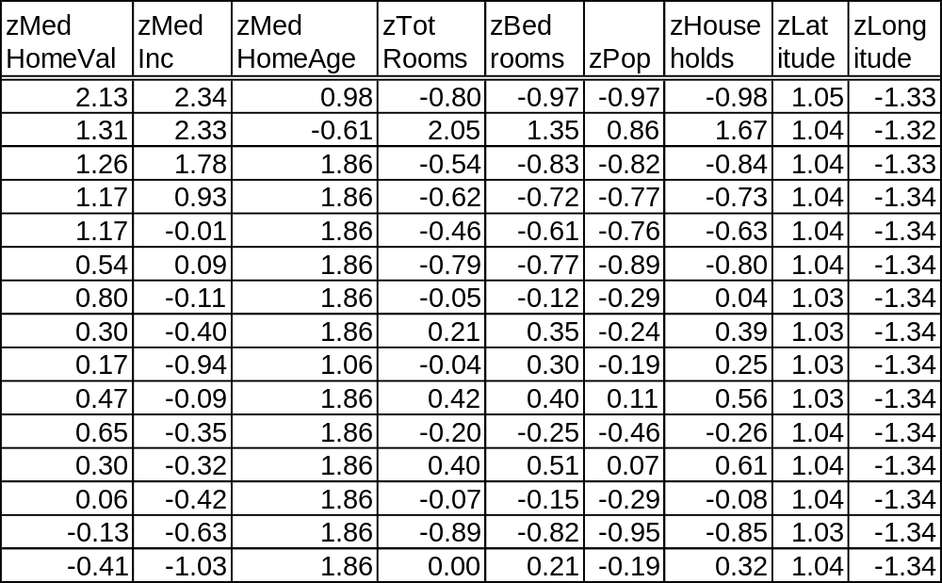
Houses Data – Same Data Normalized

Slide 8
R Needed to Create Previous Table
m<-mean(houses$MedianHomeVal)
sigma<-sd(houses$MedianHomeVal)
houses$zMedHomeVal<-(houses$MedianHomeVal-m)/sigma
m<-mean(houses$MedianIncome)
sigma<-sd(houses$MedianIncome)
houses$zMedInc<-(houses$MedianIncome-m)/sigma
m<-mean(houses$MedianHomeAge)
sigma<-sd(houses$MedianHomeAge)
houses$zMedHomeAge<-(houses$MedianHomeAge-m)/sigma
m<-mean(houses$TotalBedRooms)
sigma<-sd(houses$TotalBedRooms)
houses$zBedrooms<-(houses$TotalBedRooms-m)/sigma
.
.
.

Slide 9
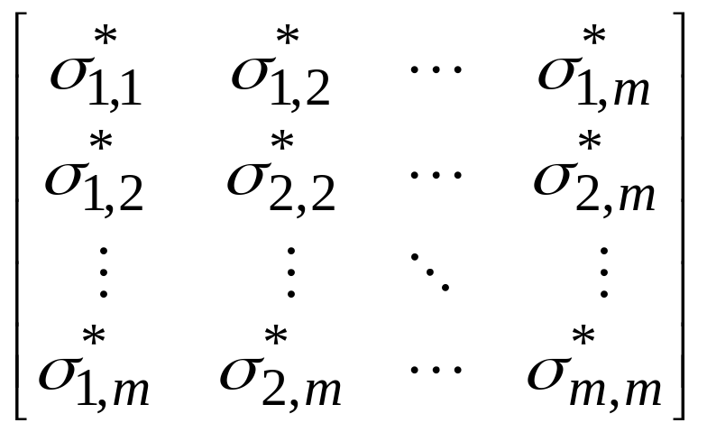
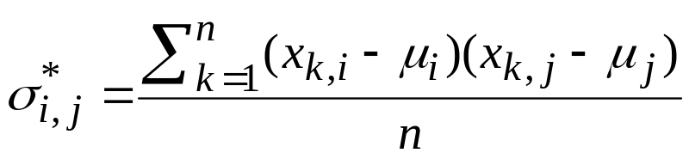
The Key to PCA is a Covariance Matrix
The previous table is a giant matrix called the Z matrix (20,640 rows, 8 columns)
8 columns include all names except zMedHomeVal which is going to be our predicted variable
Cov(Z)=
Where

Slide 10
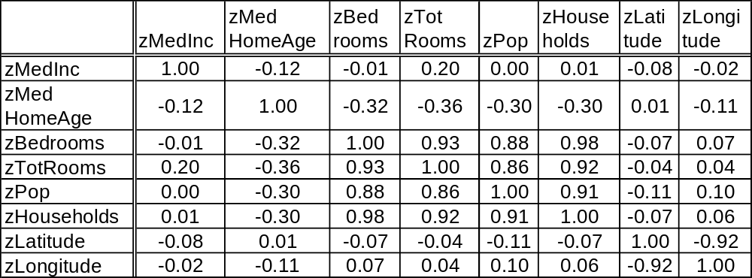
Cov() in R
Output of cov(houses)
Note number close to 1 implies variables are colinear
Independent variables show 0, but 0 does not guarantee independence

Slide 11
Covariance Matrix (II)
It’s clear that Population, Households, Total Rooms, and Bedrooms are highly correlated
Also Latitude is highly negatively correlated with longitude
We can see this with pairs(houses) which we have used before to show a draftsman’s plot

Slide 12
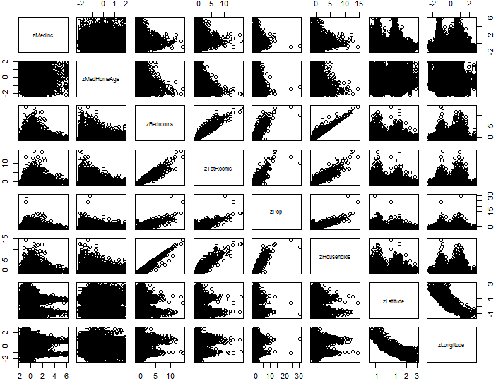
Draftsman’s Plot of Z-Scored Housing Data

Slide 13
The ith Principal Component is…
Yi=ei^{T}Z where Z is the standardized Matrix and ei^{T} is the transpose of the ith eigenvector of the covariance matrix
If you haven’t had linear alg, don’t worry we can use R to compute eigenvectors
If you had linear algebra then… we told you eigenvectors were important!

Slide 14
Eigenvalues and Eigenvectors
> eigen(cov(houses3))
$values
[1] 3.9066 1.907947 1.071961 0.821998 0.148054 0.081664 0.046899 0.014791
$vectors
[,1] [,2] [,3] [,4] [,5] [,6] [,7] [,8]
[1,] -0.045144 -0.035300 0.890917 -0.407818 -0.056213 -0.057214 -0.168837 -0.0415559
[2,] 0.218498 0.016026 -0.393864 -0.886341 0.034911 0.091478 -0.040843 -0.0039577
[3,] -0.490500 0.060715 -0.117157 -0.063410 0.377398 -0.231003 -0.221091 -0.7023544
[4,] -0.483771 0.074611 0.093019 -0.115204 0.317365 0.557980 0.550480 0.1529124
[5,] -0.471967 0.026036 -0.116247 -0.082506 -0.848952 0.131099 -0.022261 -0.1335842
[6,] -0.491718 0.063521 -0.109440 -0.096658 0.138694 -0.402963 -0.302346 0.6781067
[7,] 0.073022 0.701976 0.012535 0.098898 0.049269 0.464578 -0.521878 0.0366216
[8,] -0.075640 -0.701255 -0.055776 0.069705 0.100433 0.477759 -0.503636 0.0505843
Now the original variables are replaced by the principal components
Component1 is -.05*zMedianInc+.22*zMedHomeAge -.49*zBedrooms etc.
In other words… (next slide)

Slide 15
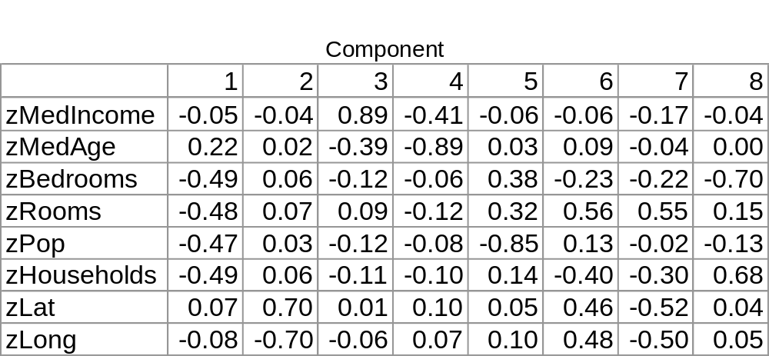
PCA
We’ve now replaced our original 8 variables with 8 independent variables
The key though is we don’t need all of them

Slide 16
Remember the eigenvalues?
3.9, 1.9, 1.1 etc. are the first, second and third eigenvalues which correspond to the first, second, and third principal component.
They explain the % of variance.
So 3.9 out of 8 variables means the first principal component explains 3.9/8 = 49% of the variance (almost half)
Continued on next slide

Slide 17
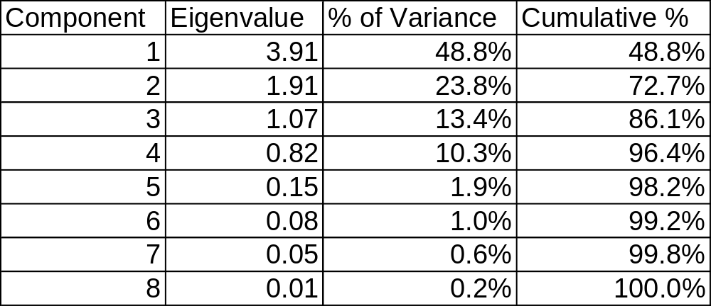
Dimension Reduction
This suggests we get 96% of the model explained by the 4 new independent variables (principal components)
Or 98% is explained by 5 principal components

Slide 18
How Many Principal Components do we use?
You can make a table like the previous slide and decide to cut off at a certain percentage 95% or 98%
Or you can make a scree plot like on next page with R: > screeplot(hPCA2,type="lines")

Slide 19
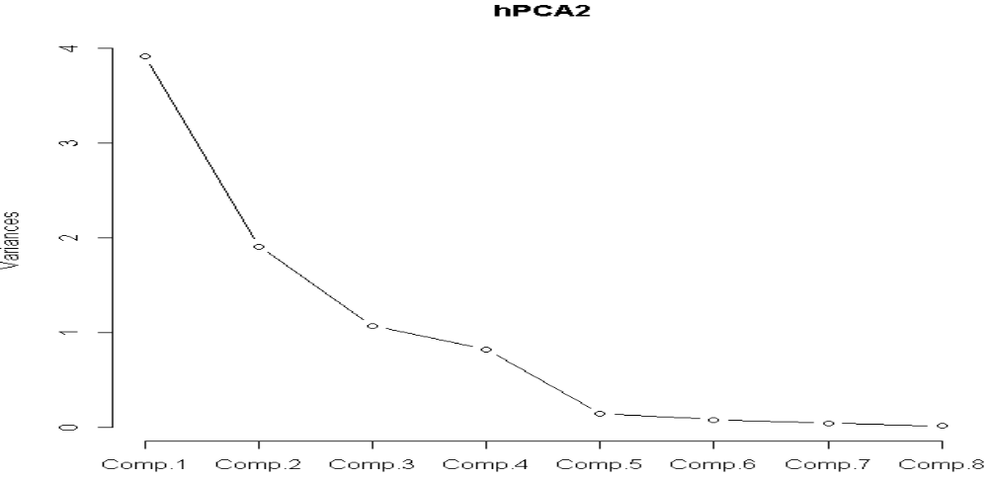
How Many Principal Components (II)?
Typically, you stop when the scree plot gets flat (5)
But it might be worth trying the model with both 4 and 5 components and seeing if it makes a difference

Slide 20
PCA in R
You can do all of this directly in R without computing eigenvalues or covariant matrices etc.
> hPCA<-princomp(houses)
We can plot a screeplot as before, and we can get the components with
> hPCA$loadings

Slide 21
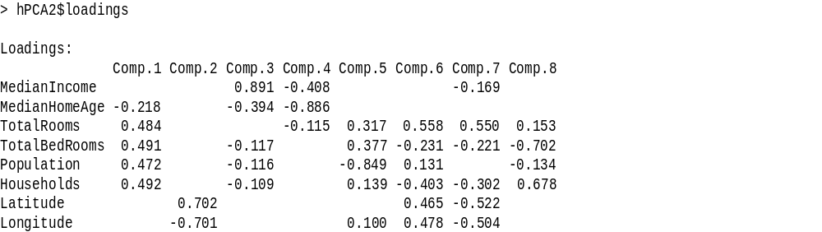
Output of hPCA$Loadings
Our previously defined components are same except our Comp1 = -Comp1 here. But that won’t affect results

Slide 22
User Defined Composites
Notice in this case we had 8 variables where 4 were obviously highly correlated
It’s a lot less complicated to make your own composite variable
M=(zTotRooms/4+zBedrooms/4+zPop/4+zHouseholds/4)
N=(zLatitude/2 –zLongitude/2)
Note the latter has a negative because they were negatively correlated
In this case we’ve replaced 6 variables with the 2 variables M and N so that we have 4 total instead of 8, and the 4 variables should be largely independent so that we can do Naïve Bayes or Regression without getting into trouble
This is less complicated than PCA, but if you don’t know what you are doing, you can screw it up.

Slide 23
Go To R

