Slide 1
Lecture 7
Summary of Everything Important Up to Now
Breitzman 7/25/18

Slide 2
K-Means Clustering
K-Means Clustering involves, picking a K and the algorithm will create K clusters
  The clusters are built with a similarity matrix which is created by computing similarity distances between each possible row and column entry.
  A good all around distance measure is cosine similarity, which we will talk about in the next slide
  Other distance measures are Euclidean distance (from high school), Jaccard (|A∩B|/|AUB|), and about a million others
K vectors are picked at random and they become the initial K clusters.
Note this is a shortcoming, because if a different K initial vectors are chosen, we may get different clusters in the end

Slide 3
Similarity and Dissimilarity
Once we have a similarity measure, we can compute a similarity matrix which contains pairwise distances between every entry and every other entry
The similarity matrix is symmetric and contains 1=max distance on the diagonal
Some clustering algorithms use a dis-similarity matrix
To compute a dis-similarity matrix, take each entry a_{ij} and replace it with 1-a_{ij}

Slide 4

Cosine Similarity or Distance
Recall the dot product of 2 vectors A=<a,b,c> and B=<d,e,f> is given by A•B=ad+be+cf
Recall the norm of a vector A=<a,b,c> is ||A||=
Finally recall if A and B are vectors A•B=||A||*||B||*Cosϴ where ϴ is the angle between A and B
It follows of course that Cosϴ =(A•B)/(||A||*||B||)
We can use the left hand side as a similarity measure. Strictly speaking, we should take the Inverse Cosine of each side and get the angle between the vectors as a dis-similarity measure, but there is no harm in avoiding the inverse Cosine.

Slide 5
K-Means Clustering Algorithm
Randomly name k elements C₁ through C_{k}
All other elements are assigned to C₁ through C_{k} based on similarity distance
Calculate mean centroid for each cluster C₁ to C_{k}
Recalculate similarities and reassign all members to new clusters
Stop when clusters are same 2 times in a row

Slide 6
Hierarchical Clustering Algorithm
some prefer hierarchical clustering because it leads to the same result every time, and doesn’t force the user to pre-decide the number of clusters
The clusters are determined by a dendrogram, which is cut at a certain stage
In theory the algorithm produces one giant cluster, but we tend to cut the dendogram and stop the algorithm before that happens.
Algorithm:
Build similarity matrix
Find max similarity ignoring diagonals (which are always 1)
If max similarity is at row i and column j then merge i and j (in the dendrogram) and recalculate similarity matrix
If old similarity matrix was n x n then new one is (n-1) x (n-1). Go to step 2

Slide 7
Hierarchical Clustering Algorithm (II)
If we are naïve about this, it can be very slow. We don’t really want to recalculate the similarity matrix at each step
If we merge the similarity matrix at each stage we need to define how to change the merged rows and columns.
Suppose we are merging element 4 and element 5. In this case we adjust row 4 and zero out row 5.
Choices for row 4 include (average of row 4 and row 5 – “Average Link”, max of row 4 and 5 – “Single Link”, “min of row 4 and 5 – “Complete Link”)
The naïve method of recalculating similarity matrix by merging vectors will be equivalent to average link. (Actually, average link is usually computed wrong, so it’s not quite the same but still effective)

Slide 8
Hierarchical Clustering Algorithm (III)
The Single Link method when merging two elements changes the similarity metric to the maximum of the two similarities. This has the effect of connecting 2 clusters based on the most similar members
The complete link method takes the minimum of all similarities. This has the effect of connecting clusters based on their least similar members
Complete link leads to many small clusters, while Single link leads to larger more diverse clusters
Average link is somewhere in between
Computing average link properly can be expensive so most people fudge it by taking averages of averages

Slide 9
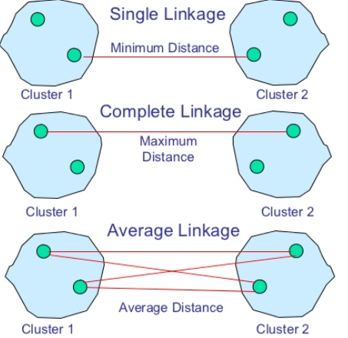
Single, Complete, Average Link
Note we can merge any 2 clusters using these methods without computing a centroid (Although except for very extreme cases, the average link and closest centroids will usually be very similar)

Slide 10
K-Means Classification
Although I prefer hierarchical clustering to k-means clustering, the k-means classification algorithm is actually very useful.
In K-means classification we generally already have the data in clusters, and wish to determine which clusters new data should reside in.
Suppose we have 25 clusters, with an average of 1000 members each. If I try to place a new data point based on a distance measure, I am computing 25,000 distances
The idea behind k-means classification, is we pick a k (say 3) and compute centroids for each existing cluster
The centroid can be the average of the vertices of each member (which is not exactly correct, but usually causes no harm).
We then identify the k (3) centroids with minimal distance with our new data point
We then try to place our new data point in the ‘best’ of those k clusters
The ‘best’ can be determined by using minimum distance between each member and the new data point, or by finding the most members with a small cutoff distance, or something else that makes sense

Slide 11
Multiple Data Types
It’s easiest to think of classification and clustering in terms of a single distance measure, however in real life we will encounter data of differing types
The clustering and classification will still depend on distance measures, but they may be hybrids of the types on the next slide

Slide 12
Data Types and Similarity Strategies
Term data, Frequency Data, Vector Data
  E.g. Movies, Terms in a document, Products bought at amazon, etc.
  Use Cosine Similarity
Asymmetric Binary Data – Data with 2 values, but positive value is of high importance, negative is ignored
  E.g. Has fever, has Diabetes, tested positive for something
  Use Jaccard
Symmetric Binary Data – Data with 2 values both of equal importance
  E.g M/F, Smoker/non-Smoker, Like/Didn’t Like
Categorical (Nominal) Data – Data that can take on multiple states but values have no meaningful order
  E.g. Red, Yellow, Blue, Green; Code X, Code Y, Code Z;
  Distance: match=1, non-match=0
Ordinal Data – Attributes that have a meaningful order
  Poor, Fair, Good, Excellent; Freezing, Cold, Mild, Warm, Hot
  Normalize then Euclidean distance
Numeric or Continuous Data – Regular data like 10, 20, 30, etc.
  Normalize then Euclidean

Slide 13
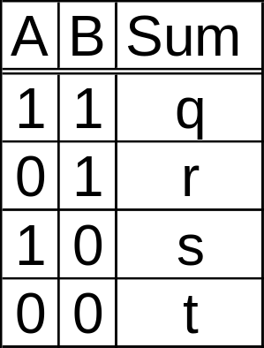
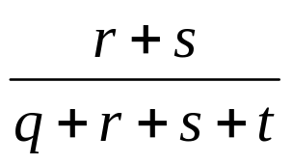
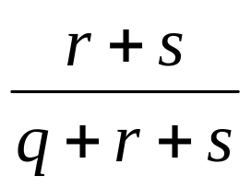
Binary Data
Symmetric Binary Distance: d(A,B)=
Asymmetric Binary Distance: d(A,B)=
Note in the latter, negative matches (t) are considered unimportant
Note Sim(A,B)=1-d(A,B)

Slide 14
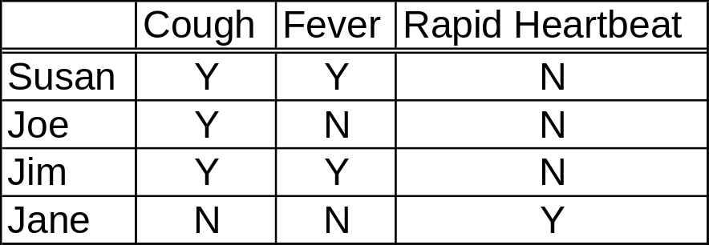
Asymmetric Binary Data Example
D(Susan,Joe)=1/2; Sim(Susan,Joe)=1/2
D(Susan,Jim)=0; Sim(Susan,Joe)=1
D(Susan,Jane)=(2+1)/3=1 Sim(Susan,Jane)=0
This distance measure is widely known as the jaccard distance

Slide 15
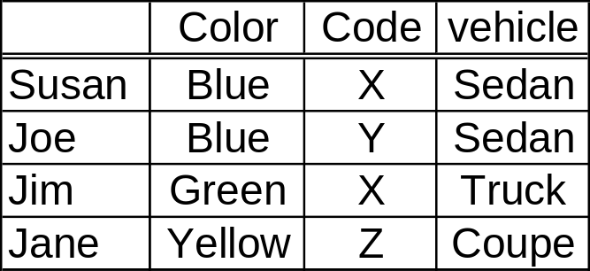
Categorical Data Example
Similarity=Matches/Variables
Sim(Susan,Susan)=3/3=1; D(Susan,Susan)=0
Sim(Susan,Joe)=2/3; D(Susan,Joe)=1/3
Sim(Susan,Jim)=1/3; D(Susan,Jim)=2/3
Sim(Susan,Jane)=0; D(Susan,Jane)=1

Slide 16
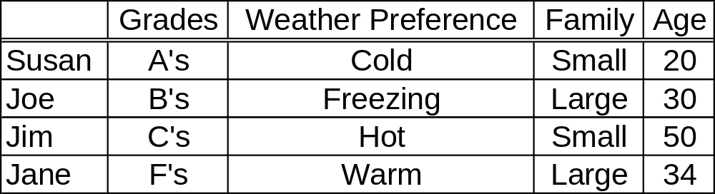
Ordinal and Numerical Data Example
Convert Ordinal Data to [0,1] by (Rank-1)/(Max-1)
For example Max Rank=A=5,Rank(F)=1
F=0, D=.25, C=.5, B=.75, A=1
Freezing=0, Cold=.33, Warm=.66, Hot=1
Small=0, Large=1
For age use min-max normalization (x-min)/(max-min)
20→0, 30→(30-20)/(50-20)=1/3, 50→1, 34→14/30=7/15

Slide 17
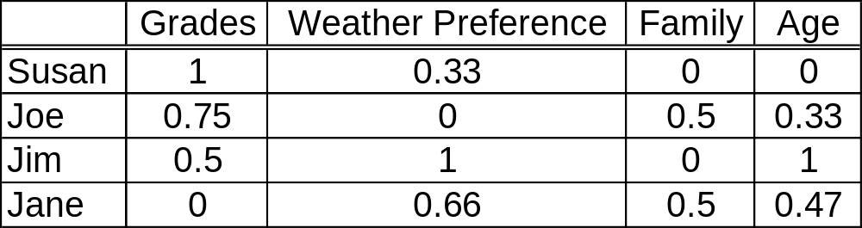
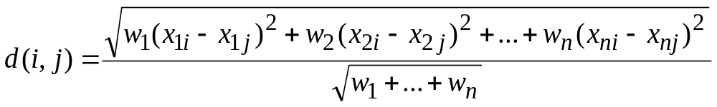
Transformed Table
Normalized Weighted Euclidean Distance
Regular Euclidean Distance is the same except we let each w=1
It should be clear that distance=0 for identical items and 1 for complete opposites (provided the data is transformed to be in [0,1])
Note weights can be added to the other distance measures as well

Slide 18
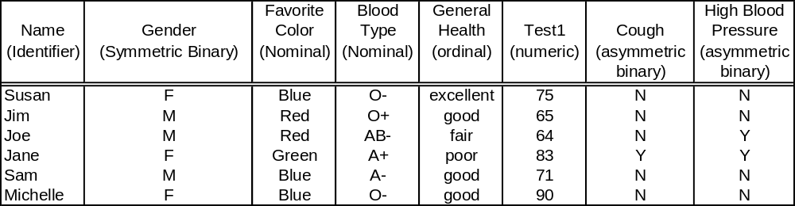
What do we do with mixed data?
Normalize the data and Compute Similarity Matrices for each type (5 types in this case)
Each Matrix is the Same Dimension (6x6 in this case)
Add Each Matrix together (first make them all similarity or dis-similarity matrices if they are not all the same type)
Divide each entry by 5 so that final similarities (or dis-similarities are between 0 and 1)
Actually if we want to weight each variable equally multiply the Nominal and Asymmetric matrices by 2 before adding and then divide by 7
Matrix should be symmetric with diagonals = 1 for similarity or 0 for dis-similarity
Now we see why it is best to have our clustering algorithm not recalculate the similarity matrix multiple times

Slide 19
Clustering V Classification
Clustering involves grouping related data into clusters such that records within the clusters are similar to one another and dissimilar to records outside of the cluster
Classification involves partitioning a target variable
How are they related? We use training data to cluster data based on a number of variables. When new data comes along we classify it based on the cluster it should belong to and use that to predict the value of our target variable
E.g. Predict income bracket based on education level and neighborhood; predict fraud based on spending history versus latest transaction; Predict age based on buying habits; Predict diagnosis based on numerous test results
Most of our course is related to classification (also known as supervised learning)
In all of our classification examples we will use training data. It is good practice to hold aside some amount of training data to test the model
Beware of overfit. Testing data will tell us if our model has been overfit

Slide 20
Basic Stats
Mean, Median, Mode
  In R if you have a variable x, use mean(x), median(x). Not an easy way to get mode. See example in basicStatsR.doc
Normal Distribution
  In R hist(x) can be used to see if you have a normal or skewed distribution
Boxplots useful for identifying medians, quartiles, range, and potential outliers
  boxplot(x) in R
Linear Regression (least squares)
See basicStatsR.doc to see how each of these are implemented in R

Slide 21
Classification - Linear Regression
Linear Regression – aka Line of best fit is very rudimentary and bad but not awful
We can and will do much better
However in cases where the correlation coefficient is high (.9 or above), linear regression is not a bad classifier
Caution: If using linear regression, use it to predict values within the range of the training data.
  Extrapolating a rating based on a new data point with outside of the training data can lead to ridiculous results
  Extrapolation outside of the trained range should be avoided
  (This is getting ahead of ourselves, but this is also true with Neural Networks)

Slide 22
Classification - Multiple Regression
In most cases when data mining we will have lot’s of variables
Basing a model on a single variable is silly, when there are so many other variables that may add prediction power
Multiple Regression uses the prediction power of multiple variables to create a model
A lot of people use multiple regression incorrectly
Strictly speaking, a regression model is only valid if the following assumptions are validated: Linearity, Independence, Normality, and Constant Variance
These are described in MultipleRegress.doc

Slide 23
Classification - Decision Trees
Decision Trees are useful for predicting yes/no questions
  Is customer X a credit risk?
  Is Y a likely terrorist?
  Is the transaction fraudulent?
  Will Y buy a computer/car/house? Etc.
Advantages are many
  Learns by example
  Decision process completely clear (unlike Neural Networks which are opaque at best)
  Can be vetted by analysts just by looking at tree
  Works on large data sets/very efficient
  Decision run time proportional to height of the tree
  Tree height is independent (and smaller) than database size
Has some disadvantages as well
  Doesn’t handle continuous data well (data must be categorized)
  Missing data will confuse the model (branch decisions depend on data)
  Susceptible to overfitting (pruning can help)
  Correlations among data points are ignored
  Doesn’t handle noisy data well

Slide 24
Decision Tree Algorithms
Decision trees are built based on training data
The two most popular tree building algorithms are CART and C4.5
Both are one-pass, recursive, greedy algorithms
Greedy algorithms are not necessarily optimal, but they take the biggest bite at each stage (that is, it tries to eliminate the largest amount of the remaining population at each stage)

Slide 25
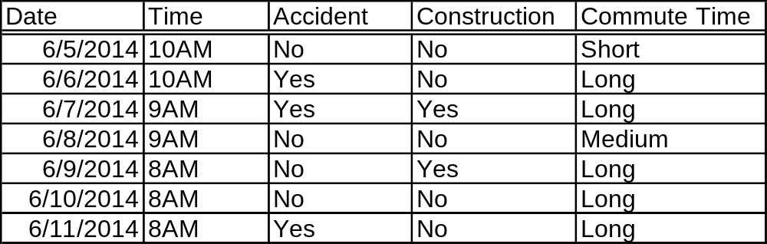
Decision Tree Pseudocode (II)
Target is commute time: (short, medium, long)
  Attributes are a list of variables like CommuteTime=(8,9,10), isConstruction=(Y,N), isAccident=(Y,N)
  Examples are a set of previous commutes with values for each attribute
Steps
  Algorithm finds best attribute is 8AM, creates 2 subtrees by calling itself with one tree containing the 3 examples for 8AM and one with the 4 examples for 9,10AM.
  For the left subtree the algorithm realizes all examples have long commute times so it returns a leaf node with long as the target
  For the 9,10 subtree it recursively calls itself treating the remaining 4 nodes as a whole new process
This is quantified in the next slides

Slide 26
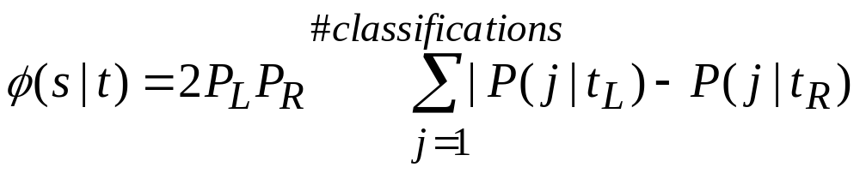
CART
(Classification and Regression Trees)
Only makes binary trees
Every attribute will have a potential left and right child node
Greedy part is the split that maximizes the equation
We’ll define all of these variables next

Slide 27
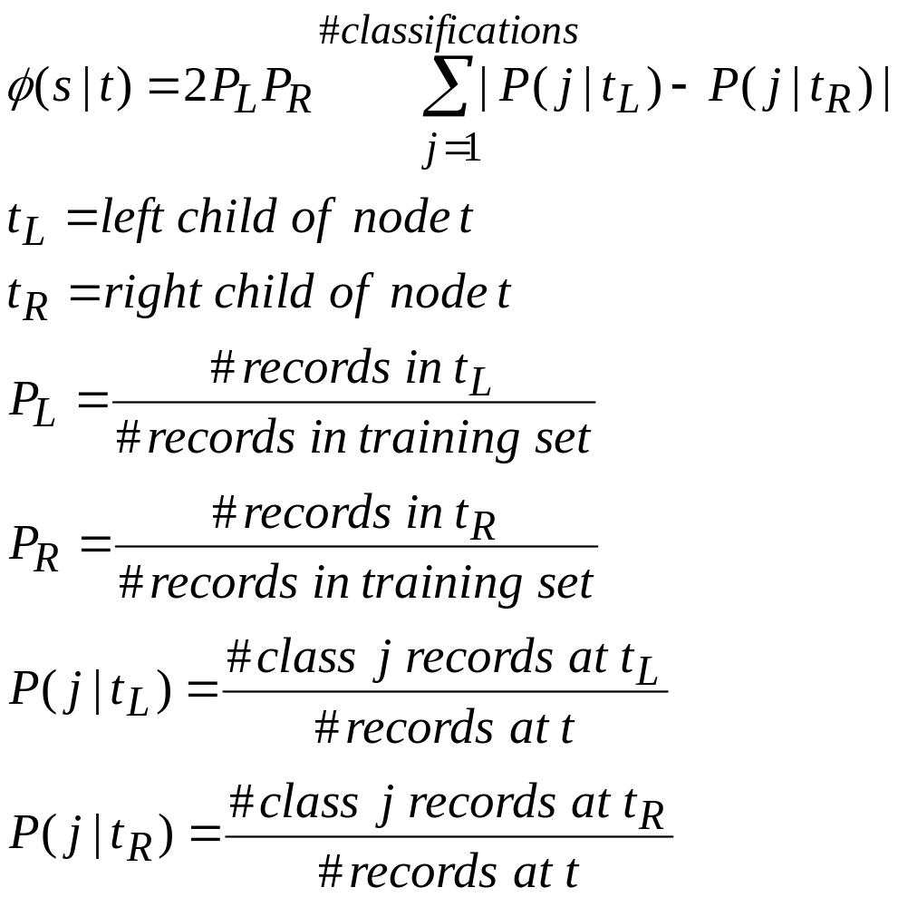
CART (II)

Slide 28
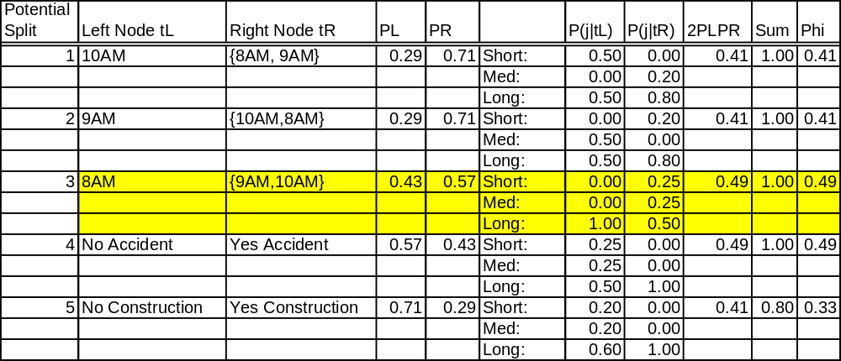
Potential Splits (CART) First Iteration

Slide 29
Entropy in C4.5
Consider the result of a coin toss.
How many bits do I need to store that result?

Slide 30
Entropy in C4.5 (II)
If I store a head as 1 and tail as 0, I only need 1 bit to store a result.
If I’m trying to store N results I need N bits.
How many bits do I need to store something of probability of P? -Lg(P) of course! Clear as mud right?
Consider our coin toss. Pr(head) = ½. Note that
–Lg(1/2) = 1 so that’s 1 bit. -Lg(1/4) = 2 because it takes 2 bits to store HH which has probability ¼.
Does everybody remember their log rules? Can you confirm the math above?

Slide 31
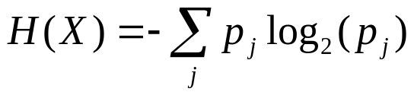
Entropy in C4.5 (III)
Suppose we have a target variable X whose k possible values have probabilities p1,p2,p3,…pk
What is the smallest number of bits required (on average) to store a stream of symbols representing the values of X?
The answer is called the Entropy of X and is defined as
Where does this come from? We saw the Log part on the previous slide. We multiply by each probability to get a weighted average for this mythical Entropy used in the algorithm

Slide 32
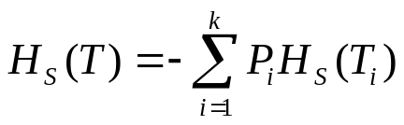
Information Gain in C4.5
Suppose we have a candidate split S that partitions the training data set T into subsets T1, T2, T3,..Tk. The mean information requirement can be calculated as the weighted sum of the entropies for the individual subsets
Where Pi represents the proportion of records in subset i
We then define “information gain” to be gain(S)=H(T)-HS(T), that is the gain is the decrease in entropy (randomness) from the previous state of the tree by making split S
Since C4.5 is a greedy algorithm we choose the split with the largest gain

Slide 33
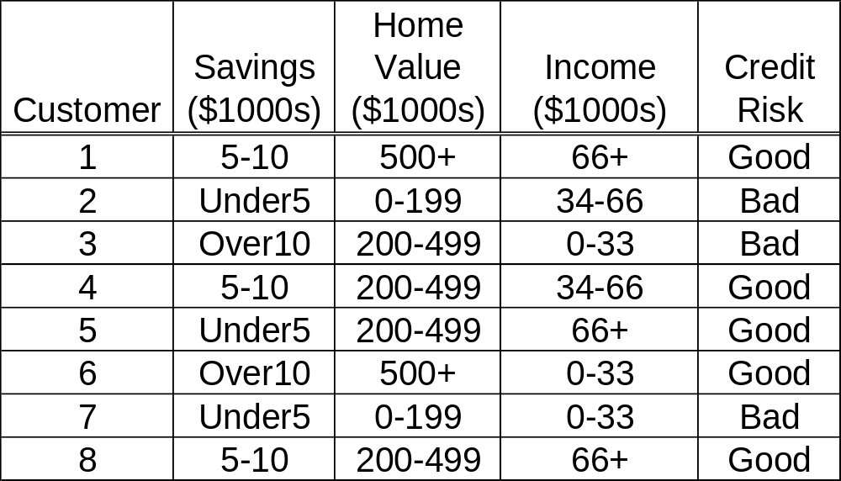
Training Data from before

Slide 34
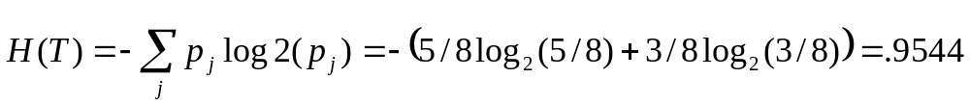
Entropies
Before any splitting we have 8 records with 5 classified as “good” credit risks and 3 as “bad” credit risks
We next compute entropy for savings noting that Punder5=3/8, P5-10=3/8 and Pover10=2/8
The under5 case has 1 record that is a good credit risk and 2 that are bad so the entropy is
–(1/3)log2(1/3)–(2/3)log2(2/3)=.9183
Similarly entropies for 5-10 and over10 are 0 and 1 respectively
So Hsavings(T)=(3/8)(.9183)+(3/8)(0) + (2/8)(1)=.5944

Slide 35
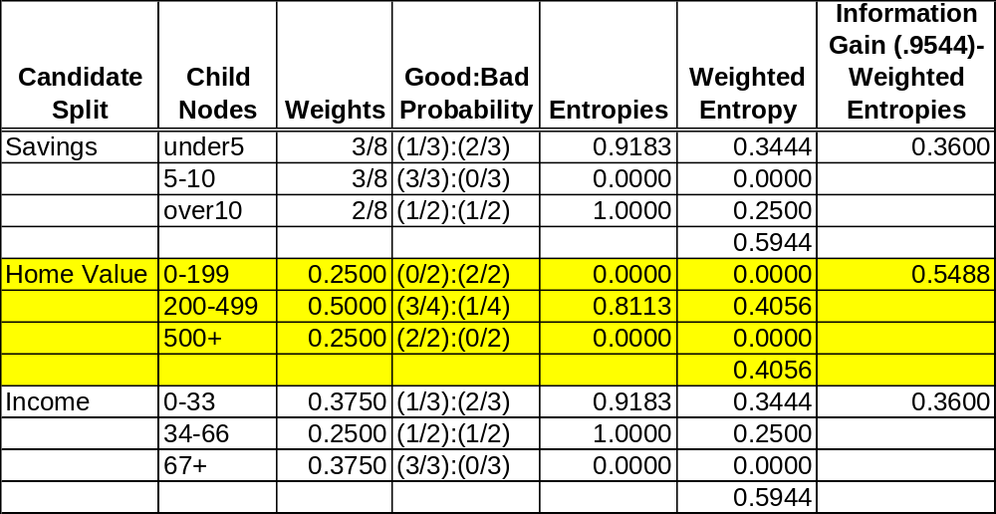
Information Gain (First Iteration)
So we will split on home value:0-199 will go to bad, 500+ will go to good, and we will have to make a new table for 200-499

Slide 36
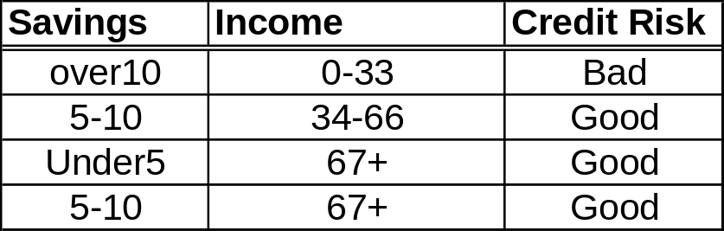
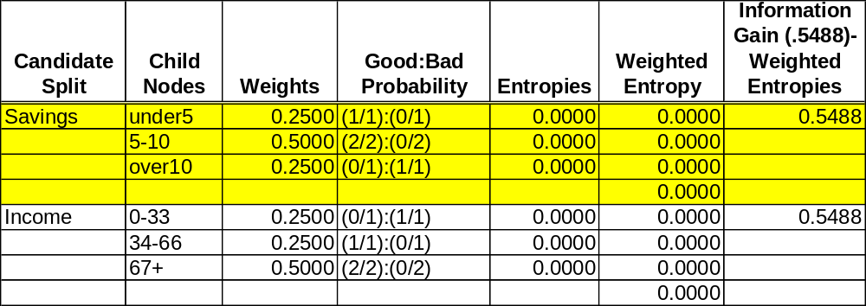
Second iteration

Slide 37
Summary
Highlights of the first 7 Lectures.
I think this is most of what’s important
Did I miss anything?
Exam will be self contained. Don’t worry about memorizing anything
Shouldn’t be more difficult than the hw

