Slide 1
Lecture 10 – Time Series Modeling
Breitzman 11/6/2018

Slide 2
Introduction
A lot of problems depend on time
For example predicting the GDP of a country for year t will greatly depend on the GDP of that country for year t-1
Other examples include counts of sunspots, forecasting tides (or tide heights), forecasting sales, global and local temperatures etc.
The statistics can get pretty heavy so I’ll pretty much avoid a lot of the theory and give some practical tools for dealing with time series

Slide 3
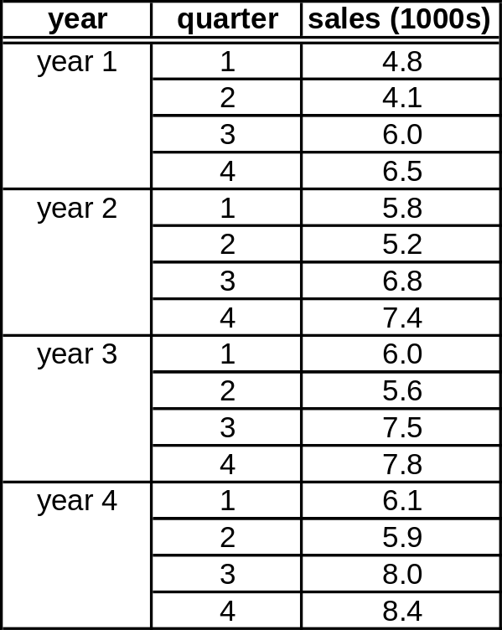
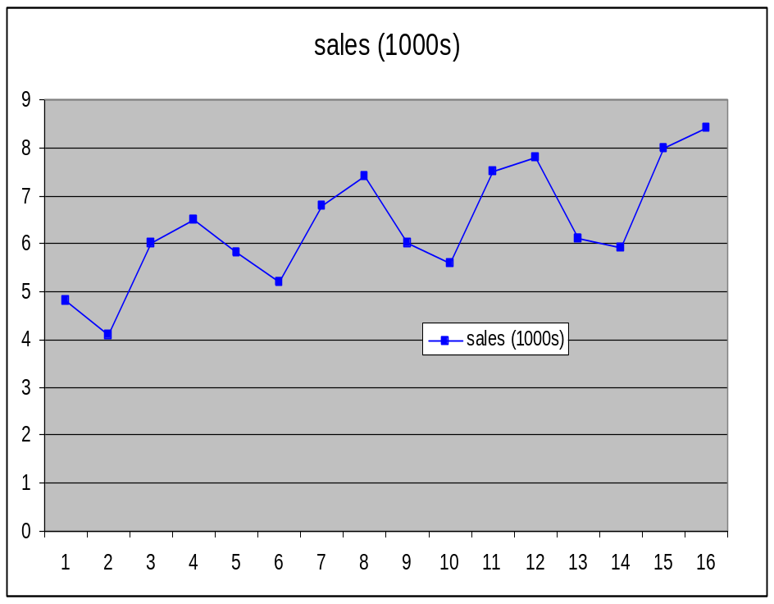
The Classic Example from MBA School
How much can we expect sales to be in the 4th quarter of year 5.
Typically in business school they take a bunch of means, centered means, seasonal means etc. 10 formulas later magically get an answer without showing you why it works
Here’s a mathematician’s view of the problem.

Slide 4
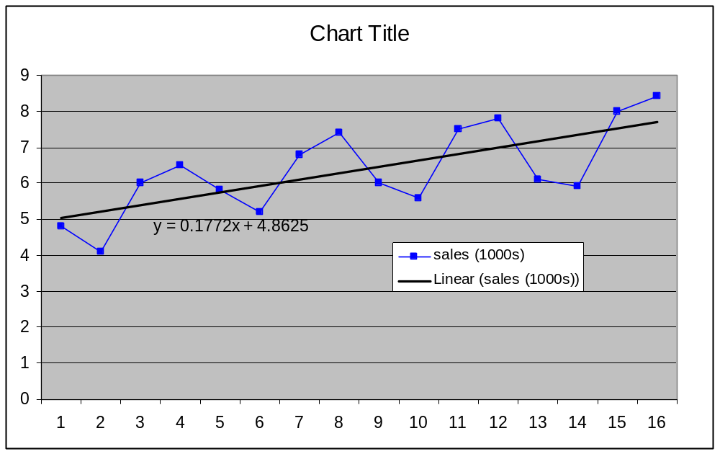
Step 1: Have Excel or R Create the Trendline
Excel will find the regression line and give you the formula
This will save you a bunch of work in the business school method
We can use the formula to do a bad prediction of quarterly sales shown in the next worksheet

Slide 5
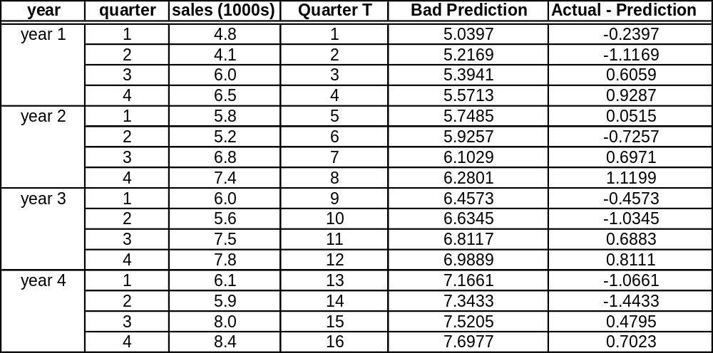
Step 2: Compute Bad Prediction and Error
Bad prediction is just .1772T + 4.8625 of course
If we actually plot the errors we see that we actually have a “stationary” set (more on that later, but it can be thought of as a non-random pattern with a mean of 0)

Slide 6
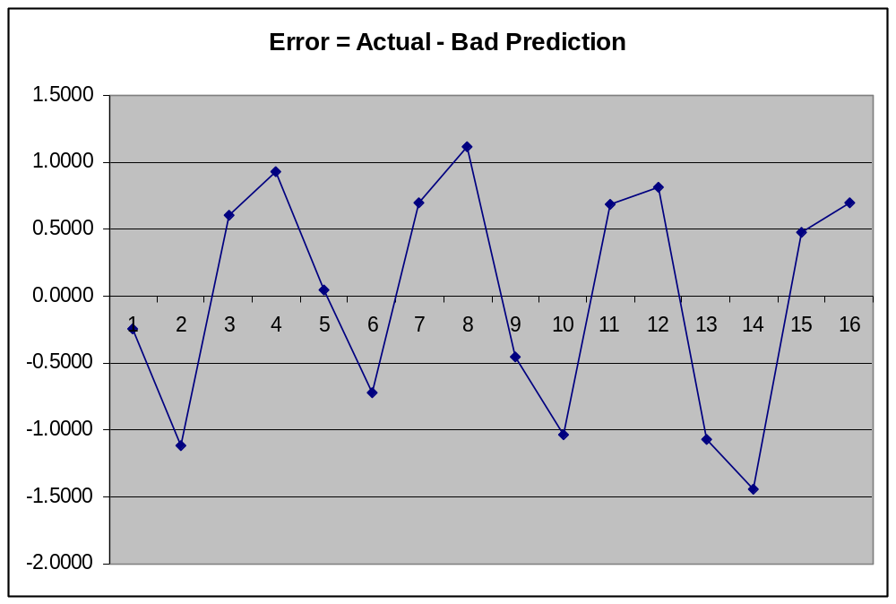
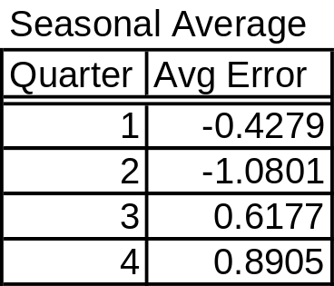
Notice a Definite Pattern
First and second quarters are bad and third and fourth quarters are better
We can take averages of quarterly errors to get a “seasonal average”
If we take our “seasonal average” and add it to our prediction for the next 4 quarters we should get a pretty good forecast

Slide 7
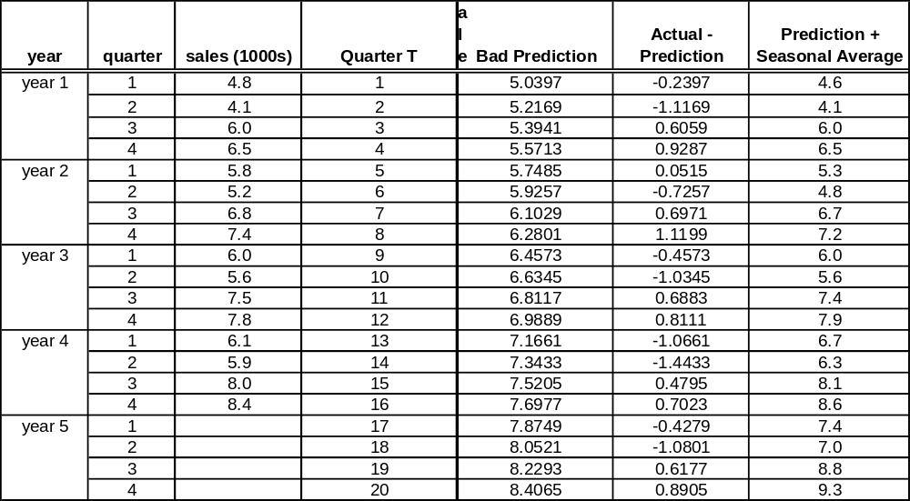
Final Prediction is Not Bad
If anyone remembers the original question, the answer is sales should be 9,300 in 4th quarter of year 5
Chart on the next page gives a little confidence that the projection is in the ball park

Slide 8
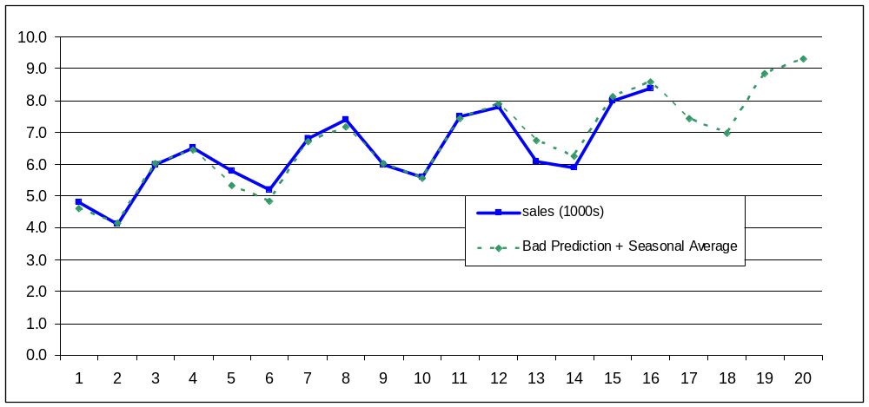
Original Plus Projection of Next 4 Quarters
This does a decent job when there is a definite trend and a seasonal difference
It works for economics, weather, etc. as long as you don’t go too far into the future

Slide 9
The Problem with Business School
All trends are linear in business school
  That’s not really an issue. If we can fit a curve to the data we can always subtract out the trend like we did in the linear case
  Often taking a log of our data will make it linear
Not every pattern is quarterly
  But we can always compute a “seasonal average” as long as there is some kind of repeating pattern

Slide 10
Stationary v Non-Stationary
To model time series we need our data to be “stationary”
A stationary series is one whose probability distribution does not change over time. That is mean and variance is constant over time
A couple of examples follow

Slide 11
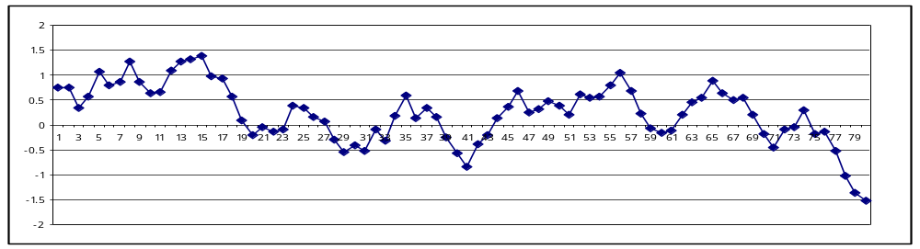
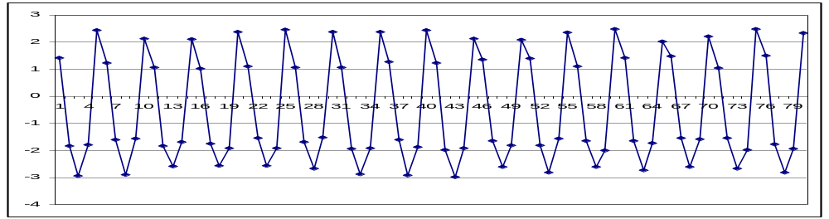
Stationary v Non-Stationary
First data set is not stationary. We can’t take 2 slices of the same size and get same mean
Second set is stationary. Every 5 point chunk has roughly the same mean and variance

Slide 12
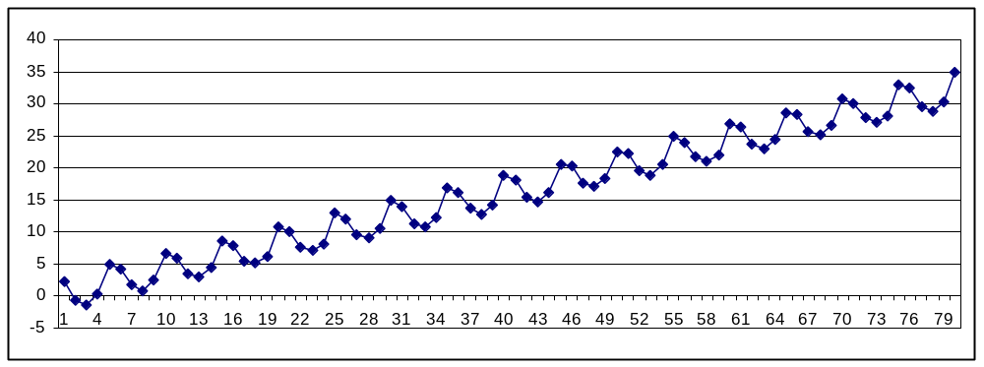
Stationary v Non-Stationary (II)
This time series is not stationary but it can be made stationary by “subtracting” the trend as we did earlier

Slide 13
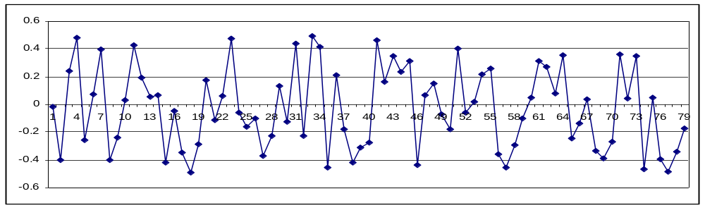
Stationary v Non-Stationary (III)
The first time series is clearly not stationary. The second is made by taking the first difference (that is x_{t} = (y_{t} – y_{t-1})
It’s probably still not stationary but it’s a lot closer to being stationary.
This is a standard trick. You can also try taking the second difference, third difference etc.

Slide 14
Stationary v Non-Stationary (IV)
To test a time series for “stationaryness” use the Dickey-Fuller test.
Don’t ask how to compute it, just use R
Before we go to R a couple of quick notes
  In the literature you will see AR, MA, ARMA, ARIMA models
  AR stands for auto regression (it essentially means the next data point is largely dependent on the previous. This generally means the data will increase or decrease rather than bounce up and down)
  MA stands for moving average (it essentially means the data repeats every k cycles)
  ARMA is a model taking both of these into consideration
  ARIMA is a model that takes both into consideration and also adds a difference as we discussed above (the I stands for integration which is the inverse of a differential)
Go to R

