Slide 1
Lecture 12
Seriation/Clustering
Breitzman 4/24/2017

Slide 2
Introduction
We haven’t done much with clustering in Data Mining 2.
In Data Mining 1 we talked about k-means clustering and hierarchical clustering
Tonight we’ll talk about seriation.
Seriation can be used with clustering to clean up the results or if we’re lucky…
  It can be used by itself for clustering
Go to http://www.atgc-montpellier.fr/permutmatrix/manual/SeriationCorps.htm

Slide 3
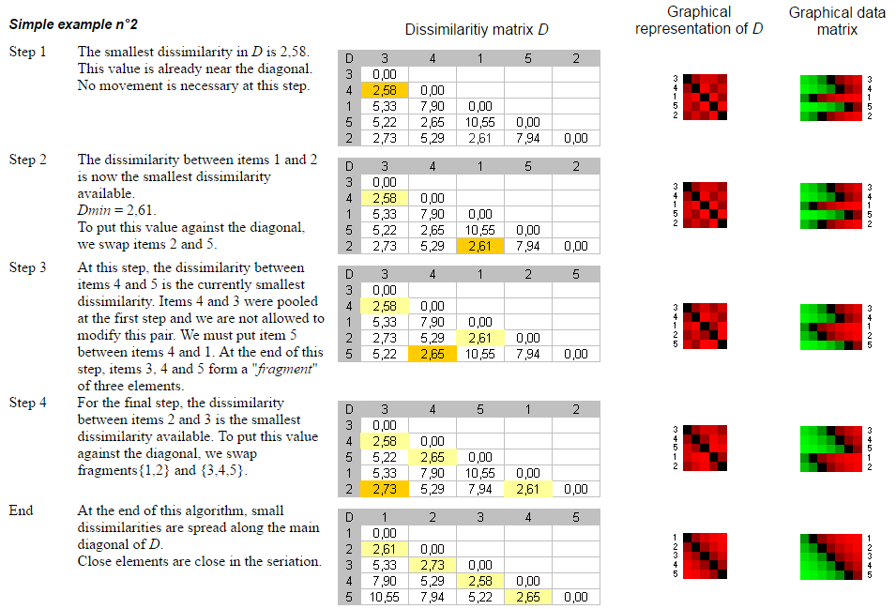
Simple Example Stolen from Previous Website

Slide 4
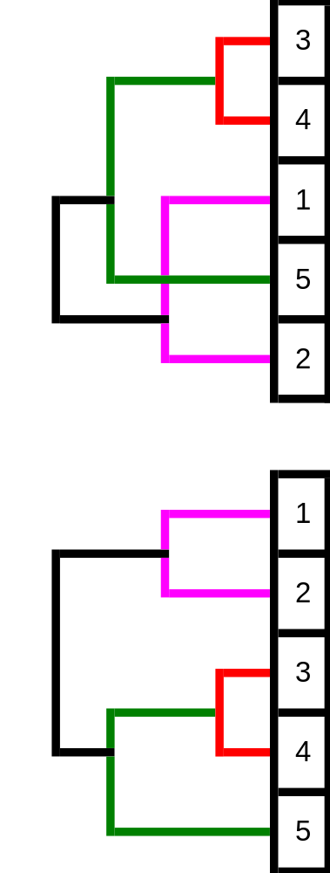
Hierarchical Clusters from Before and After Seriation
Note seriation (from previous page) cleans up the hierarchy
In the non-seriated hierarchy we have the green cluster crossing the pink cluster
Note also that things that belong together tend to be next to each other even without the clustering
That is, 1 is next to 2, 3 is next to 4, (3,4) is next to 5 etc
If we plotted this as a heatmap, after seriation we could see where we should make our clusters without running a clustering algorithm
This will become more obvious when we do our real example

Slide 5
The Setup…
Last semester in Text Mining, Chris, John, Matt, Mihir, Parvati, Yousuf and others created a corpus of Linked-in docs, web pages, press releases, google scholar articles etc. on a topic of their choice
They then removed stopwords, lemmatized, etc. their corpus
After the semester I put all 1,292 documents into one giant corpus to test whether k-means clustering would be smart enough to separate each set into it’s proper topic
Results are on the next page

Slide 6
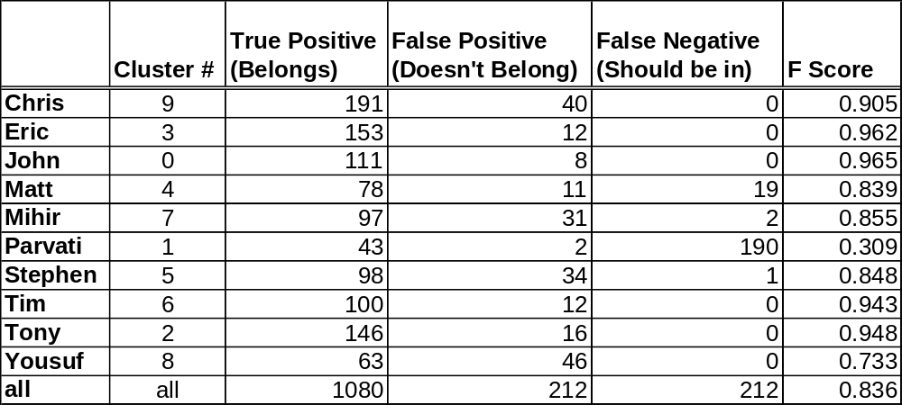
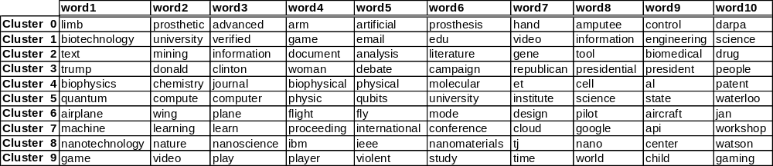
Results

Slide 7
Results (II)
Note that k-means does the best on cluster 0 (prosthetics) because the topic has nothing to do with the others
It also does well on the politics, airplane, and gaming clusters
It inexplicably puts gaming in the biotechnology cluster though
Overall it does a decent job, and we could make it better by making things like email, et al, jan, edu, etc. into stopwords

Slide 8
Seriation of Documents
The question is whether we could do a decent job of clustering the documents with seriation?
How?
Take entire corpus; do TF/IDF to get a list of 1000 or 2000 most important words
(A human edited list would work better, but we don’t have time)
Each document is then a 2000 dimension sparse vector with term frequencies
Seriation puts closest vectors together which ought to work as a clustering method

Slide 9
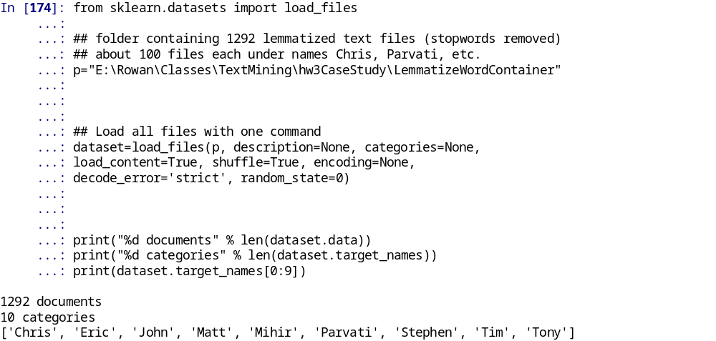
Step 1: Read in Corpus
A great thing about sklearn is that if you keep your corpus as a bunch of text files in a hierarchical directory, load_files will load all of the files and keep the directory structure; all in one line

Slide 10
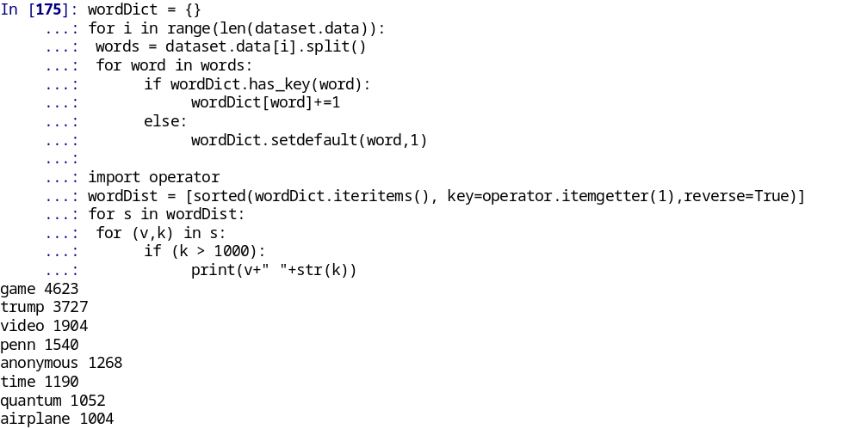
Step 2: Make List of all words; sort by freq.
A Python dictionary is useful for keeping track of the occurrences of each word
Don’t know why ‘penn’ and ‘anonymous’ appear so frequently.

Slide 11
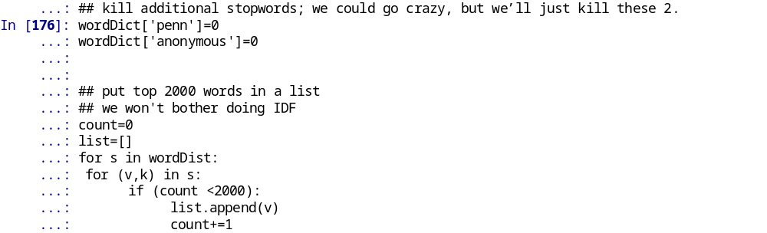
Step 3: Make List of Top 2000 Words
2000 is just arbitrary. I don’t know if it would work better with 100, 500, 1000, 10000.
Note also, the first word and 2000th word have the same weight here. Don’t know if this will be a problem

Slide 12
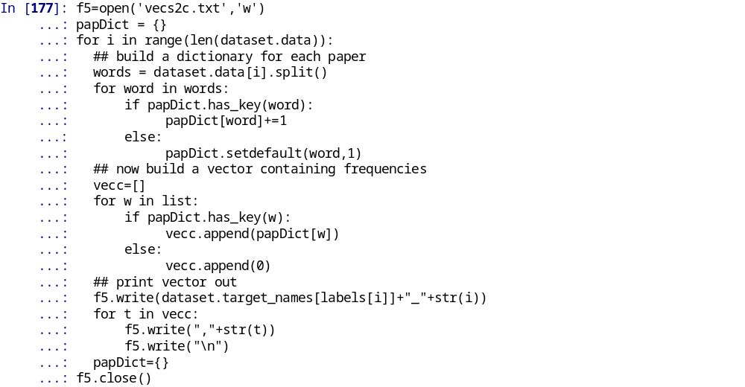
Step 4: Write out each document as a sparse vector
Use a dictionary for each document. Then check to see if any words from the document match the top 2000 words

Slide 13
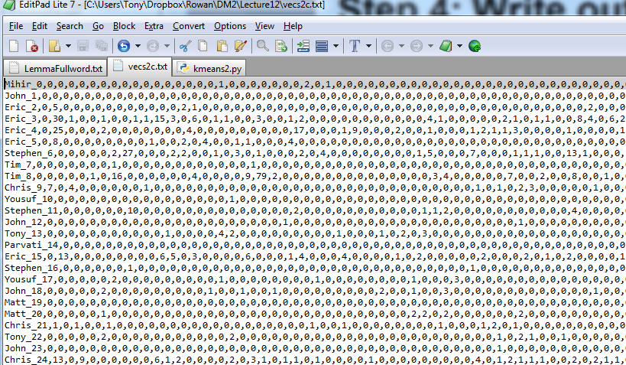
Snapshot of output
(Total of 1292 vectors; each has 2000 elements)

Slide 14
Go to R
Go to Seriation2000.pdf

Slide 15
Unrelated Seriation Demo in R
This one has nothing to do with clustering.
But it might be the coolest thing you’ve seen in a while
Go to SeriationLouvre.pdf

