Slide 1
Anaconda Madness
11/14/2018

Slide 2
I Spent 2 hours fighting with Anaconda last night…
It was actually Graham’s fault, but that’s another story
Maybe this is something you already know, or maybe it will save you some time
Unfortunate fact. If you upgrade Anaconda it doesn’t automatically update your Jupyter notebook
Last week I upgraded from Python 3.5.2 to 3.7.0. I also updated Scikit learn to work with 3.7.0. Suddenly my jupyter notebook wouldn’t recognize scikit-learn even though my Python 3.7 from anaconda prompt did. Why?

Slide 3
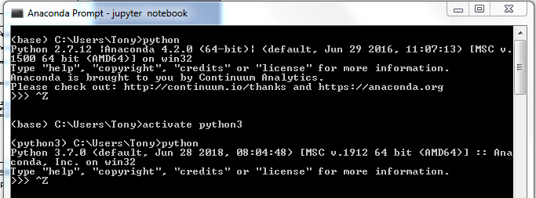
My Setup
Base is 2.7.12
Use Activate to switch to 3.7.0

Slide 4
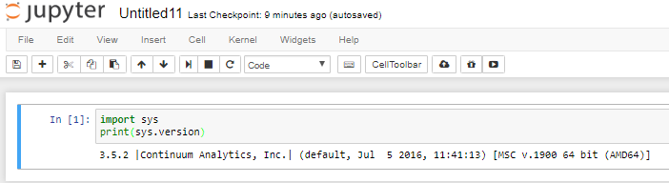
My Setup (Continued)
Why isn’t 3.7.0 available in jupyter?
See unfortunate fact on previous slide

Slide 5
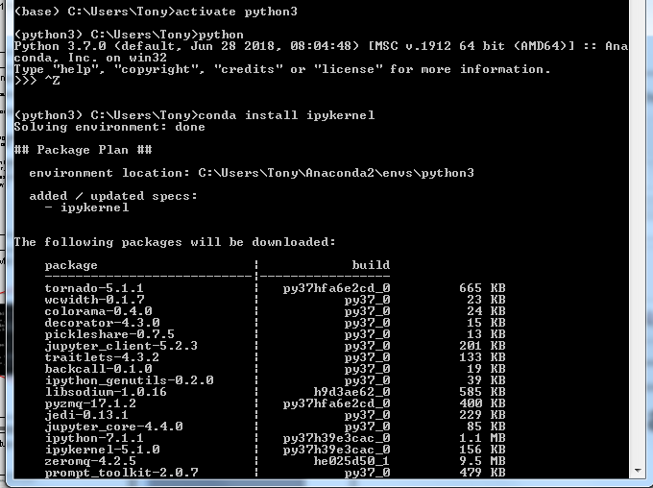
Jupyter update
To update jupyter do this!

Slide 6
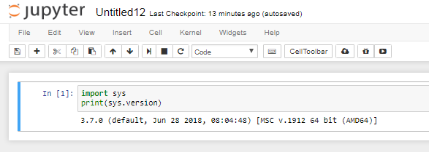
Result!
Don’t ask me why it took so long to get here. Note the first 3 answers on stackexchange took me on a wild goose chase.
Hopefully this will save you some grief

Slide 7
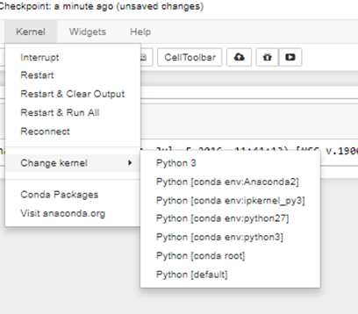
Next Issue. Currently Unresolved
How do I get jupyter to give my various environments sensible names? Python 3 is still 3.5.2 even though I thought that kernel was killed by 3.7.0. Currently 3.7.0 is in conda env python3

