Slide 1
Lecture 11
Link Analysis
Breitzman 11/14/2018

Slide 2
Introduction
Link analysis is a non-standard data mining technique
Most books don’t cover it
  Han, Kamber, Pei devote 1 paragraph to it and call it link mining
  Larose doesn’t mention it at all (in either book)
  Hand, Mannila, Smyth don’t mention it
  Dunham devotes 1 paragraph and lumps it in with market basket analysis
The technique is based on graph theory and is primarily used to detect
  Insurance fraud
  Bank fraud
  Crime rings
  Terrorist networks
In recent years it has been used more to capture social media relationships and to deal with malicious URLs

Slide 3
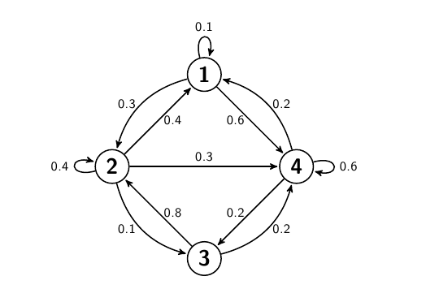
Recall from Discrete Math (or Algorithms) that a Graph is a set of nodes and weighted edges
Graphs can be used to model social networks, computer networks, relationships, distances etc.

Slide 4
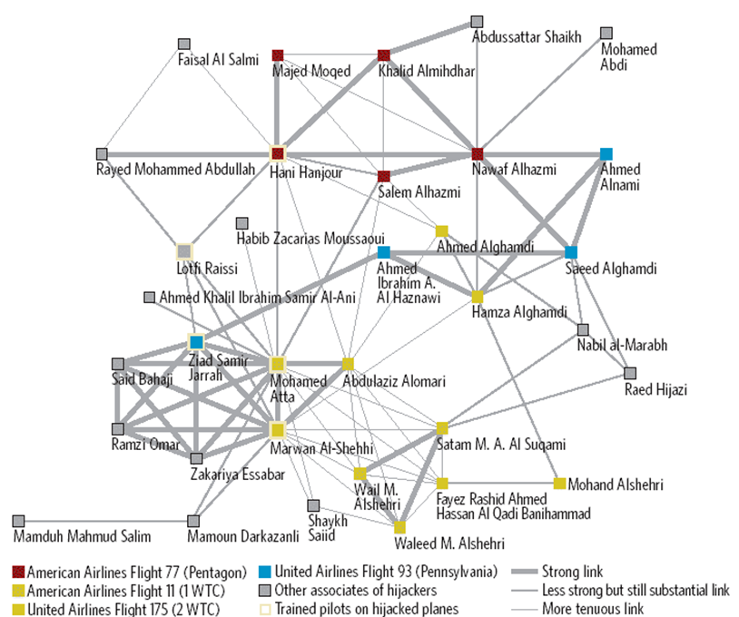
Example: Mapping Known Associates of
9/11 Hijackers (Source: Coplink Informatics)

Slide 5
More Mundane Example: Insurance Fraud
Staged car accidents have several common characteristics
  Occur late at night in non-urban areas to avoid eyewitnesses
  Drivers usually young males with many passengers but never children or senior citizens
  Police always called to the scene
  Multiple serious injuries are claimed even when there is almost no damage to the cars
Estimates are that 20% of all accident claims are fraudulent
Without a pattern the claim is likely to be paid because although they look suspicious, they can’t be easily proved to be fraudulent

Slide 6
Staged Car Accident (II)
If it’s a one time event it’s not easily detected
Repeated patterns can be found via link analysis
Every instance put into a graph and all connections made looking for a pattern
For example if multiple instances exist where the injuries are reported by the same chiropractor, or the damage is inflated by the same garage then that pattern can be used to detect fraud

Slide 7
Opioids etc.
Similar analysis can be used to identify doctors that repeatedly write fraudulent prescriptions involved in overdoses or gun dealers that repeatedly sell guns that are used in crimes

Slide 8
Neo4j vs SQL
For many years link analysis could not be scaled because SQL databases do not lend themselves to link analysis
Neo4j and other graph databases have changed that
Graph databases store data in graphs and queries are done by following paths between nodes
For example parsing something my mother might say is easier with a graph database: “Who was that actress from the Sopranos? She played the wife of the guy from that gangster movie and before that he played Shoeless Joe Jackson?”

Slide 9
Neo4j vs SQL (II)
In SQL we need to take all actresses in the Sopranos, join to all movies they’ve been in, join to all actors that played husbands to the actresses and then join to all their other movies to see which ones ever played Shoeless Joe Jackson
In a graph database we find all movies with a character named Shoeless Joe Jackson and expand out to all other characters played by same actor and then all roles for any actresses that ever played a wife of one of the characters. We get a path from Field of dreams to the Sopranos in 2 links.

Slide 10

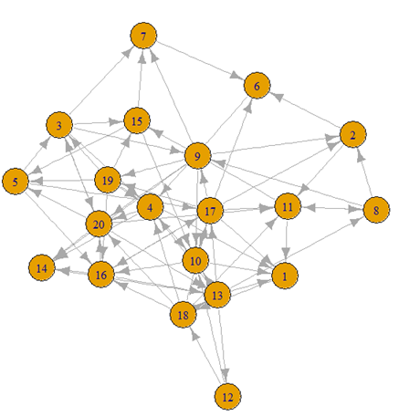
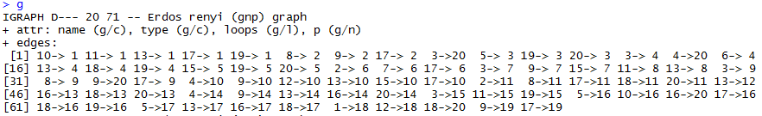
Link Analysis Metrics (1. Random Graph)

Slide 11
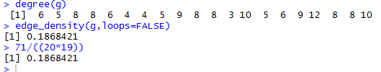
Link Analysis Metrics (2. Degree, Density)
Degree is the number of edges going to and from a node
Density is the number of edges divided by the total possible edges
Possible is (20*19)=380
Actual is 71
Density is 71/380=.186
A graph with high density is said to be strongly connected

Slide 12
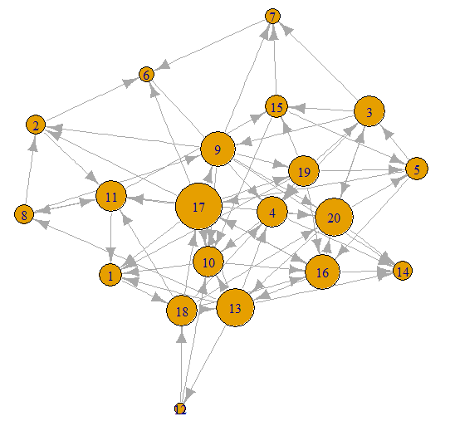

Link Analysis Metrics
(Nodes resized based on degree)

Slide 13
Link Analysis Metrics
(Hubs and Authorities)
The hubs and authorities algorithm developed by Jon Kleinberg was initially used to examine web pages.
Hubs were expected to contain catalogs with a large number of outgoing links; while authorities would get many incoming links from hubs, presumably because of their high-quality relevant information.
An authority is a web page (node) with a lot of links to it. (similarly a paper with a lot of citations is assumed to be important or a tweet that gets a lot of retweets is assumed to have an impact)
A hub is a web page (node) that points to a lot of other pages (e.g. wikipedia is a hub)

Slide 14

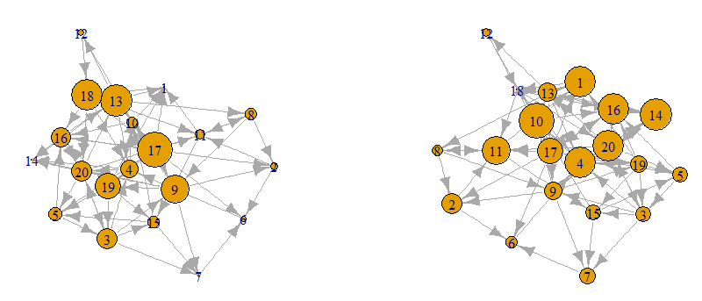
Link Analysis Metrics
(Hubs and Authorities II)

Slide 15

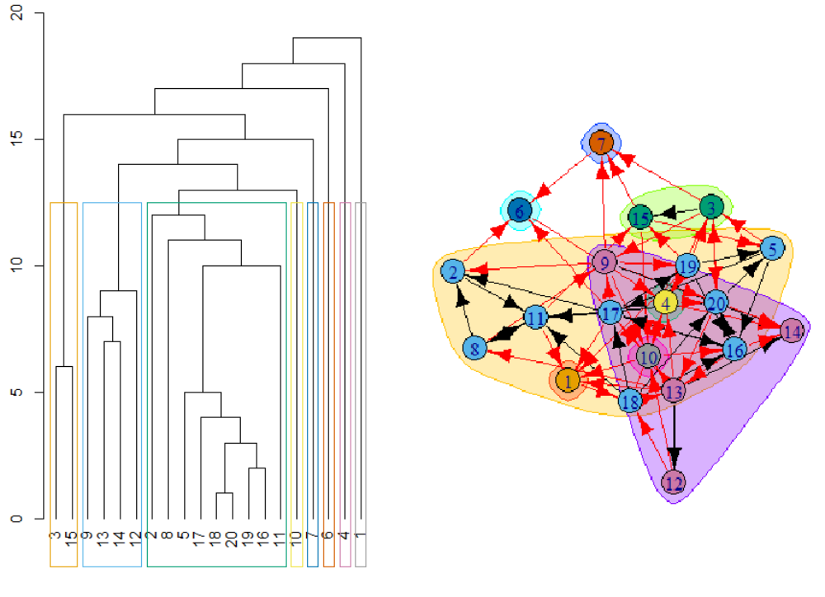
Link Analysis Metrics
(Betweenness and Clustering)
Betweenness
  A measure of the degree to which a given node lies on the shortest paths between other nodes in the graph
  A node has high betweenness if the shortest paths between many pairs of other nodes in the graph pass through it

Slide 16
Link Analysis Metrics
(Link Prediction)
If A and B are both friends with C,D,E,F, then at some point we expect A and B to become friends if they are not already
This is similar to a concept called co-citation coupling in scientific papers. If A and B both cite to papers C,D,E, and F we expect that A and B are about related topics and we cluster them together.
Link prediction can be used to predict how organized crime might evolve, how drug lords might expand territory, how social networks might expand, etc.

Slide 17
Link Analysis Metrics
(Page Rank (I))
PageRank was invented by Google but has now been generalized to work on any directed graph.
You probably don’t remember this, but there was a time before Google when many search engines competed such as Altavista, Lycos, Yahoo, Ask Jeeves, Dogpile etc.
Yahoo and Ask Jeeves hired thousands of indexers that basically tried to find content on all kinds of topics. This was doomed to fail as the web expanded
Alta Vista and Lycos were term indexers they basically crawled the web and built a reverse index of all terms that appeared, much like Google does now.

Slide 18
Link Analysis Metrics Page Rank (II)
(term spam)
Alta Vista was the top search engine from 1996 to 1999. As a result term spammers started optimizing their sites for it.
For example if you were selling sneakers on the web, you wanted to float to the top of the search no matter what people were searching for.
  A typical ploy would be to add long lists of terms and phrases that have nothing to do with sneakers (movies, music, sex, etc.) into your web site in the same color as the background so that they don’t actually show up.
  If done right, your sneaker company would show up in the top 10 of every search.
  If it didn’t you just add the text (again in background color) of the sites that did come up in the top 10.
If search was going to be useful something had to be done.

Slide 19
Link Analysis Metrics Page Rank (III)
(Source: Mining Massive Data Sets Rajaraman, Ullman)
To combat term spam,Google introduced two innovations:
  PageRank was used to simulate where Web surfers, starting at a random page, would tend to congregate if they followed randomly chosen outlinks from the page at which they were currently located, and this process were allowed to iterate many times. Pages that would have a large number of surfers were considered more “important” than pages that would rarely be visited. Google prefers important pages to unimportant pages when deciding which pages to show first in response to a search query.
  The content of a page was judged not only by the terms appearing on that page, but by the terms used in or near the links to that page. Note that while it is easy for a spammer to add false terms to a page they control, they cannot as easily get false terms added to the pages that link to their own page, if they do not control those pages.

Slide 20
Link Analysis Metrics Page Rank (IV)
(Source: Mining Massive Data Sets Rajaraman, Ullman)
As we shall see pageRank is fairly complicated to compute, but avoiding it and just using the second innovation will not work.
One might think that simply counting the number of in-links for each page would be a good approximation to where random surfers would wind up. However, if that is all we did, then the hypothetical sneaker-seller could simply create a “spam farm” of a million pages, each of which linked to his sneaker page.
The sneaker page looks very important and a search engine would be fooled.

Slide 21
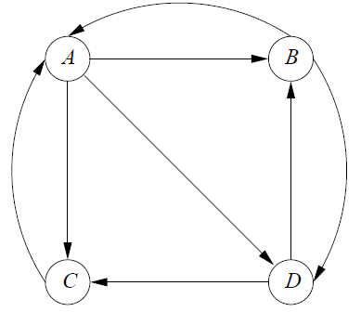
Link Analysis Metrics Page Rank (V)
(Source: Mining Massive Data Sets Rajaraman, Ullman)
Suppose the following figure represents a simplified version of the web
Thus A links to B, C, D. B links to A,D. C links to A. D links to B,C.
PageRank attempts to identify the pages that would most likely be visited by a random visitor from a given spot on the web
The behavior of a random surfer indicates which pages most users of the Web are likely to visit. Users are more likely to visit useful pages than useless pages.

Slide 22
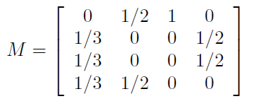
Link Analysis Metrics Page Rank (VI)
(Source: Mining Massive Data Sets Rajaraman, Ullman)
A random surfer at A is likely to visit B, C, D with 1/3 probability each. Someone at B will visit A or D with probability ½
So a transition matrix for the idealized web above would look like this
When a random user opens up a browser he/she might start at any of the pages A,B,C,D. This can be represented by the vector V₀=[¼, ¼, ¼, ¼]^{T}.
After step 1 we get V₁ = MV₀, after step 2 we get V₂=MV₁=M(MV₀) etc.

Slide 23
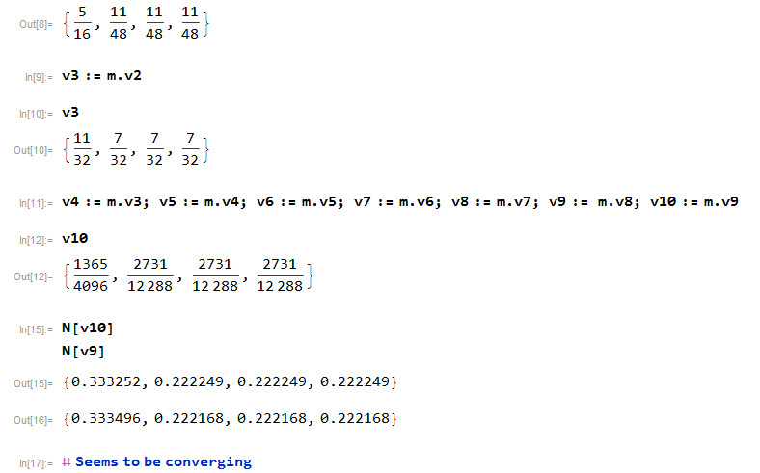
Link Analysis Metrics Page Rank (VII)

Slide 24
Link Analysis Metrics Page Rank (VIII)
Let’s suppose it converges at Vn. Then what we have is Vn+1=Vn or in other words Vn = mVn.
Does that look familiar?

Slide 25
Link Analysis Metrics Page Rank (IX)
It follows that Vn is an Eigenvector.
It’s an Eigenvector that has all non-negative components and components that add up to 1 (since they are probabilities)
This leads to a much easier way to compute the Vector Vn.

Slide 26
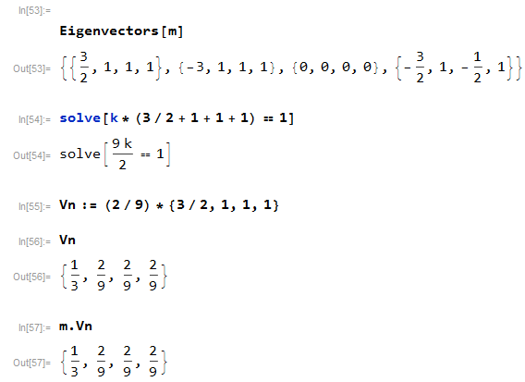
Link Analysis Metrics Page Rank (X)
Thus A is highest ranked and is returned first

Slide 27
Link Analysis Metrics Page Rank (XI)
You might argue that 1/3 is not much higher than 2/9 so the algorithm doesn’t do much
However imagine we have billions of web pages. Ebay.com’s PageRank will be orders of magnitude above Rowan.edu
Let’s see what R does with this

Slide 28

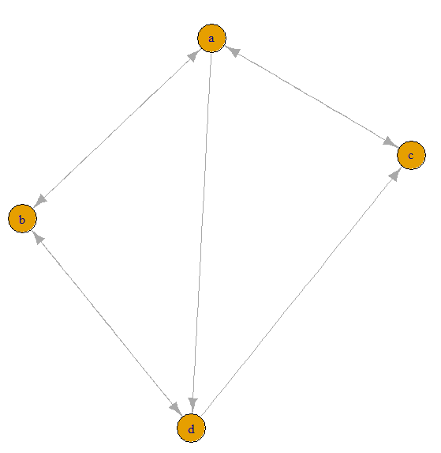
Link Analysis Metrics Page Rank (XII)
Convince yourself that this is the same graph and same PageRank as above

Slide 29
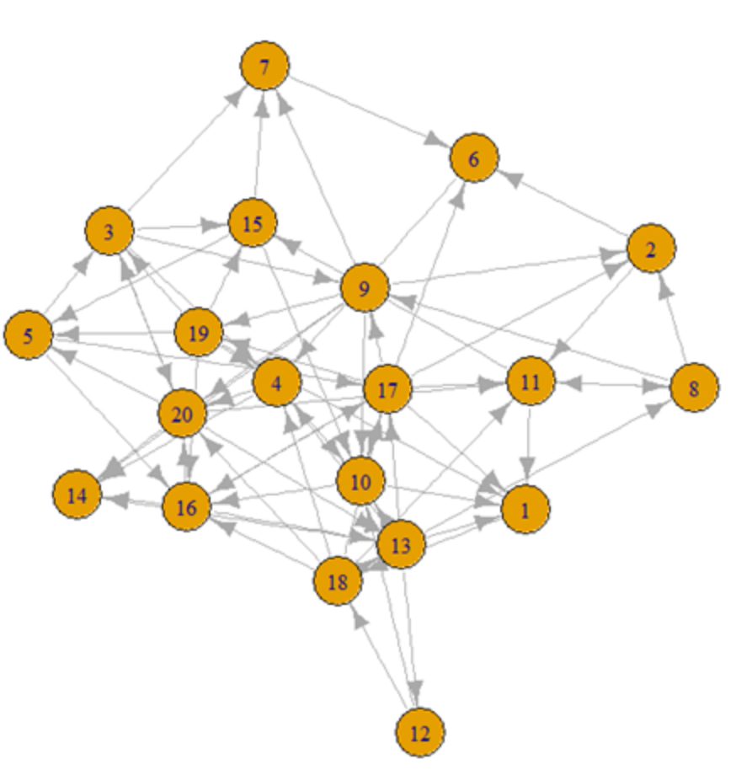
Link Analysis Metrics Page Rank (XIII)
Recall Earlier example

Slide 30
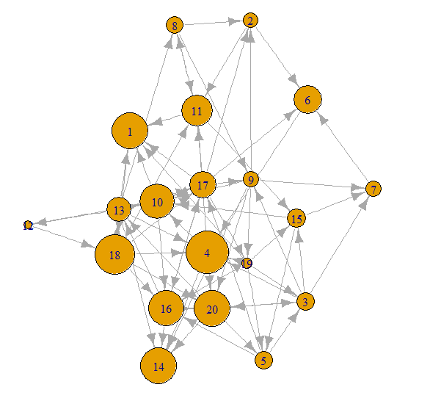
Link Analysis Metrics Page Rank (XIV)
Resized proportional to PageRank
Note that 4 has the highest PageRank. 15 slides back it was second (of 20) among authorities and 9th among hubs.

Slide 31

PageRank Paper Cited 10,000+ Times
Why does it work?
  It’s like citation analysis only better
  It not only ranks pages by the number of pages linking to it, (that would not defeat spam farms)
  It ranks pages as “important” only if they are linked by other “important” papers
  This is actually an idea developed by my old boss and frequent collaborator Francis Narin. (see https://en.wikipedia.org/wiki/PageRank )
  Also see cartoon on Wikipedia page (next slide)

Slide 32
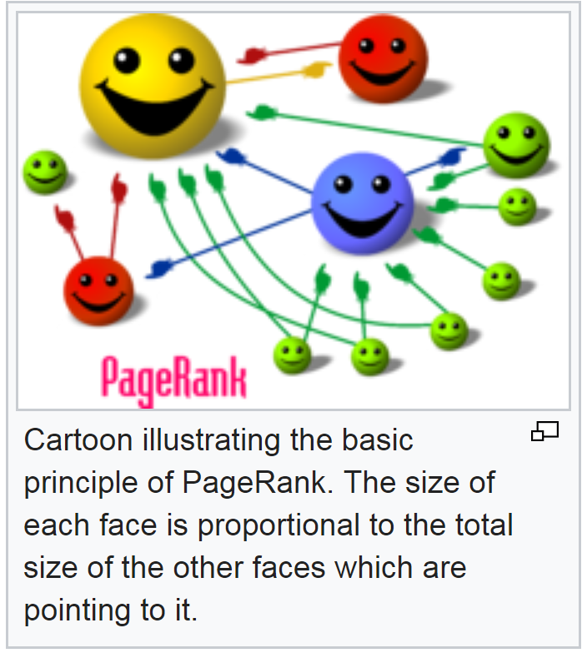
From Wikipedia

