Slide 1
Knowing All Data Science: a minutes long tour of the limits of the space of data science
Ron Neely
2018.Oct.18
https://github.com/SpeedCoder5/notes

Slide 2
Is it possible to know all of Data Science?
In minutes?
What?
How?
Why?
Wide – not deep.
For whom?
New to Data Science
Business Folks - $
Seasoned Data Scientists

Slide 3
Agenda: a perspective – open to suggestions
Covered
Not Covered
What is data science?
Learn: A method to learn fast and recall more
The space of sci-kit learn
A capability maturity model for data science
Deliverables
Limits
Arguably: How NN, AI and ML fit it
Details of
Neural Networks (NN)
Artificial Intelligence (AI)
Machine Learning (ML)

Slide 4
What is data science? Is there anything new? Has it all been done before?
Wikipedia: Data science is an interdisciplinary field that uses scientific methods, processes, algorithms and systems to extract knowledge and insights from data in various forms, both structured and unstructured.
Anything missing from above definition?

Slide 5
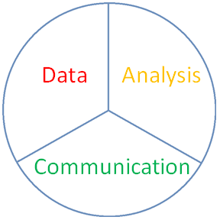
What is data science? Is there anything new? Has it all been done before?
Wikipedia: Data science is an interdisciplinary field that uses scientific methods, processes, algorithms and systems to extract knowledge and insights from data in various forms, both structured and unstructured.
Data => Information => Knowledge
Analysis
Visualization
Predictive Model
Communication
Advice
Repeat
Data Science Wheel

Slide 6
How do you learn quickly? How do you remember what you learned?

Slide 7
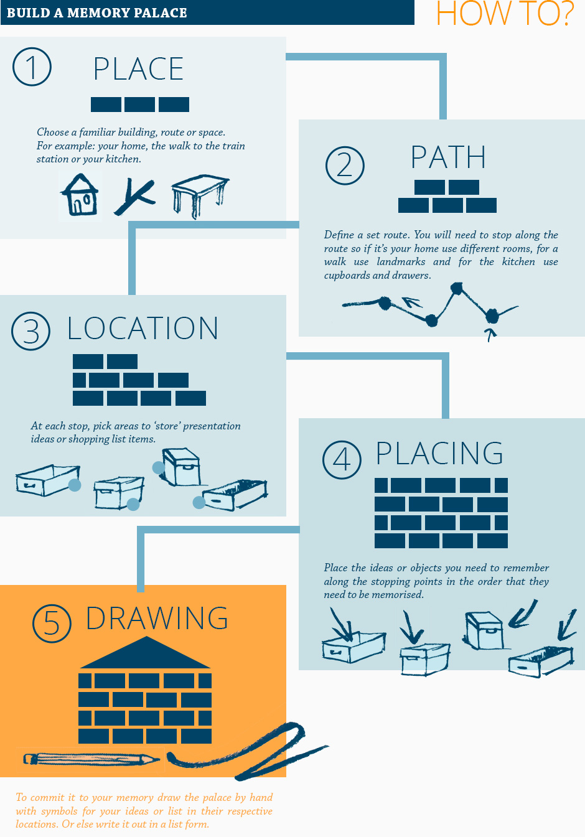

Method of Loci - Learn faster - Recall more
Who? Ancient Greek poet: Simonides of Creos
Are we losing geo-spatial capability?
Use mental “maps” to get to data: Getting to a desired destination requires both:
start point
AND basis with origin
http://advertisementfeature.cnn.com/think-brilliant/memory-palace.html
Notes:
Banquet and collapsed temple. Who was there?
Treasure map, end point, start point, and basis with origin (North, South, East, West)

Slide 8

Method of Loci Map
Drawing

Slide 9

Method of Loci Map
Drawing
Place

Slide 10
Method of Loci Map
Drawing
Place
Path

Slide 11

Method of Loci Map
Drawing
Place
Path
Location

Slide 12
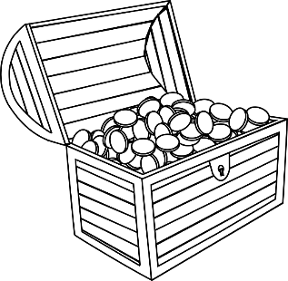
Method of Loci Map
Drawing
Place
Path
Location
Placing

Slide 13

Scikit-learn’s “butterfly map”
Notes:
Start point:

Slide 14
Scikit-learn’s “butterfly map” – with origin and very loosely-defined basis
Supervised
Unsupervised
Categorical
Numeric
Notes:
Supervised: train from known outcomes
Unsupervised: learn and discover relationships in data
Loosely defined: can assign numbers to categories, can assign known labels to clusters

Slide 15
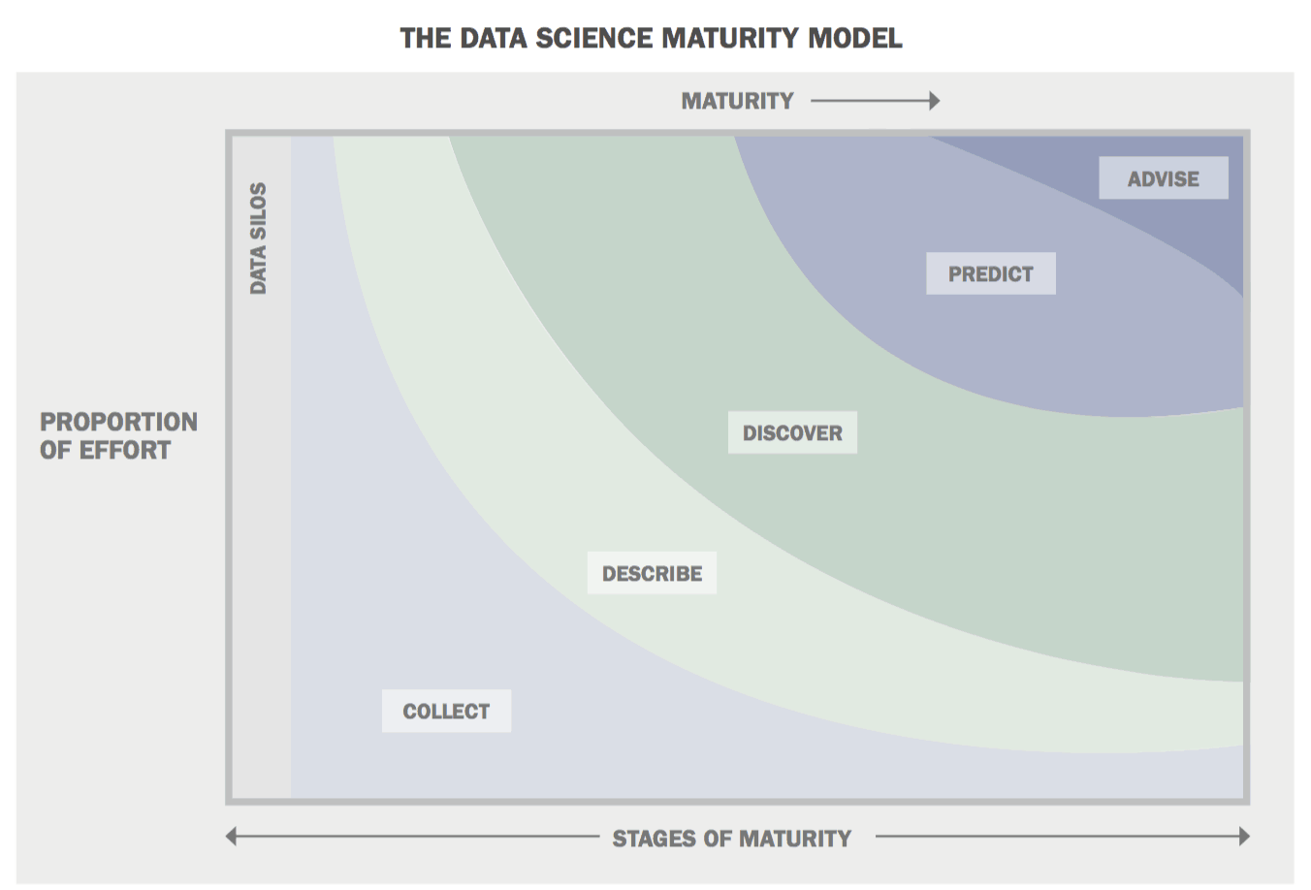
Booz Allen Hamilton's (BAH's) Field Guide to Data Science
Where are you?
Individual
Organization
Per Project
Notes:
What are the origin and basis vectors?

Slide 16
Booz Allen Hamilton's (BAH's) Field Guide to Data Science
Where are you?
Individual
Organization
Per Project
Goal: Advice
Notes:
While advice is the goal what proportion of effort constitutes it as a deliverable? How much space does advise take up on the graph?

Slide 17
Booz Allen Hamilton's (BAH's) Field Guide to Data Science
Where are you?
Individual
Organization
Per Project
Goal: Advice
Notes:
While advice is the goal what proportion of effort constitutes it as a deliverable? How much space does advise take up on the graph?

Slide 18
Booz Allen Hamilton's (BAH's) Field Guide to Data Science
Where are you?
Individual
Organization
Per Project
Goal: Advice
$$$$
$$$
$
$
$
Notes:
While advice is the goal what proportion of effort constitutes it as a deliverable? How much space does advise take up on the graph?

Slide 19
BAH Field Guide: Data Science is the art of turning data into actions:
Tradecraft creates data products
Drive actions – advice – possibility and danger
Supports and encourages shifting between:
Deductive (hypothesis-based) reasoning
Inductive (pattern-based) reasoning
Necessary for companies to compete
Capabilities can be built over time
Different kind of team sport
Company-wide open culture – commitment to insights from data

Slide 20
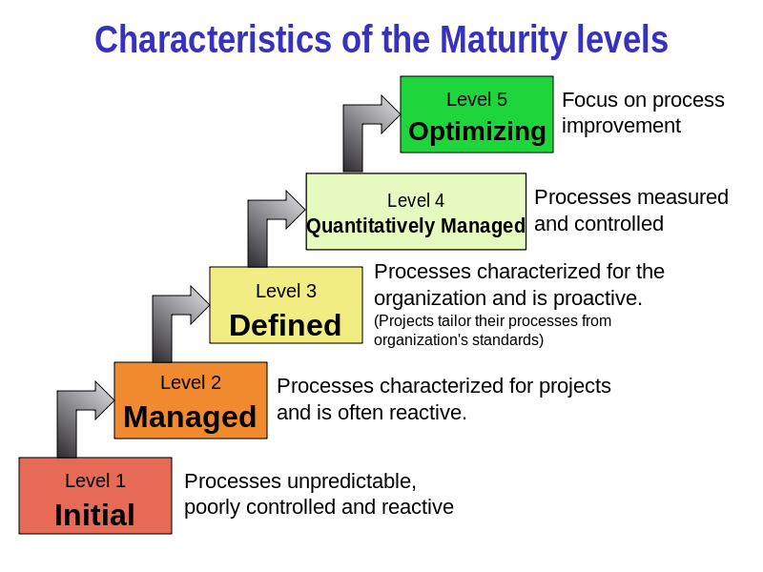
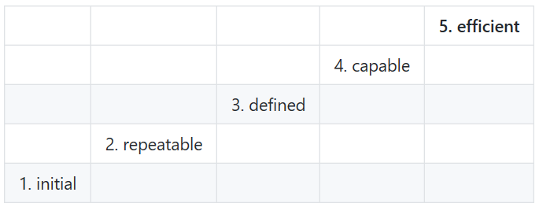
Vs. DoD Process Capability Maturity Model (CMM) Levels?
Earned Value Management = value earned from work being done dau.mil
Plan your work work your plan
source: wikipedia
Effort
Maturity

Slide 21
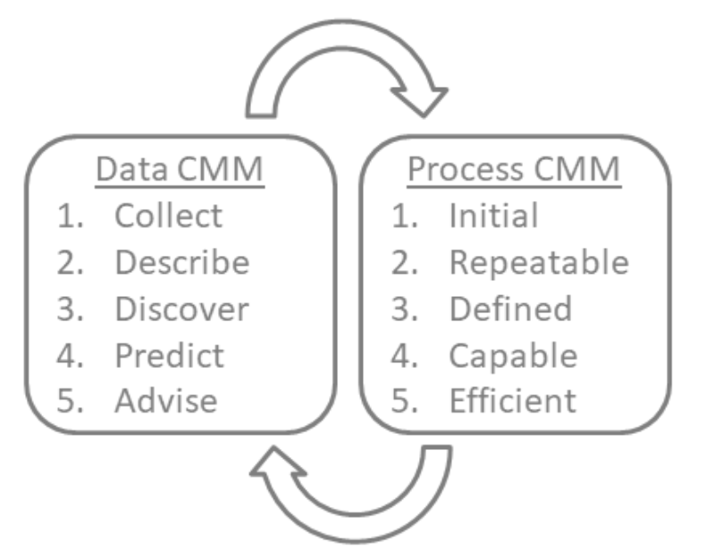
BAH Data CMM and DOD Process CMM Complement Each Other

Slide 22
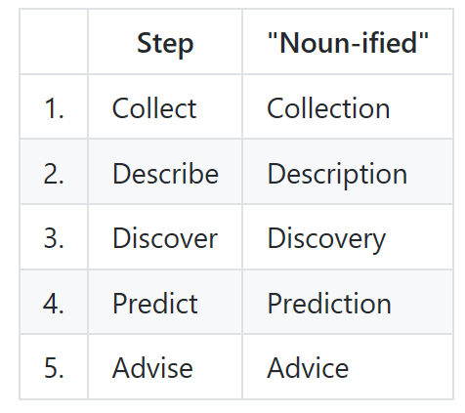
“Noun-ified” Deliverables for Data Science Efforts

Slide 23
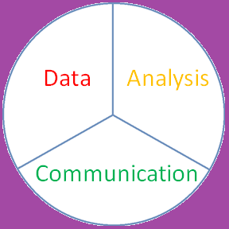
Limits of Data Science – States of Being
Do
Have
Be
Possibility - clockwise (Opportunity):
DS provides Clarity, Predictions, Advice
You declare where to go (what to be) next
Data is only a starting point
Be -> Do -> Have
Empowering
Danger - counterclockwise (Constraint):
DS provides justification to constrain being
Data limits where you can go next
Data becomes beginning and ending
Have -> Do -> Be
Limiting
Advice
Justification
Notes:
Clockwise: be, do, have

Slide 24
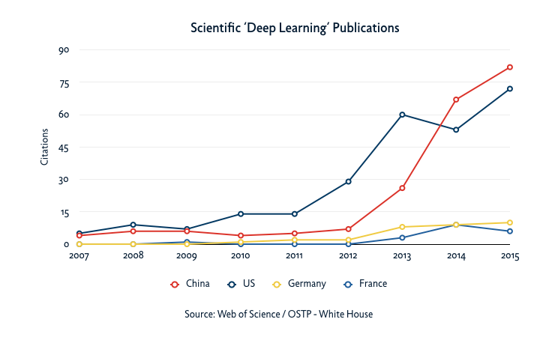
stakes

Slide 25
Thank you
What we covered:
What
How
Why
Limits
of Data Science
What did you learn? Any questions?
Ron Neely https://github.com/SpeedCoder5/notes

