Slide 1

s w i p e m u s i c
Luis ong, kevin Lee, Terrence ho, and Atharva padhye

Slide 2
s w i p e m u s i c
Gesture Controlled Bluetooth Speaker
Play, Skip, Forward, Pause with ease
LEDs dance to the Volume of the music

Slide 3
s w i p e m u s i c
Gesture Sensor
Bluetooth
Speaker
Mic
Spotify Client Server
MCU
LED Strip
Backend Server

Slide 4

s w i p e m u s i c
FUTURE APPLICATIONS
HANDS FREE media control system
Can be applied to smart watch technology…
Used to control many applications from electronics to house-hold appliances

Slide 5
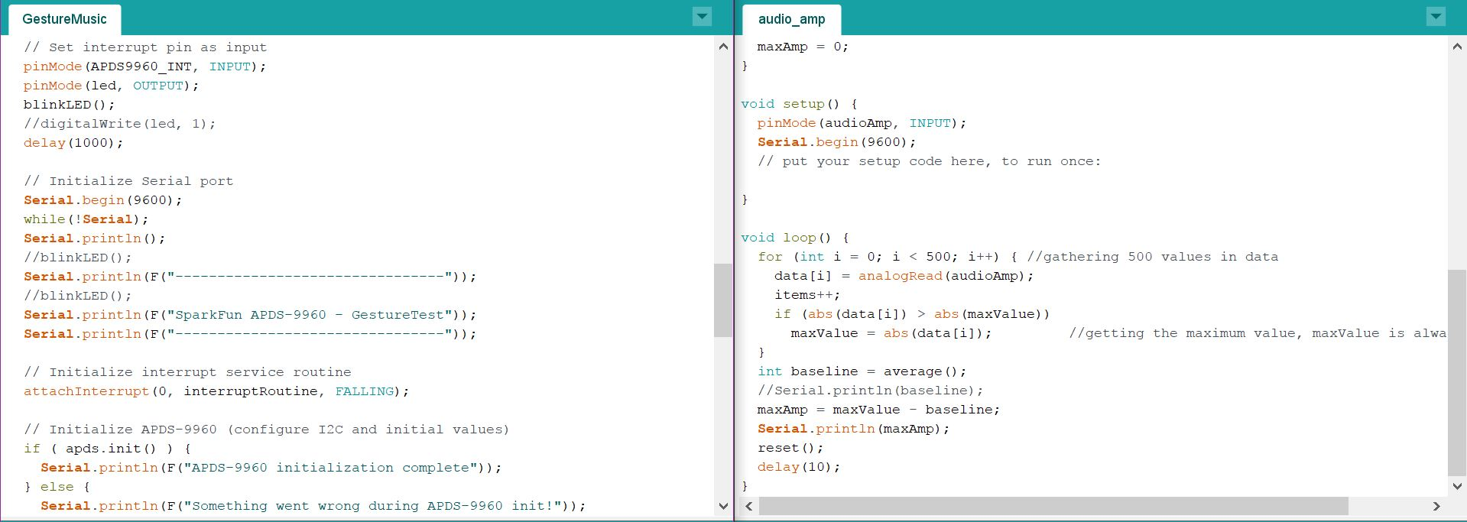

Slide 6

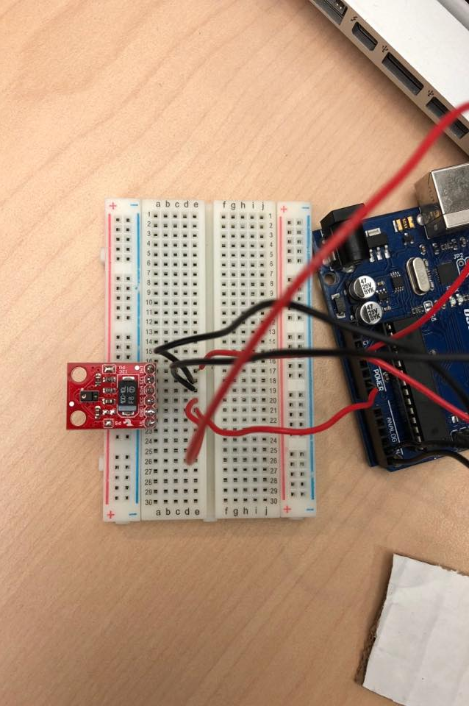
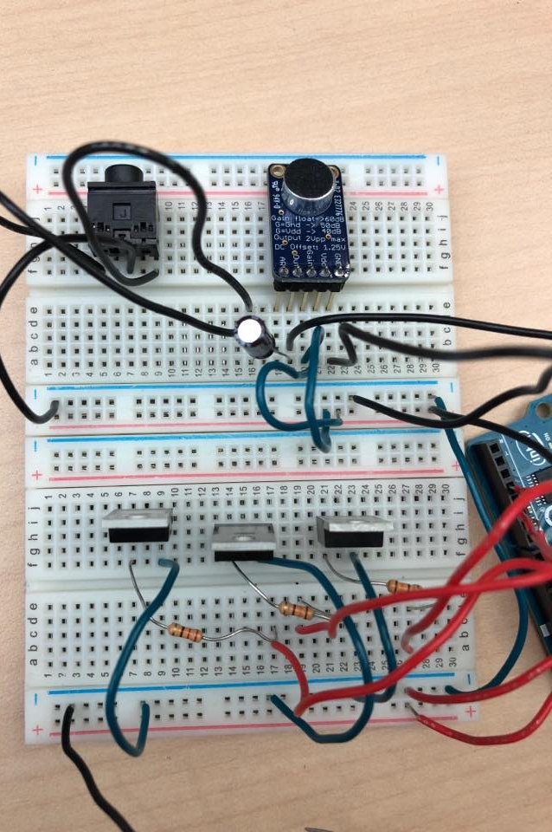



s w i p e m u s i c

Slide 7
Any Questions?

Slide 8
Thanks!

