Slide 1
Employee salary prediction using linear regression
CAPSTONE PROJECT
Presented By:

Slide 2
OUTLINE
Problem Statement
System Development Approach
Algorithm & Deployment (Step by Step Procedure)
Result
Conclusion
Future Scope
References

Slide 3
Problem Statement
The main purpose of the Employee Salary Prediction project is to estimate an employee's salary based on experience or other factors
The motive is to make the hiring and salary process more accurate, efficient, and data-driven.
It’s also useful for learners to understand how machine learning can solve real business problems
It supports data-based decision-making in hiring and budgeting
Reduces manual effort in calculating salaries and minimizes human bias.

Slide 4
System Approach
1. System Requirements
To build and run this project, the following system setup is recommended:
Operating System: Windows 10 / 11, Linux, or macOS
Processor: Intel i3 or above (or equivalent)
RAM: Minimum 4 GB (8 GB recommended)
Software:
Python (version 3.7 or above)
Jupyter Notebook or any Python IDE (VS Code, PyCharm, etc.)
Web Browser (for viewing notebooks or web app)

Slide 5
2. Libraries Required to Build the Model
The following Python libraries are used to build the Linear Regression model and support data handling and visualization
Library | Purpose
pandas | To load and manage structured data in table format (DataFrames)
numpy | For numerical operations and array handling
matplotlib | To create basic graphs and visualizations
seaborn | For advanced and beautiful data visualizations
scikit-learn | To perform machine learning tasks like regression, train-test split, and evaluation

Slide 6
Algorithm & Deployment
Step 1: Import Required Libraries
Import required Python libraries for data handling, visualization, and machine learning
Each library serves a purpose:
pandas- to work with data in table
numpy- for numerical operations
matplotlib.pyplot & seaborn- for plotting graphs
sklearn.linear_model.LinearRegression – to build our linear regression model
train_test_split – to divide our data into training and test sets
mean_squared_error, r2_score- to evaluate the model’s performance

Slide 7
Step 2: Create or Load the Dataset
Create or load a dataset containing employee experience (in years) and their corresponding salaries
data = {
'Experience': [1, 2, 3, ..., 10],
'Salary': [30000, 35000, ..., 80000]
}
This dataset maps years of experience to salary, allowing the model to learn the relationship between them
Step 3: Visualize the Data
Plot a scatter graph of experience vs. salary to understand the pattern (usually linear in this case)
To visually confirm that the data has a linear trend (as required by linear regression)
Step 4: Split Data into Train and Test Sets
Split the dataset into training and testing sets

Slide 8
Step 5: Train the Linear Regression Model
Create a linear regression model and train it using the training data (x_train, y_train).
Step 6: Make Predictions
Use the trained model to predict salaries for the test set (x_test) and compare with actual salaries
Step 7: Evaluate the Model
Measure the model's performance using evaluation metrics like:
Mean Squared Error (MSE)
R² Score (Coefficient of Determination)
Step 8: Plot Regression Line
Plot the original data points and overlay the regression line to show the model's fit visually
Step 9: Predict Salary for Custom Input
Take custom input (e.g., 6.5 years of experience), pass it to the model, and display the predicted salary

Slide 9
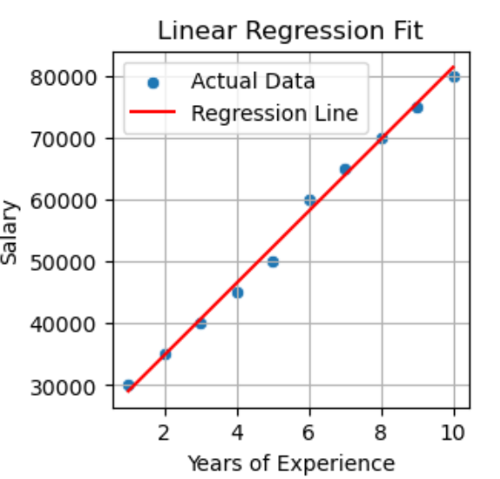
Result

Slide 10
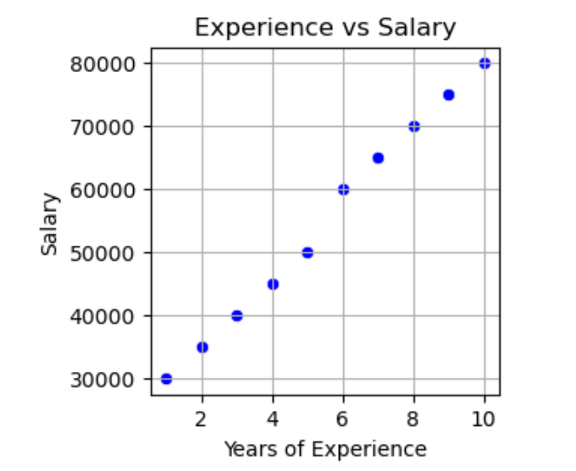

Slide 11
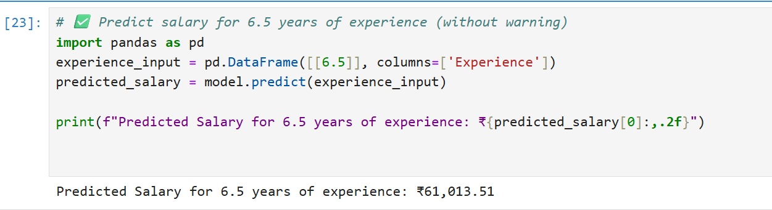

Slide 12
Git hub link below:-
https://github.com/Swati2001-singh/Employee-Salary-Prediction-.git

Slide 13
Conclusion
The Employee Salary Prediction using Linear Regression demonstrates how machine learning can be used to predict outcomes based on historical data. In this case, we predicted an employee’s salary based on their years of experience.
By training the model on a sample dataset, we established a linear relationship between experience and salary. The model was able to make reasonably accurate predictions, as seen in the test evaluation metrics and visual regression line.
This project shows that Linear Regression is a simple yet effective algorithm for solving real-world regression problems. It can be useful for HR departments, job portals, and salary benchmarking platforms to make data-driven salary decisions.
In future versions, we can improve accuracy by including more features like education level, job role, location, and skill sets, and using more advanced machine learning models.

Slide 14
Future scope(Optional)
The future scope of the Employee Salary Prediction is broad and promising. As the job market continues to evolve, this system can be enhanced by including more detailed features such as education level, skills, location, job title, and industry type to make predictions more accurate and personalized. In the long run, it can be integrated into HR management systems and recruitment platforms to help employers make data-driven decisions when offering salaries. Additionally, with the adoption of more advanced machine learning techniques like decision trees, ensemble models, or deep learning, the model's prediction capabilities can significantly improve. This project also has the potential to guide job seekers by showing them how to increase their earning potential based on market trends and career development paths. Ultimately, it contributes to building fair, transparent, and efficient compensation systems in both local and global job markets.

Slide 15
References
https://www.google.com
https://www.slideshare.net/

Slide 16
THANK YOU

