Slide 1
StartIQ Startup blueprint generator agent
CAPSTONE PROJECT
Presented By:
HITANSHI MEHTA
Dept: Informaion Technology
College: Government Engineering College, Gandhinagar.

Slide 2
OUTLINE
Problem Statement
Technology used
Wow factor
End users
Result
Conclusion
Git-hub Link
Future scope
IBM Certifications

Slide 3
Problem Statement
Starting a business is hard — especially when you don’t know where to begin or how to create a solid plan. Most new founders don’t have access to expert advice, real startup examples, or tools that explain things clearly.
Proposed Solution: A Startup Blueprint Generator Agent, powered by RAG (Retrieval-Augmented Generation), transforms raw startup ideas into complete, actionable business blueprints.

Slide 4
Technology used
IBM cloud lite services:
Watsonx.ai Studio
Watsonx.ai Runtime
Cloud Object Storage
Natural Language Processing (NLP)
Retrieval Augmented Generation (RAG)
IBM Granite model

Slide 5
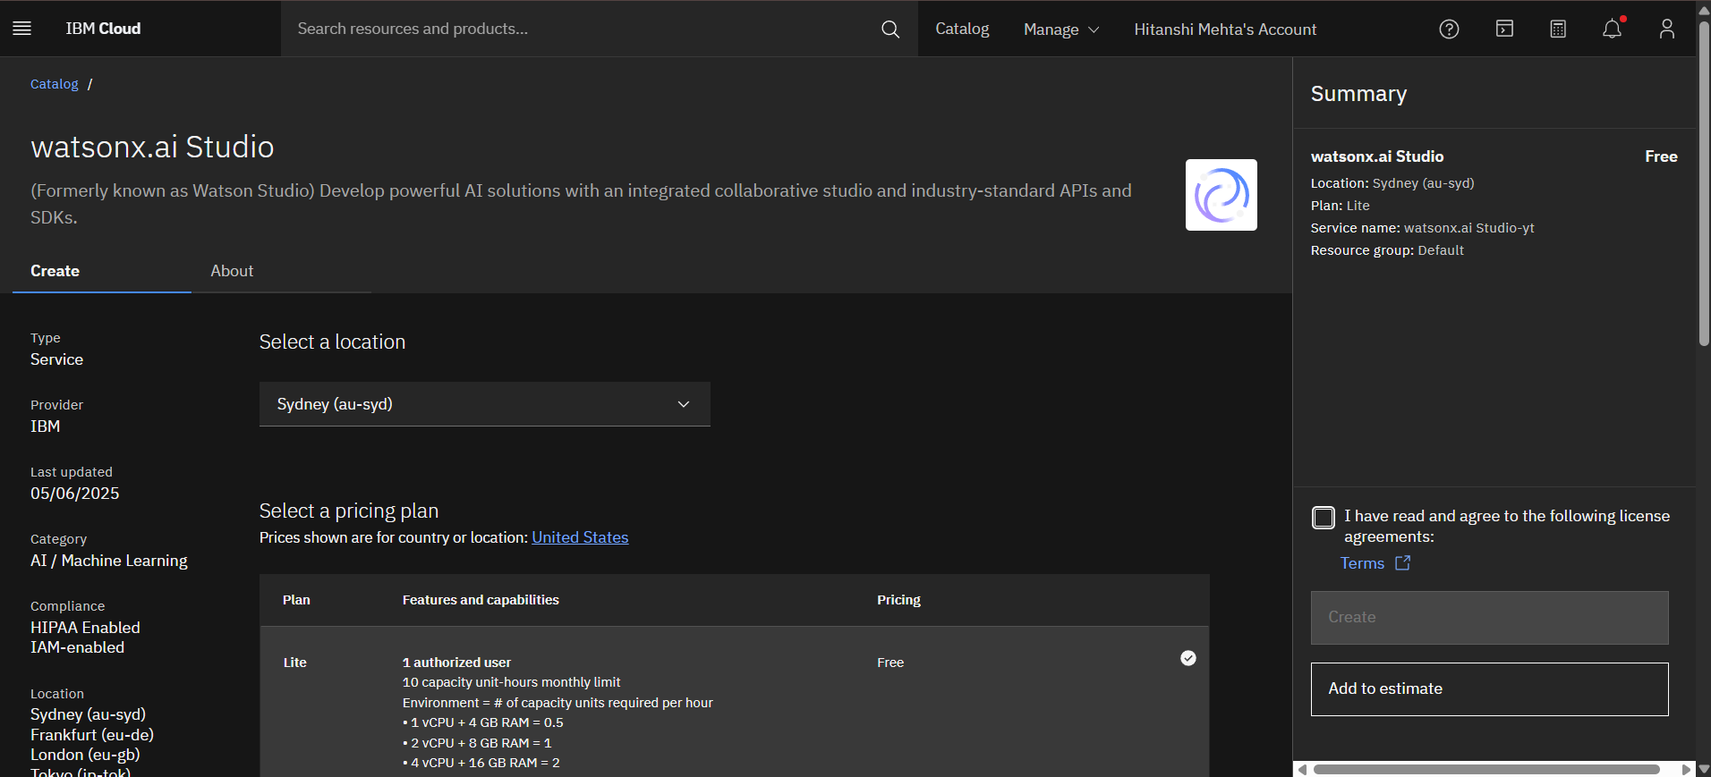
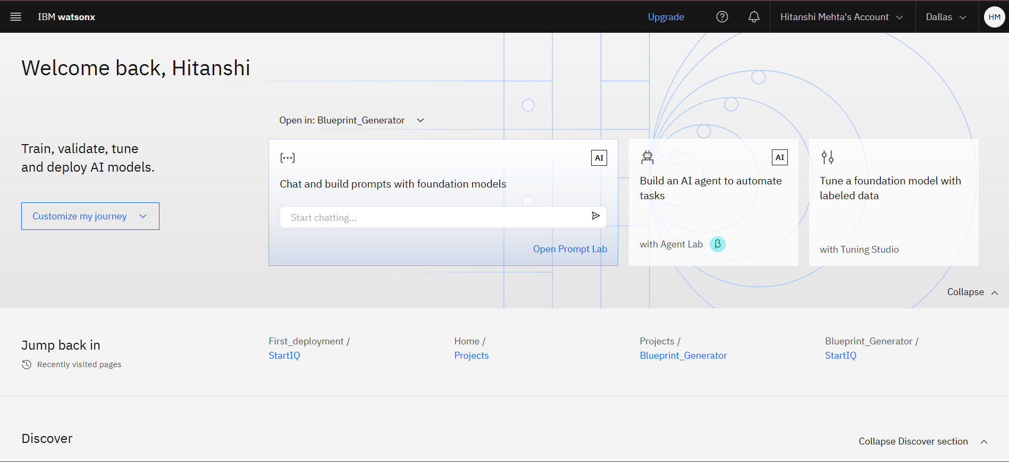
IBM cloud services used
IBM Cloud Watsonx AI Studio
IBM Cloud Watsonx AI runtime
IBM Cloud Agent Lab
IBM Granite foundation model

Slide 6
Wow factors
StartIQ helps founders turn ideas into complete, investor-ready startup plans instantly. Just describe your idea, and it generates a smart, structured blueprint grounded in real startup knowledge.
Unique features:
Builds complete, ready-to-use startup plans in minutes.
Grounded in real-world startup data, not just AI guesses.
Talks like a co-founder - clear, friendly, and practical.
Adapts to your idea, stage, and industry automatically.
Delivers investor-ready content you can actually use.
Replaces templates and research with instant, smart guidance.

Slide 7
End users
First-time founders – who need step-by-step startup guidance.
Solo entrepreneurs – building and validating ideas on their own.
Student innovators – working on startup ideas or competitions.
Non-technical founders – needing clear, jargon-free planning help.
Early-stage teams – aligning on roadmap, GTM, and business model.

Slide 8
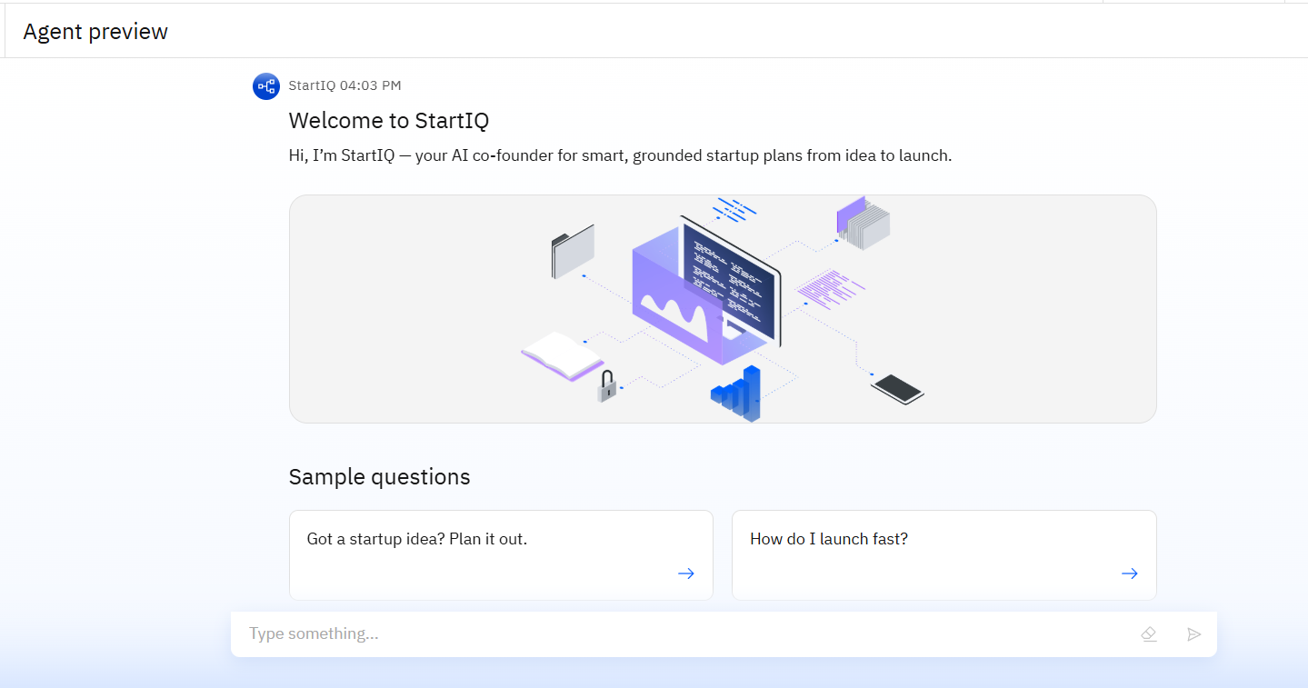
Results

Slide 9
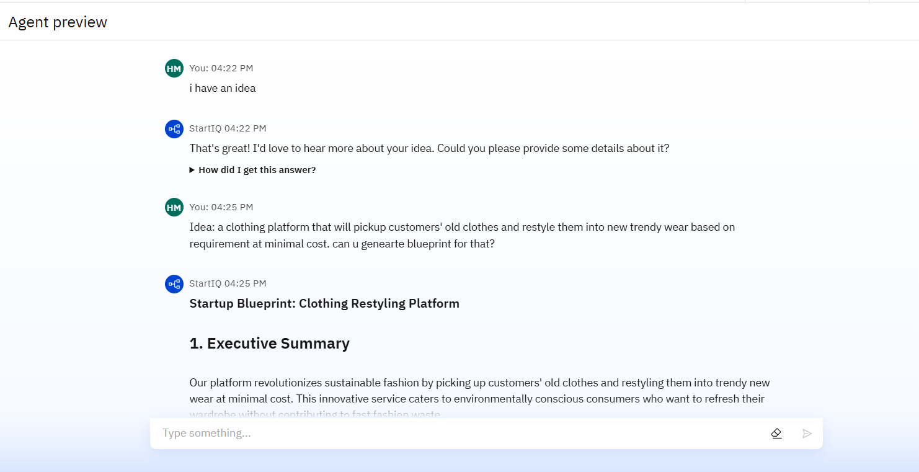
Results

Slide 10
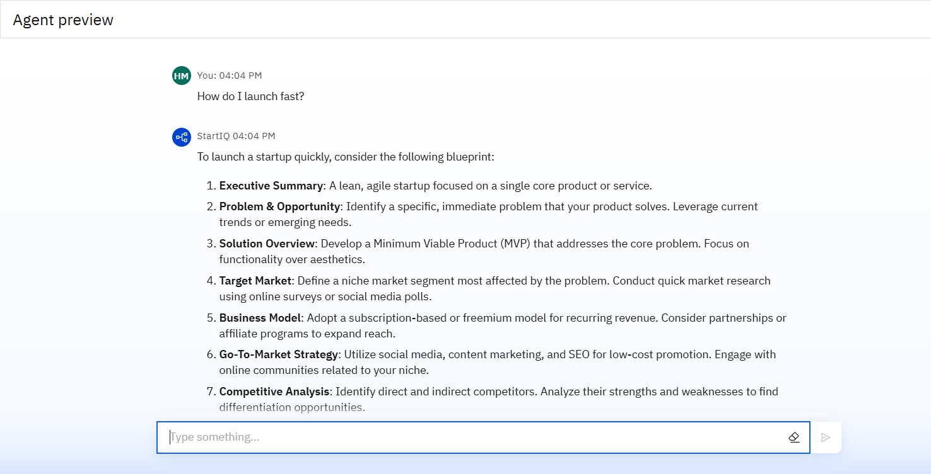
Results

Slide 11
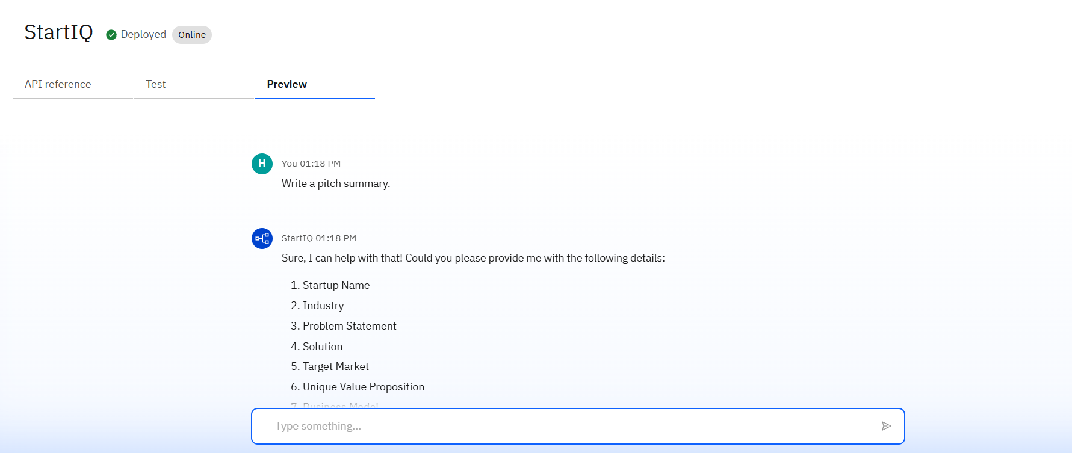
Results
Deployed AI Agent

Slide 12
Conclusion
StartIQ simplifies startup planning by turning ideas into clear, structured, investor-ready blueprints.
It combines the power of AI with real-world startup knowledge, ensuring advice is practical, not just generic.
Designed for early-stage founders, StartIQ acts like a smart co-founder - always ready to guide, adapt, and support.

Slide 13
Future scope
Plans that match your personality and way of working.
Custom advice based on your country and industry.
Turn your plan into a full pitch deck with one click.
Get matched with the right co-founders, mentors, or programs.
Track your progress and stay on top of next steps.
Get updates to your plan as markets and trends change.

Slide 14
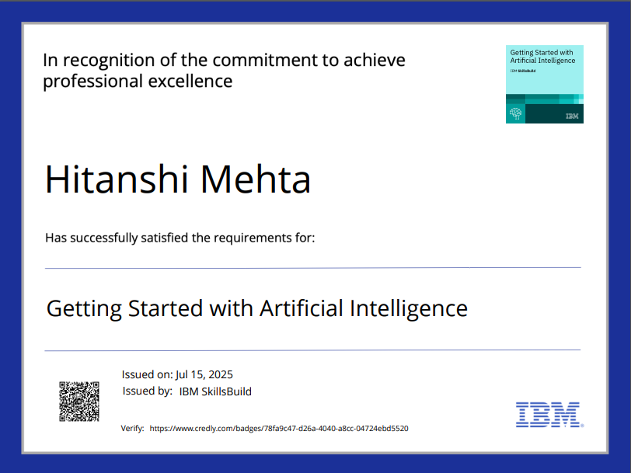
IBM Certifications

Slide 15
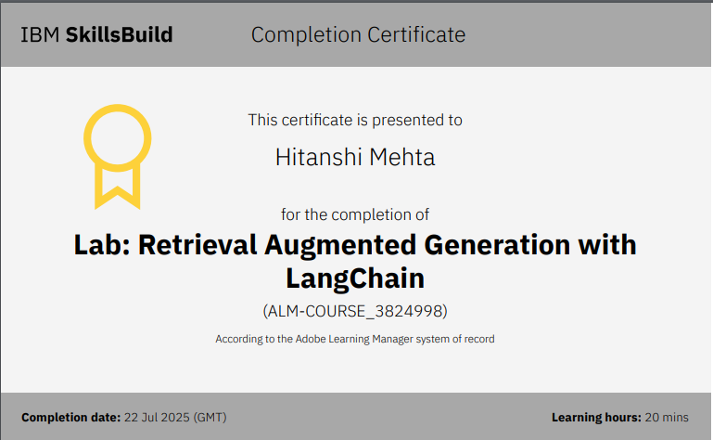

Slide 16


Slide 17
GitHub Link
https://github.com/codeHit-24/IBM_INTERNSHIP.git

Slide 18
THANK YOU!

