Slide 1


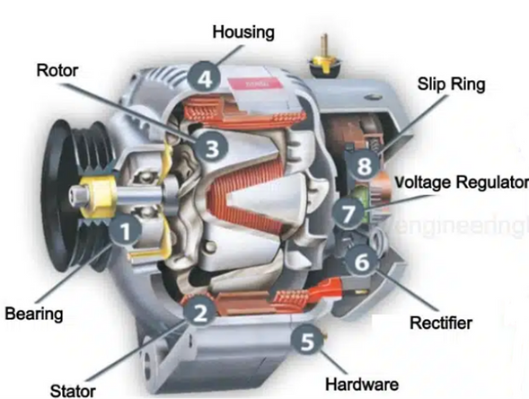
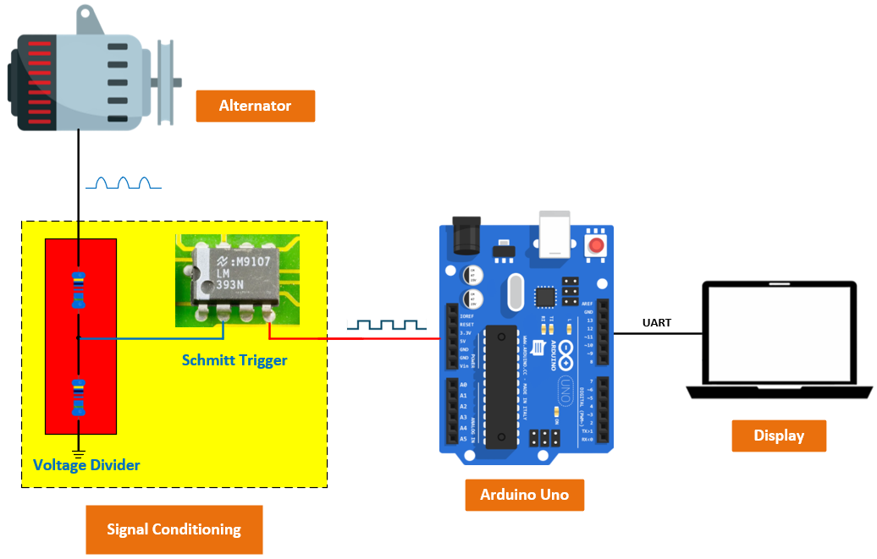
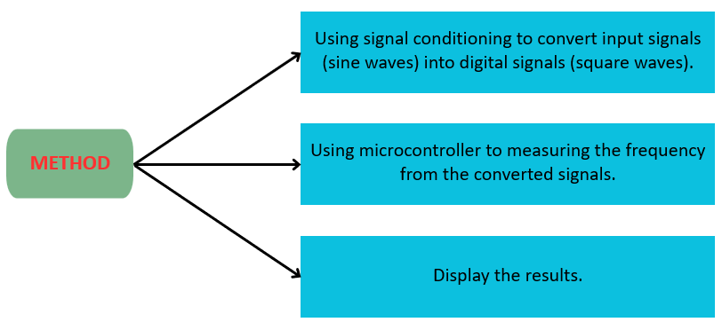
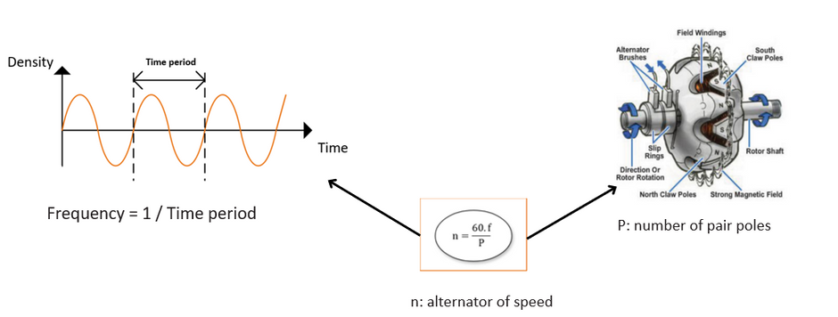
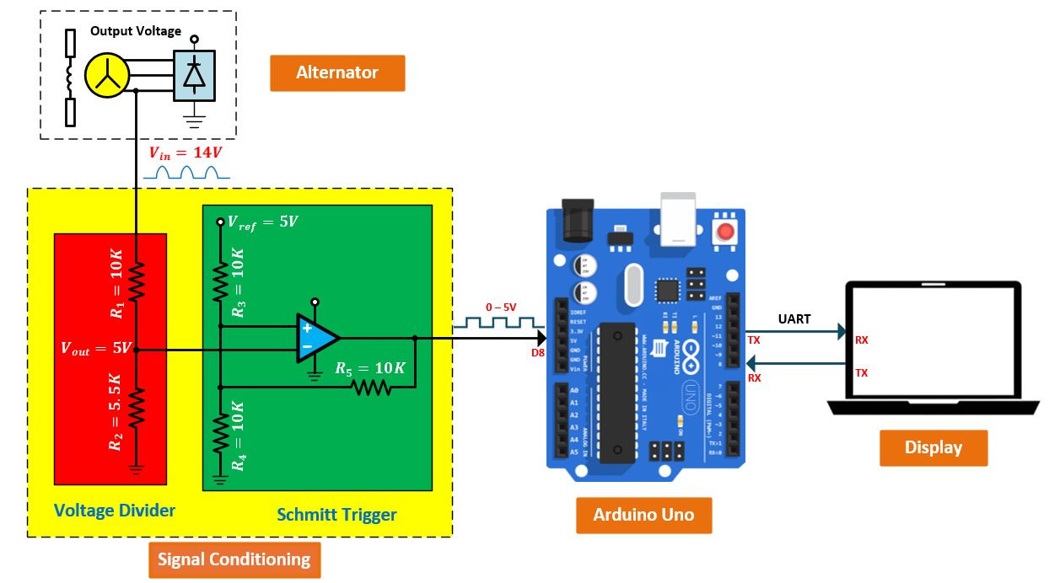
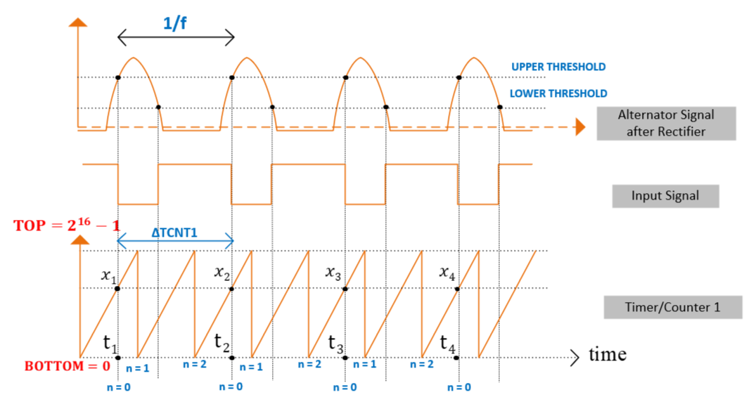
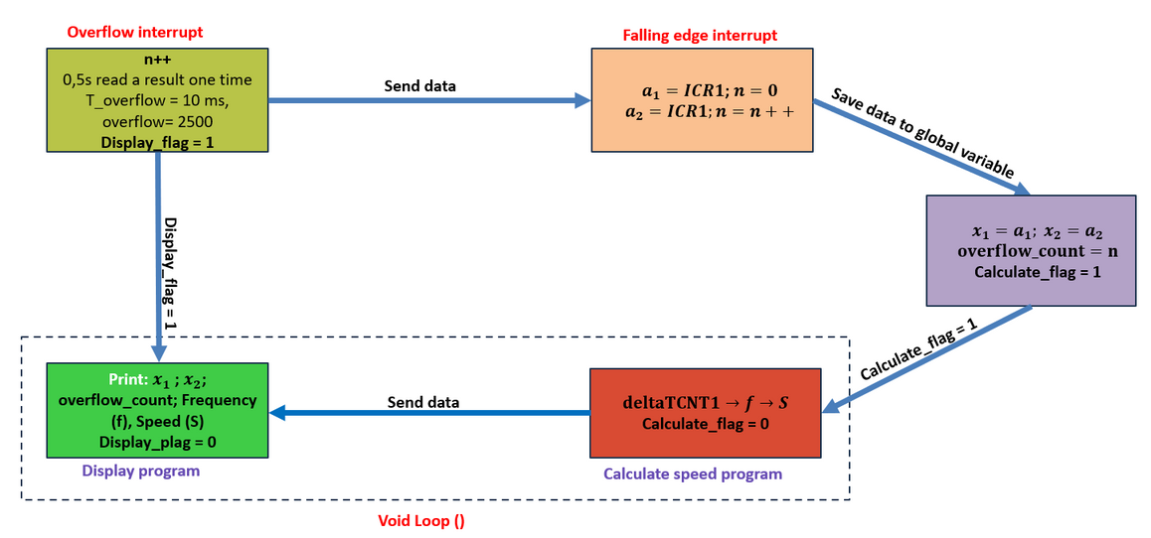
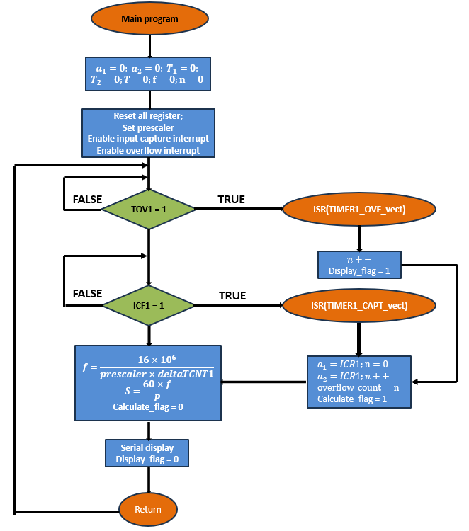
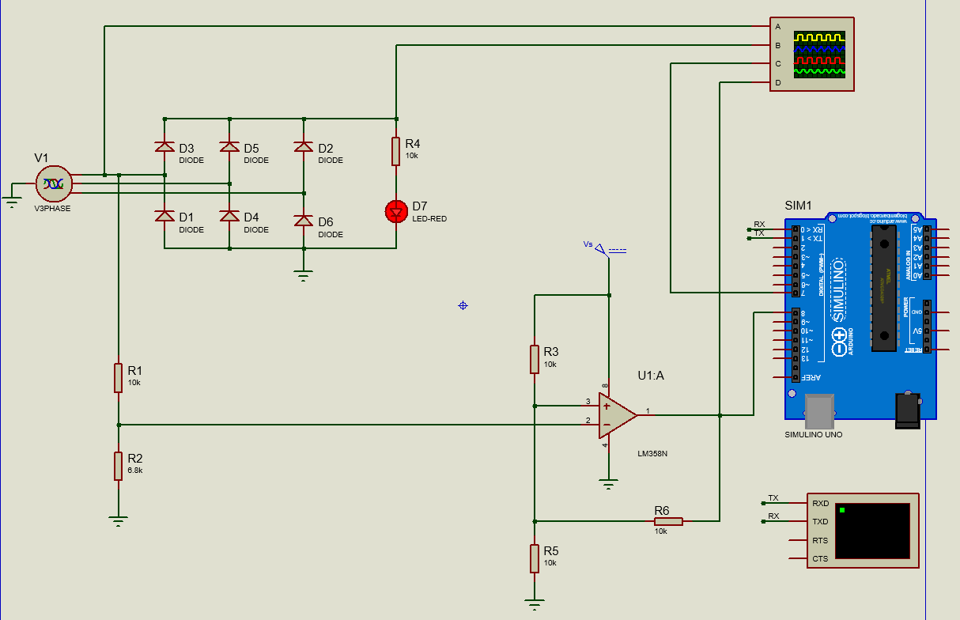
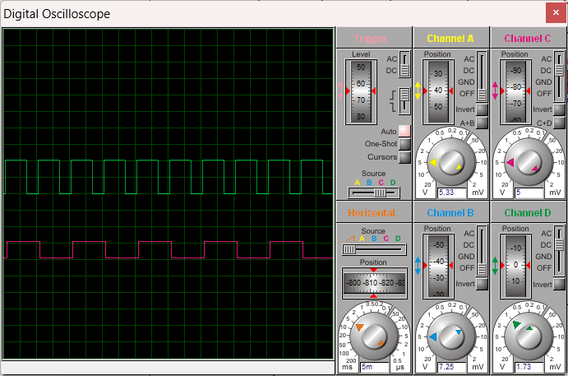
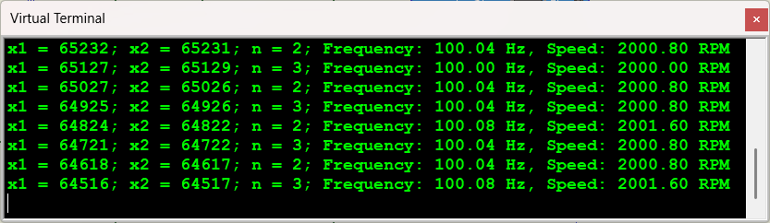
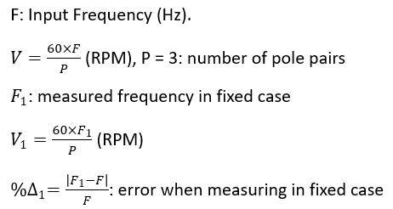
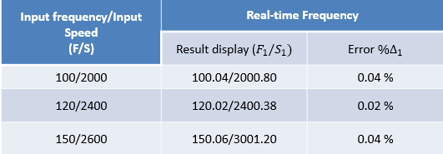
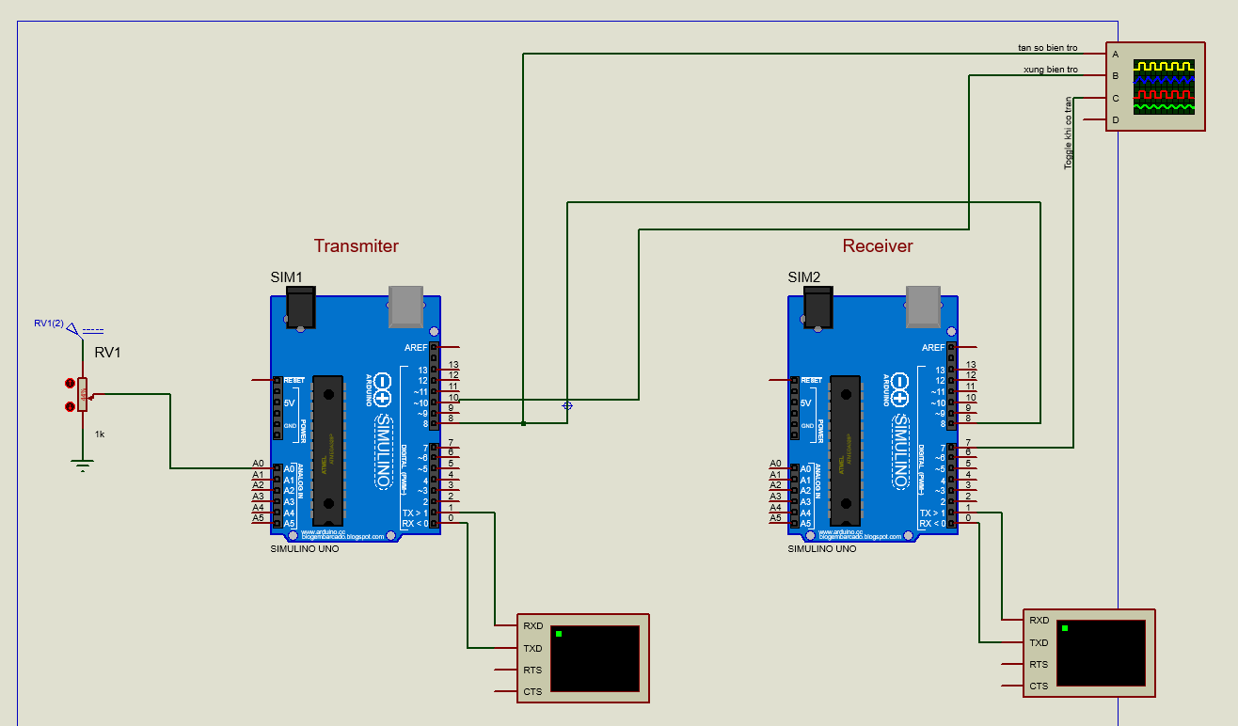
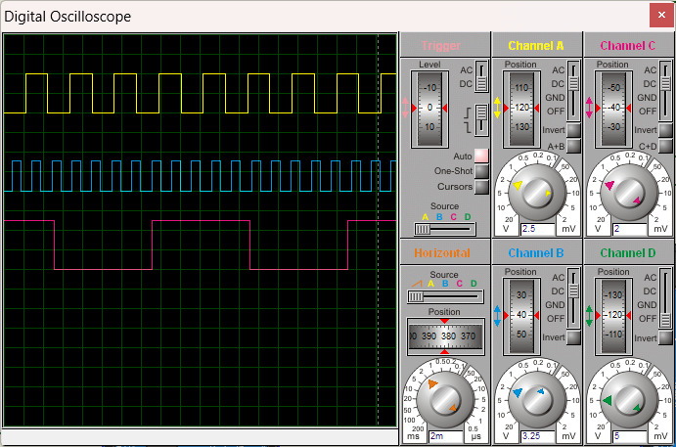
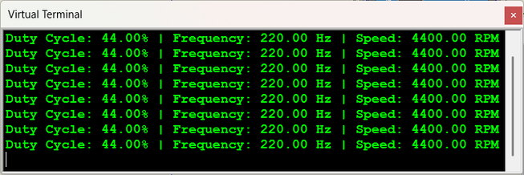
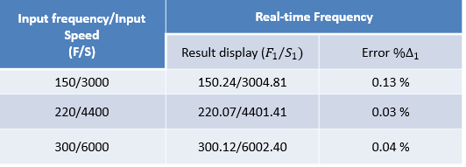
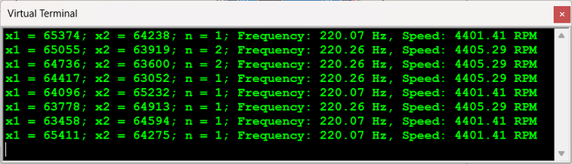
HO CHI MINH UNIVERSITY OF TECHNOLOGY
OFFICE FOR INTERNATION STUDY PROGRAM
DEPARTMENT OF AUTOMOTIVE ENGINEERING
DESIGN A MEASURING SYSTEM AND METHOD FOR MEASURING THE SPEED OF AN ALTERNATOR
Student: Nguyễn Quốc Kiệt ID: 1952802
Instructor: Ph.D Trần Đăng Long
1. General information about alternator:
I. INTRODUCTION
3. Mesuring method
The alternator is a 3-phase synchronous generator.
Phase voltage is the voltage measured across a single component in a three-phase source or load.
Figure 1. Alternator
2. The relationship between alternator speed and frequency:
Objectives: Design a measuring system and method for measuring the speed of an alternator. The system is designed to accurately measure important parameters including frequency and operating speed of the alternator.
System requirements:
- Measurement: error less than 5%
- Measuring range: 500 – 15000 RPM.
- Graphical User Interface: clear and user-friendly.
Figure 2. Formula to calculate the Speed of Three-Phase Synchronous Generator
Figure 3. General layout diagram
II. WIRING DIAGRAM
III. TIMING DIAGRAM
IV. WORK-FLOWS
V. ALGORITHMS
VII. SIMULATION AND RESULTS
1. Fixed frequency case:
Figure 5. Fix frequency case result display
Figure 4. Program simulation on Proteus
2. Real-time frequency case:
Table. Results for the fixed frequency case show errors
VIII. CONCLUSION
✓ Generator speed measurement system is stable
✓ Speed ​​value is read continuously and error-free
✓ Speed ​​error is always less than 5%
✓ Display information clearly and accurately
Figure 6. Program simulation on Proteus
Table. Results for the real-time frequency case show errors
Figure 7. Real-time frequency case result display

