Slide 1



Ho Chi Minh City University of Technology
Faculty of Transportation Engineering
WEEKLY-REPORT
Student name’s: Nguyen Quoc Kiet
ID: 1952802

Slide 2

CONTENT
01
INTRODUCTION
02
THEORETICAL BASIS
03
GENERAL LAYOUT DESIGN
04
WIRING DIAGRAM
05
TIMING DIAGRAM
06
ALGORITHMS
07
SIMULATION AND RESULTS

Slide 3
INTRODUCTION
This report will show the measuring product design and the method how to measure the alternator’s speed.
Using Arduino Uno to measure the single phase’s frequency then calculate the alternator’s RPM
Testing in room temperature 25(Degrees); no shock or vibration; test in short time (< 30 minutes)
Measuring range: 500 – 8500 RPM
Error ≤ 5%

Slide 4
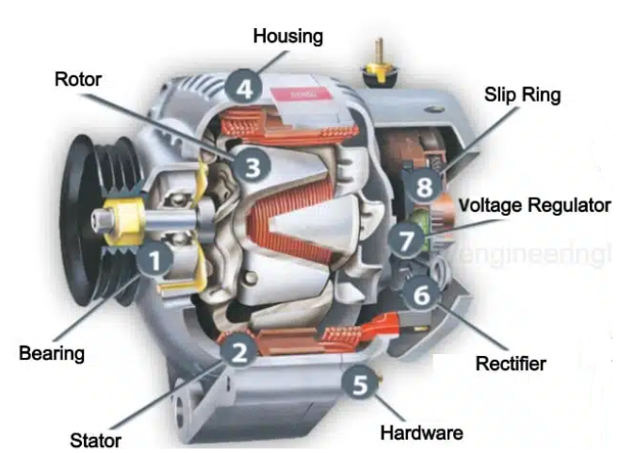
THEORETICAL BASIS
General Information
The alternator is a 3-phase synchronous generator
Phase voltage: is the voltage measured across a single
component in a three-phase source or load

Slide 5
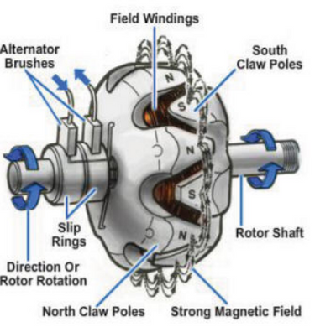
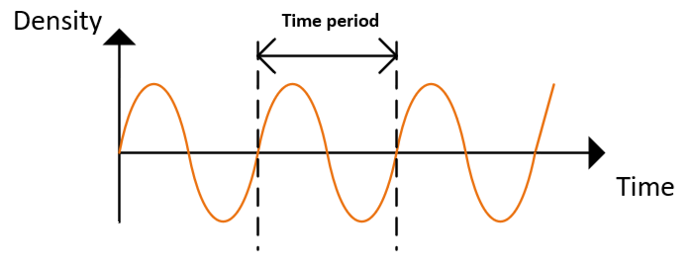
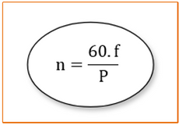
THEORETICAL BASIS
2. The relationship between alternator’s speed and frequency
Frequency = 1 / Time period
P: number of pair poles
n: alternator of speed

Slide 6
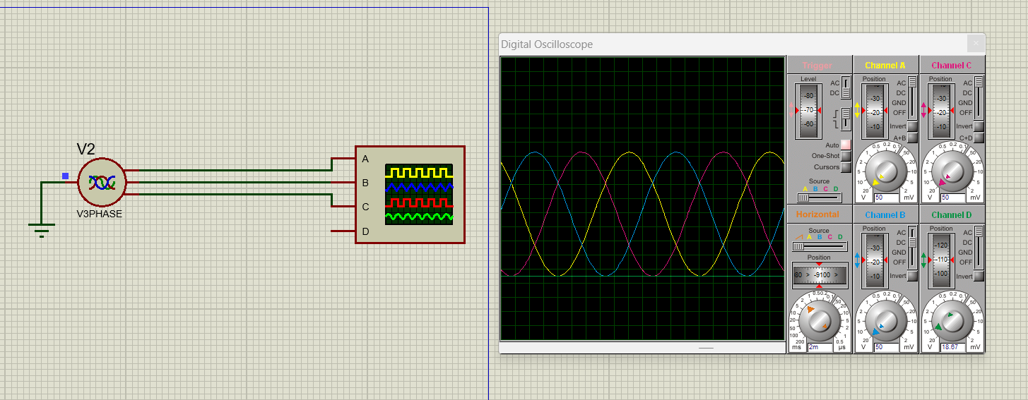
THEORETICAL BASIS
2. The relationship between alternator’s speed and frequency
Figure: Frequency of 3-phase (AC) voltage

Slide 7
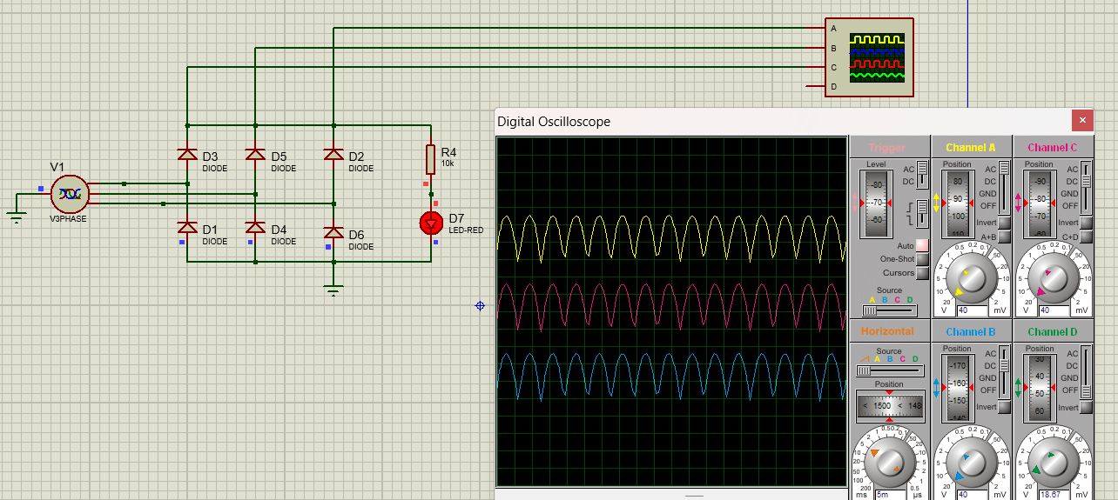
THEORETICAL BASIS
2. The relationship between alternator’s speed and frequency
Figure: Single phase voltage signal after rectifier

Slide 8
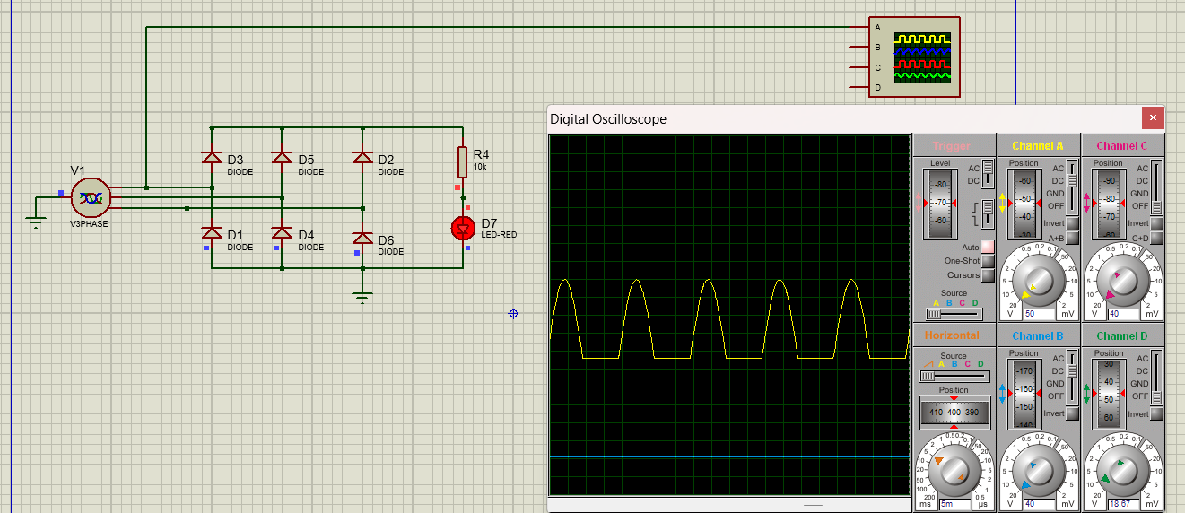
THEORETICAL BASIS
2. The relationship between alternator’s speed and frequency
Figure: Frequency of one phase voltage with respect ground

Slide 9
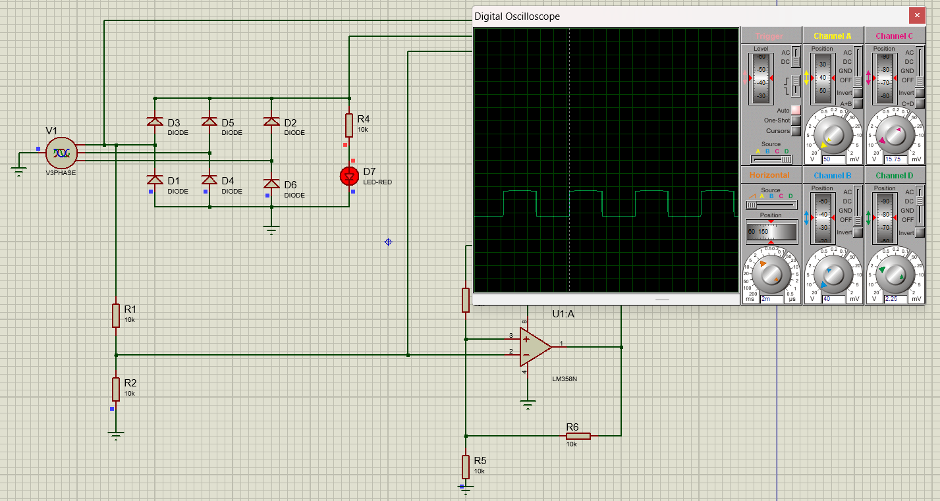
THEORETICAL BASIS
2. The relationship between alternator’s speed and frequency
Figure: Frequency of one phase voltage after Schmitt Trigger

Slide 10

THEORETICAL BASIS
3. Measuring method:
Using signal conditioning to convert input signals (sine waves) into digital signals (square waves).
Using microcontroller to measuring the frequency from the converted signals.
METHOD
Display the results.

Slide 11
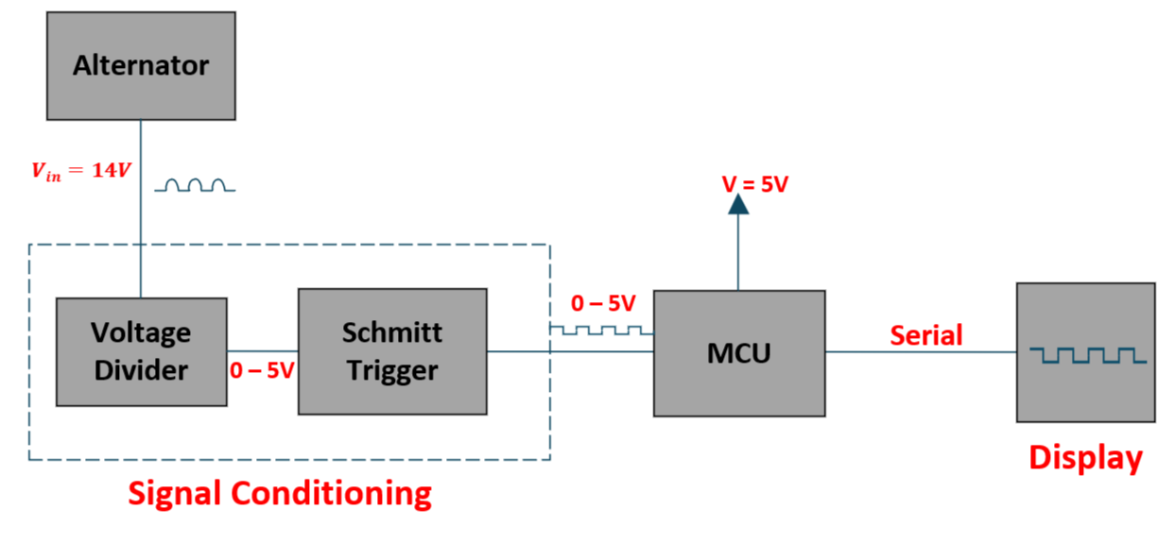
GENERAL LAYOUT DESIGN

Slide 12
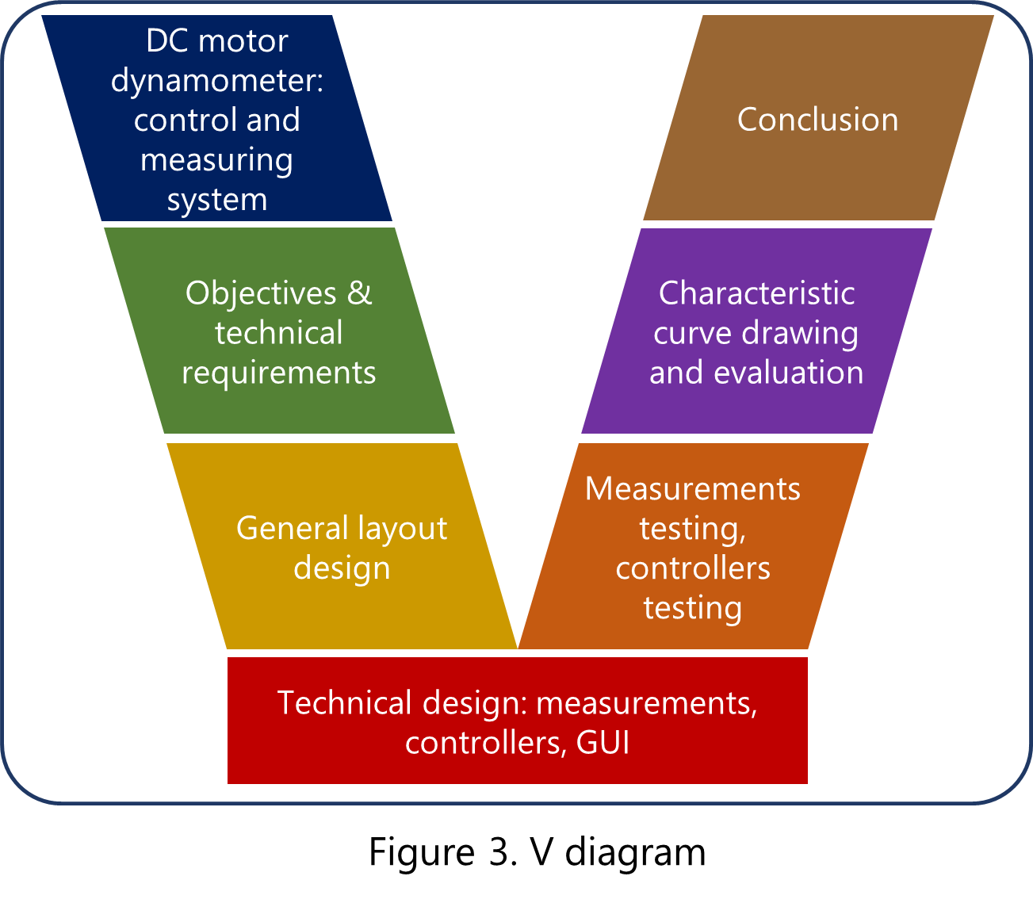
DC motor dynamometer: control and measuring system
Conclusion
Objectives & technical requirements
Characteristic curve drawing and evaluation
General layout design
Measurements testing, controllers testing
Technical design: measurements, controllers, GUI
Figure 3. V diagram

Slide 13
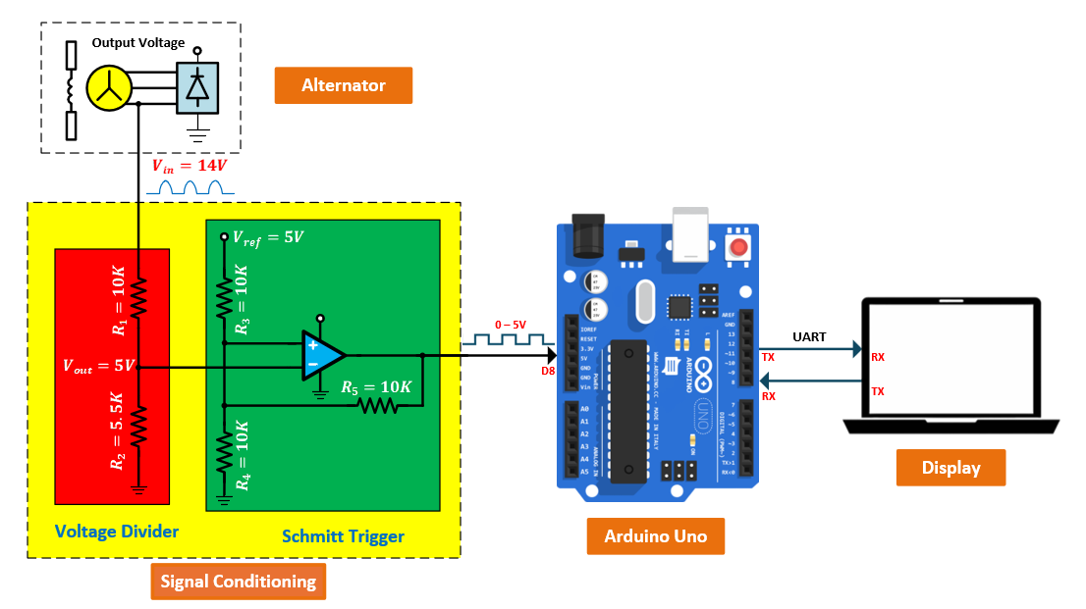
WIRING DIAGRAM

Slide 14
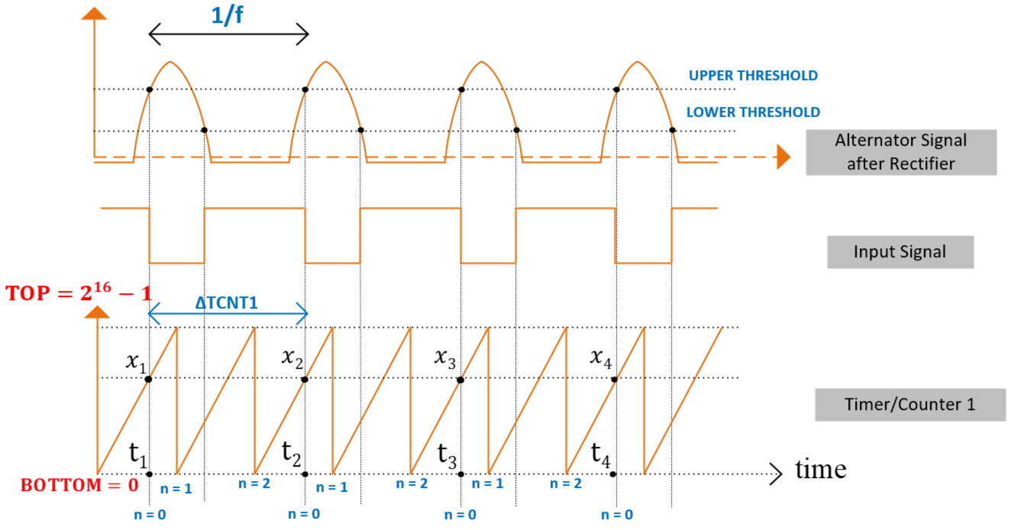
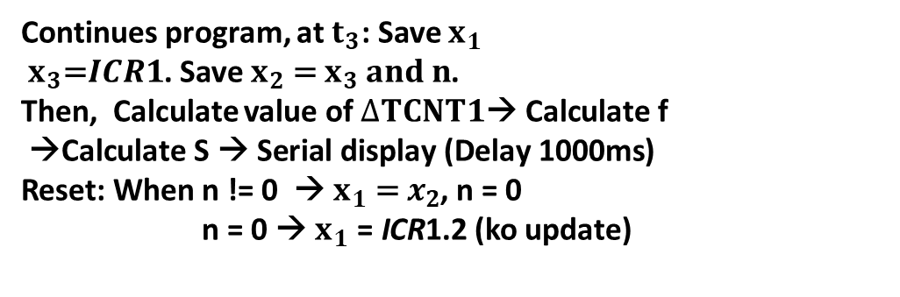
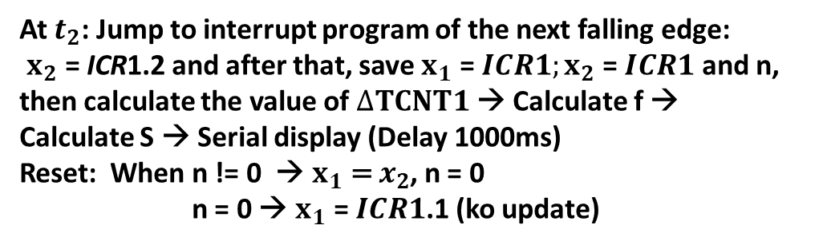
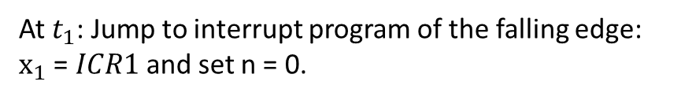
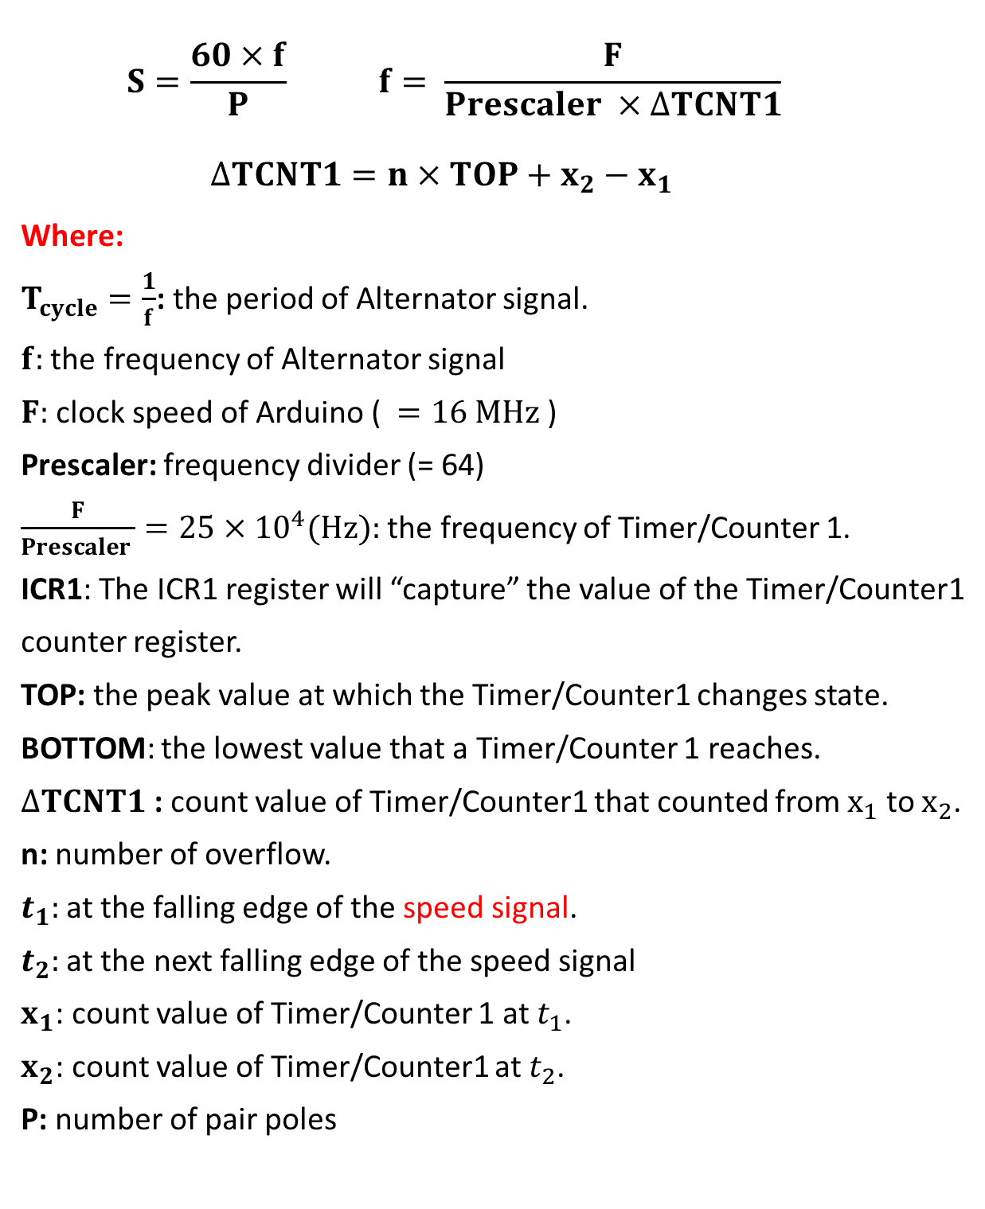
TIMING DIAGRAM
$$S=\frac{60×f}{P} f= \frac{F}{Prescaler ×∆TCNT1}$$
$${∆TCNT1=n×TOP+x_{2}−x}_{1}$$
Where:
$T_{cycle}=\frac{1}{f}$: the period of Alternator signal.
$f:$ the frequency of Alternator signal
$F:$ clock speed of Arduino ( $=16 MHz$)
Prescaler: frequency divider (= 64)
$\frac{F}{Prescaler }=25×{10}^{4}(Hz):$ the frequency of Timer/Counter 1.
ICR1: The ICR1 register will “capture” the value of the Timer/Counter1
counter register.
TOP: the peak value at which the Timer/Counter1 changes state.
BOTTOM: the lowest value that a Timer/Counter 1 reaches.
$∆TCNT1$: count value of Timer/Counter1 that counted from $x_{1}$ to $x_{2}$.
n: number of overflow.
$t_{1}:$at the falling edge of the speed signal.
$t_{2}:$ at the next falling edge of the speed signal
$x_{1}$: count value of Timer/Counter 1 at $t_{1}$.
$x_{2}$: count value of Timer/Counter1 at $t_{2}$.
P: number of pair poles
At $t_{1}$: Jump to interrupt program of the falling edge: $x_{1} \text{=} ICR1$ and set n = 0.
After, exit interrupt program and the program continues execution. Until Timer/Counter1 overflow, jump to interrupt program Overflow and n++ ( if n>1 → n =0 )
At $t_{2}$: Jump to interrupt program of the next falling edge:
$x_{2} \text{=} \text{ICR}\text{1}\text{.2}$ and after that, save $x_{1} \text{=} ICR1;x_{2} \text{=} ICR1 \text{and} \text{n}$, then calculate the value of $∆TCNT1$ → Calculate f →
Calculate S → Serial display (Delay 1000ms)
Reset: When n != 0 → $x_{1} \text{= }x_{2}$, n = 0
n = 0 → $x_{1} \text{=} ICR1\text{.1}$ (ko update)
Continues program, at $t_{3}$: Save $x_{1}$ $x_{3}\text{=}ICR1$. Save $x_{2}\text{ = }x_{3} and n$.
Then, Calculate value of $∆TCNT1\text{→ }\text{Calculate} \text{f}$
$\text{→}\text{Calculate} \text{S} \text{→} \text{Serial} \text{display}\text{ (}\text{Delay}\text{ 1000}\text{ms}\text{)}$
Reset: When n != 0 → $x_{1}\text{ = }x_{2}$, n = 0
n = 0 → $x_{1} \text{=} \text{ICR}\text{1}\text{.}\text{2}$ (ko update)

Slide 15
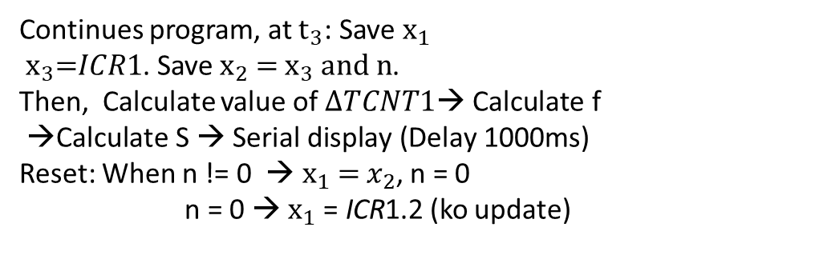
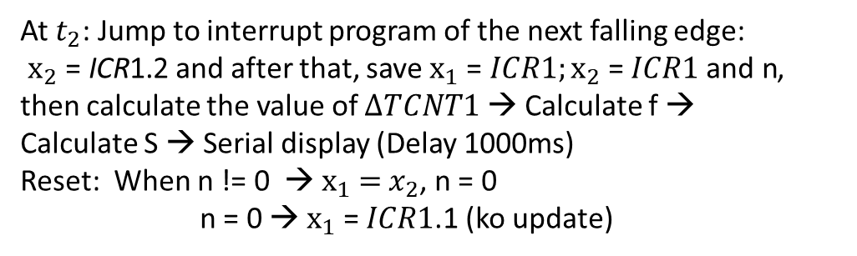
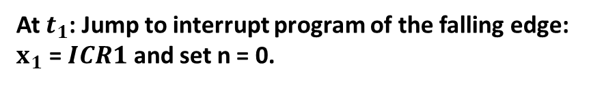

TIMING DIAGRAM
$$S=\frac{60×f}{P} f= \frac{F}{Prescaler ×∆TCNT1}$$
$${∆TCNT1=n×TOP+x_{2}−x}_{1}$$
Where:
$T_{cycle}=\frac{1}{f}$: the period of Alternator signal.
$f:$ the frequency of Alternator signal
$F:$ clock speed of Arduino ( $=16 MHz$)
Prescaler: frequency divider (= 64)
$\frac{F}{Prescaler }=25×{10}^{4}(Hz):$ the frequency of Timer/Counter 1.
ICR1: The ICR1 register will “capture” the value of the Timer/Counter1
counter register.
TOP: the peak value at which the Timer/Counter1 changes state.
BOTTOM: the lowest value that a Timer/Counter 1 reaches.
$∆TCNT1$: count value of Timer/Counter1 that counted from $x_{1}$ to $x_{2}$.
n: number of overflow.
$t_{1}:$at the falling edge of the speed signal.
$t_{2}:$ at the next falling edge of the speed signal
$x_{1}$: count value of Timer/Counter 1 at $t_{1}$.
$x_{2}$: count value of Timer/Counter1 at $t_{2}$.
P: number of pair poles
At $t_{1}$: Jump to interrupt program of the falling edge: $x_{1} \text{=} ICR1$ and set n = 0.
After, exit interrupt program and the program continues execution. Until Timer/Counter1 overflow, jump to interrupt program Overflow and n++ ( if n>1 → n =0 )
At $t_{2}$: Jump to interrupt program of the next falling edge:
$x_{2} \text{=} \text{ICR}\text{1}\text{.2}$ and after that, save $x_{1} \text{=} ICR1;x_{2} \text{=} ICR1 \text{and} \text{n}$, then calculate the value of $∆TCNT1$ → Calculate f →
Calculate S → Serial display (Delay 1000ms)
Reset: When n != 0 → $x_{1} \text{= }x_{2}$, n = 0
n = 0 → $x_{1} \text{=} ICR1\text{.1}$ (ko update)
Continues program, at $t_{3}$: Save $x_{1}$ $x_{3}\text{=}ICR1$. Save $x_{2}\text{ = }x_{3} and n$.
Then, Calculate value of $∆TCNT1\text{→ }\text{Calculate} \text{f}$
$\text{→}\text{Calculate} \text{S} \text{→} \text{Serial} \text{display}\text{ (}\text{Delay}\text{ 1000}\text{ms}\text{)}$
Reset: When n != 0 → $x_{1}\text{ = }x_{2}$, n = 0
n = 0 → $x_{1} \text{=} \text{ICR}\text{1}\text{.}\text{2}$ (ko update)

Slide 16
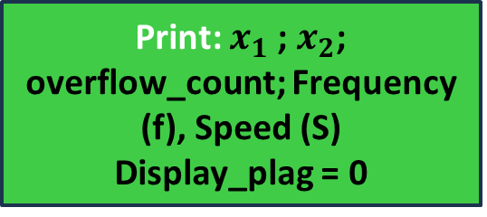
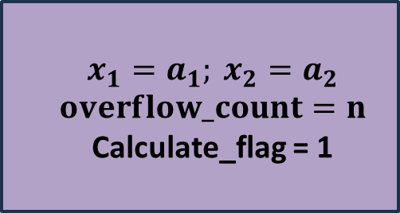
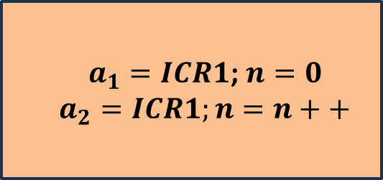

WORK-FLOWS
Overflow interrupt
Falling edge interrupt
n++ 0,5s read a result one time T_overflow = 10 ms,
overflow= 2500 Display_flag = 1
$a_{1}=ICR1$; $n=0$ $$a_{2}=ICR1;n=n++$$
Send data
Save data to global variable
$$x_{1}=a_{1}; x_{2}=a_{2} \\ overflow_count=n$$ Calculate_flag = 1
Display_flag = 1
Calculate_flag = 1
Print: $x_{1}$; $x_{2}$; overflow_count; Frequency (f), Speed (S) Display_plag = 0
$deltaTCNT1→f→S$ Calculate_flag = 0
Send data
Display program
Calculate speed program
Void Loop ()

Slide 17
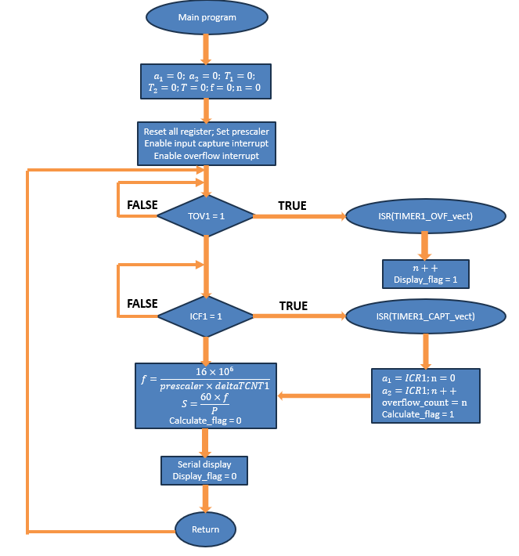
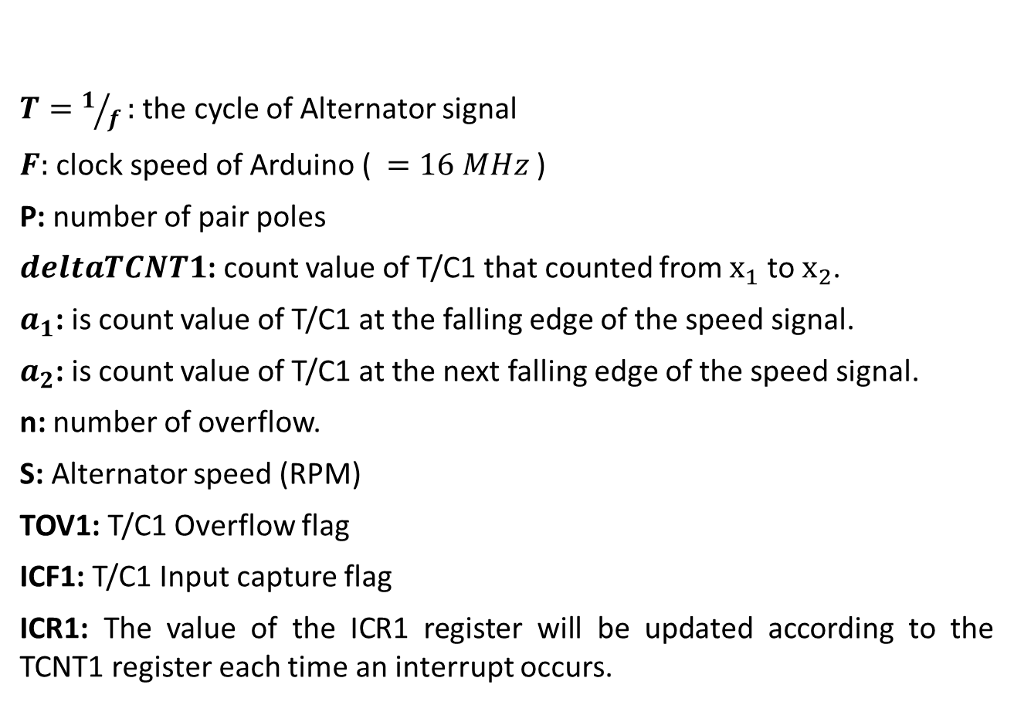
ALGORITHMS
$T=1/f:$ the cycle of Alternator signal
$F:$ clock speed of Arduino ( $=16 MHz$)
P: number of pair poles
$deltaTCNT1$: count value of T/C1 that counted from $x_{1}$ to $x_{2}$.
$a_{1}$: is count value of T/C1 at the falling edge of the speed signal.
$a_{2}$: is count value of T/C1 at the next falling edge of the speed signal.
n: number of overflow.
S: Alternator speed (RPM)
TOV1: T/C1 Overflow flag
ICF1: T/C1 Input capture flag
ICR1: The value of the ICR1 register will be updated according to the TCNT1 register each time an interrupt occurs.

Slide 18

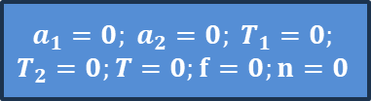
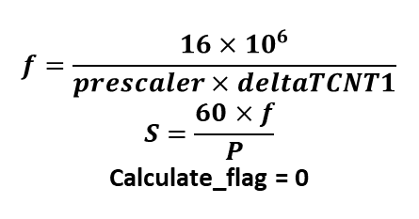
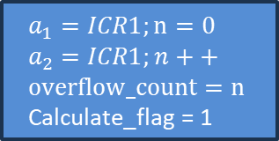
Main program
$$a_{1}=0; a_{2}=0; T_{1}=0;$$
$$T_{2}=0;T=0;f=0;n=0$$
Reset all register;
Set prescaler Enable input capture interrupt Enable overflow interrupt
FALSE
TOV1 = 1
TRUE
ISR(TIMER1_OVF_vect)
$$n++$$
Display_flag = 1
FALSE
ICF1 = 1
TRUE
ISR(TIMER1_CAPT_vect)
$$f=\frac{16×{10}^{6}}{prescaler×deltaTCNT1} \\ S=\frac{60×f}{P}$$ Calculate_flag = 0
$$a_{1}=ICR1;n=0 \\ a_{2}=ICR1;n++ \\ overflow_count=n \\ \text{Calculate}\text{_}\text{flag}\text{ = 1}$$
Serial display Display_flag = 0
Return

Slide 19
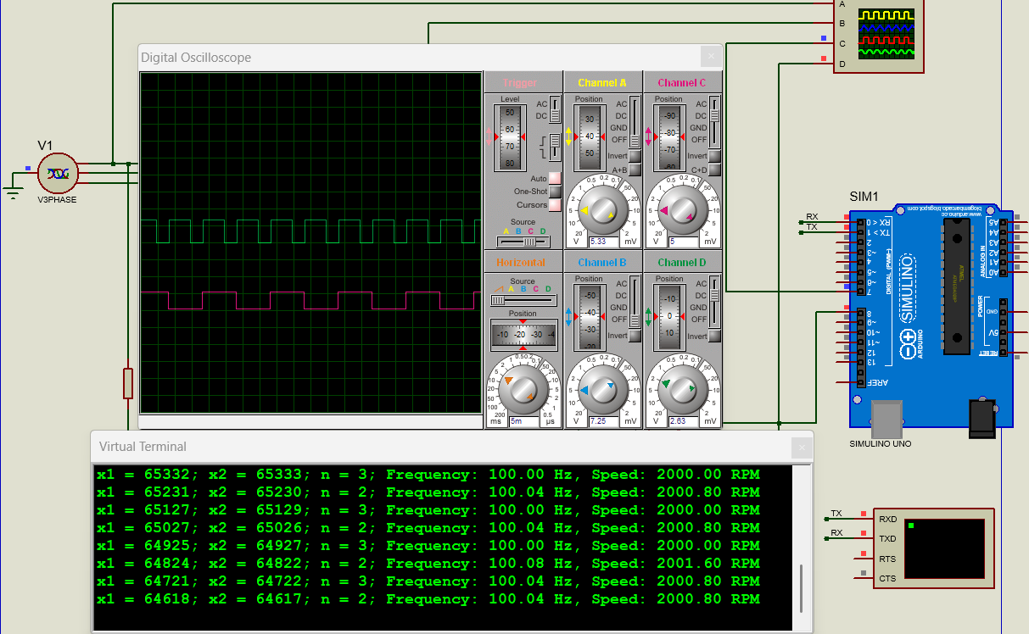

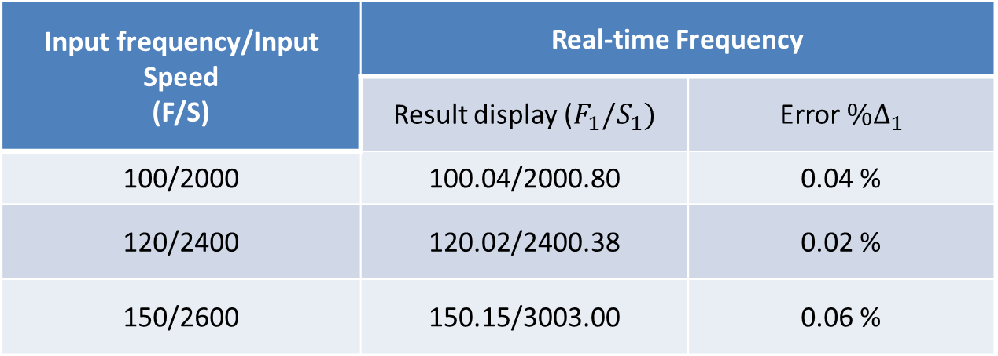
SIMULATION AND RESULTS
Fixed Frequency case:
F: Input Frequency (Hz).
$V=\frac{60×F}{P}$ (RPM), P = 3: number of pole pairs
$F_{1}$: measured frequency in fixed case
$V_{1}=\frac{60×F_{1}}{P}$ (RPM)
$\%∆_{1}=\frac{\left|F_{1}−F\right|}{F}$: error when measuring in fixed case
Input frequency/Input Speed (F/S) | Real-time Frequency
 | Result display ($F_{1}/S_{1})$ | Error $\%∆_{1}$
100/2000 | 100.04/2000.80 | 0.04 %
120/2400 | 120.02/2400.38 | 0.02 %
150/2600 | 150.15/3003.00 | 0.06 %

Slide 20
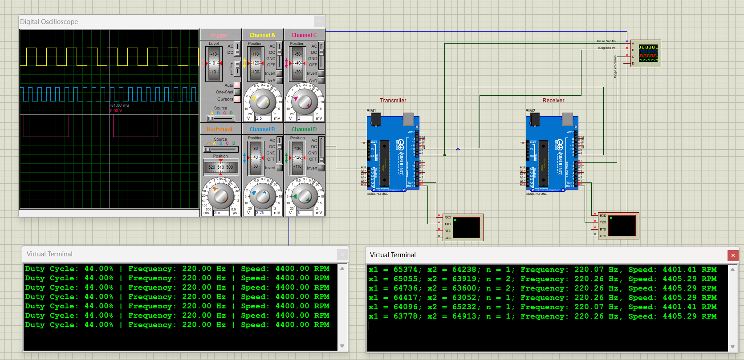
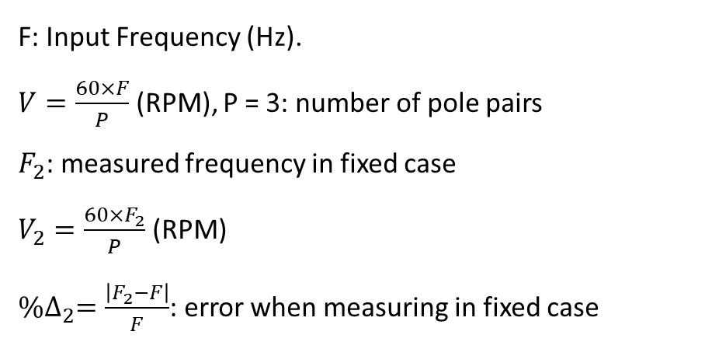
SIMULATION AND RESULTS
Real-time Frequency case:
F: Input Frequency (Hz).
$V=\frac{60×F}{P}$ (RPM), P = 3: number of pole pairs
$F_{2}$: measured frequency in fixed case
$V_{2}=\frac{60×F_{2}}{P}$ (RPM)
$\%∆_{2}=\frac{\left|F_{2}−F\right|}{F}$: error when measuring in fixed case

Slide 21
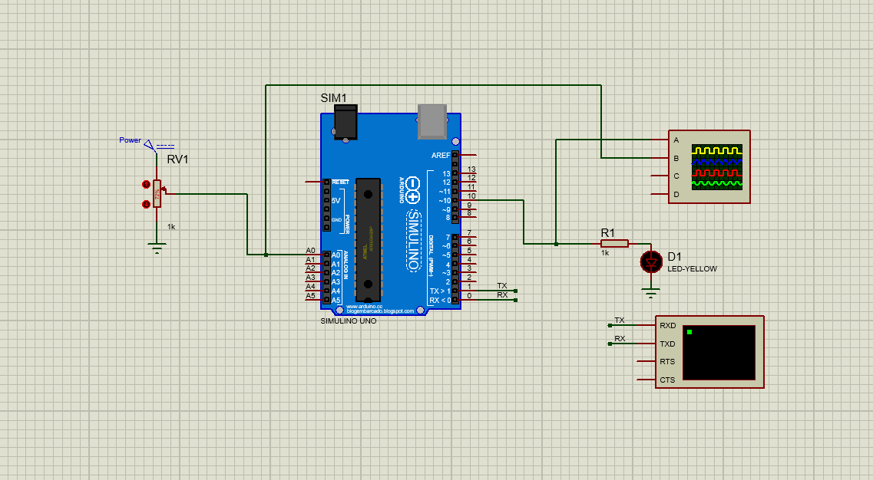
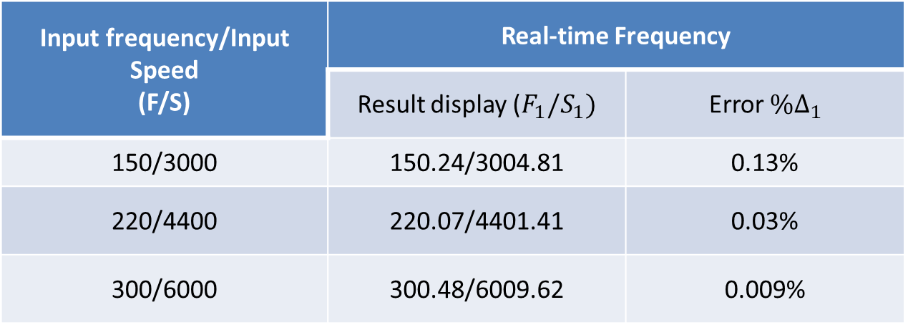
Input frequency/Input Speed (F/S) | Real-time Frequency
 | Result display ($F_{1}/S_{1})$ | Error $\%∆_{1}$
150/3000 | 150.24/3004.81 | 0.13%
220/4400 | 220.07/4401.41 | 0.03%
300/6000 | 300.48/6009.62 | 0.009%

