Slide 1
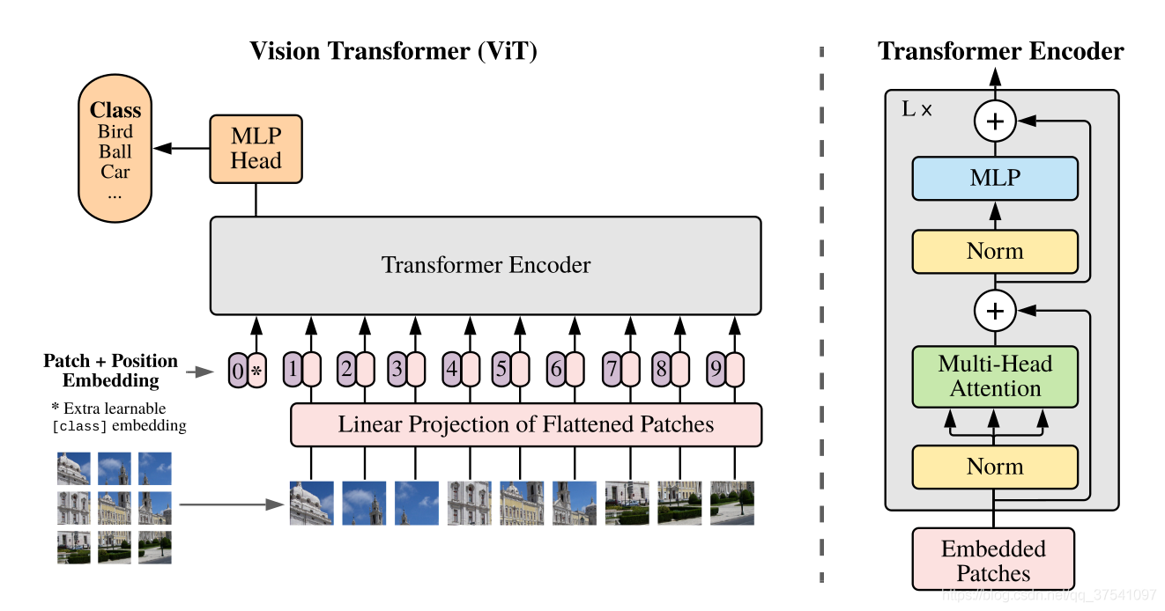
Vision Transformer(ViT)
MLP head
Transformer Encoder
Embedding

Slide 2
Embedding
Dim = 3:
IMG: [224,224,3]
Dim = 2:
IMG: [224,224]
196 Patches: [16,16,3]
196 Patches: [16,16]
196 Flattened Patches:[768]
196 Flattened Patches:[256]
Linear Projection
Tokens:[196,768]
Tokens:[196,768]

Slide 3


Embedding
“*”: [class]token [1,768] Postion Embedding:[197,768]
Tokens = cat(cls,Tokens) +Postion Embedding
Tokens:[197,768]

Slide 4
Transformer Encoder
Transformer Encoder = L Encoder Blocks
Encoder
Layer Norm
Multi-Head Attention
Dropout
Layer Norm
MLP block
Dropout

Slide 5
Transformer Encoder
Transformer Encoder = L Encoder Blocks
MLP block
Full connect layer (Linear)
GELU
Dropout
Full connect layer(Linear)
Dropout

Slide 6
MLP heads
Layer Norm
MLP head (Classify)
Full connect layer (Linear)
RELU
Full connect layer(Linear)
Blackboard→讨论→EE219
https://arxiv.org/abs/2010.11929

