Slide 1
Chronos
Cloud Services and IoT
Automated Plant Watering

Slide 2
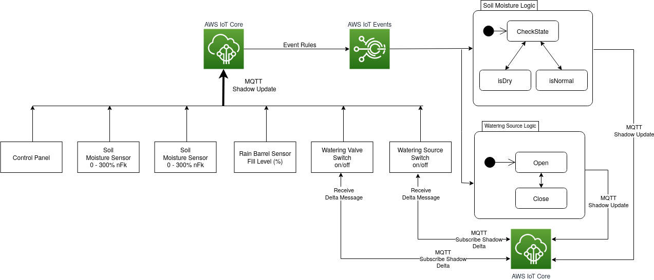
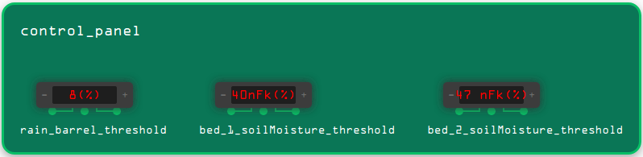
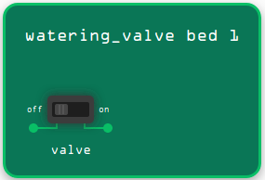
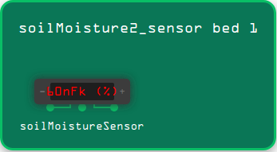
SELECT state.reported.value, state.reported.bed_id
FROM '$aws/things/+/shadow/update/accepted'
WHERE regexp_matches(topic(3), 'soilMoisture[0-9]{1,2}_sensor')
{
"value": 50,
"bed_id": 1
}
$aws/things/<valve_name>/shadow/update
{ "state": { "desired": {"valve_open": true} } }
$aws/things/<device_name>/shadow/update
{ "state": { "reported": {
"value": 50,
"bed_id": 1
} } }
$aws/things/<valve_name>/shadow/update/delta
{ "state": { "valve_open": true } }

Slide 3
Lessons Learned
Use of AWS IoT Services with AWS-Console, CLI and Terraform
Use of MQTT
IoT Events -> Utilize of State Model Logic
Docker (via Terraform Resource; docker-compose)
Missing IoT Events Terraform resource -> AWS CLI workaround
Incomplete IoT Events Documentation (examples, string-pattern)
No informative IoT Events log messages
AWS Educate Account -> Missing permissions for several services

