Slide 1


Slide 2
What’s that?
Bot Framework
Cognitive Services
Azure Service Fabric
Machine Learning
Visual Studio Team Services
Xamarin
*surprise
Project Elephant is an Onboarding Bot that helps new employees to master their onboarding faster.

Slide 3
The Team

Slide 4
How does it work?

Slide 5
Learnings
Bot Framework poorly documented in some points
Tutorials avoid beginner’s mistakes
Xamarin ramp-up hard for non .NET devs

Slide 6
Next steps
Satisfaction Prompts Users can give feedback if the answer was helpful or not
Enable user inputs
Users can add their own learnings to the knowledge database
Open for others
Enable other companies to integrate own knowledge DBs

Slide 7
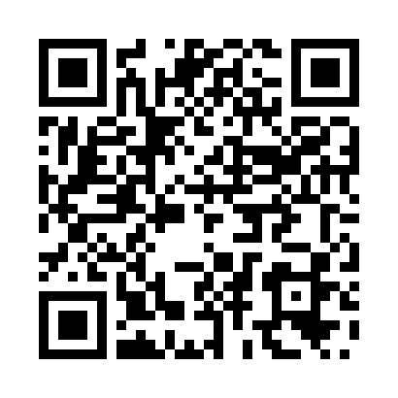
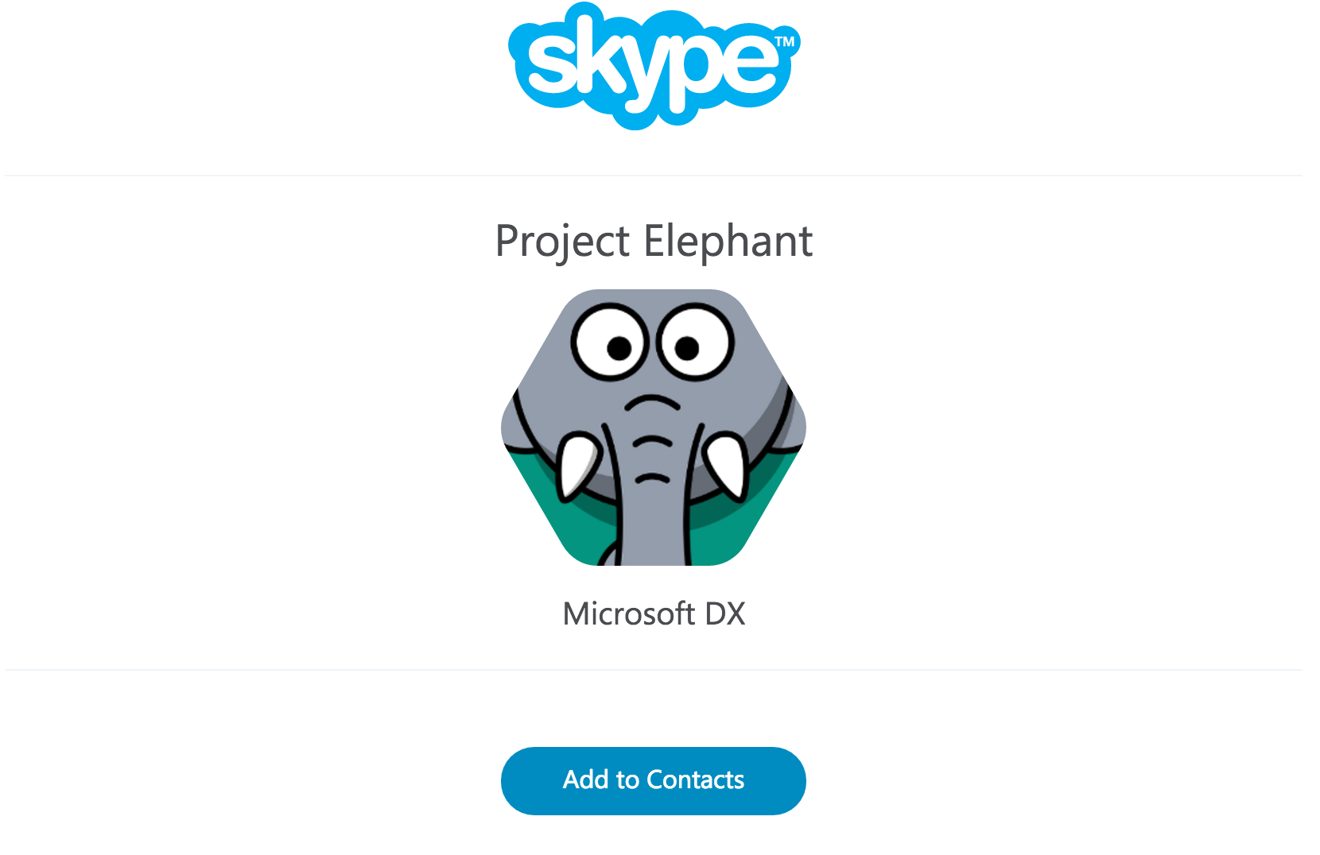

Slide 8
aka.ms/ProjectElephant

