Slide 1

Computer Fundamentals
Topic
Microprocessor
Lectured by
Deen Md. Abdullah

Slide 2
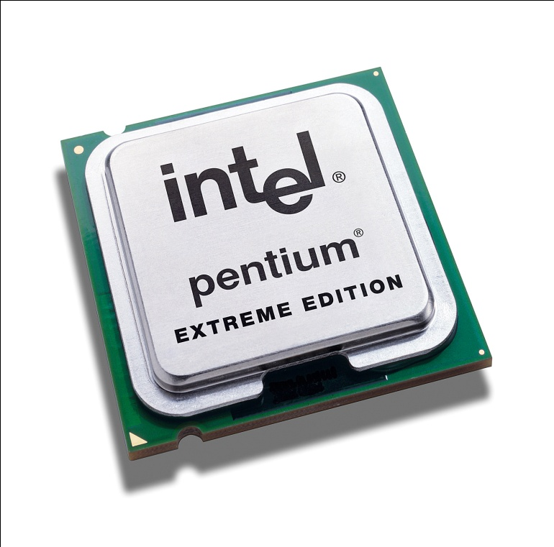
Microprocessor
The control centre of the entire computer system is called the microprocessor in a microcomputer. It accepts data from input devices, process data, and send result to output devices under control of a stored program.
Data
Input
Microprocessor
Output
Process Data

Slide 3
Function of Microprocessor
Instruction Fetch:
The processor first fetches an instruction from the main memory.
Instruction Decode:
The instruction is then decoded to determine what action is required to be done.
Operand Fetch:
Based on instruction the processor fetches, if required, data from main memory or I/O module.
Execution:
The instruction is then executed which may require performing arithmetic or logical operations on data.
Interrupt:
In addition to execution, CPU also supervises and controls I/O devices. If there is any request from I/O devices, called interrupt, the CPU suspends execution of the current program and transfers control to an interrupt handling program.
Operand Store:
Finally, the results of an execution may require transfers of data to memory or an I/O module.
Instruction Fetch
Instruction Decode
Operand Fetch
Execution
Operand Store
Yes
No
Interrupt
Instruction Cycle

Slide 4
Components of Microprocessor
The major components of a microprocessor are:
1) Register
Registers are used for keeping data that are needed local to the processor.
2) Arithmetic Logic Unit (ALU)
Arithmetic Logic Unit (ALU) is the data processing unit and performer of primitive
arithmetic and logic operations of the microprocessor.
The functions of ALU are:
Arithmetic operations i.e., addition, subtraction, multiplication, and division.
Logical Operations i.e., AND, OR, NOT, NAND, NOR, XOR.
Decision making.
3) Control Unit
The control unit coordinates, initiates, communicates, and controls the operation of the
microprocessor or central processing unit. It is the control central of the whole system.

Slide 5
Communication Diagram
Primary Memory
CPU
Control Unit
Instructions
Status
Control Commands
Control Commands
Arithmetic Logic Unit
Data
Results

