Slide 1
Tokens in C
Keywords
These are reserved words of the C language. For example int, float, if, else, for, while etc.
Identifiers
An Identifier is a sequence of letters and digits, but must start with a letter. Underscore ( _ ) is treated as a letter. Identifiers are case sensitive. Identifiers are used to name variables, functions etc.
Valid: Root, _getchar, __sin, x1, x2, x3, x_1, If
Invalid: 324, short, price$, My Name
Constants
Constants like 13, ‘a’, 1.3e-5 etc.

Slide 2
Tokens in C
String Literals
A sequence of characters enclosed in double quotes as “…”. For example “13” is a string literal and not number 13. ‘a’ and “a” are different.
Operators
Arithmetic operators like +, -, *, / ,% etc.
Logical operators like ||, &&, ! etc. and so on.
White Spaces
Spaces, new lines, tabs, comments ( A sequence of characters enclosed in /* and */ ) etc. These are used to separate the adjacent identifiers, kewords and constants.

Slide 3
Basic Data Types
Integral Types
Integers are stored in various sizes. They can be signed or unsigned.
Example Suppose an integer is represented by a byte (8 bits). Leftmost bit is sign bit. If the sign bit is 0, the number is treated as positive. Bit pattern 01001011 = 75 (decimal). The largest positive number is 01111111 = 2⁷ – 1 = 127. Negative numbers are stored as two’s complement or as one’s complement. -75 = 10110100 (one’s complement). -75 = 10110101 (two’s complement).
Notes:
C is strongly typed. The variables and constants etc have a certain data types. All variables could have been double type, but then multiplying double numbers is very expensive. So the various data types have been provided for the reason of efficiency and ease of handling.

Slide 4
Basic Data Types
Integral Types
char Stored as 8 bits. Unsigned 0 to 255. Signed -128 to 127.
short int Stored as 16 bits. Unsigned 0 to 65535. Signed -32768 to 32767.
int Same as either short or long int.
long int Stored as 32 bits. Unsigned 0 to 4294967295. Signed -2147483648 to 2147483647
Notes:
C guarantees only following:
Sizeof(short) <= sizeof(int) <= sizeof(long).

Slide 5
Basic Data Types
Floating Point Numbers
Floating point numbers are rational numbers. Always signed numbers.
float Approximate precision of 6 decimal digits .
Typically stored in 4 bytes with 24 bits of signed mantissa and 8 bits of signed exponent.
double Approximate precision of 14 decimal digits.
Typically stored in 8 bytes with 56 bits of signed mantissa and 8 bits of signed exponent.
One should check the file limits.h to what is implemented on a particular machine.

Slide 6
Constants
Numerical Constants
Constants like 12, 253 are stored as int type. No decimal point.
12L or 12l are stored as long int.
12U or 12u are stored as unsigned int.
12UL or 12ul are stored as unsigned long int.
Numbers with a decimal point (12.34) are stored as double.
Numbers with exponent (12e-3 = 12 x 10⁻³ ) are stored as double.
12.34f or 1.234e1f are stored as float.
These are not valid constants:
25,000 7.1e 4 $200 2.3e-3.4 etc.

Slide 7
Constants
Character and string constants
‘c’ , a single character in single quotes are stored as char. Some special character are represented as two characters in single quotes. ‘\n’ = newline, ‘\t’= tab, ‘\\’ = backlash, ‘\”’ = double quotes. Char constants also can be written in terms of their ASCII code. ‘\060’ = ‘0’ (Decimal code is 48).
A sequence of characters enclosed in double quotes is called a string constant or string literal. For example “Charu” “A” “3/9” “x = 5”

Slide 8
Variables
Naming a Variable
Must be a valid identifier.
Must not be a keyword
Names are case sensitive.
Variables are identified by only first 32 characters.
Library commonly uses names beginning with _.
Naming Styles: Uppercase style and Underscore style
lowerLimit lower_limit
incomeTax income_tax

Slide 9
Declarations
Declaring a Variable
Each variable used must be declared.
A form of a declaration statement is
data-type var1, var2,…;
Declaration announces the data type of a variable and allocates appropriate memory location. No initial value (like 0 for integers) should be assumed.
It is possible to assign an initial value to a variable in the declaration itself.
data-type var = expression;
Examples
int sum = 0;
char newLine = ‘\n’;
float epsilon = 1.0e-6;

Slide 10
Global and Local Variables
Global Variables
These variables are declared outside all functions.
Life time of a global variable is the entire execution period of the program.
Can be accessed by any function defined below the declaration, in a file.
/* Compute Area and Perimeter of a circle */
#include <stdio.h>
float pi = 3.14159; /* Global */
main() {
float rad; /* Local */
printf( “Enter the radius “ );
scanf(“%f” , &rad);
if ( rad > 0.0 ) {
float area = pi * rad * rad;
float peri = 2 * pi * rad;
printf( “Area = %f\n” , area );
printf( “Peri = %f\n” , peri );
}
else
printf( “Negative radius\n”);
printf( “Area = %f\n” , area );
}

Slide 11
Global and Local Variables
Local Variables
These variables are declared inside some functions.
Life time of a local variable is the entire execution period of the function in which it is defined.
Cannot be accessed by any other function.
In general variables declared inside a block are accessible only in that block.
/* Compute Area and Perimeter of a circle */
#include <stdio.h>
float pi = 3.14159; /* Global */
main() {
float rad; /* Local */
printf( “Enter the radius “ );
scanf(“%f” , &rad);
if ( rad > 0.0 ) {
float area = pi * rad * rad;
float peri = 2 * pi * rad;
printf( “Area = %f\n” , area );
printf( “Peri = %f\n” , peri );
}
else
printf( “Negative radius\n”);
printf( “Area = %f\n” , area );
}

Slide 12
Operators
Arithmetic Operators
+, - , *, / and the modulus operator %.
+ and – have the same precedence and associate left to right.
3 – 5 + 7 = ( 3 – 5 ) + 7 ≠ 3 – ( 5 + 7 )
3 + 7 – 5 + 2 = ( ( 3 + 7 ) – 5 ) + 2
*, /, % have the same precedence and associate left to right.
The +, - group has lower precendence than the *, / % group.
3 – 5 * 7 / 8 + 6 / 2
3 – 35 / 8 + 6 / 2
3 – 4.375 + 6 / 2
3 – 4.375 + 3
-1.375 + 3
1.625

Slide 13
Operators
Arithmetic Operators
% is a modulus operator. x % y results in the remainder when x is divided by y and is zero when x is divisible by y.
Cannot be applied to float or double variables.
Example
if ( num % 2 == 0 )
printf(“%d is an even number\n”, num)’;
else
printf(“%d is an odd number\n”, num);

Slide 14
Type Conversions
The operands of a binary operator must have a the same type and the result is also of the same type.
Integer division:
c = (9 / 5)*(f - 32)
The operands of the division are both int and hence the result also would be int. For correct results, one may write
c = (9.0 / 5.0)*(f - 32)
In case the two operands of a binary operator are different, but compatible, then they are converted to the same type by the compiler. The mechanism (set of rules) is called Automatic Type Casting.
c = (9.0 / 5)*(f - 32)
It is possible to force a conversion of an operand. This is called Explicit Type casting.
c = ((float) 9 / 5)*(f - 32)

Slide 15
Automatic Type Casting
char and short operands are converted to int
Lower data types are converted to the higher data types and result is of higher type.
The conversions between unsigned and signed types may not yield intuitive results.
Example
float f; double d; long l;
int i; short s;
d + f f will be converted to double
i / s s will be converted to int
l / i i is converted to long; long result
Hierarchy
Double
float
long
Int
Short and char

Slide 16
Explicit Type Casting
The general form of a type casting operator is
(type-name) expression
It is generally a good practice to use explicit casts than to rely on automatic type conversions.
Example
C = (float)9 / 5 * ( f – 32 )
float to int conversion causes truncation of fractional part
double to float conversion causes rounding of digits
long int to int causes dropping of the higher order bits.

Slide 17
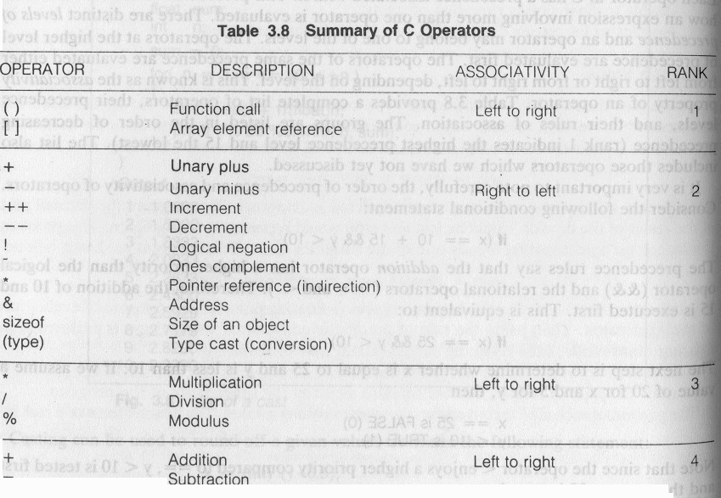
Precedence and Order of evaluation

Slide 18
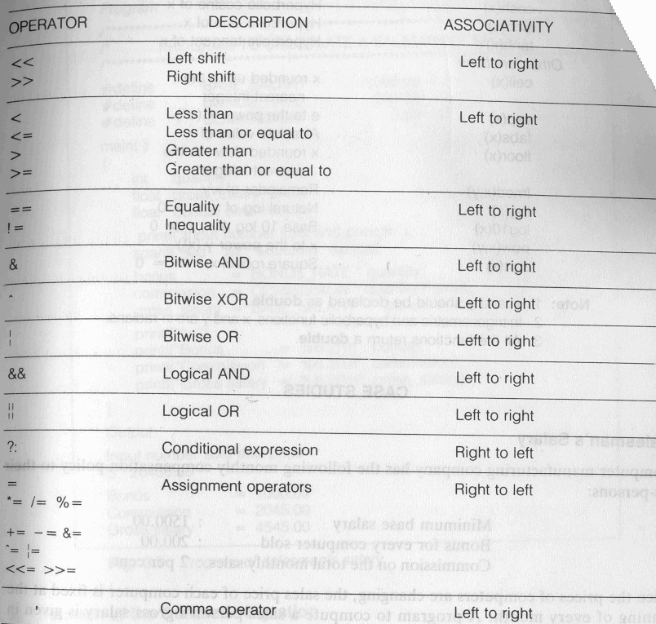
Precedence and Order of evaluation

Slide 19
Operators
Relational Operators
<, <=, > >=, ==, != are the relational operators. The expression
operand1 relational-operator operand2
takes a value of 1(int) if the relationship is true and 0(int) if relationship is false.
Example
int a = 25, b = 30, c, d;
c = a < b;
d = a > b;
value of c will be 1 and that of d will be 0.

Slide 20
Operators
Logical Operators
&&, || and ! are the three logical operators.
expr1 && expr2 has a value 1 if expr1 and expr2 both are nonzero.
expr1 || expr2 has a value 1 if expr1 and expr2 both are nonzero.
!expr1 has a value 1 if expr1 is zero else 0.
Example
if ( marks >= 40 && attendance >= 75 ) grade = ‘P’
If ( marks < 40 || attendance < 75 ) grade = ‘N’

Slide 21
Operators
Assignment operators
The general form of an assignment operator is
v op= exp
Where v is a variable and op is a binary arithmetic operator. This statement is equivalent to
v = v op (exp)
a = a + b can be written as a += b
a = a * b can be written as a *= b
a = a / b can be written as a /= b
a = a - b can be written as a -= b

Slide 22
Operators
Increment and Decrement Operators
The operators ++ and –- are called increment and decrement operators.
a++ and ++a are equivalent to a += 1.
a-- and --a are equivalent to a -= 1.
++a op b is equivalent to a ++; a op b;
a++ op b is equivalent to a op b; a++;
Example
Let b = 10 then
(++b)+b+b = 33
b+(++b)+b = 33
b+b+(++b) = 31
b+b*(++b) = 132

Slide 23
Floating Point Arithmetic
Representation
All floating point numbers are stored as
such that d₁ is nonzero. B is the base. p is the precision or number of significant digits. e is the exponent. All these put together have finite number of bits (usually 32 or 64 bits ) of storage.
Example
Assume B = 10 and p = 3.
23.7 = +0.237E2
23.74 = +0.237E2
37000 = +0.370E5
37028 = +0.370E5
-0.000124 = -0.124E-4

Slide 24
Floating Point Arithmetic
Representation
S_{k} = { x | B^{k-1} <= x < B^{k} }. Number of elements in each Sk is same. In the previous example it is 900.
Gap between seuccessive numbers of Sk is B^{k-p}.
B1-p is called machine epsilon. It is the gap between 1 and next representable number.
Underflow and Overflow occur when number cannot be represented because it is too small or too big.
Two floating points are added by aligning decimal points.
Floating point arithmetic is not associative and distributive.

