Slide 1
Introduction of microprpcessor
E 4160

Slide 2
Chapter outline
Block diagram of a computer system
Basic components of a computer system using block diagrams:
Cpu
Memory
Input and output unit
Evolution of microprocessor : 4,8,16,32 dan 64 byte
Nibble, byte, word dan longword
Fecthing and execution cycles.
Internal structure and basic operation of a microprocessor (arithmetic and logic unit, control unit, register sets, accumulator, condition code register, program counter, stack pointer)
Bus system: data bus, address bus and control bus.
Microprocessor clock system
Examples of microprocessor: 8085,8086.

Slide 3
Introduction
A computer is a programmable machine that receives input, stores and manipulates data//information, and provides output in a useful format.

Slide 4
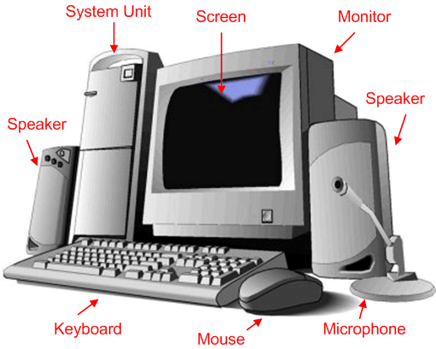
1.1 DIAGRAM OF A COMPUTER SYSTEM
A computer is a programmable machine that receives input, stores and manipulates data//information, and provides output in a useful format.
Diagram Of A Computer System

Slide 5
1.1 BLOCK DIAGRAM OF A BASIC COMPUTER SYSTEM
Basic computer system consist of a Central processing unit (CPU), memory (RAM and ROM), input/output (I/O) unit.
Address bus
CPU
ROM
RAM
I/O
interface
I/O
devices
Data bus
Control bus
Block diagram of a basic computer system

Slide 6
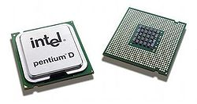
Basic component of microcomputer
CPU - Central Processing Unit
the portion of a computer system that carries out the instructions of a computer program
the primary element carrying out the computer's functions. It is the unit that reads and executes program instructions.
The data in the instruction tells the processor what to do.
Pentium D dual core processors

Slide 7
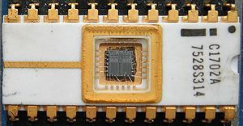
2. Memory
physical devices used to store data or programs (sequences of instructions) on a temporary or permanent basis for use in an electronic digital computer.
Computer main memory comes in two principal varieties: random-access memory (RAM) and read-only memory (ROM).
RAM can be read and written to anytime the CPU commands it, but ROM is pre-loaded with data and software that never changes, so the CPU can only read from it.
ROM is typically used to store the computer's initial start-up instructions.
In general, the contents of RAM are erased when the power to the computer is turned off, but ROM retains its data indefinitely.
In a PC, the ROM contains a specialized program called the BIOS that orchestrates loading the computer's operating system from the hard disk drive into RAM whenever the computer is turned on or reset.

Slide 8
3. I/O Unit
Input/output (I/O), refers to the communication between an information processing system (such as a computer), and the outside world possibly a human, or another information processing system.
Inputs are the signals or data received by the system, and outputs are the signals or data sent from it
Devices that provide input or output to the computer are called peripherals
On a typical personal computer, peripherals include input devices like the keyboard and mouse, and output devices such as the display and printer. Hard disk drives, floppy disk drives and optical disc drives serve as both input and output devices. Computer networking is another form of I/O.

Slide 9
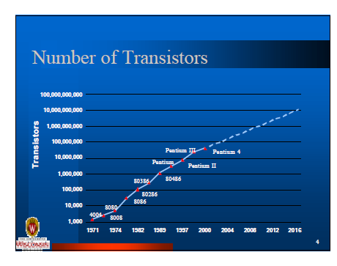
Evolution of Microprocessor

Slide 10

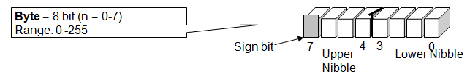
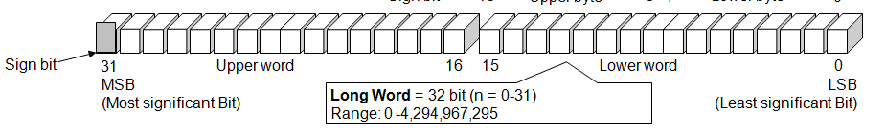
DATA SIZE
Nibble | 4 bit
Byte | 8 bit
Word | 16 bit
Long word | 32 bit

Slide 11
Fetching & Execution Cycles
Fetching Cycles
The fetch cycle takes the instruction required from memory, stores it in the instruction register, and
moves the program counter on one so that it points to the next instruction.
Execute cycle
The actual actions which occur during the execute cycle of an instruction.
depend on both the instruction itself and the addressing mode specified to be used to access the data that may be required.

Slide 12
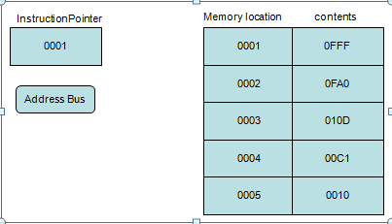
Fetching an instruction
Step 1
Instruction pointer (program counter) hold the address of the next instruction to be fetch.

Slide 13
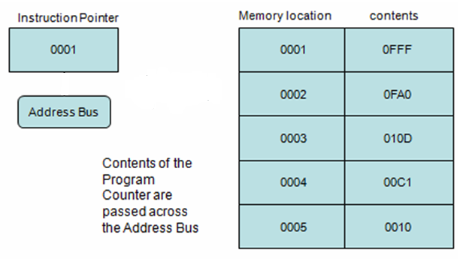
FETCHING AN INSTRUCTION (cont.)
Step 2

Slide 14
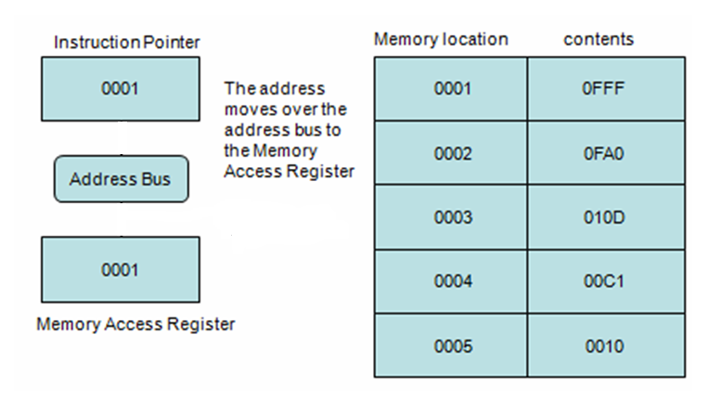
FETCHING AN INSTRUCTION (cont.)
Step 3

Slide 15
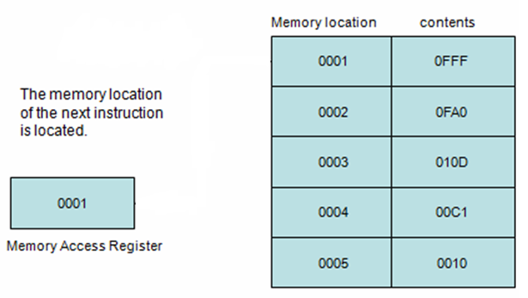
FETCHING AN INSTRUCTION (cont.)
Step 4

Slide 16
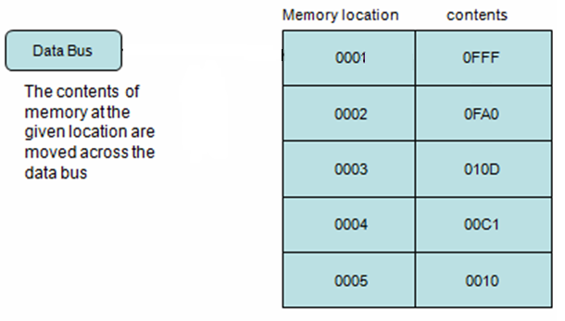
FETCHING AN INSTRUCTION (cont.)
Step 5

Slide 17
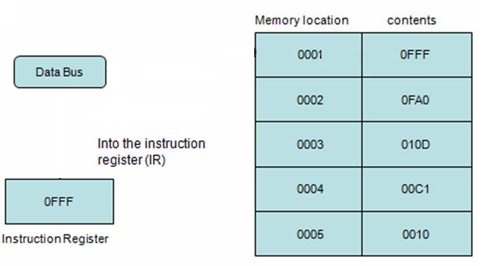
FETCHING AN INSTRUCTION (cont.)
Step 6

Slide 18
Internal structure and basic operation of microprocessor
ALU
Register Section
Address bus
Data bus
Control and timing section
Control bus
Block diagram of a microprocessor

Slide 19
Arithmetic and logic unit (ALU)
The component that performs the arithmetic and logical operations
the most important components in a microprocessor, and is typically the part of the processor that is designed first.
able to perform the basic logical operations (AND, OR), including the addition operation.
The inclusion of inverters on the inputs enables the same ALU hardware to perform the subtraction operation (adding an inverted operand), and the operations NAND and NOR.

Slide 20
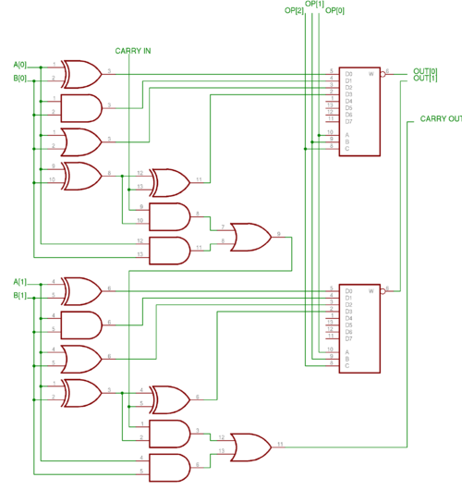
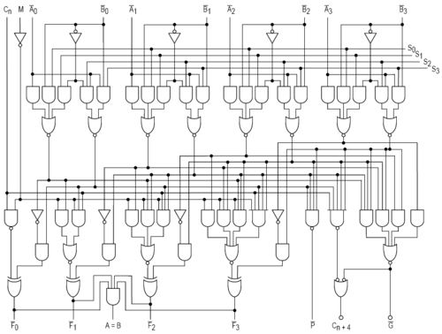
Internal structure of ALU
2 bits of ALU
4 bits of ALU

Slide 21
Control unit
The circuitry that controls the flow of information through the processor, and coordinates the activities of the other units within it.
In a way, it is the "brain within the brain", as it controls what happens inside the processor, which in turn controls the rest of the PC.
On a regular processor, the control unit performs the tasks of fetching, decoding, managing execution and then storing results.

Slide 22
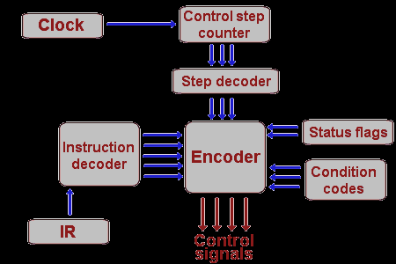
Internal structure of control unit

Slide 23
Register sets
The register section/array consists completely of circuitry used to temporarily store data or program codes until they are sent to the ALU or to the control section or to memory.
The number of registers are different for any particular CPU and the more register a CPU have will result in easier programming tasks.
Registers are normally measured by the number of bits they can hold, for example, an "8-bit register" or a "32-bit register".

Slide 24
Register in motorola 68000 microprocessor
31 16 15 8 7 0
D0
D1
D2
D3
D4
D5
DATA REGISTERS
D6
D7
31 16 15 8 7 0
A0
A1
A2
A3
A4
A5
ADDRESS REGISTERS
A6
A7
USER STACK POINTER
A7
STACK POINTER
SUPERVISOR STACK POINTER
PC
PROGRAM CONTER
15 8 7 0
SYSTEM BYTE
USER VYTE
SR
STATUS REGISTER

Slide 25
accumulator
a register in which intermediate arithmetic and logic results are stored.
example for accumulator use is summing a list of numbers.
The accumulator is initially set to zero, then each number in turn is added to the value in the accumulator.
Only when all numbers have been added is the result held in the accumulator written to main memory or to another, non-accumulator, CPU register.

Slide 26
Condition code register (CCR)
an 8 bit register used to store the status of CPU, such as carry, zero, overflow and half carry.

Slide 27
Flag | Name | Description
Z | Zero flag | Indicates that the result of a mathematical or logical operation was zero.
C | Carry flag | Indicates that the result of an operation produced an answer greater than the number of available bits. (This flag may also be set before a mathematical operation as an extra operand to certain instructions, e.g. "add with carry".)
X | Extend flag | Masks the XIRQ request when set. It is set by the hardware and cleared by the software as well is set by unmaskable XIRQ.
N | Negative/ Sign flag | Indicates that the result of a mathematical operation is negative. In some processors, the N and S flags have different meanings: the S flag indicates whether a subtraction or addition has taken place, whereas the N flag indicates whether the last operation result is positive or negative.
V | Overflow Flag | Indicates that the result of an operation has overflowed according to the CPU's word representation, similar to the carry flag but for signed operations.
I | interrupts | Interrupts can be enabled or disabled by respectively setting or clearing this flag. Modifying this flag may be restricted to programs executing in supervisor mode

Slide 28
Program counter (PC)
a 16 bit register, used to store the next address of the operation code to be fetched by the CPU.
Not much use in programming, but as an indicator to user only.
Purpose of PC in a Microprocessor
to store address of tos (top of stack)
to store address of next instruction to be executed.
count the number of instructions.
to store base address of the stack.

Slide 29
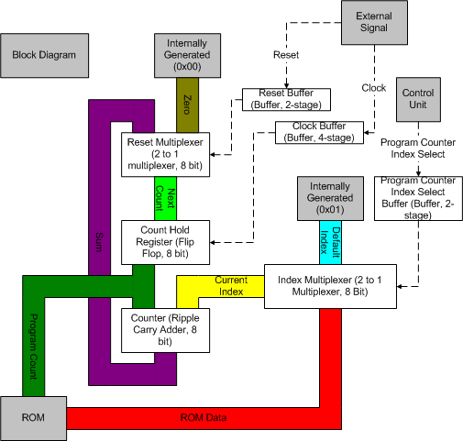
Internal structure of PC

Slide 30
Stack pointer (SP)
The stack is configured as a data structure that grows downward from high memory to low memory.
At any given time, the SP holds the 16-bit address of the next free location in the stack.
The stack acts like any other stack when there is a subroutine call or on an interrupt. ie. pushing the return address on a jump, and retrieving it after the operation is complete to come back to its original location.

Slide 31
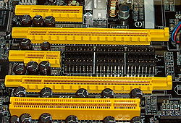
Bus system
a subsystem that transfers data between computer components inside a computer or between computers.
4 PCI Express bus card slots (from top to bottom: x4, x16, x1 and x16),
compared to a traditional 32-bit PCI bus card slot (very bottom).

Slide 32
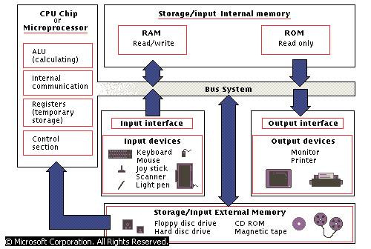
Bus system connection

Slide 33
Data bus
The data bus is 'bi-directional'
data or instruction codes from memory or input/output.are transferred into the microprocessor
the result of an operation or computation is sent out from the microprocessor to the memory or input/output.
Depending on the particular microprocessor, the data bus can handle 8 bit or 16 bit data.

Slide 34
Address bus
The address bus is 'unidirectional', over which the microprocessor sends an address code to the memory or input/output.
The size (width) of the address bus is specified by the number of bits it can handle.
The more bits there are in the address bus, the more memory locations a microprocessor can access.
A 16 bit address bus is capable of addressing 65,536 (64K) addresses.

Slide 35
Control bus
The control bus is used by the microprocessor to send out or receive timing and control signals in order to coordinate and regulate its operation and to communicate with other devices, i.e. memory or input/output.

Slide 36
Micro processor clock
Also called clock rate, the speed at which a microprocessor executes instructions. Every computer contains an internal clock that regulates the rate at which instructions are executed and synchronizes all the various computer components.
The CPU requires a fixed number of clock ticks (or clock cycles) to execute each instruction. The faster the clock, the more instructions the CPU can execute per second. Clock speeds are expressed in megahertz (MHz) or gigahertz ((GHz).
Some microprocessors are superscalar, which means that they can execute more than one instruction per clock cycle.
Like CPUs, expansion buses also have clock speeds. Ideally, the CPU clock speed and the bus clock speed should be the same so that neither component slows down the other. In practice, the bus clock speed is often slower than the CPU clock speed, which creates a bottleneck. This is why new local buses, such as AGP, have been developed.

Slide 37
Examples of micro processor
Intel 8085
Intel 8086

Slide 38
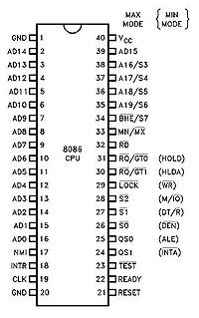
8086
The 8086 is a 16-bit microprocessor chip designed by Intel, which gave rise to the x86 architecture; development work on the 8086 design started in the spring of 1976 and the chip was introduced to the market in the summer of 1978.
The Intel 8088, released in 1979, was a slightly modified chip with an external 8-bit data bus (allowing the use of cheaper and fewer supporting logic chips and is notable as the processor used in the original IBM PC.

Slide 39

8085
The Intel 8085 is an 8-bit microprocessor introduced by Intel in 1977.
It was binary-compatible with the more-famous Intel 8080 but required less supporting hardware, thus allowing simpler and less expensive microcomputer systems to be built.
An Intel 8085AH processor.
Produced | From 1977 to 1990s
Common manufacturer(s) | Intel and several others
Max. CPU clock rate | 3,5 and 6 MHz
Instruction set | pre x86
Package(s) | 40 pin DIP

