Slide 1

SOURABH GARG

Slide 2
Outline
Objective
Introduction:
1.what is cryptography?
2.its types and techniques.
3.RC4
4.what is steganography?
5.least significant bit steganography
About our project
Result

Slide 3
OBJECTIVE
To create a application which can encrypt a secret message with a key using cryptography and hide that encrypted message in an image and decrypt that image using that key.

Slide 4
What is Cryptography?
Cryptography or cryptology; is derived from Greek word kryptós, "hidden, secret"; and graphein, "writing".
It is the practice and study of techniques for secure communication in the presence of third parties (called adversaries)

Slide 5
Key Terms:
Plaintext – A message in its natural format readable by an attacker
Ciphertext – Message altered to be unreadable by anyone except the intended recipients
Key – Sequence that controls the operation and behavior of the cryptographic algorithm

Slide 6
Types and Techniques
Substitution Cipher
  substitute one letter for another
  For e.g. a->h,s->b,k->z
  ask->hsb
Transposition Cipher
  Change position of letter in text
  Word Jumble
  For e.g. secreat->recates

Slide 7
Monoalphabetic Cipher
  Caesar(e.g. a->d, b->e)
Polyalphabetic Cipher
  Vigenère cipher
  cipher text=(plain text + key)mod26
  Vernam cipher
  Cipher text=plaintext XOR key

Slide 8
Classification:
Symmetric
  Same key for encryption and decryption
  Key distribution problem
Asymmetric
  Mathematically related key pairs for encryption and decryption
  Public and private keys

Slide 9
BLOCK CIPHER
A block cipher is a deterministic and computable function of k-bit keys and n-bit (plaintext) blocks to n-bit (ciphertext) blocks.
Some of the commonly used block ciphers are DES, 3DES, AES etc.

Slide 10
STREAM CIPHER
A stream cipher is a symmetric key cipher where plaintext digits are combined with a pseudorandom cipher digit stream (keystream).
For e.g. RC2,RC4 algorithm

Slide 11
RC4:stream cipher
RC4 was designed by Ron Rivest of RSA Security in 1987. While it is officially termed "Rivest Cipher 4“.
RC4 generates a pseudorandom stream of bits (a keystream). As with any stream cipher, these can be used for encryption by combining it with the plaintext using bit-wise exclusive-or to generate the keystream, the cipher makes use of a secret internal state

Slide 12
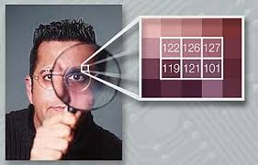
What is Steganography?
Origin of the term: steganos: secret – graphy: writing

Slide 13
Steganography
Steganography is the art and science of writing hidden messages in such a way that no one apart from the intended recipient knows of the existence of the message.
This can be achieve by concealing the existence of information within seemingly harmless carriers or cover
Carrier: text, image, video, audio, etc.

Slide 14

History : Steganography in Ancient Greece
-- Tattoo message on head
An ancient Greek historian Herodotus reports that messages were tattooed onto the shaved heads of slaves.
Once the hair grew back, the slaves were sent to the recipient, with the message hidden “in plain sight
”.

Slide 15
Steganography in World War I
-- Null Cipher
The message below was sent by the German
embassy in World War I.
PRESIDENT'S EMBARGO RULING SHOULD HAVE IMMEDIATE NOTICE. GRAVE SITUATION AFFECTING INTERNATIONAL LAW. STATEMENT FORESHADOWS RUIN OF MANY NEUTRALS. YELLOW JOURNALS UNIFYING NATIONAL EXCITEMENT IMMENSELY.
Taking the first letter in each word of message reveals the
hidden text: PERSHING SAILS FROM NY JUNE 1.

Slide 16
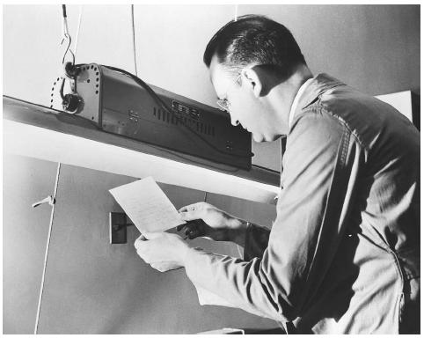
Steganography in Espionage
-- Invisible ink
  Spies use milk, fruit juice or urine as invisible inks,which darken when heated.
  An FBI agent is shown using ultraviolet light to read secret writing on a paper from a suspected spy case

Slide 17
Steganography & Cryptography
Steganography and Cryptography are closely related
The difference is in their goals...
  Cryptography: although encypted and unreadable, the existence of data is not hidden
  Steganography: no knowledge of the existence of the data
Steganography and Cryptography can be used together to produce better protection

Slide 18
Hiding a Message inside Images
The most popular medium!
Least-significant bit (LSB) modifications
  24-bit vs. 8-bit images
  Tools to implement LSB: EzStego and S-Tools
Masking and Filtering
Algorithms and Transformations

Slide 19
A Common Technique of Steganography
-- LSB
The simplest and most common type of steganography is LSB (least significant bit). The one’s bit of a byte is used to encode the hidden information.
Suppose we want to encode the letter A (ASCII 65 or binary 01000001) in the following 8 bytes of a carrier file.
01011101 11010000 00011100 10101100
11100111 10000111 01101011 11100011
becomes
01011100 11010001 00011100 10101100
11100110 10000110 01101010 11100011

Slide 20
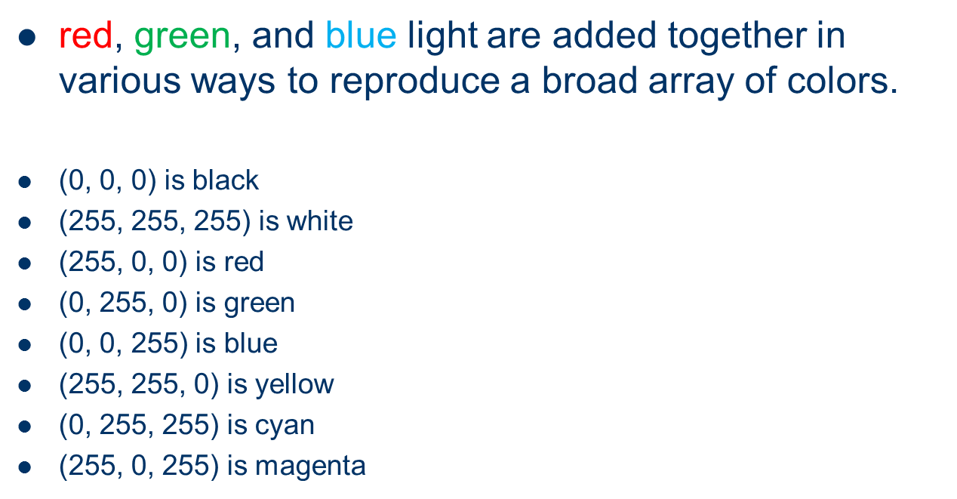
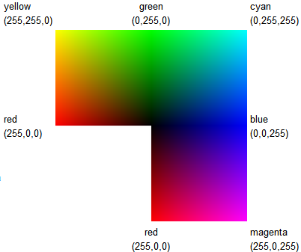
RGB Color Model in Image Files

Slide 21
Steganography
Confidentiality: any unauthorized person does not know that sensitive data exists
Survivability: verifying that the data does not get destroyed in the transmission
No detection: cannot be easily found out that the data is hidden in a given file
Visibility: people cannot see any visible changes to the file in which the data is hidden

Slide 22


Message hidden in image:
Original image
Image with hidden message

Slide 23
Hiding a Message inside Audio or Videos Files
Advantages
  Human limitations – 20.000 Hz.
  Large amount of data that can be hidden inside
  Hard to recognize because of because of the continuous flow of information (moving stream of images and sound)

Slide 24
Steganalysis
Detecting and decoding the hidden data within a given medium
Even if secret content is not revealed, modifying the cover medium changes the medium’s statistical properties

Slide 25
About our project:
Combination of cryptography and steganography
encrypt a secret message with a key using cryptography and hide that encrypted message in an image and decrypt that image using that key.

Slide 26
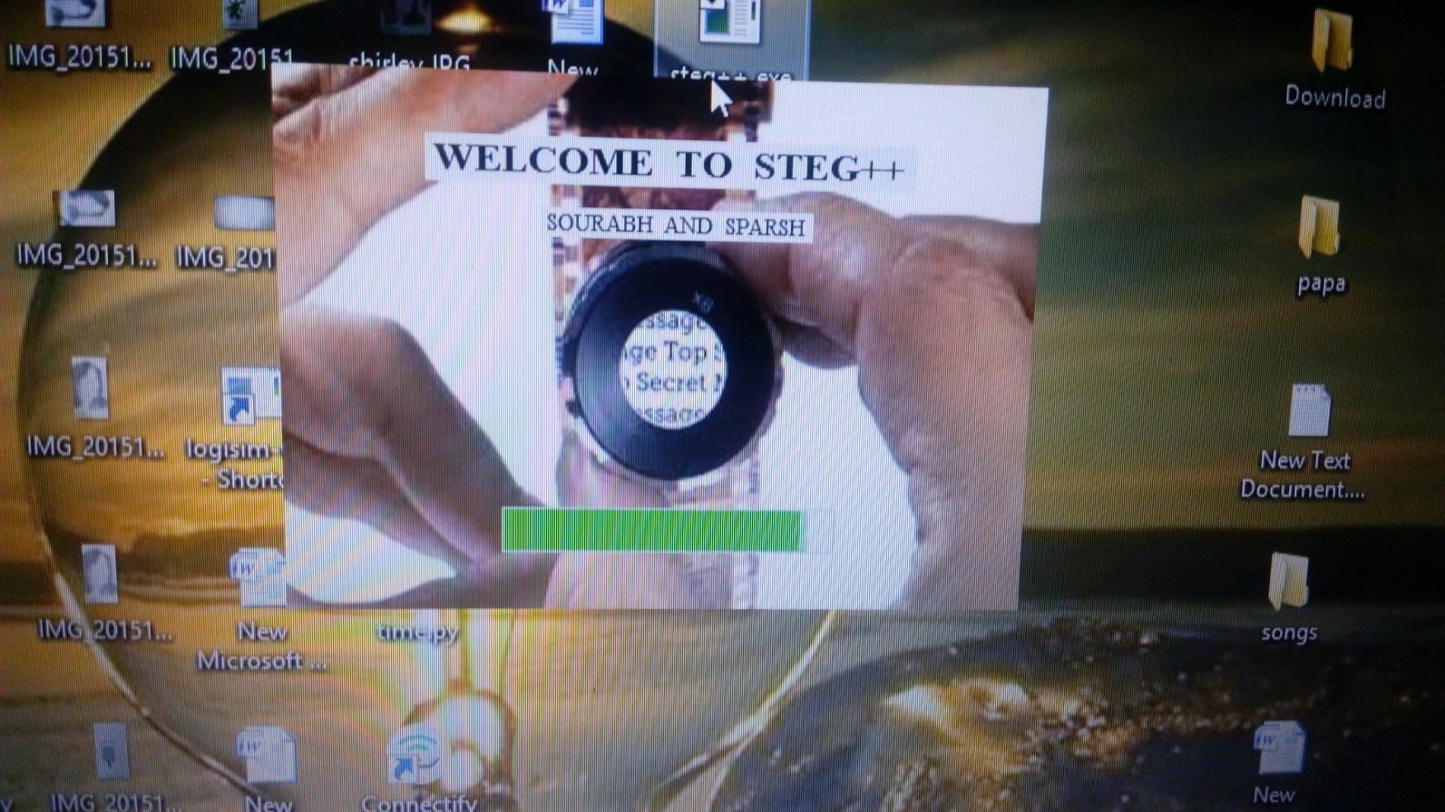
First screen with application info

Slide 27
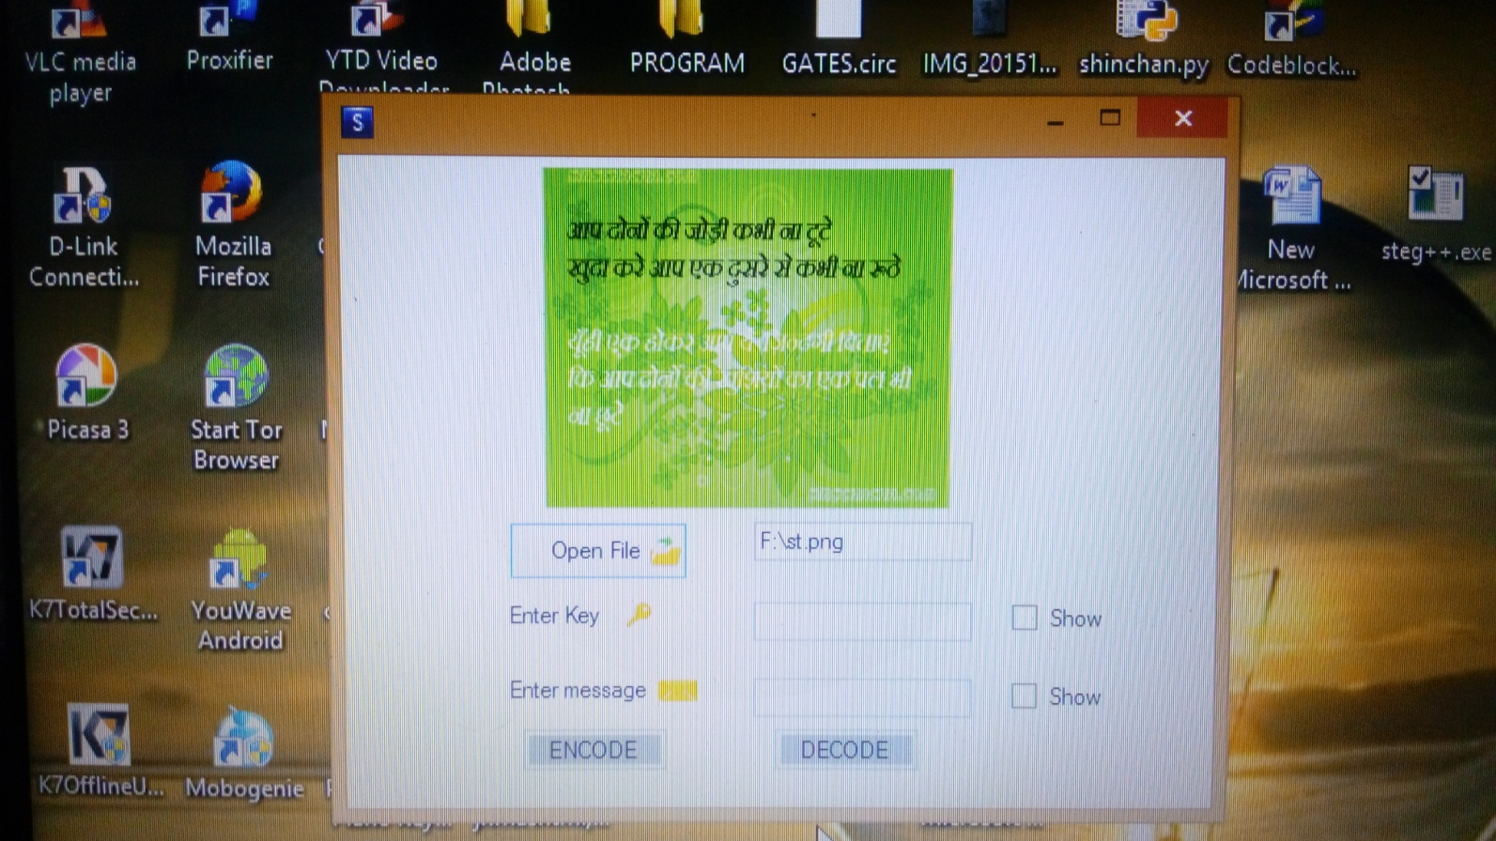
Application Main Screen

Slide 28
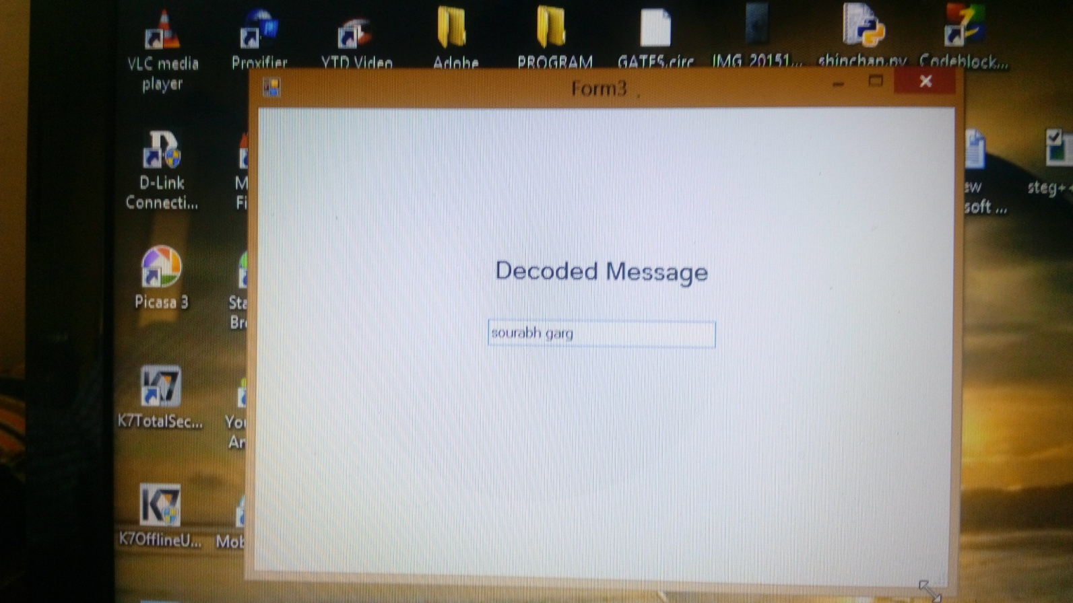
Screen for decoded message

Slide 29
Result:
The combo of cryptography and steganography leads it to a more secure application for secure communication.
Although we use RC4 and least significant bit steganography technique to encrypt and hide our message, it securely hides the message , change in the two images can not be visible by eyes ,their difference can only be seen in terms of their size and exact value of the pixels.

Slide 30


