Slide 1

GameZoo
An Innovative Teching Technology

Slide 2
Development Team
Zabrina Antry
  Master developer of the Word guessing game
Tyler Hunt
  Master developer of the Dice game
Sean Pham
  Master developer of the Mathematical game
Prashant Panth
  Master developer, UI & UX, and Design implementation
  of the modular game structure

Slide 3
Problem
Young children all over the world lack the necessary skills, motivation and opportunities to learn computer science

Slide 4
Solution
Develop a basic command line game that will be systematically developed throughout the semester

Slide 5
Current features
3 fully functional self-contained command line games implemented with C++
  Word guessing game
  Dice game
  Mathematical game
Full control over each game via the main menu and sub-game menu’s

Slide 6
New features – In Progress
Develop a curriculum for the students to follow
Incorporate in-school game competitions
Promote interest in computer science, programming and logical problem solving skills
Modularize the games
  Word guessing game
  Dice game
  Mathematical game

Slide 7
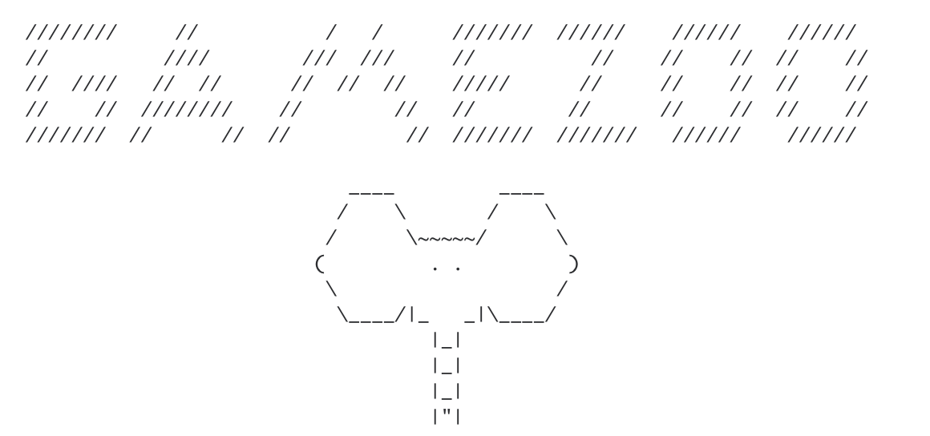
Project Demo

Slide 8
Project Needs
People
  Software engineers, UI & UX developers, designers, Big data and Cloud experts
Corporate Office
  Office space, equipment, furnishing etc.
Sales
  Sales engineers to get the word out
Funding
  Need $1 mil to continue
  Have been 100% self funded until now (1.5 years)

Slide 9
Final thoughts

