Slide 1

GameZoo
An Innovative Teching Technology

Slide 2
Development Team
Zabrina Antry
Master developer of the Word guessing game
Tyler Hunt
Master developer of the Dice game
Sean Pham
Master developer of the Mathematical game
Prashant Panth
Master developer, UI & UX, and Design implementation of the modular game structure

Slide 3
Problem
Children from all over the world lack the necessary skills, motivation and opportunities to effectively learn Computer Science

Slide 4
Solution
Develop a series of basic command line games that will be used as templates to teach students the fundamentals of programming and computer science in a fun, yet challenging way

Slide 5
Current features
3 fully functional self-contained command line games implemented in C++
Word guessing game
Dice game
Mathematical game
Full control over each game via the main menu and sub-game menu’s
Each game comes with instructions

Slide 6
New features – In Progress
Develop a curriculum for the students to follow
Develop a curriculum for each new game
Incorporate in-school game competitions
Promote interest in computer science, programming and problem solving skills
Modularize the games for deployment
Word guessing game
Dice game
Mathematical game

Slide 7
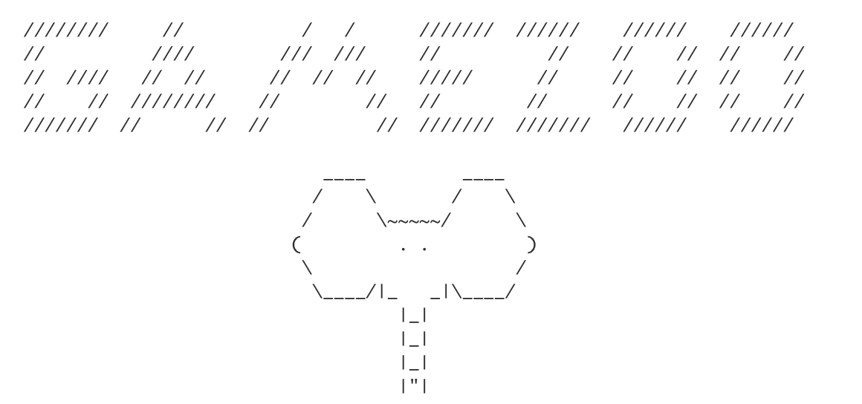
Project Demo

Slide 8
Project Needs
People
Software engineers, UI & UX developers, designers, Big data and Cloud experts
Corporate Office
Office space, equipment, furnishing etc.
Sales
Sales engineers to get the word out
Funding
Need $1 mil to continue
Have been 100% self funded until now (1.5 years)

Slide 9
Final thoughts
Regardless of initial funding we will continue to develop this new product because we believe that it is imperative that students of all ages have the opportunity to learn about computer science

