Slide 1
AI & CODING HACKATHON 2025
AI IN HEALTHCARE
Project Title: Health Saathi
Team Name - Code Crew
TEAM LEADER:
TEAM MEMBERS:
Khushi Chauhan (BSc. Cs)
Khushi Chauhan (BSc. Cs)
Sunidhi Raturi (BSc. Cs)
Shagun Kumari (BTech Cs)
Kajal Rawat (BSc. Cs)

Slide 2
PROJECT THEME
AI in Healthcare
Leveraging AI to improve healthcare access and awareness by bridging the information gap in rural and semi-urban areas through early diagnosis and personalized health education.
Problem Statement :
AI-Driven Public Health Chatbot for Disease Awareness
In India’s rural and semi-urban regions, people face significant barriers in accessing verified healthcare information. Limited internet access, and low health literacy often lead to misinformation about disease prevention, vaccination schedules, and outbreak updates. There is an urgent need for an AI-based solution that delivers trusted, multilingual, and easily accessible healthcare education through familiar communication platforms like Web-based.

Slide 3
IDEA SUMMARY
We propose the development of an AI-powered multilingual public health chatbot that acts as a virtual health assistant for citizens. The chatbot uses Natural Language Processing (NLP) to understand user queries and provides verified information about disease symptoms, preventive measures, and vaccination schedules.
The system integrates with government and WHO datasets to deliver real-time outbreak alerts and health updates. Designed for accessibility, its user-friendly interface, makes it easier for rural and semi urban’s people. The chatbot aims to achieve over 80% accuracy in health responses and improve health awareness by 20% or more in the target user base.

Slide 4

PROPOSED SOLUTION (WITH HARDWARE & SOFTWARE CONFIGURATION)
System Overview:
The proposed solution is a modular AI system consisting of a frontend chatbot interface, an AI-based backend engine, and a cloud-hosted database for scalability.
System Diagram:
User → Web → NLP Engine → Database/API → Reply

Slide 5
Software Configuration:
Component | Technology | Purpose
Backend | Python(Flask/FastAPI) | API development and chatbot logic
AI/NLP Model | Rule based + data driven NLP | Intent recognition and text
Database | MongoDB | Storage of FAQs, health data, and alerts
Frontend | Web-based API, Twilio | User communication interface
Cloud Hosting | AWS, Google Cloud | Hosting chatbot and database
Language | English | Accessibility for diverse users

Slide 6
Hardware Configuration :
Laptops/PCs for model training and development
Raspberry Pi or Edge Server for deployment prototype
Internet Connectivity for cloud synchronization
Smartphones (User Side) for WhatsApp/SMS access
Working Mechanism :
User sends a query (via WhatsApp or SMS)NLP model processes query and detects intent
Backend fetches verified health data from database
Response generated in user’s preferred language
If outbreak detected → sends automated alert to all users in affected region

Slide 7
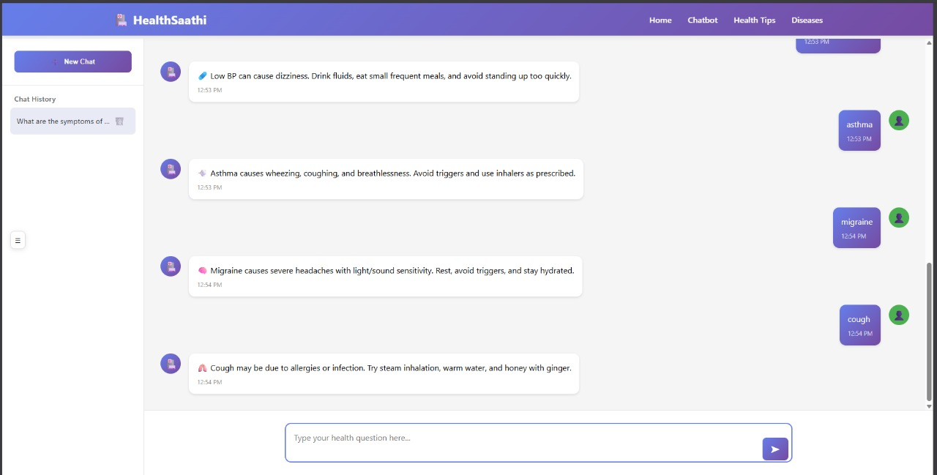
PROTOTYPE

Slide 8
INNOVATION AND CREATIVITY
Accessible Technology: It is a web-based technology, and it removes the need for a separate app.
Government Data Integration: Fetches live health updates from MoHFW and WHO APIs for verified, real-time responses.
AI Outbreak Detection: Uses basic anomaly detection models to identify and broadcast disease alerts in specific regions
User-Centric Design: Simple, intuitive interface suitable for elderly and rural users with minimal digital literacy.

Slide 9
SOCIAL IMPACT AND SCALABILITY:
Social Impact:
Promotes preventive healthcare and reduces misinformation.
Increases vaccination and hygiene awareness in underserved regions.
Bridges the digital healthcare divide between urban and rural India.
Supports national initiatives like Digital India and Ayushman Bharat by empowering citizens with accurate information.
Scalability
Easily extendable to cover maternal health, mental health, and nutrition awareness.
Can integrate with wearable devices or health management systems in future versions.
Modular architecture enables deployment in any state or language with minor NLP retraining.
Cloud-based backend allows scaling to millions of users with minimal additional cost.

Slide 10

CONCLUSION
Our AI-Driven Public Health Chatbot transforms how people access healthcare knowledge — from confusion and misinformation to clarity and empowerment.
By merging AI, accessibility, and public service, this project aims to create a digitally inclusive and health-aware India.

