Slide 1

Introduction to Human-Computer Interaction (HCI)
HCI is a branch of computer science that is concerned with the design, implementation, and evaluation of user interfaces (UI) for human use. A device that allows interaction between a human being and a computer is known as a human-computer interface.
by Camillus Njoku

Slide 2

What is Human-Computer Interaction (HCI)?
Human-computer interaction (HCI) is a multidisciplinary field of study focusing on the design of computer technology and, in particular, the interaction between humans (the users) and computers.

Slide 3

What should you learn from studying HCI ?
Facts: The facts about the nature of computers, human psychology, and social interactions.
Analysis: studying situations and drawing meaning from them
Design: This concludes the analysis.
Attitude of mind: It moves from studying people and thinking how you can do something good for them.

Slide 4
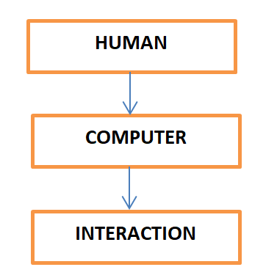
Key Concepts in HCI:

Slide 5
Key Principles of HCI
HCI principles guide the design of user-friendly and effective systems. These 7 key principles ensure that systems are accessible, usable, and enjoyable for users.
User-Centered Design
Consistency
Flexibility
Accessibility
Feedback
Error Prevention
Simplicity

Slide 6
Historical Evolution of Human-Computer Interaction (HCI)
HCI surfaced in the 1980s with the advent of personal computing, just as machines such as the Apple Macintosh, IBM PC 5150, and Commodore 64 started turning up in homes and offices in society-changing numbers. For the first time, sophisticated electronic systems were available to general consumers for uses such as word processors, game units, and accounting aids.

Slide 7
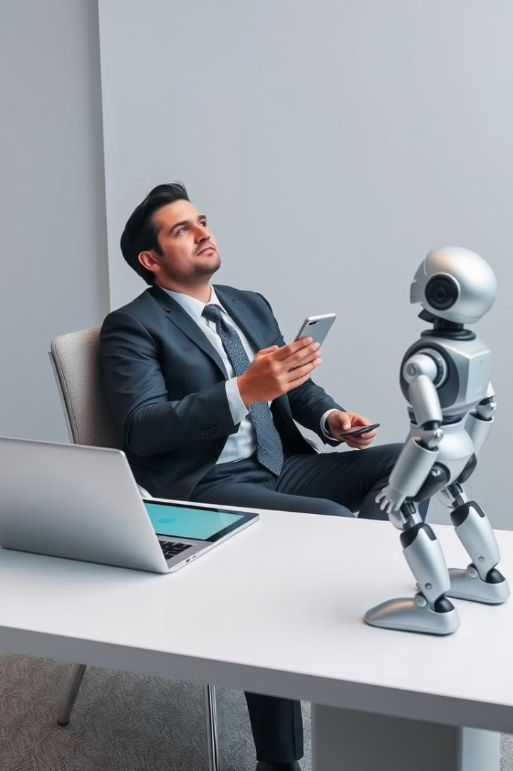



The Need for Human-Computer Interaction
As technology becomes increasingly integrated into our lives, it is crucial to design systems that are intuitive, efficient, and enjoyable to use. HCI ensures that technology serves our needs and enhances our lives.
User-Centered Design (UCD)
Ensuring technology is intuitive and easy to learn
Accessibility
People with disabilities need equal access to technology.
Improving User Experience (UX)
Users should be satisfied with their experience and find the technology enjoyable.

Slide 8

Applications of Human-Computer Interaction (HCI)
HCI principles are applied in a wide range of fields, including website design, mobile app development, virtual reality systems, and user interfaces for medical devices. These applications show how HCI improves the usability and effectiveness of technology in various aspects of everyday life.

