Slide 1
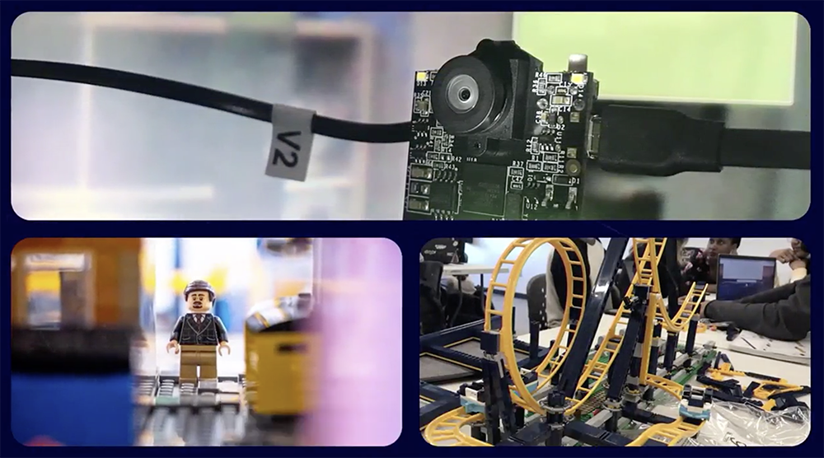
This is some sample text…

Slide 2

This is some sample text…

Slide 3
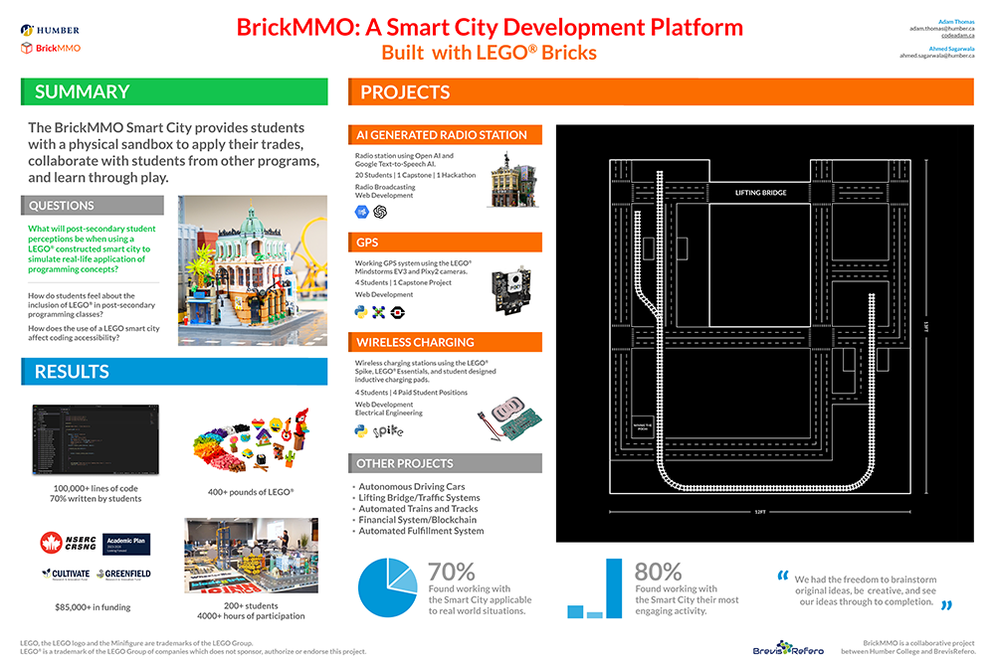
This is some sample text…

