Slide 1
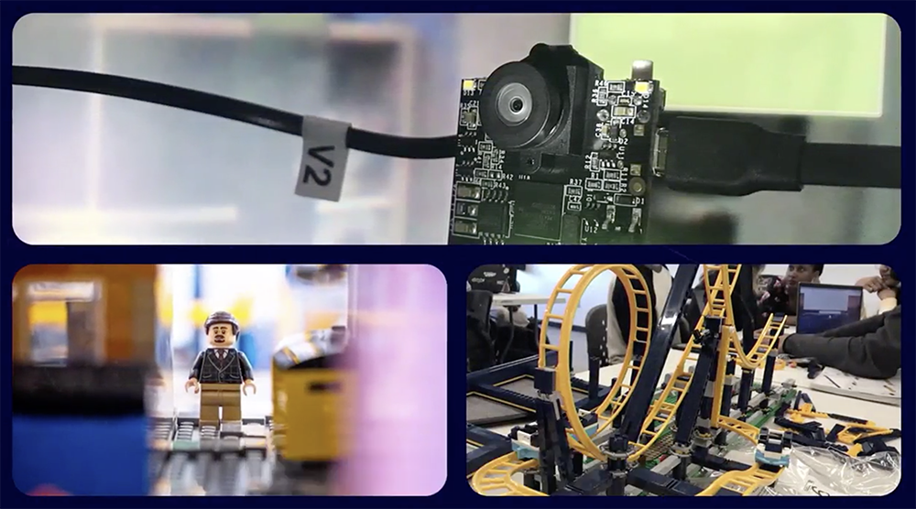
Testing some content…

Slide 2
