Slide 1
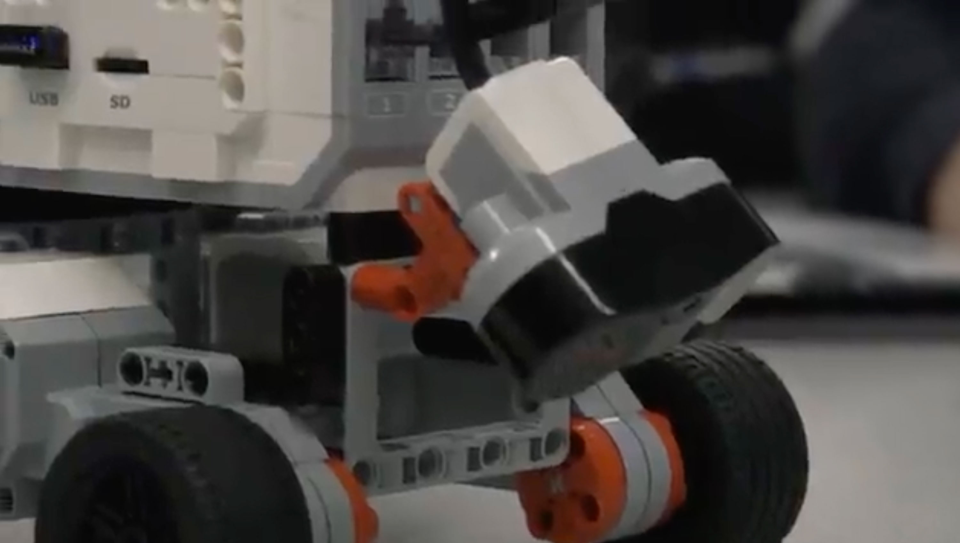

Adam Thomas
I Teach Code!
Self-taught full-stack developer.
Learning code and teaching code at Humber Polytechnic, Toronto, Canada.

