Slide 1

Improving Marketing Efficiency Through Customer Segmentation for a
UK Online Retailer
Adrija Sarkar Roll No: 23f2005006 BDM Capstone Project IIT Madras Online BS Degree Program

Slide 2
Organisation Background
Product | Unique all-occasion gifts
Established | 1981
Venture into E-commerce | 2010 (Own website + Amazon.co.uk)
Market | B2B+B2C
Dataset period | 01/12/2010 to 09/12/2011
UK BASED ONLINE
RETAILER
Sources:
UCI Machine Learning Repository: https://archive.ics.uci.edu/dataset/352/online+retail
https://link.springer.com/article/10.1057/dbm.2012.17

Slide 3
Problem Statement
Lack of Targeted Segmentation
1
All customers treated uniformly without distinguishing high-value from low-engagement buyers
Inefficient Marketing Spend
2
Promotional efforts distributed evenly, reducing potential returns and limiting revenue growth
No Data-Driven Strategy
3
Missing structured analysis of purchase patterns, spending, and recency to prioritise key customer groups
Result: Marketing inefficiency and lost revenue potential

Slide 4
Dataset Overview
Initial records: 541,909 instances No. of initial Variables: 9
Variables: InvoiceNo, StockCode, Description, Quantity, InvoiceDate, InvoiceTime, CustomerID, Country, UnitPrice
Engineered features: InvoiceDateTime, Revenue
Final Clean Dataset
392,692
Valid Transactions
4,338
Unique Customers
Variable Structure:
Numerical: Quantity, UnitPrice, Revenue
Categorical: CustomerID, Invoiceno, StockCode, Country, Description
Temporal: InvoiceDate, InvoiceTime, InvoiceDateTime
£8.89M
Total Revenue
£479.56
Avg Order Value

Slide 5
Data Cleaning Process
Integration
Timestamp
Removed Cancellations
1
2
3
4
Invalid Data
Merged Excel + UCI data to get complete variables
Created InvoiceDateTime from date + time
Dropped invoices starting with 'C'
Filtered zero/negative quantities & prices
RESULT
7
Feature Engineering
6
Duplicates
5
Missing IDs
Clean, reliable dataset ready for RFM analysis
Created Revenue = Quantity × UnitPrice
Eliminated exact duplicate records
Removed records with null CustomerID

Slide 6
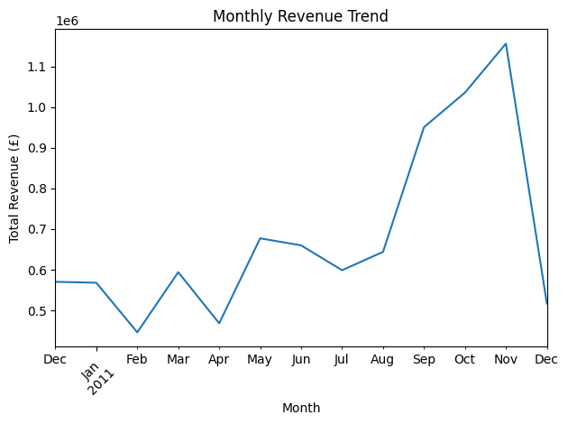
Key Findings: Revenue Distribution
Country-wise Revenue Distribution
💡 Key Insight
UK dominates revenue (82%), confirming strong domestic market dependence. Secondary markets offer growth potential.
Peak in Oct-Nov (festive season), sharp drop in Dec'11 (incomplete data)

Slide 7
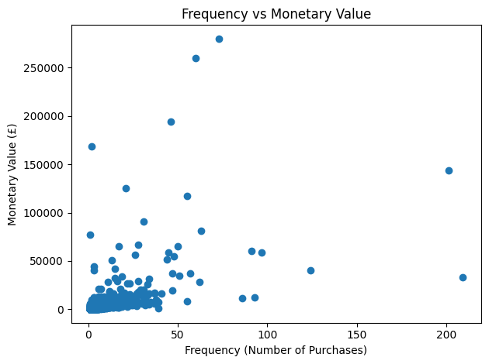
Customer Behaviour Patterns
Top 5 Customers by Purchase Frequency
Customer ID
Purchases
12748
209
r ≈ 0.55
14911
201
Moderate Positive Correlation
17841
124
13089
97
14606
93
Highly skewed distribution: Median = 2 purchases, Maximum = 209 purchases
Top 5 Customers by Monetary Value Distribution
Customer ID | Revenue
14646 | 280206.02
18102 | 259657.30
17450 | 194390.79
16446 | 168472.50
14911 | 143711.17
Median ≈ £669 and Maximum ≈ £280,206; Extreme revenue concentration
A small fraction of customers drives disproportionate revenue

Slide 8
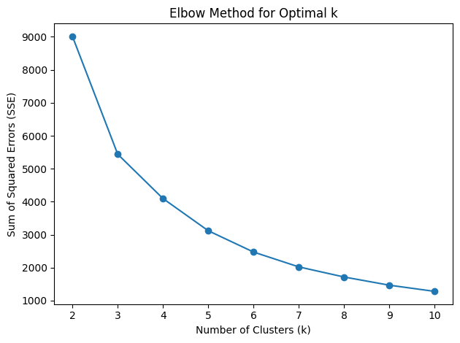
RFM Segmentation Approach
RFM Framework
R
Recency
Days since last purchase
(Lower = Better engagement)
F
Frequency
Number of transactions
(Higher = More loyal)
M
Monetary
Total revenue contributed
(Higher = More valuable)
CustomerID | Recency | Frequency | Monetary
12346.0 | 326 | 1 | 77183.60
12347.0 | 2 | 7 | 4310.00
12348.0 | 75 | 4 | 1797.24
12349.0 | 19 | 1 | 1757.55
12350.0 | 310 | 1 | 334.40
Optimal k = 3, and this confirms that three clusters provide an optimal balance between segmentation quality and interpretability.
RFM converts raw transactions into measurable customer value

Slide 9
Three Customer Segments Identified
⚠️ At-Risk / Low-Engagement
👥 Regular / Core Revenue
⭐ VIP / Champion
1,082 customers
3,230 customers
26 customers
25% of total
74.5% of total
0.6% of total
Recency:
247 days
Recency:
41 days
Recency:
6 days
Frequency:
1.58
Frequency:
4.67
Frequency:
66.42
Monetary:
£630
Monetary:
£1,850
Monetary:
£85,826
Long inactive, minimal purchases, low spend. High churn risk.
Moderate activity, consistent buying, stable revenue. Business backbone.
Very recent, extremely high frequency & spend. Strategic priority.

Slide 10
Strategic Recommendations
At-Risk Customers
Expected Impact:
Improved Marketing ROI
Enhanced Customer Retention
Data-Driven Decision Making
Sustainable Revenue Growth
🎯
• Low-cost reactivation campaigns
• Automated remarketing emails
• Limited-time discount offers
• Monitor response before investing more
Regular Customers
💎
• Structured loyalty programs
• Personalised product recommendations
• Cross-selling & upselling strategies
• Periodic promotional incentives
VIP Customers
👑
• Exclusive product previews
• Premium loyalty benefits
• Dedicated relationship management
• Priority service & early access

