Slide 1
Battle of the Neighbourhoods
Week 2

Slide 2
Finding a new business location
Finding a perfect locations for a new business is critical
Determines who your clientele is
Determines what kind of traffic your business might generate
Can impact regulations and taxes
Where is the perfect neighbourhood within Toronto to start a new nail salon business?

Slide 3
Data acquisition and cleaning
Data pulled from two main sources
FourSquare – holds data on nearby venues given a certain location
Toronto Open Data – holds demographic and geographic information on all neighbourhoods within Toronto
In total, 2020 venues were scraped from FourSquare for 140 Toronto neighbourhoods
Unrelated columns were dropped and unfilled rows were managed
Formed 2 datasets
One with data on all types of venues
One with data on only salon-type venues

Slide 4
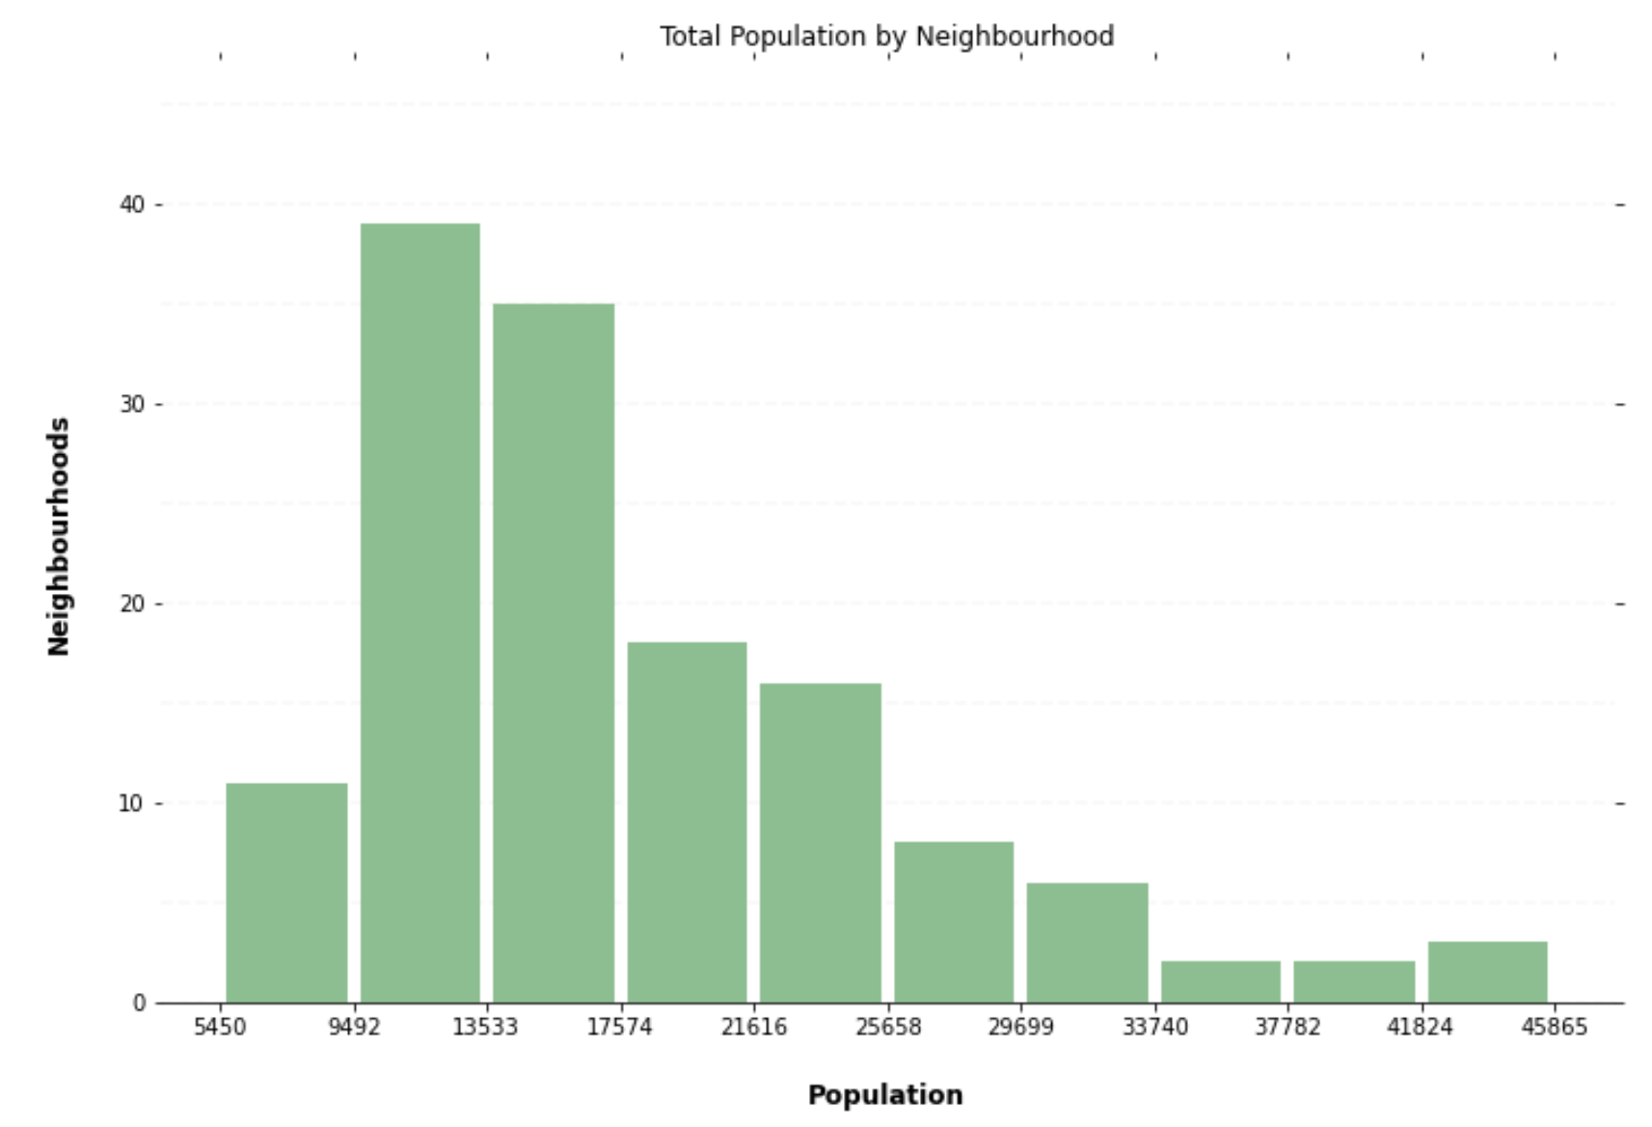
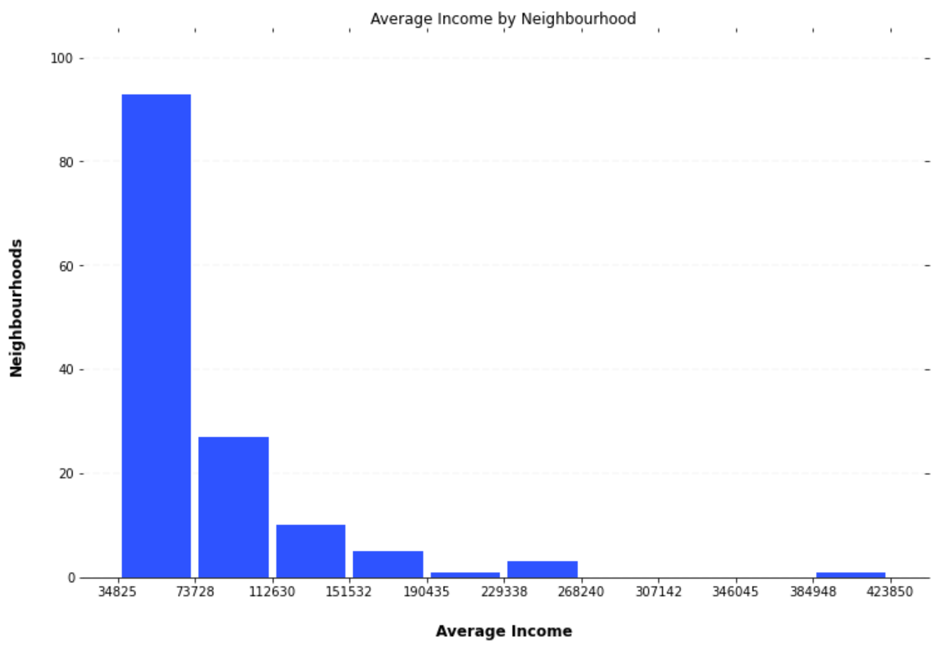
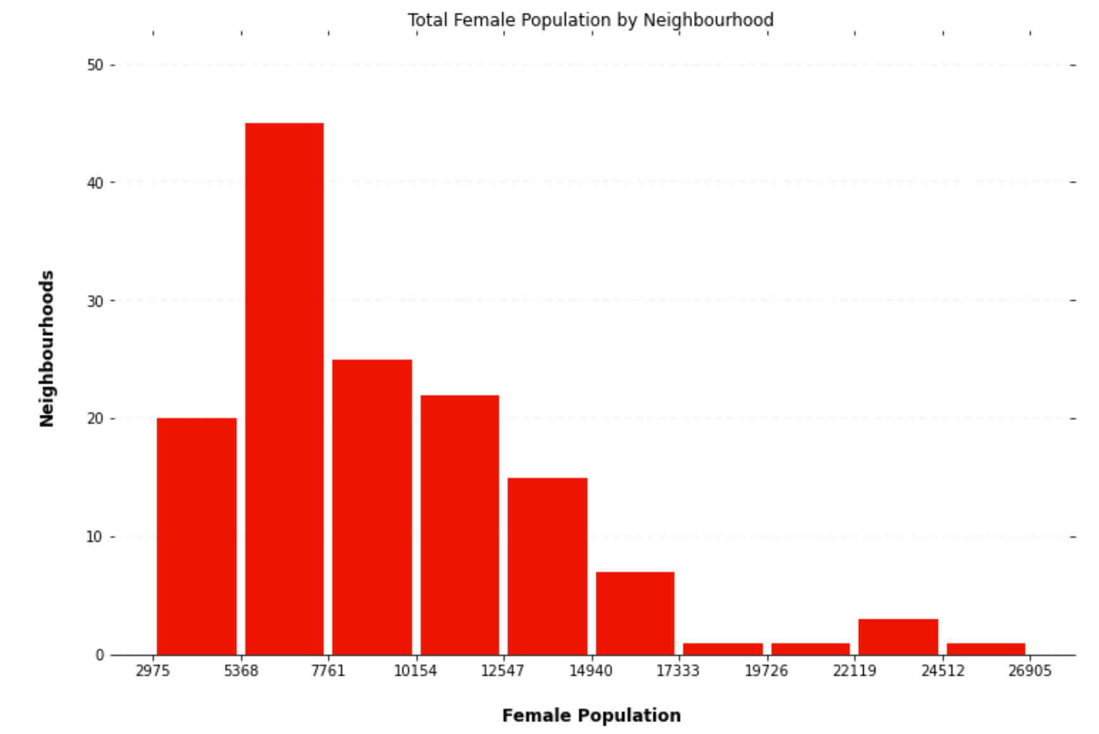
Toronto Demographics
Information on neighbourhood total population, female population and average income were graphed for exploratory analysis for use within the model

Slide 5
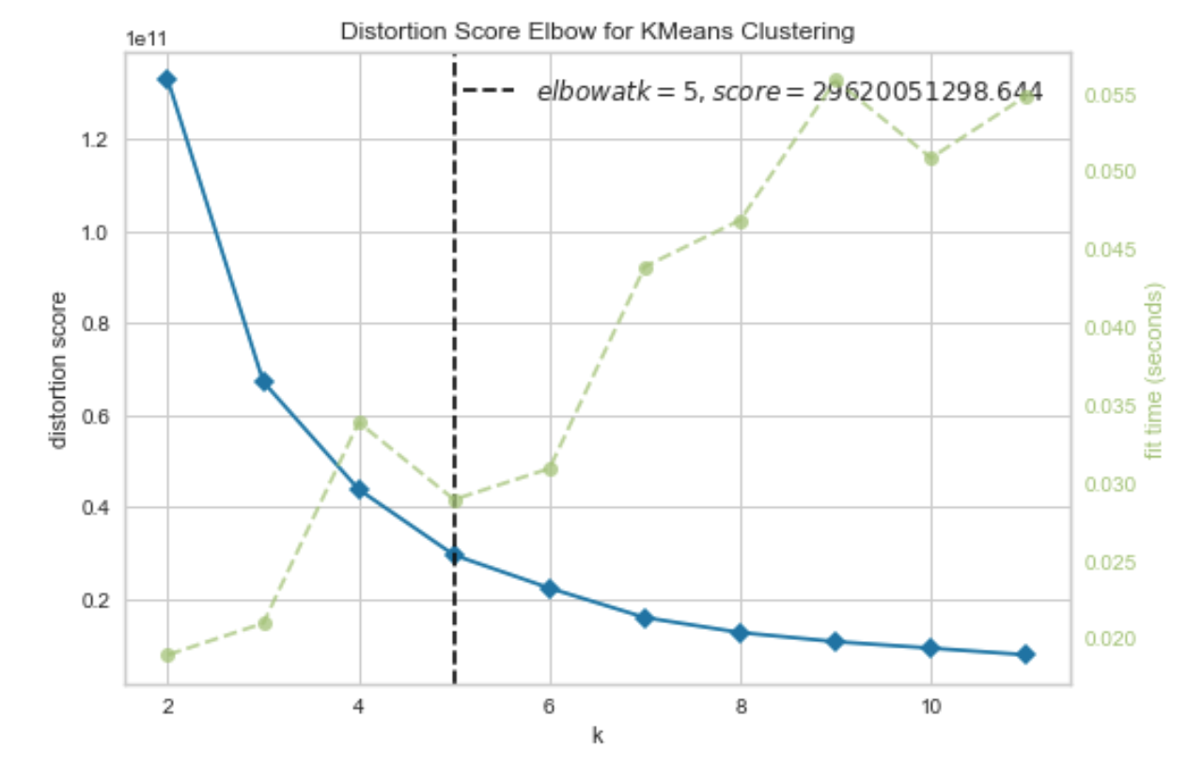
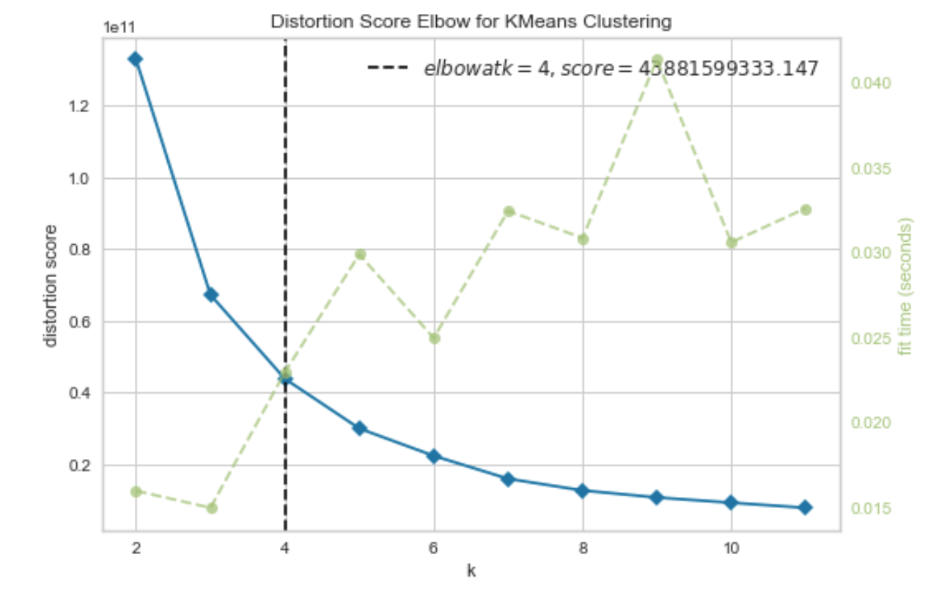
K Means – Finding a value for K
All Venues Dataset
A good value of K must be found in order to have meaningful data from the K Means model, as it determines how many clusters the model will try to form.
The Elbow method can be used to determine the optimal value of K for both datasets
K = 5 for both datasets
Salon Only Dataset

Slide 6
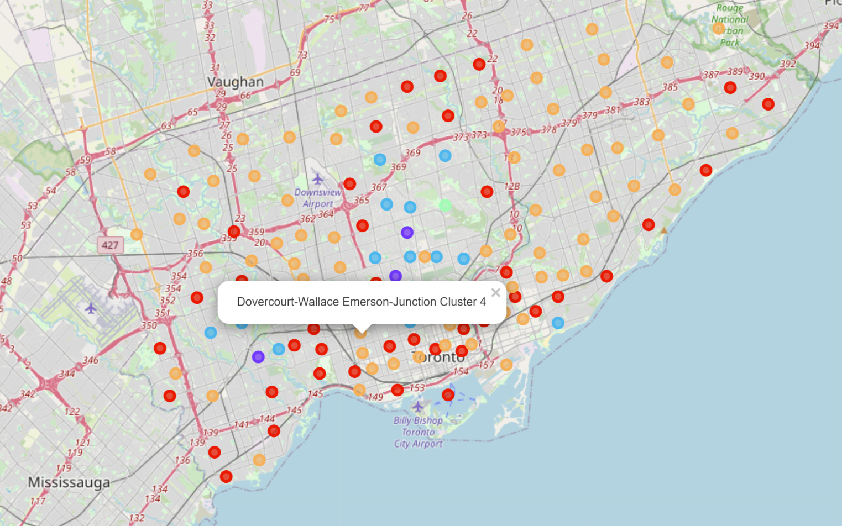
Mapping Results – All Venues
Downtown Toronto and the outskirts are mostly made up of two clusters (red and orange on the map)
The other three clusters (blue(2), purple(1), and light green(3)) forming a kind of ring in the suburbs surrounding downtown.
Colour | Cluster
Red | 0
Purple | 1
Blue | 2
Light Green | 3
Orange | 4

Slide 7
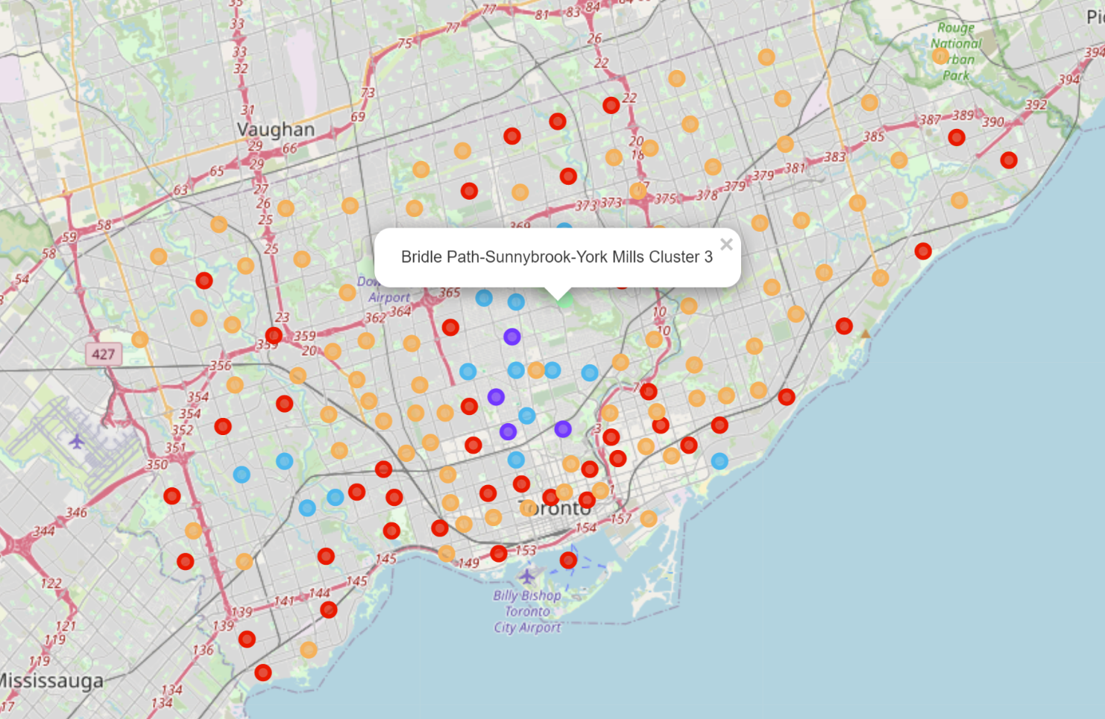
Mapping Results – Salons Only
Very similar to All Venues dataset
Downtown Toronto and the outskirts are mostly made up of two clusters (red and orange on the map)
The other three clusters (blue(2), purple(1), and light green(3)) forming a kind of ring in the suburbs surrounding downtown.
Colour | Cluster
Red | 0
Purple | 1
Blue | 2
Light Green | 3
Orange | 4

Slide 8
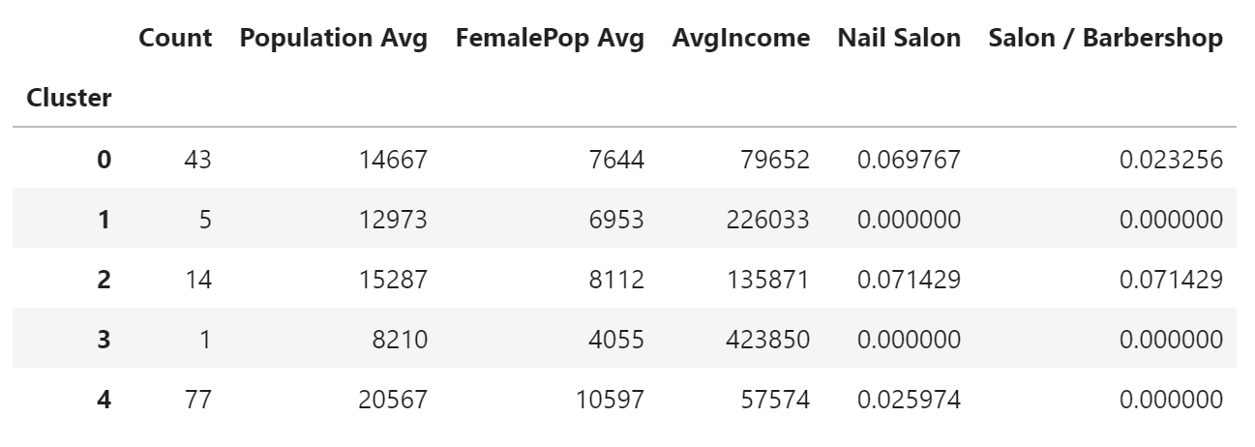
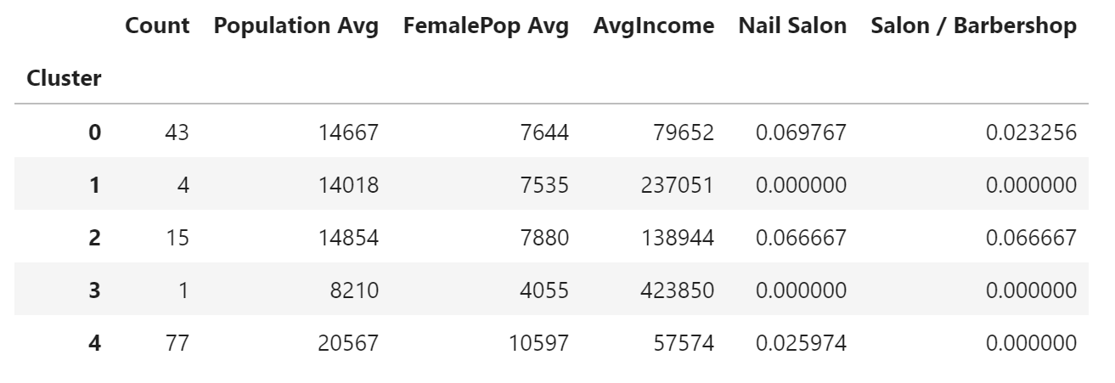
Average Results
All Venues Dataset
The two clusters with the highest average income and lowest populations (1 and 3) have no nail salons or salon/barbershops.
There might be a reason why there are no similar businesses in any of these neighbourhoods.
Cluster 2 has the highest rate of similar businesses, so neighbourhoods in that cluster can probably be dismissed, as the market might already be saturated.
Though cluster 4 has a lower average income than cluster 0, it also has a higher average female population, and less competition, with a total lack of salon/barbershops, but enough nail salons to indicate that it is possible to run a successful business in those neighbourhoods.
Salons Only Dataset

Slide 9
Conclusion
From the clustering analysis done in this report, it is likely that a neighbourhood within Cluster 4 would be the most suitable location for a new nail salon business.
This is because there are other nail salons in the cluster, implying that the business type is viable, but doesn't have the highest occurence of either nail salons or salons/barbershops, meaning that there will be less stiff competition for the new business.
A next step would be to take the neighbourhoods of Cluster 4 and find more data on the area, maybe economic data about businesses, and perform another cluster analysis to break down the cluster even further.

